Slide 1
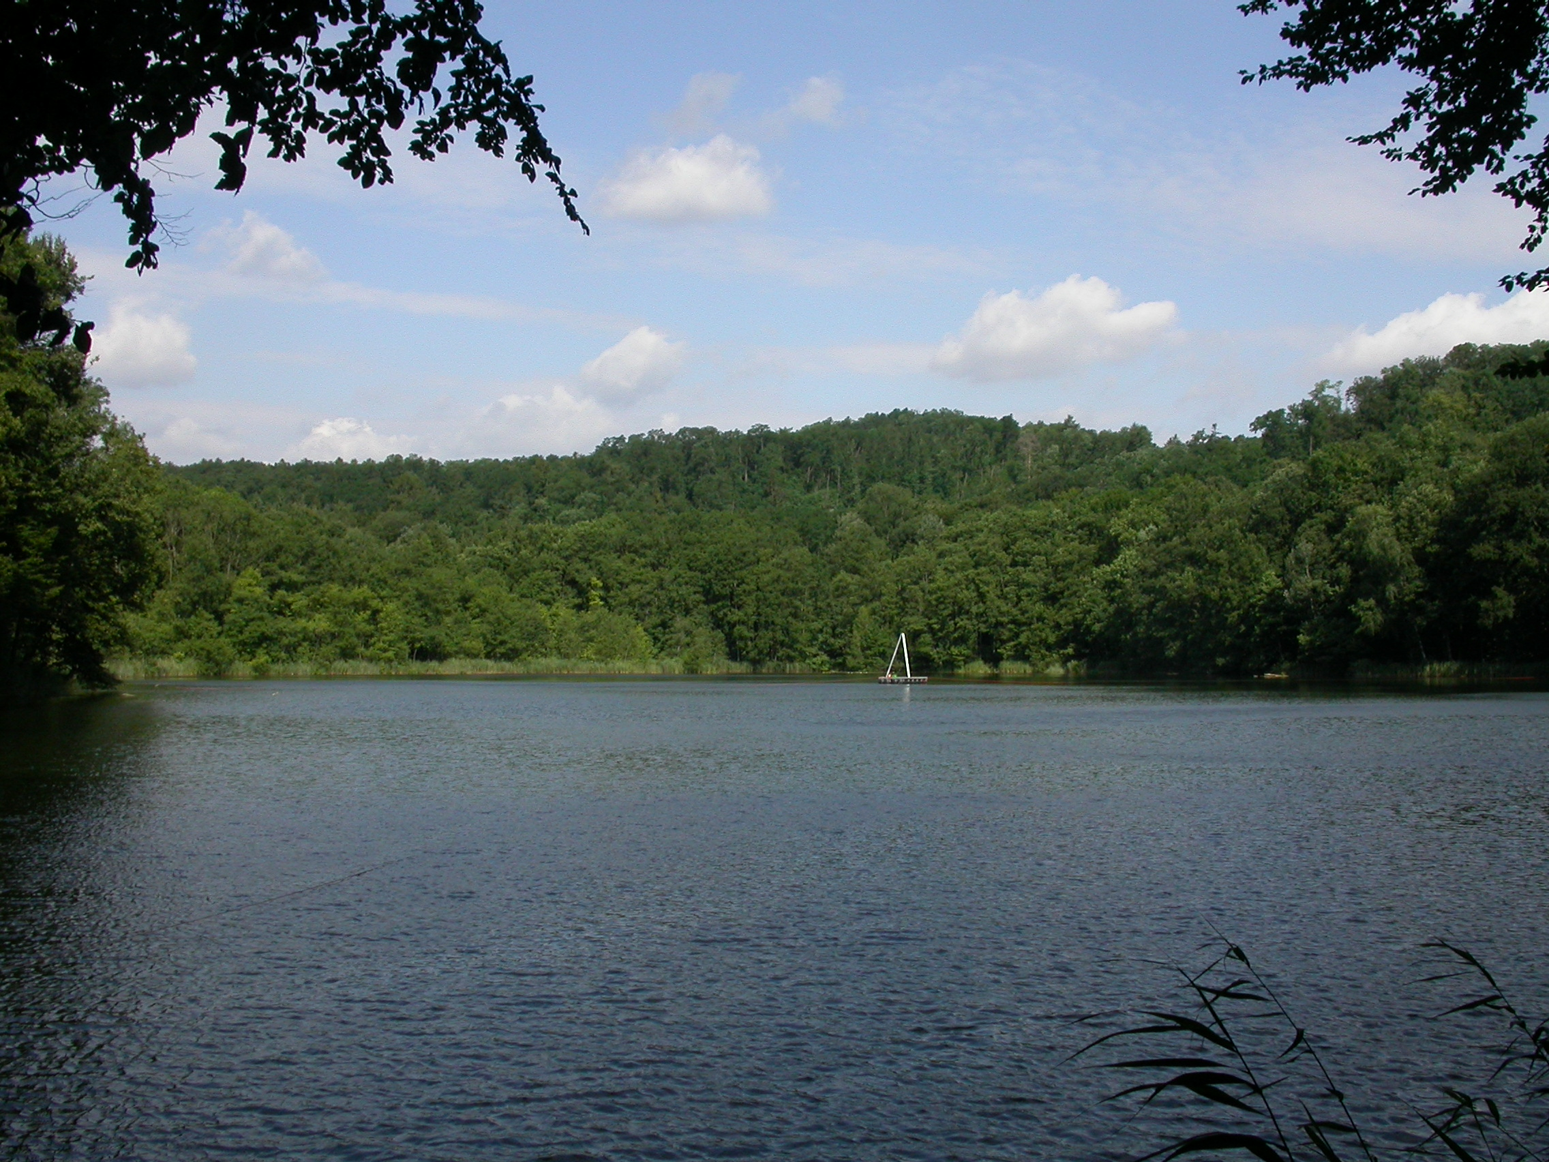





Socio-Environmental Changes in North-Eastern Germany, Brandenburg, during the Late Bronze Age
Khadijeh Alinezhad
Kleiner Tornowsee (by Dr. Walter Dörfler)

Slide 2
Research questions
The main question was to study how climate and environmental changes affected vegetation, land use, and settlement activity in northeastern Germany during the LBA (ca. 1300-800 BC; 3250-2750 BP).

Slide 3
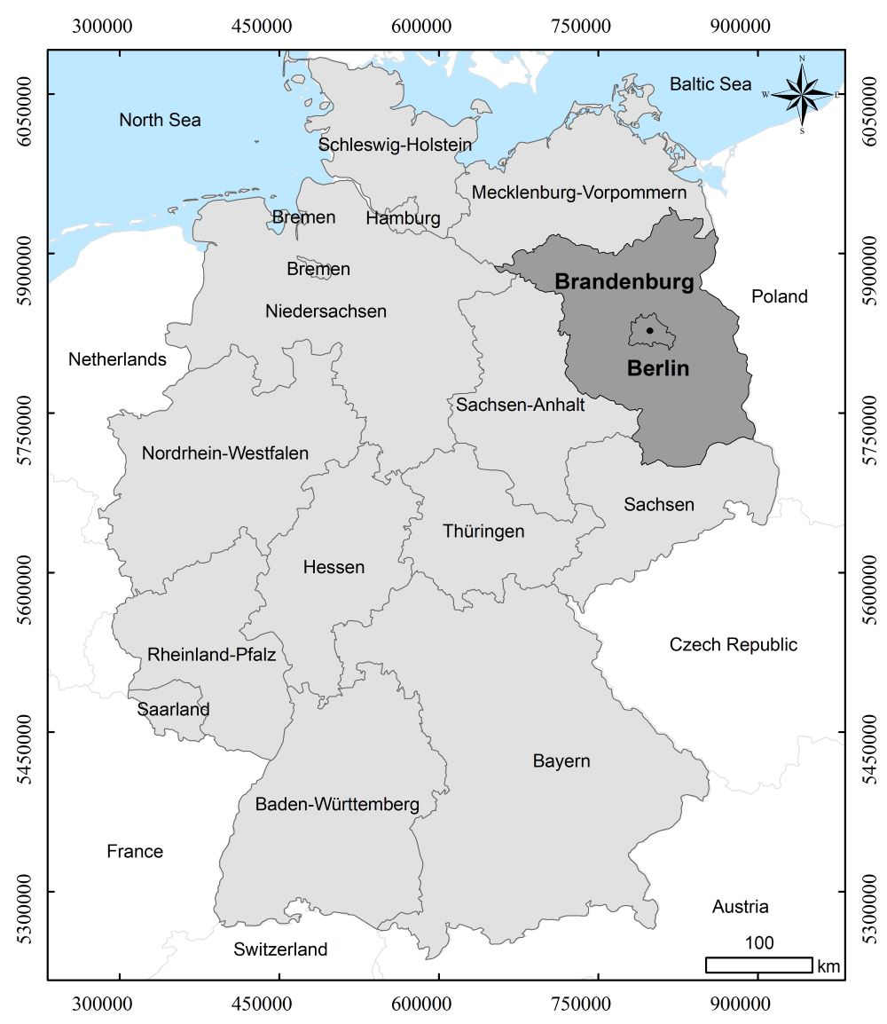
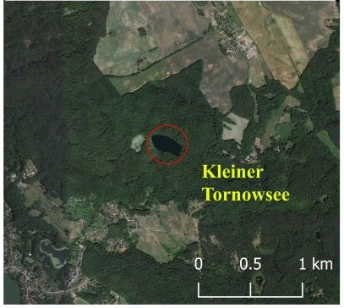
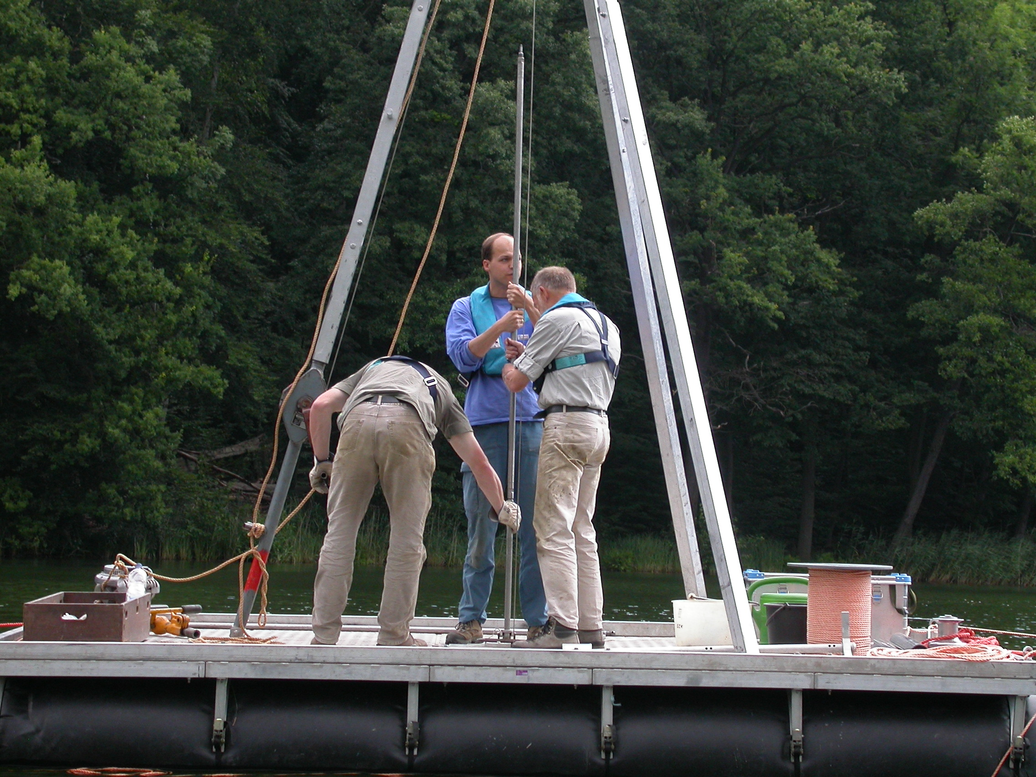
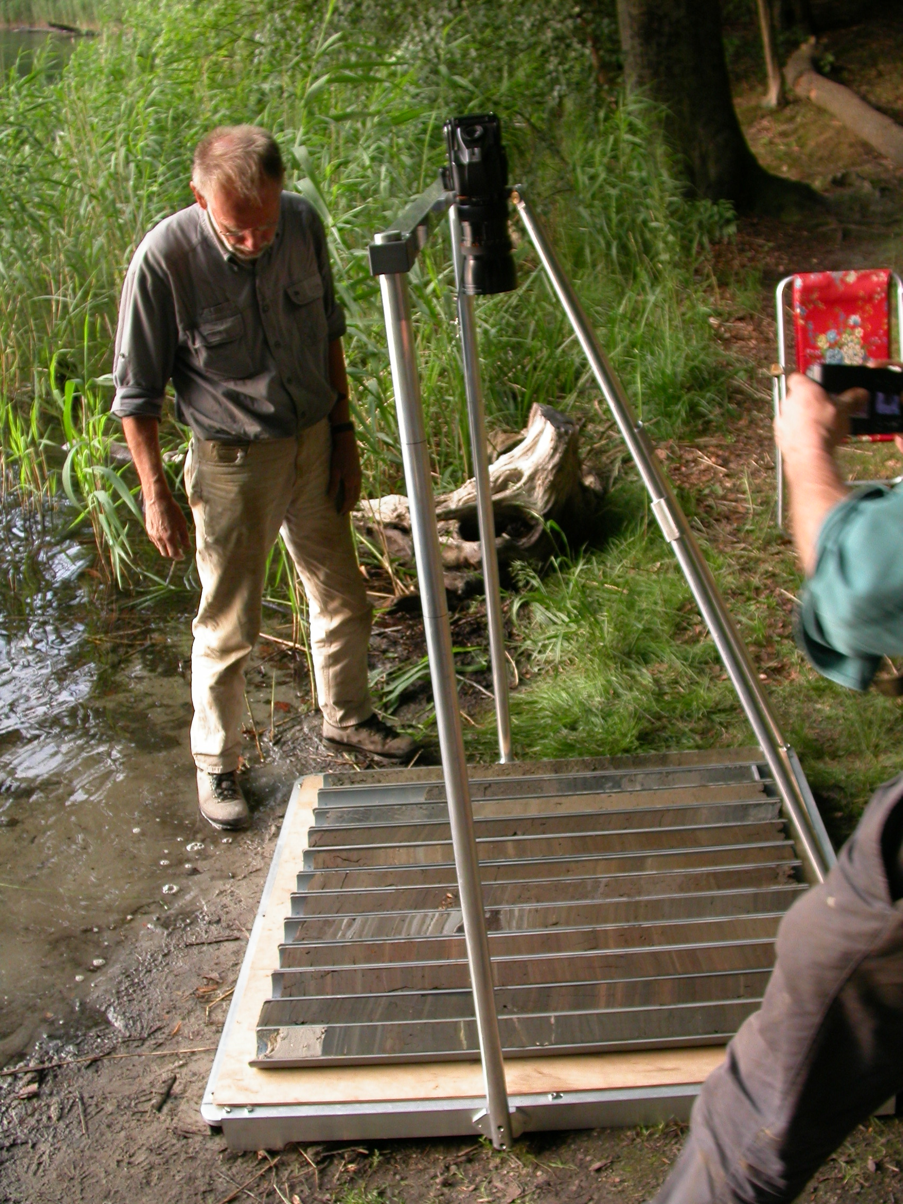
Study Area
Lake Kleiner Tornowsee (KTO)
Brandenburg, northeastern Germany:
Part of the North German Lowland;
Shaped by Pleistocene glaciations and Holocene modifications
Soil:
Dominated by less fertile sandy plains
Climate:
Subcontinental climate; mean annual temperature 8-9°C; annual precipitation 500–560 mm
Kleiner Tornowsee (KTO) coring in 2005
using Usinger piston corer (Mingram et al., 2007)
(Photos by Water Dörfler)
Notes:
To address this research question, I analysed sediment cores from Lake Kleiner Tornowsee, located in Brandenburg in northeastern Germany.
This region is part of the North German Lowland. It was shaped by Pleistocene glaciations and later Holocene processes, and it is dominated by relatively poor sandy soils.
The area has a sub-continental climate, with a mean annual temperature of about 8 to 9 degrees Celsius and annual precipitation of between 500 and 560 millimetres.

Slide 4
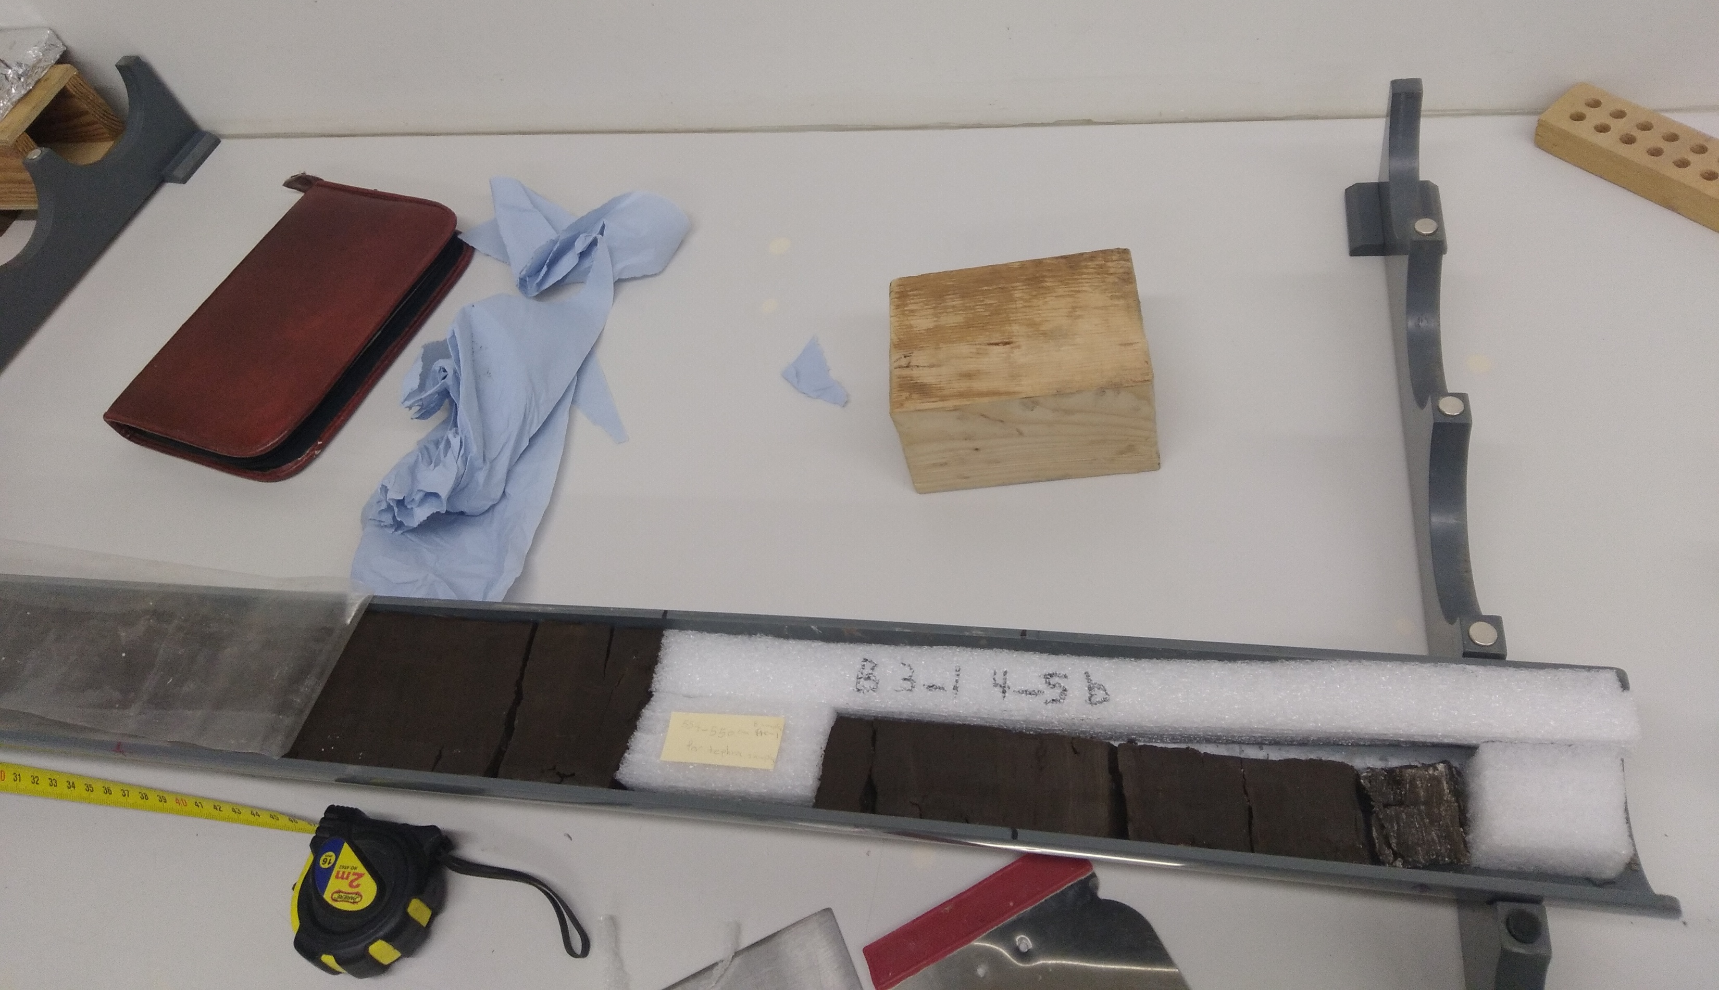
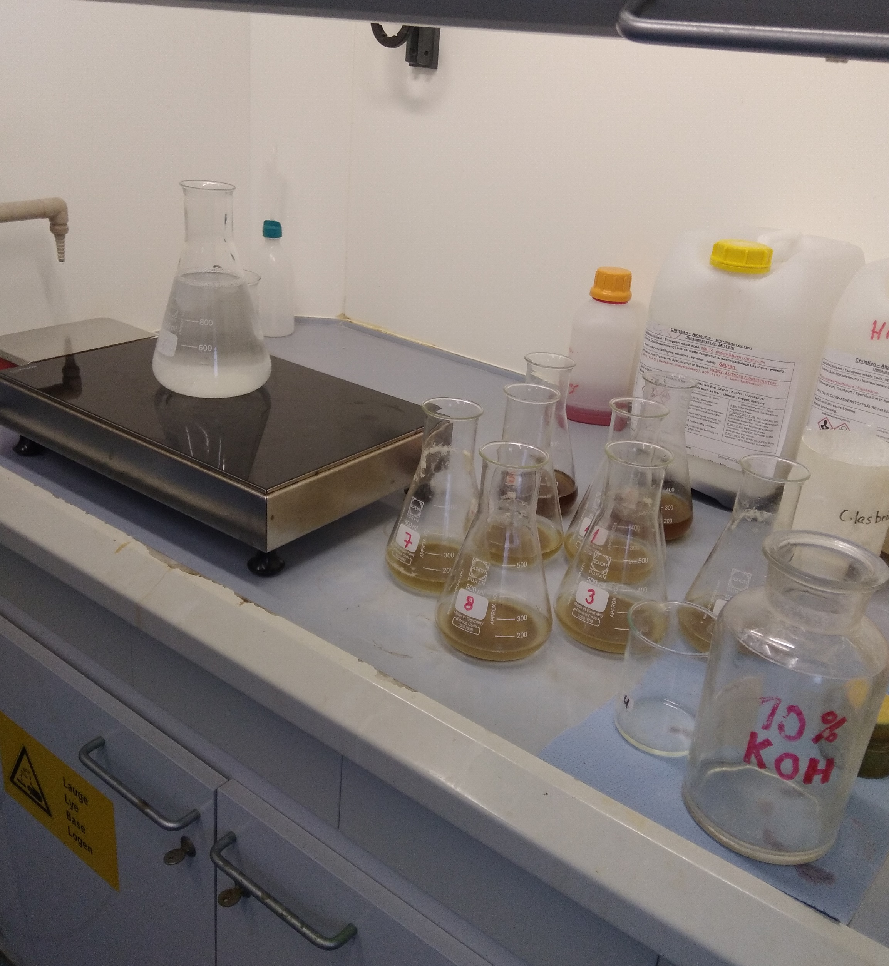
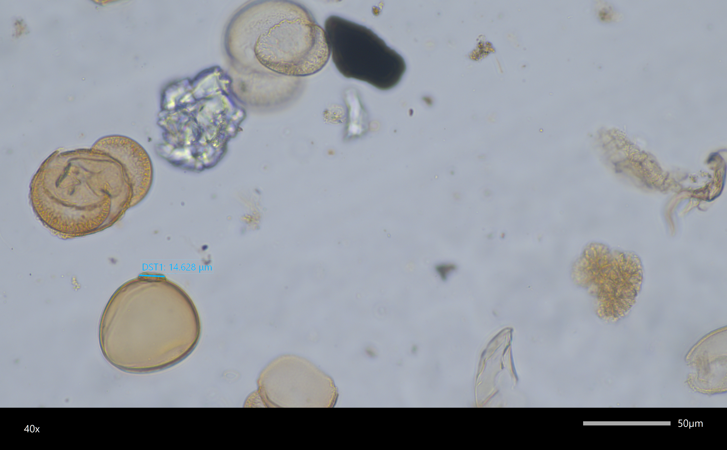
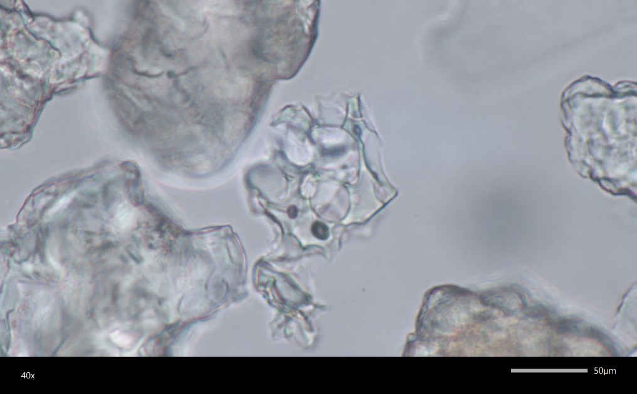
Methods
Multiproxy approach
Chronology
Based on 35 Radiocarbon (¹⁴C) samples and varve dating from KTO sediment (myself in collaboration with I. Feeser, W. Dörfler, and S. Dreibrodt)
Pollen analysis
On KTO sediment, in total around 60 pollen samples at 1-2 cm intervolves with min. of 600 total terrestrial pollen (by myself)
Tephra analysis
On KTO sediment, in total around 40 tephra samples at 1-2 cm intervolves (by myself)
Geochemical data
On KTO sediment, 50 volumetric samples were collected at 2-cm intervals (S.Dreibrodt)
Climatic data
Local pollen-based climate reconstruction based on KTO pollen data (in collaboration with R. Geng)
Regional proxy-based climate reconstruction based pollen and chironomid data extracted from global climate data published by Kaufman et al. (2020) & McKay et al. (2024) (in collaboration with M. Weinelt)
Climate Model Simulations (in collaboration with E. van Dijk)
Archaeological data
Taken from published sources
Notes:
This study is based on a multiproxy approach. I combined chronological, palynological, geochemical, climatic datasets and archaeological evidance.
For chronology, I used 35 radiocarbon samples from the Kleiner Tornowsee sediment, combined with varve counting to build the age model.
For vegetation and human activity reconstruction, I analysed around 60 pollen samples from the core.
To investigate possible volcanic impacts, I also analysed about 40 tephra samples.
In addition, geochemical measurements were used to understand environmental changes within the lake.
For climate reconstruction, I worked at three spatial scales.
At the local scale, I used pollen-based climate reconstructions derived from my own pollen data.
At the regional scale, I used pollen- and chironomid-based reconstructions extracted from published global datasets.
And at the continental scale, I compared these results with climate model simulations.
Finally, I synthesised and interpreted all these datasets together to reconstruct socio-environmental dynamics during the Late Bronze Age.

Slide 5
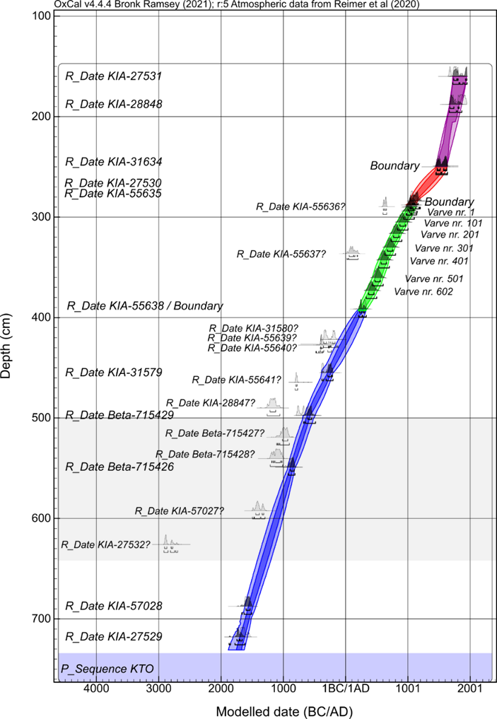
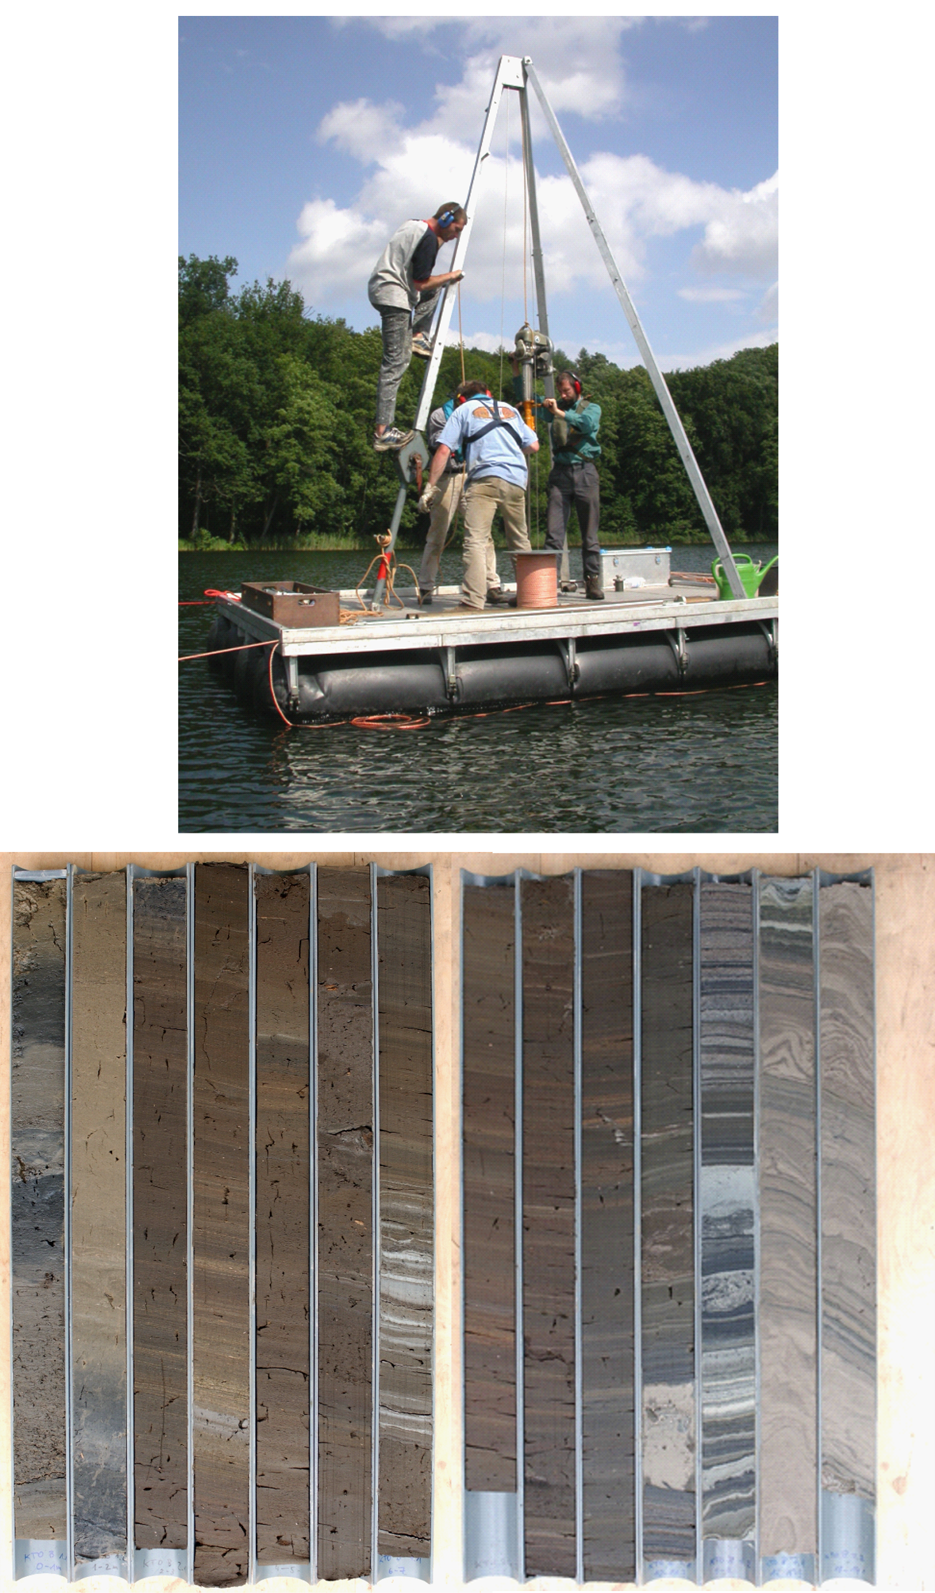
The Age-depth model
The Late Bronze Age
from 628-540 cm; ca.1270-800 BC/BCE
Late Bronze Age
Notes:
Having a reliable chronological framework is essential to reconstruct environmental and societal changes.
Therefore, we established an age–depth model based on thirty-five radiocarbon dates, mainly from terrestrial plant remains, combined with varve counting.
Using this model, we identified the sediment sections that correspond to the Late Bronze Age.
This section was then analysed palynologically in order to reconstruct vegetation changes and human activities during the LBA.

Slide 6
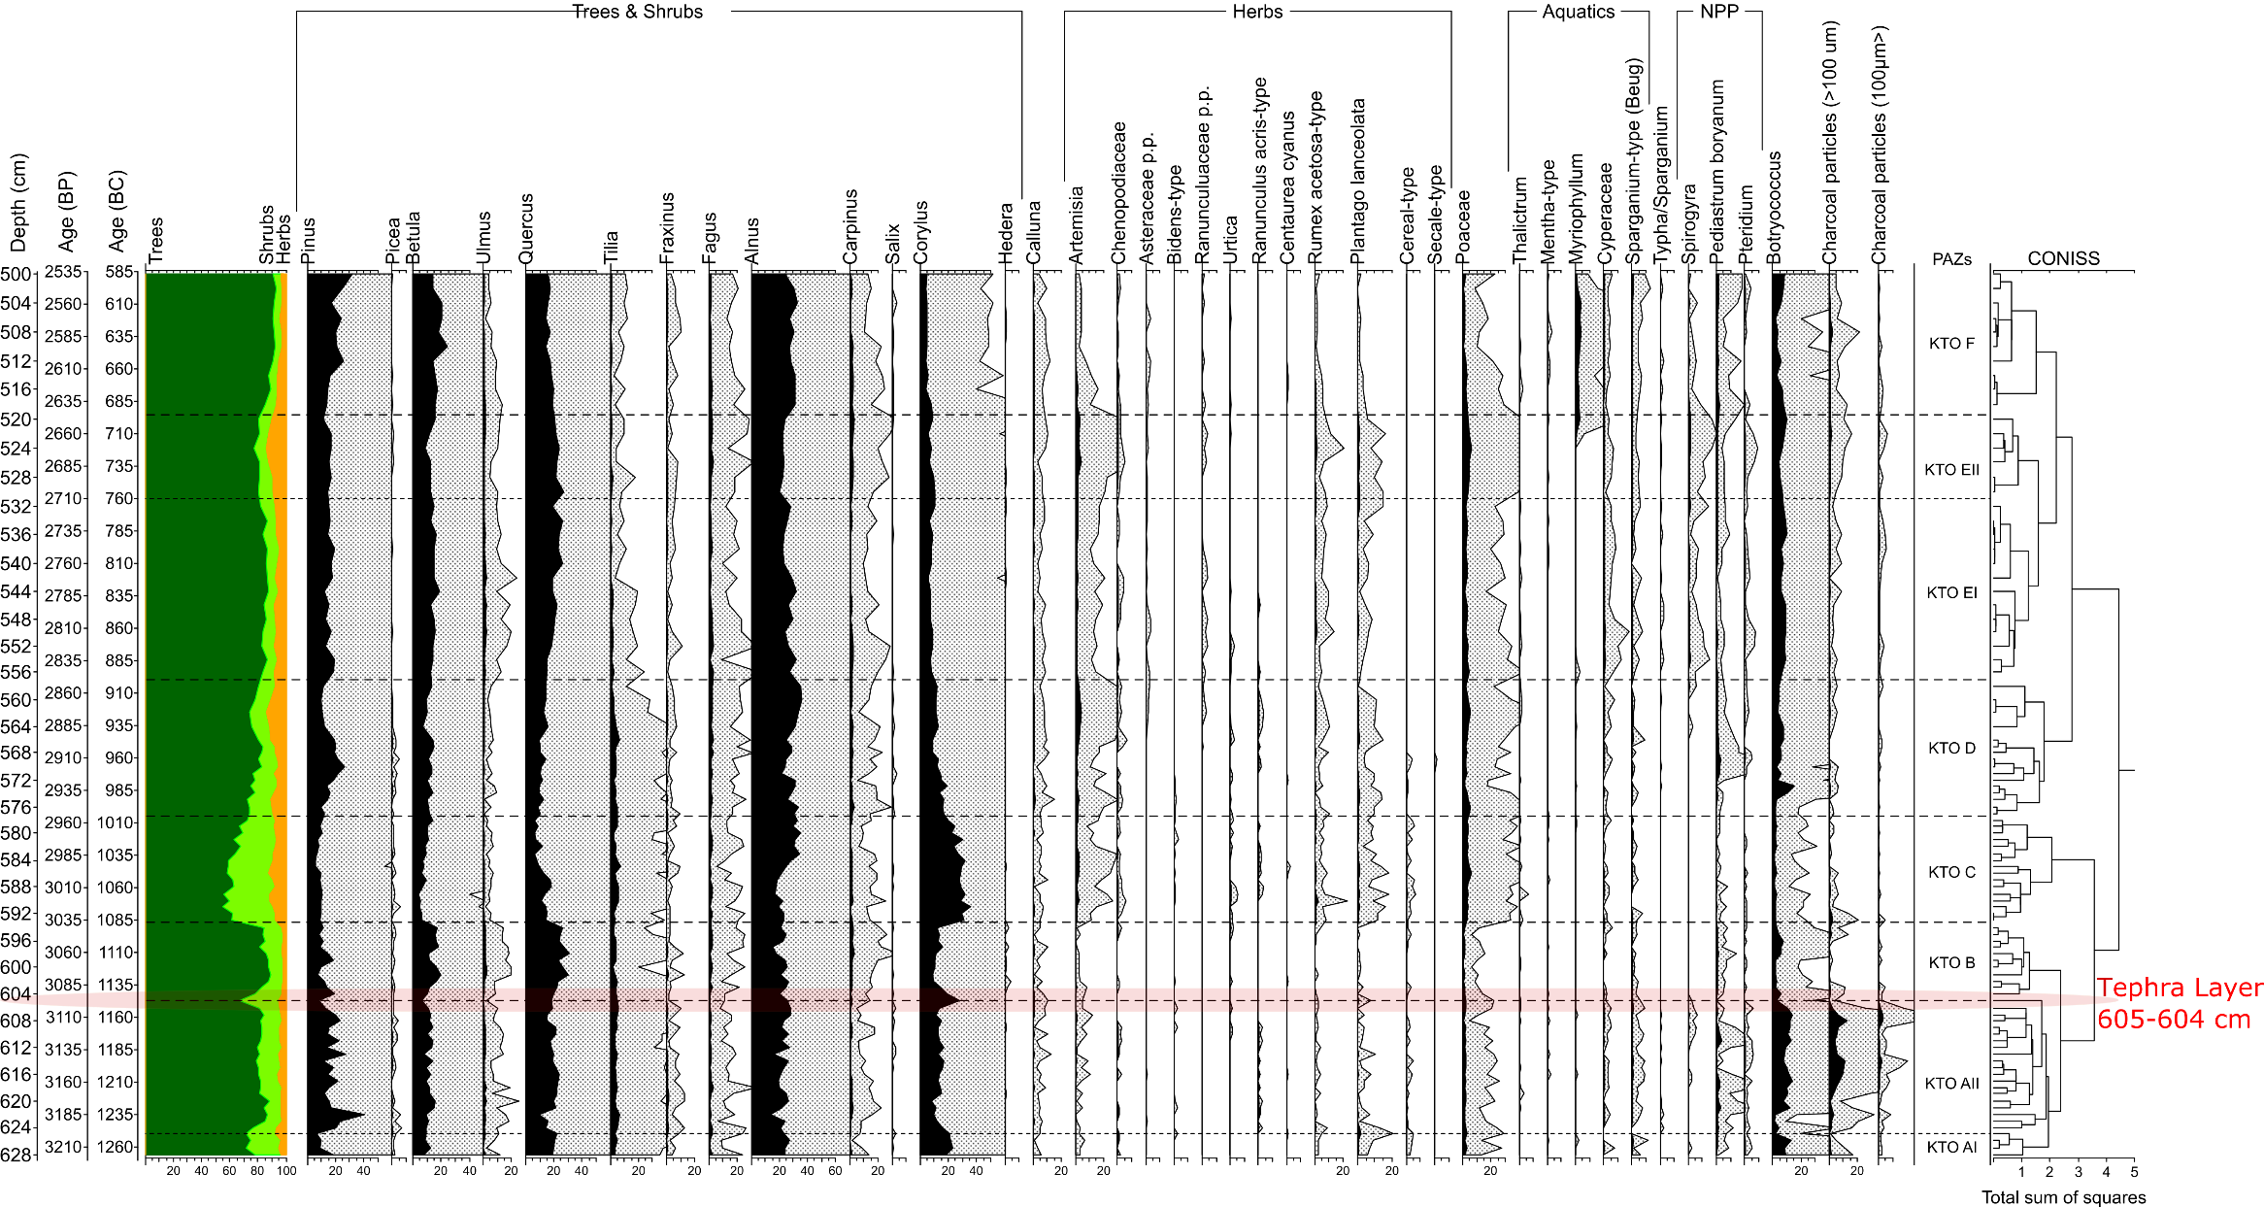
Palynological data
Anthropogenic indicators
Shrubs
Trees
After ~1100 BC (3050 BP)
human activity recovery
woodland clearance
cereal pollen rises slightly
grazing indicators rise
ca. 1250–1100 BC (3200-3050 BP)
Reforestation
Reduced human activity
Simplified pollen percentage diagram of Kleiner Tornowsee
Notes:
Here you see the simplified pollen percentage diagram for the Late Bronze Age.
I focus here on the main vegetation trends and indicators of human activity.
Between about 1250 and 1100 BC, we observe clear reforestation together with a decline in anthropogenic indicators.
This suggests reduced land use and lower human activity, which likely reflects a demographic contraction in the region.
After around 1100 BC, this pattern changes.
Anthropogenic indicators, including cereal pollen and grazing indicators, and shrubs start to rise, while woodland cover decreases.
This indicates a recovery of human activity, renewed land use, and gradual landscape reopening. These environmental changes and renewed land-use were also reflected in settlement organisation.

Slide 7
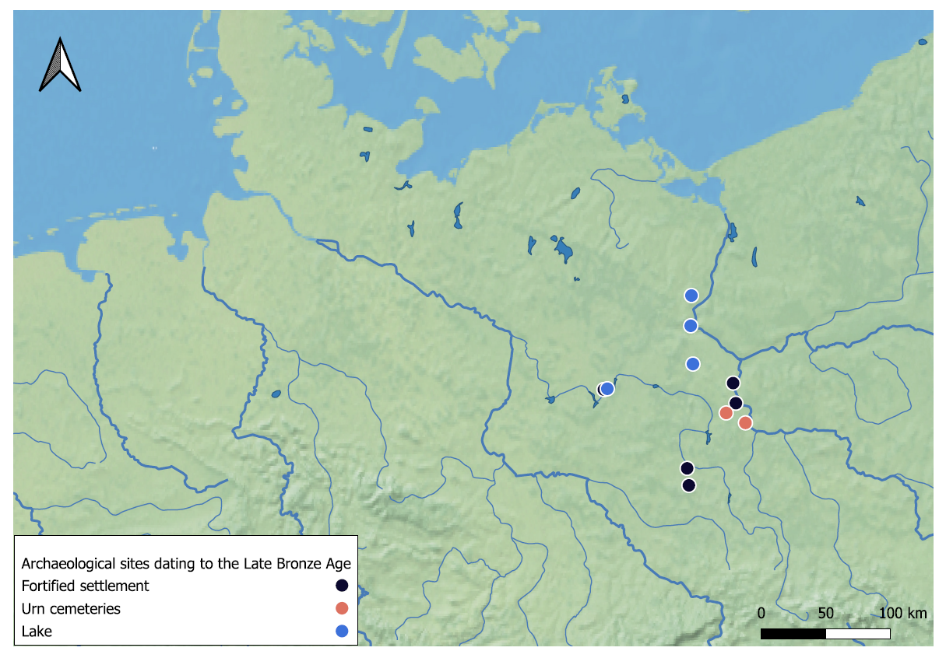



Archaeological evidence
Changes in settlement organisation
Densely organised hamlet-like clusters
Often located near reliable water sources
Start of fortification at ca.1200 BC; peak after 1100 BC
Oder River
Felchowsee
Sacrower See
Großer Krebssee
Kleiner Tornowsee
Römerschanze
Lebus
Müllrose
Lossow
Settlements located in environmentally favourable positions
Lübbenau
Eisenhüttenstadt
Calau
scattered individual farmsteads
hamlet-like clusters of log houses
Notes:
Archaeological evidence from the study region shows that instead of scattered farmsteads, settlements became more densely organised hamlet-like clusters, often located near reliable water sources and environmentally favourable areas.
From around 1200 BC, and especially after 1100 BC, fortified settlements also appear, which indicates increasing population, resource management, and strategies to reduce risk.
So overall, the archaeological evidence supports the pollen results, showing renewed settlement expansion and intensified human activity after the earlier phase of decline.

Slide 8


Pollen data
Geochemical data
Local pollen-based climate reconstructions
ca. 1100 and 1000 BC (3050-2950 BP)
ca. 1200 and 1150 BC (3150-3100 BP)
Notes:
Here, the multiproxy data show clear environmental changes between about 1200 and 1000 BC.
Between about 1200 and 1150 BC, precipitation increases while temperature decreases and we see a strong peak in detrital input. This suggests a phase of landscape instability, with strong fluvial activity and soil erosion.
After about 1100 BC, detrital input increases again, which coincides with increasing anthropogenic indicators and reduced woodland cover.
This suggests that erosion in this later phase was influenced by both climate conditions and renewed human land use and woodland clearance.
Overall, this interval shows how environmental changes and human activity interacted with each other under changing hydrological conditions.

Slide 9
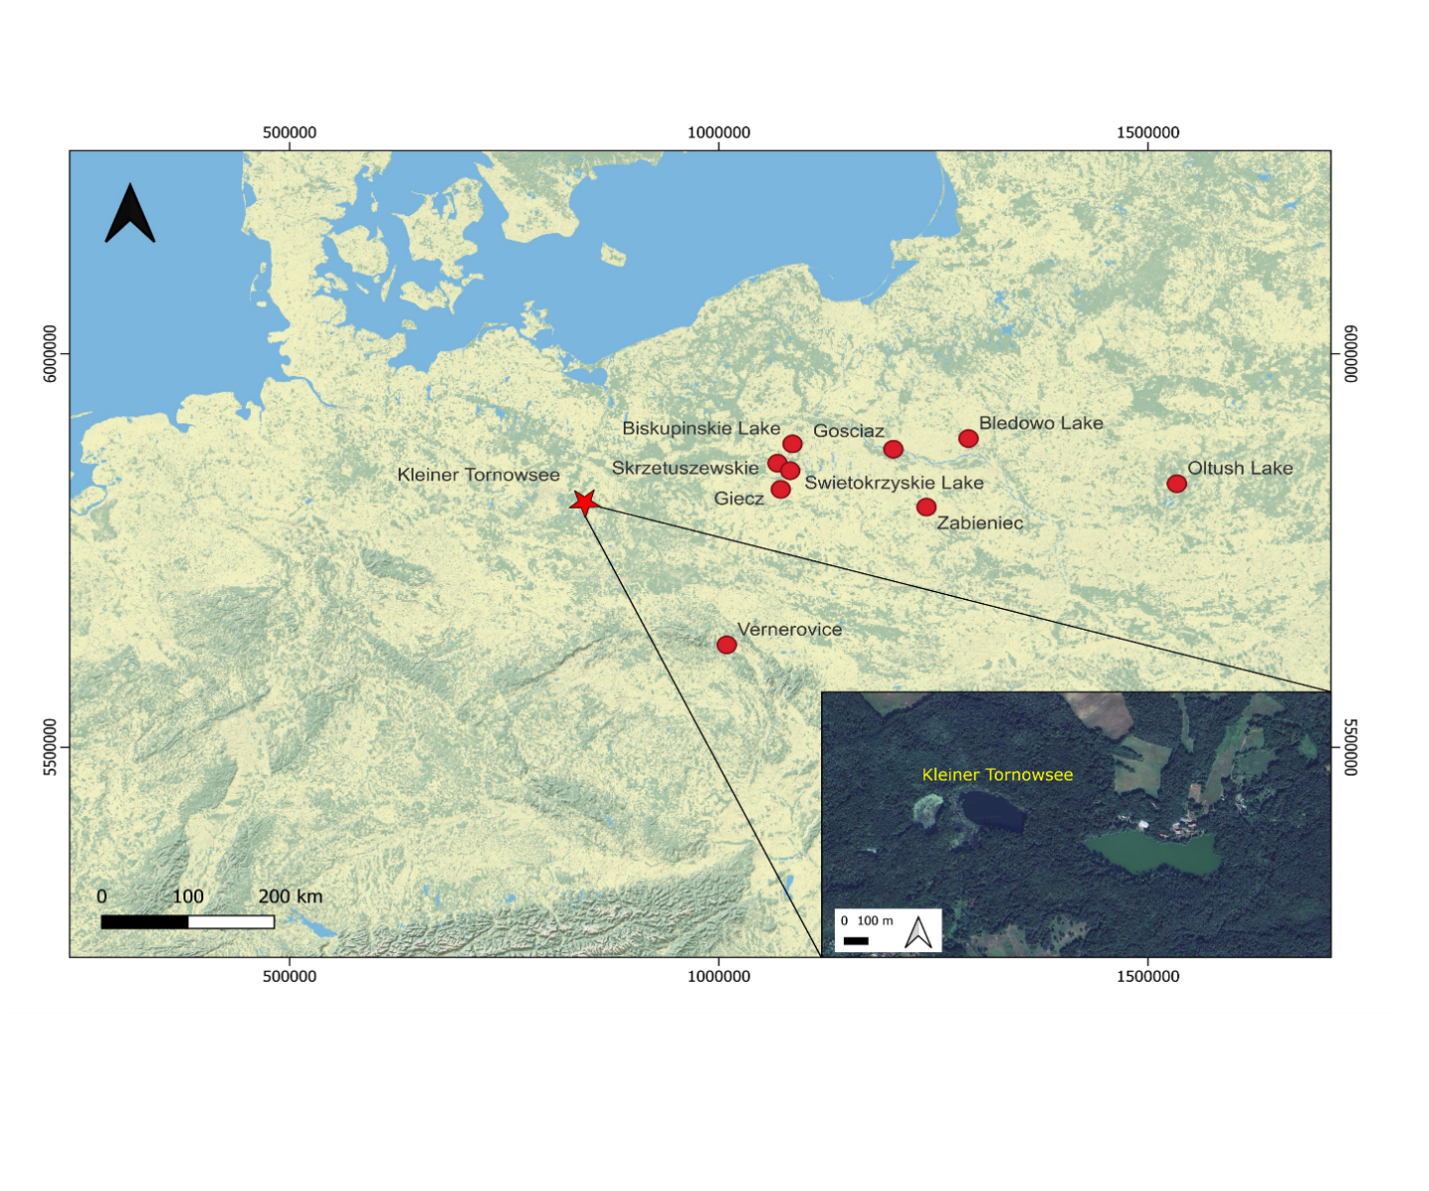
Regional Climatic data-based on pollen and chironomid
~ 1100 and 1000 BC
~1200-1150 BC
~ 1100 and 1000 BC
~1200-1150 BC
Locations of paleoenvironmental records
Notes:
To place the local environmental signals into a broader context, I compared them with regional climate reconstructions based on pollen and chironomid records.
The regional proxy-based reconstruction results show that the increase in precipitation and decrease in temperature between 1200 to 1150 BC which is followed by increase in temperature and higher precipitation between 1100 and 1000 BC was not local but rather a regional climatic event.

Slide 10
Continental Climatic data-The model simulations
3150-3100 BP
3050-3000 BP
red rectangle indicates the location of the sites used for local and regional climate reconstructions
Notes:
And then, I compared the local and regional results with climate model simulations at the European scale.
The models also show a shift to cold and wet conditions around 1200 BC.
After about 1100 BC, they indicate a transition to warm and still relatively wet conditions.
This confirms that the environmental changes observed in the Tornowsee record were part of a broader large-scale climatic pattern.

Slide 11






Social-ecological Resilience
- diversified economy (millet +pulses + oil plants, mixed farming, grazing integration)
- storage systems indicating buffering (communal?)
- settlement restructuring
- continuation of exchange networks
higher adaptive capacity
Pit storage
human mobility
Notes:
The archaeological and environmental evidence from the LBA suggests a relatively high adaptive capacity.
The economy was diversified, combining different crops and animal husbandry.
Storage systems, including pit storage, indicate buffering strategies.
Settlements were reorganised, and exchange networks with other European regions continued.
Altogether, this suggests that societies were able to adjust their land use and maintain resilience under environmental stress.

Slide 12
Thank you!

