Slide 1



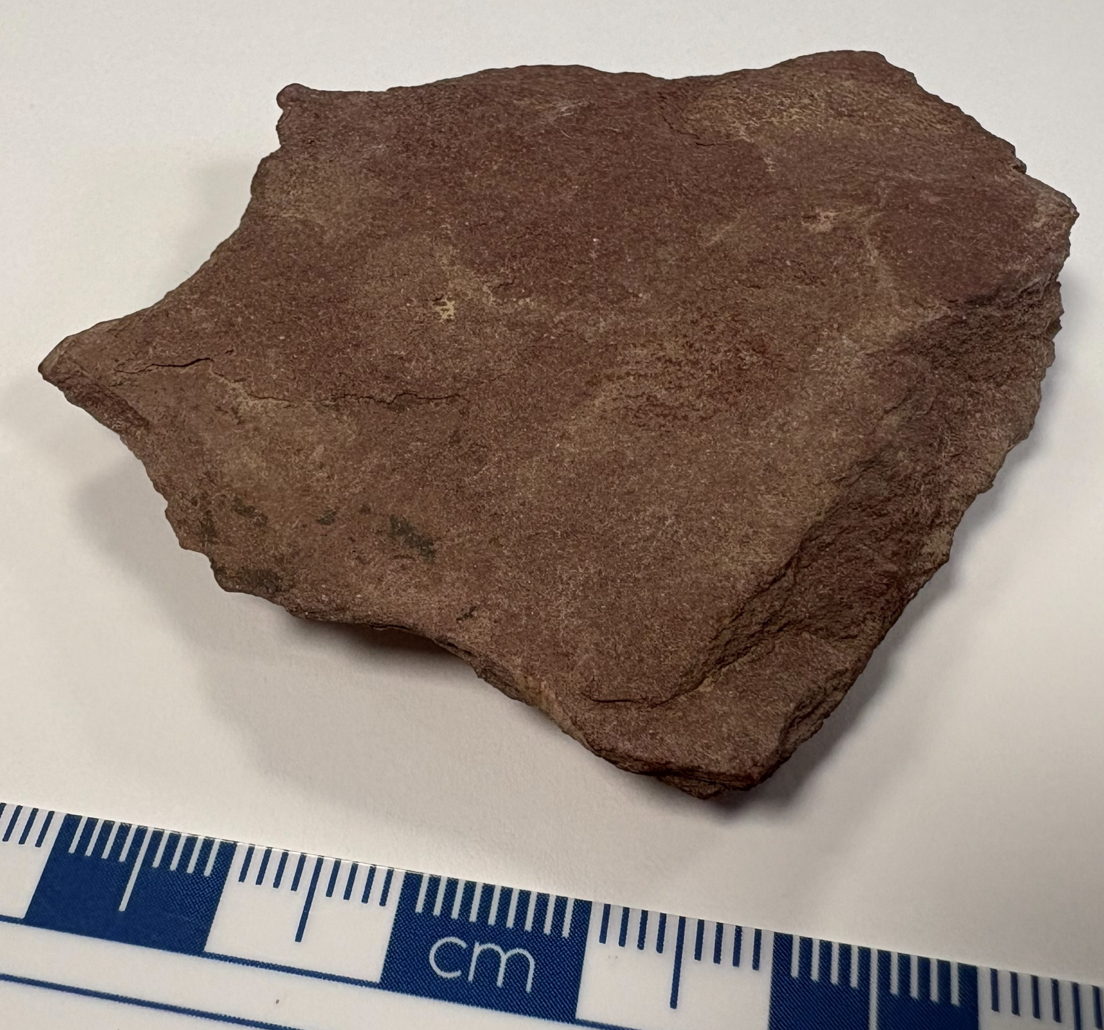
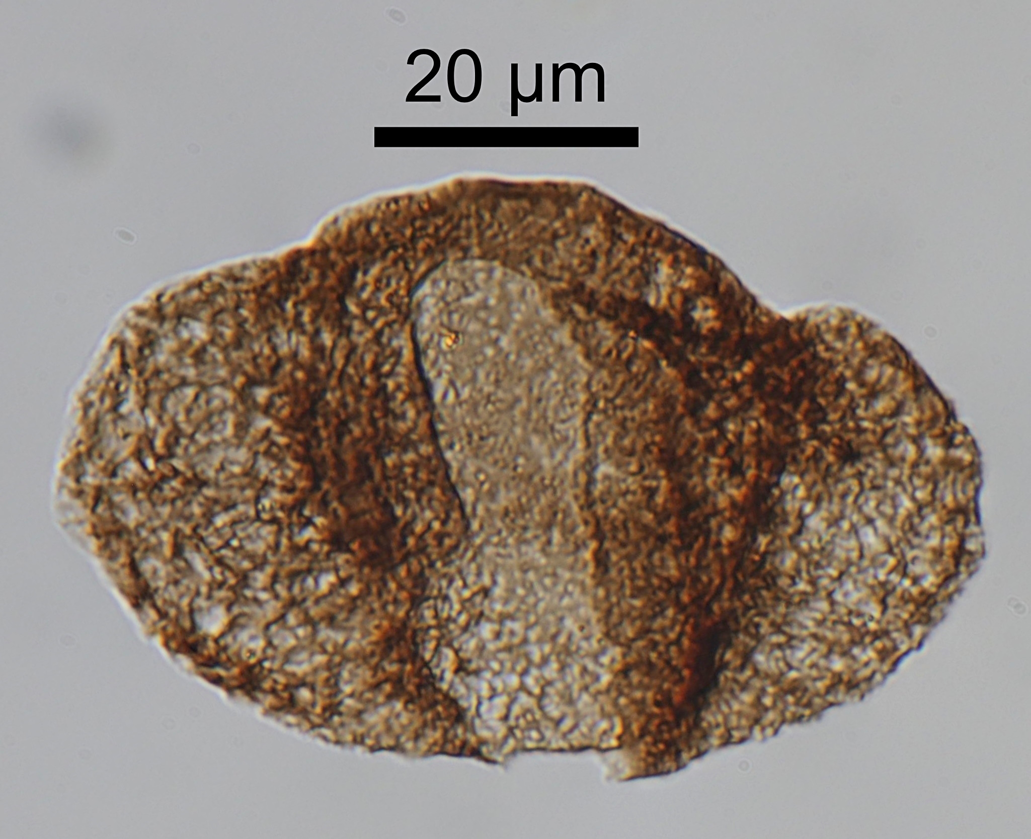
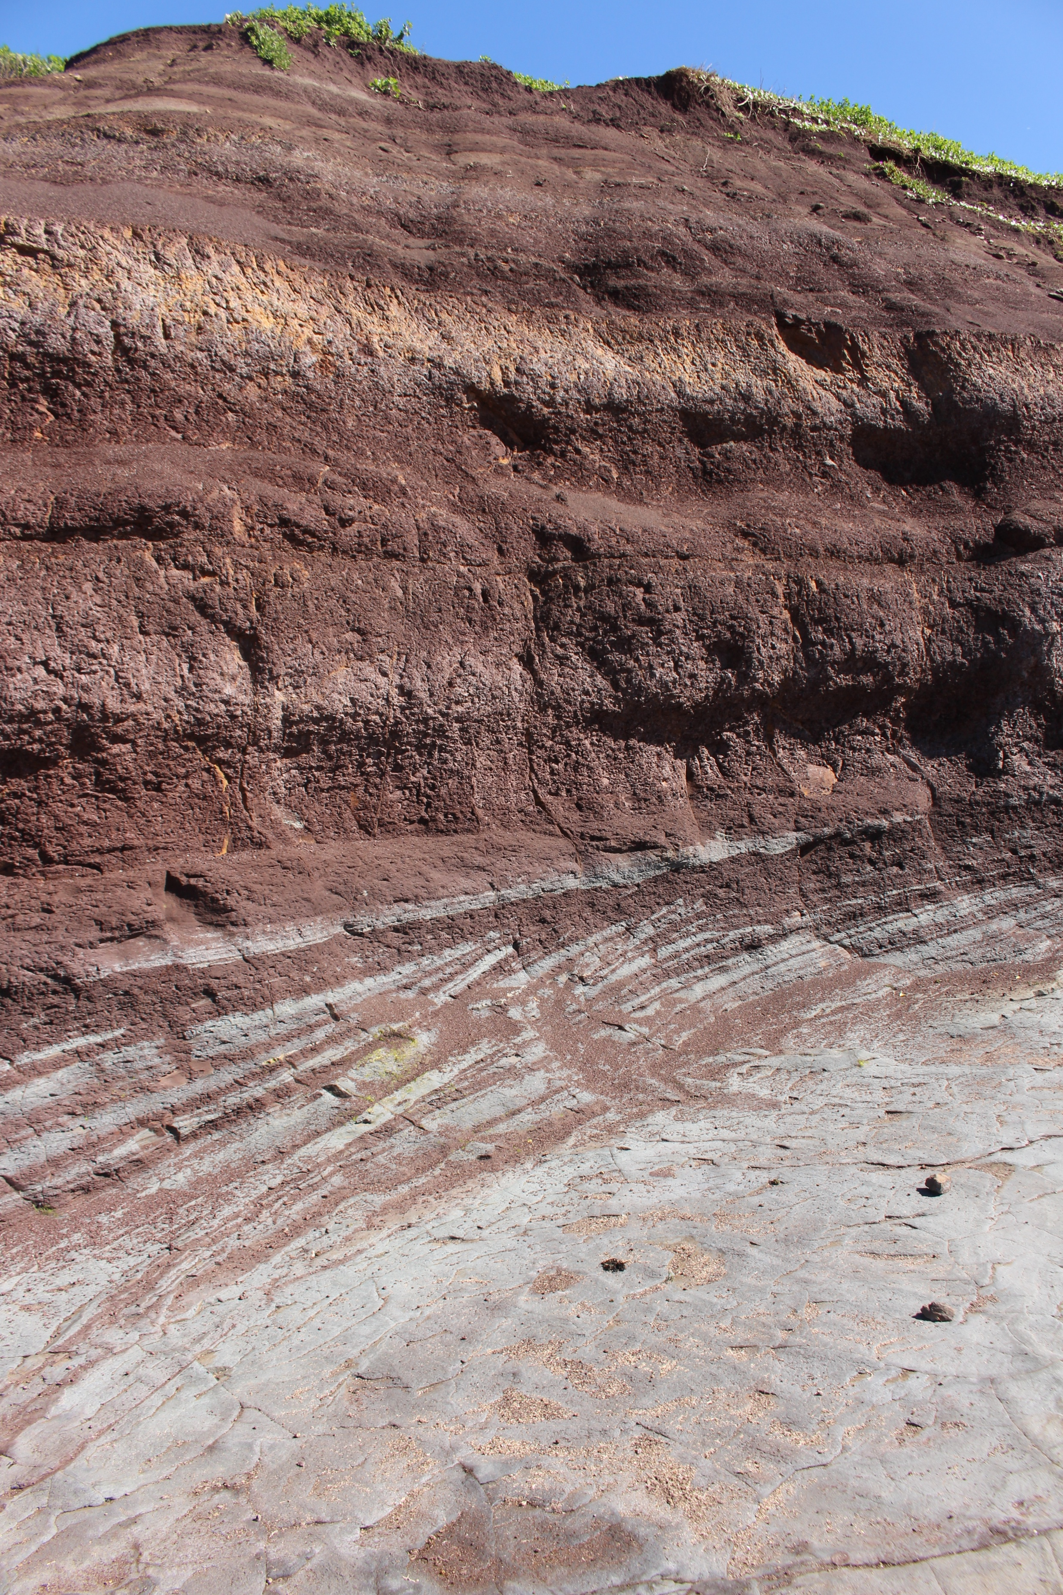
Red bed redemption: How highly weathered mudrocks can hold well-preserved plant microfossils from the Early Triassic of the Sydney Basin, southeastern Australia
¹
²
³
Marcos Amores¹, Tracy D. Frank², Christopher R. Fielding², Chris Mays^{1,3}
1 m
1 cm
Bald Hill Claystone outcrop
(Long Reef, Sydney, AUS)
Bald Hill Claystone core sample
(Bunnerong-1, 373.59 m depth)
Alisporites australis pollen grain
(Bunnerong-1, 373.59 m depth)

Slide 2
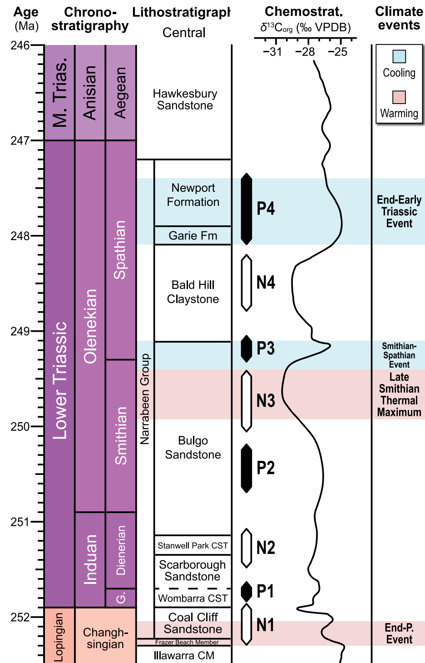
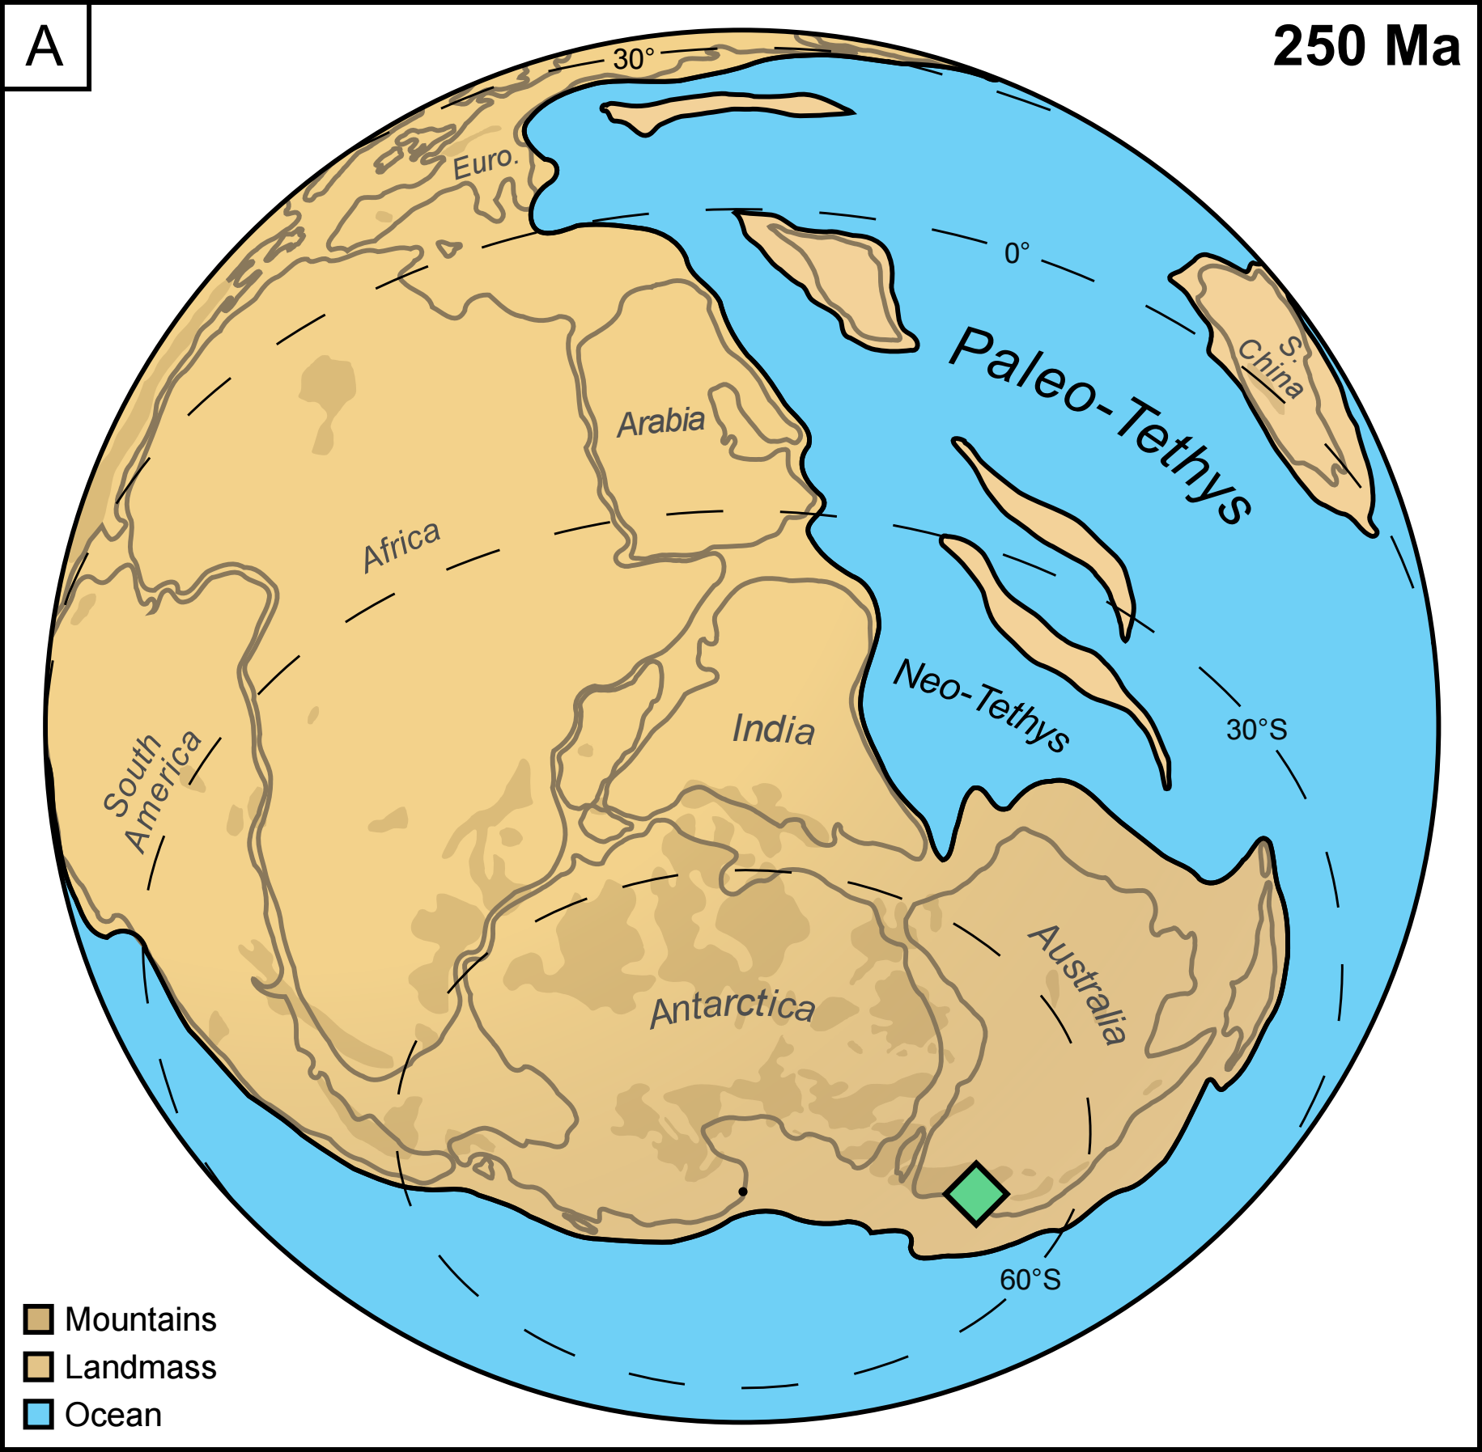
Sydney
Basin
Amores et al. (in prep.)
Mountains from Scotese (2016), PALEOMAP (https://www.earthbyte.org/paleomap-paleoatlas-for-gplates/)
Coastline from Merdith et al. (2021), Earth-Science Reviews 214, 103477
Adapted from Mays et al. (2026), Global and Planetary Change 263, 105536

Slide 3
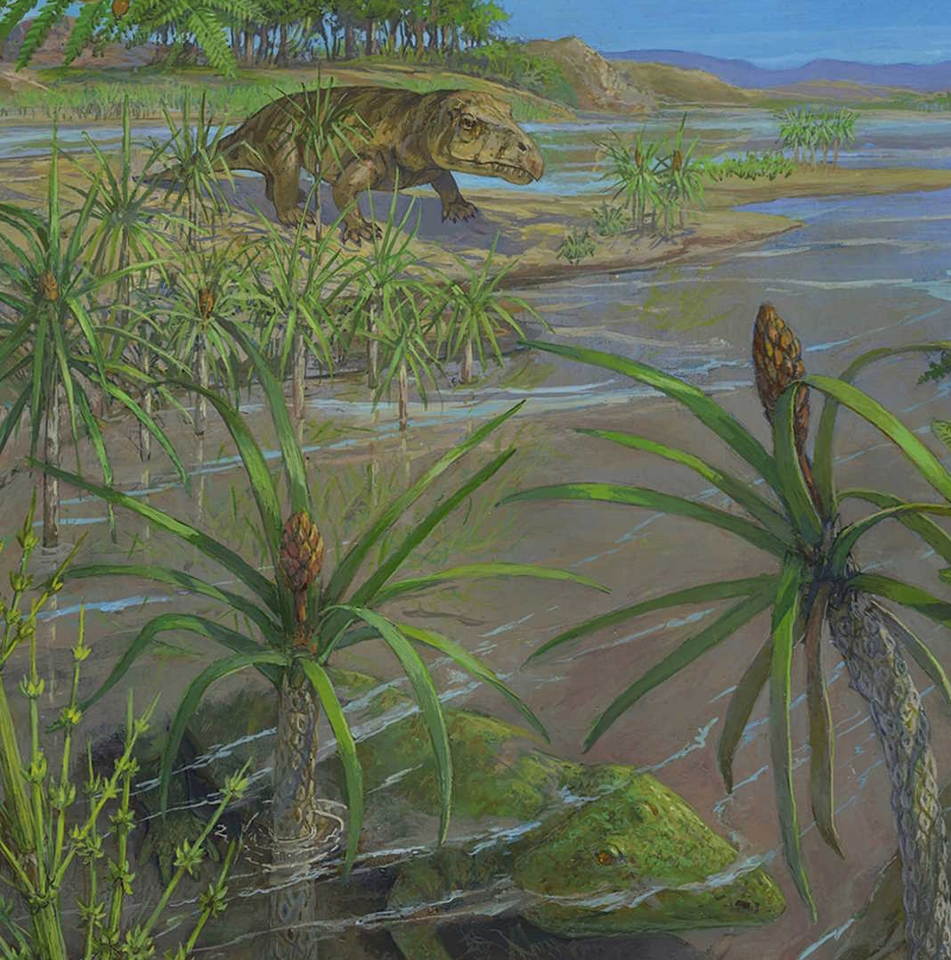
Adapted from Mays et al. (2026), Global and Planetary Change 263, 105536
Vajda & Kear (2024), Alcheringa, v. 48(3), pp. 1–12
© Michael Rothman

Slide 4
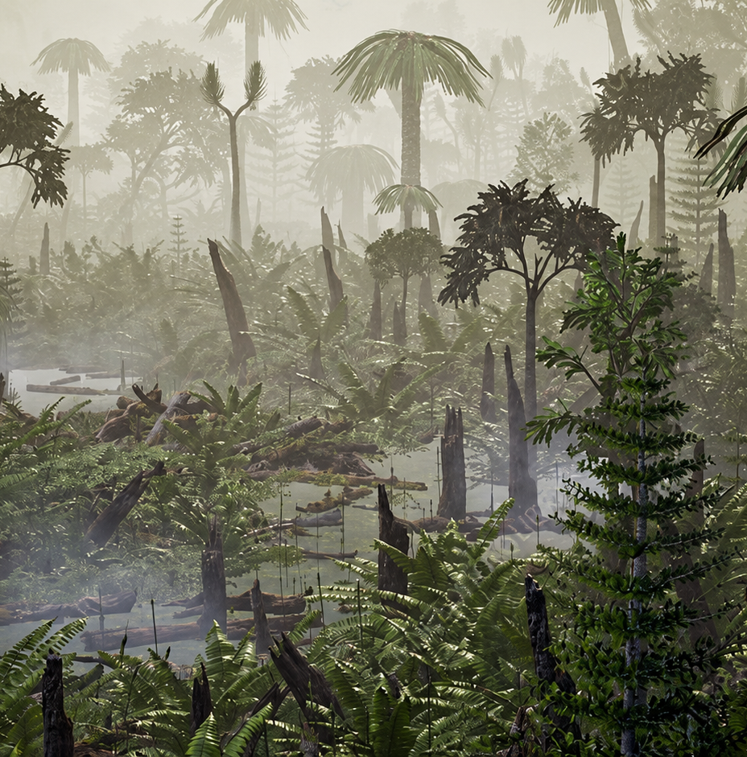
Late Permian Glossopterid peat-forming forests
Adapted from Mays et al. (2026), Global and Planetary Change 263, 105536
© Richard Jones

Slide 5
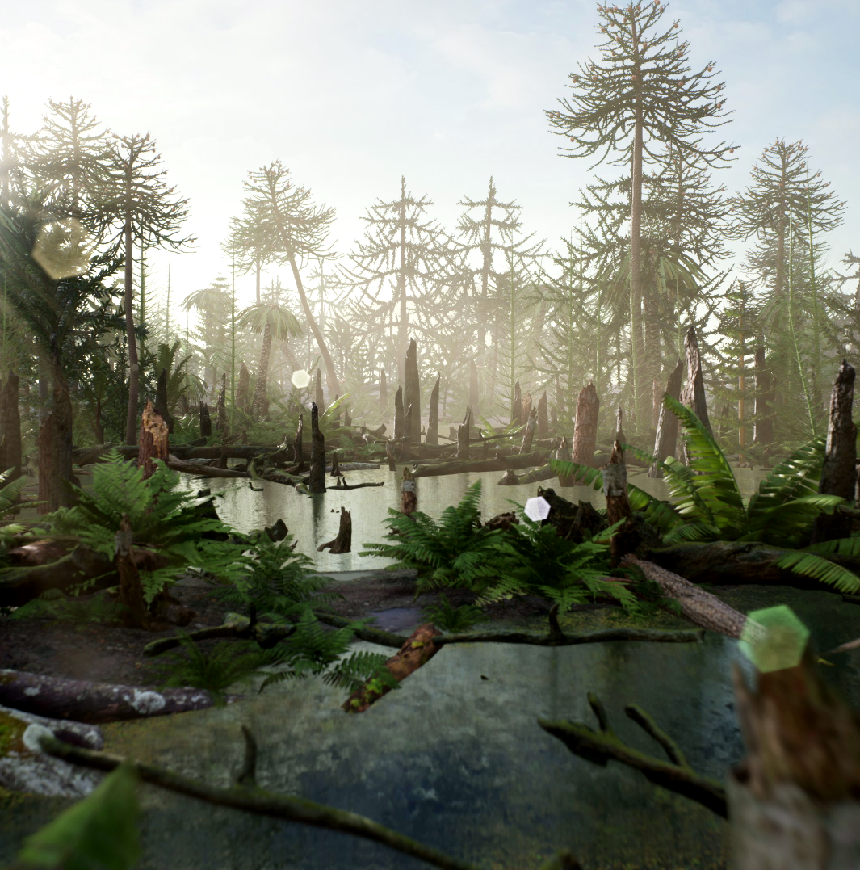
Early Triassic floristic turnovers
Adapted from Mays et al. (2026), Global and Planetary Change 263, 105536
© Julio Lacerda
© Richard Jones

Slide 6
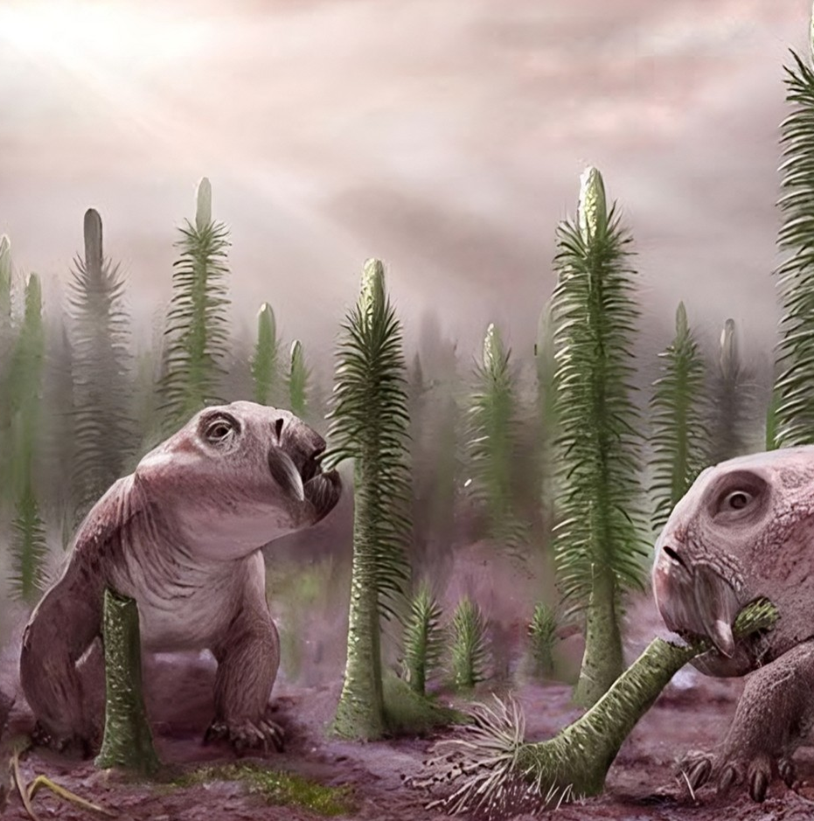
Early Triassic floristic turnovers
Adapted from Mays et al. (2026), Global and Planetary Change 263, 105536
© Victor O. Leshyk

Slide 7
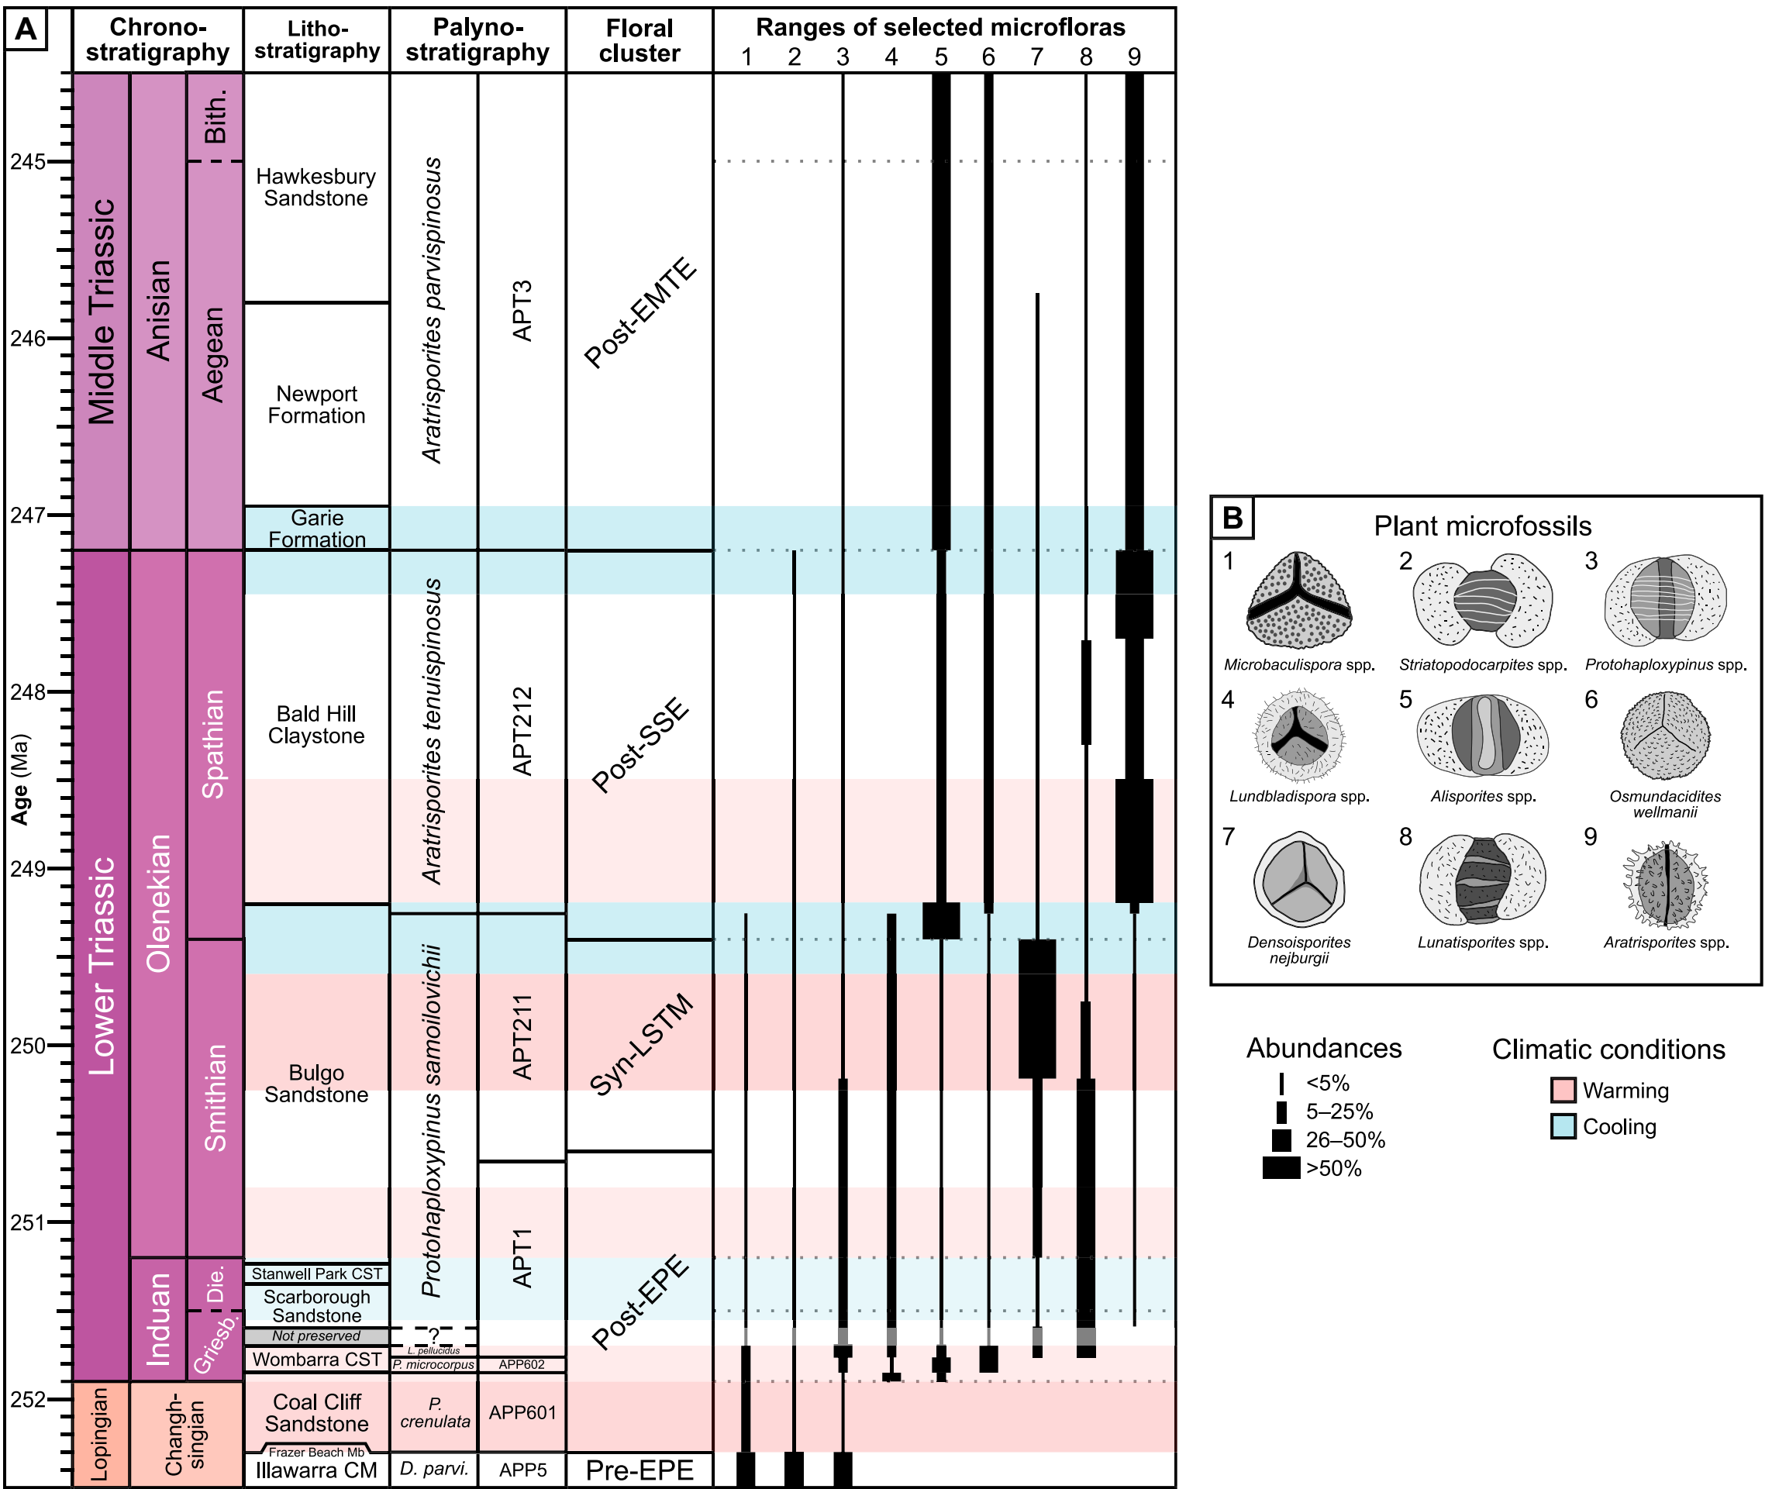
Amores et al. (2025),
GSA Bulletin 137(7–8),
pp. 3255–3282

Slide 8
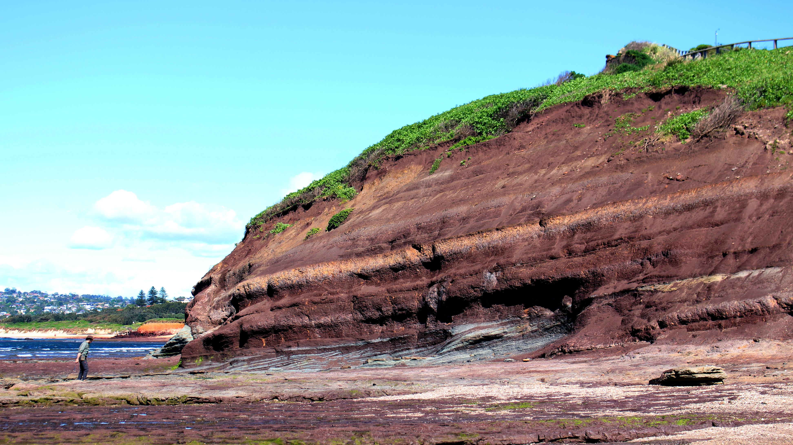
Bald Hill Claystone (Long Reef, Sydney, Australia)

Slide 9
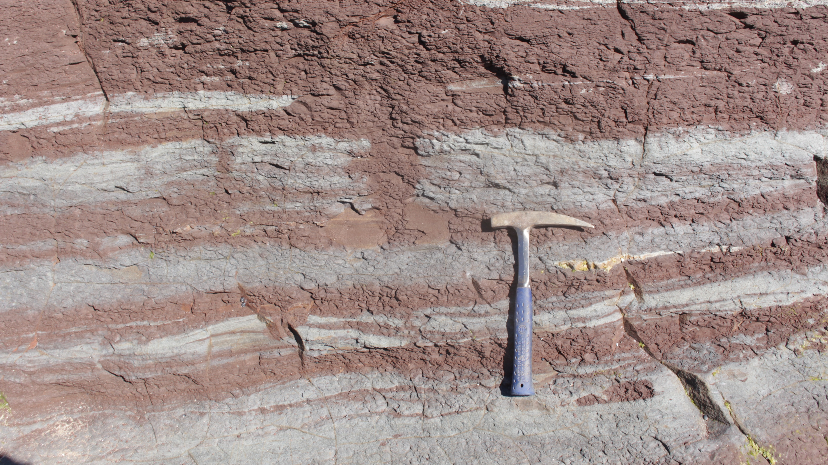
Bald Hill Claystone (Long Reef, Sydney, Australia)

Slide 10
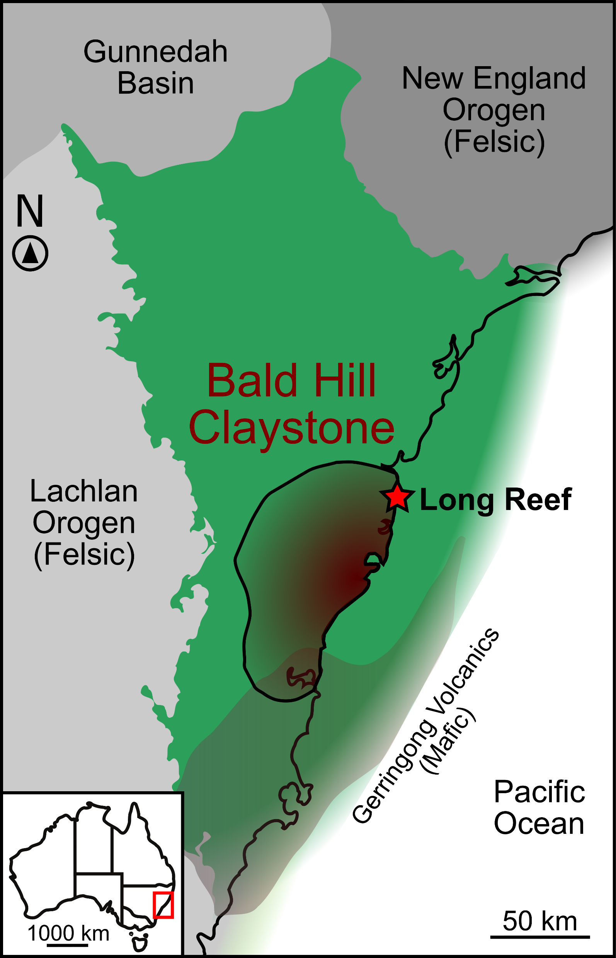
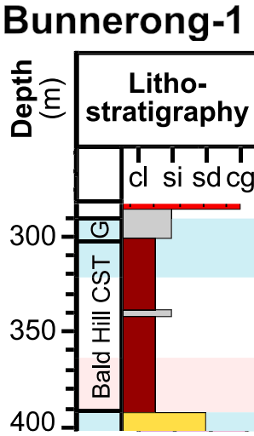
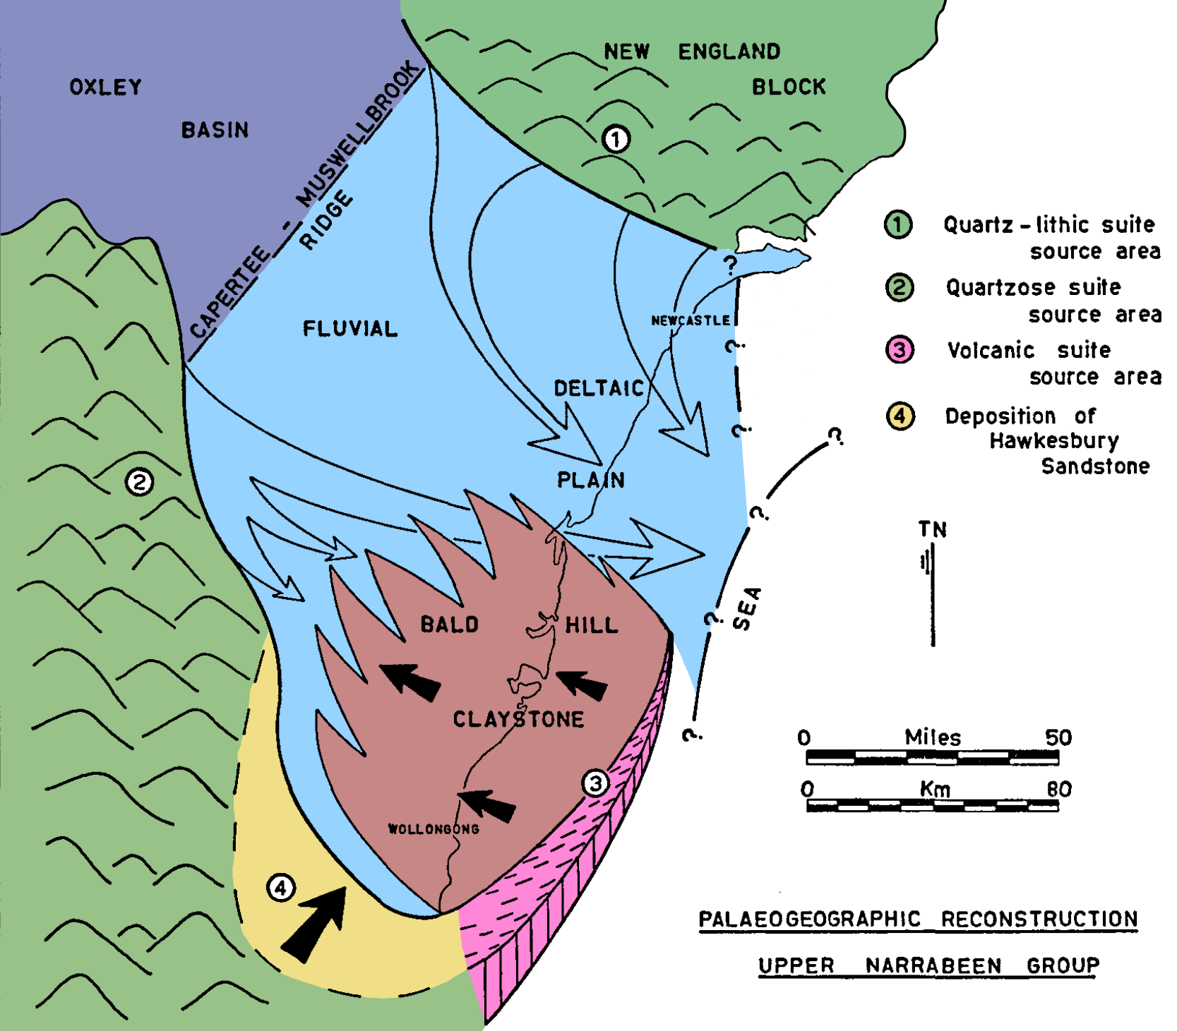

Sydney
Amores et al. (2025),
GSA Bulletin 137(7–8),
pp. 3255–3282
Modified from Ward (1972), Journal of the Geological Society of Australia 19(3), pp. 393–409
Mafic source area
(subsurface)
Formation isopach (>20 m) adapted from Goldbery & Holland (1973), AAPG Bulletin 57(7), pp. 1314–1334
Amores et al. (in prep.)

Slide 11
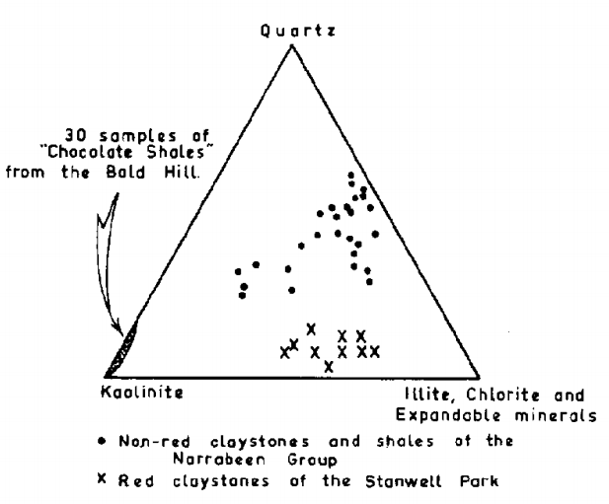
Loughnan (1970), Journal of Sedimentary Research 40(3), pp. 822–828
Amores et al. (2025),
GSA Bulletin 137(7–8),
pp. 3255–3282
Modified from Ward (1972), Journal of the Geological Society of Australia 19(3), pp. 393–409

Slide 12
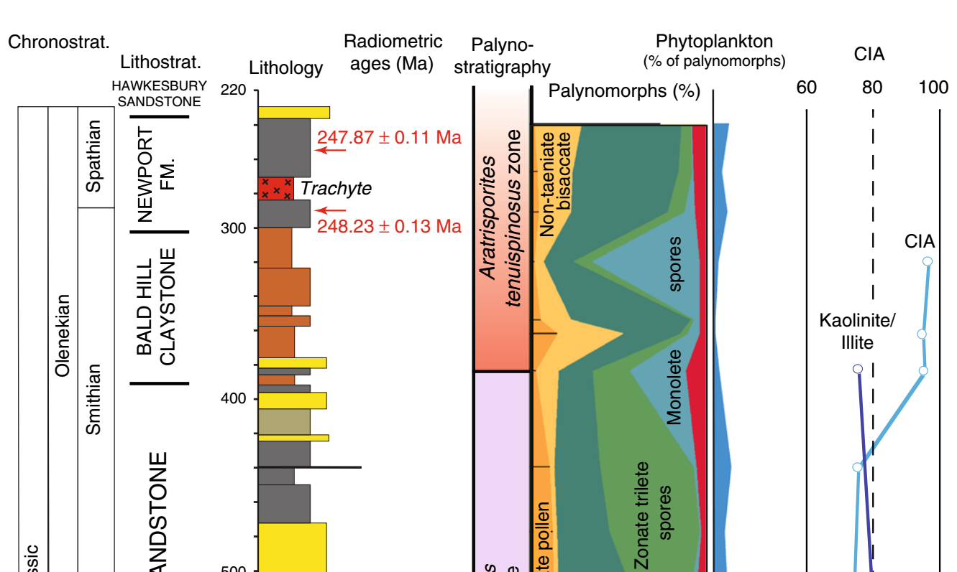
Loughnan (1970), Journal of Sedimentary Research 40(3), pp. 822–828
Adapted from Fielding et al. (2019), Nature Communications 10(385)

Slide 13
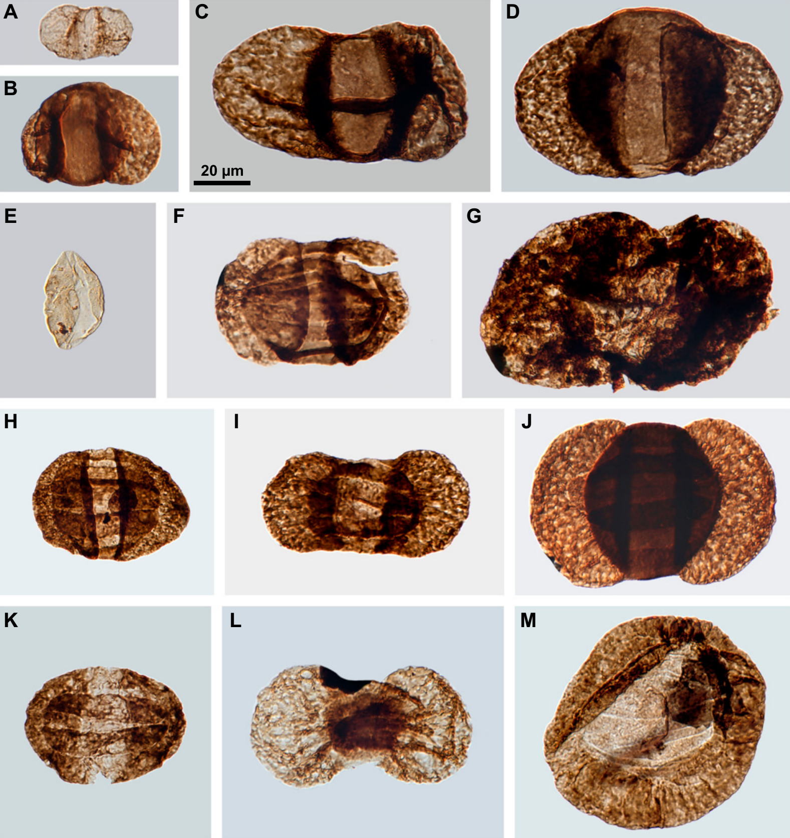
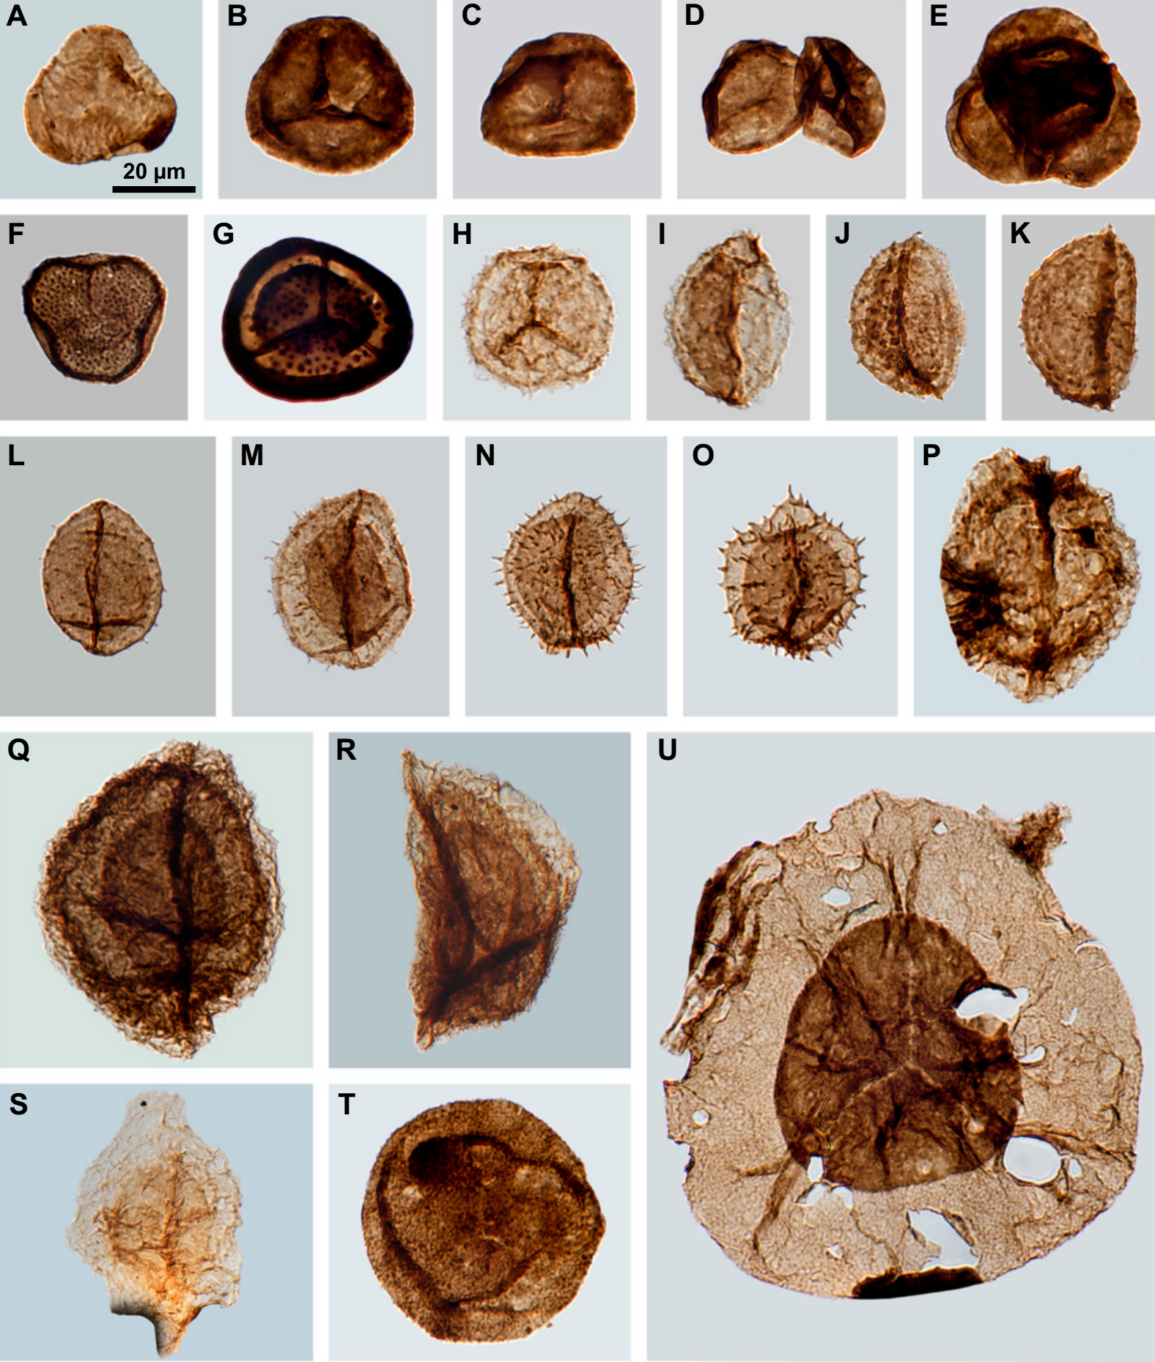
Amores et al. (2025), GSA Bulletin 137(7–8), pp. 3255–3282

Slide 14
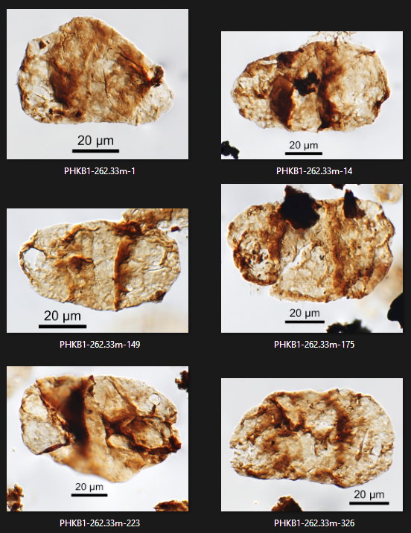
Newport Formation
Amores et al. (2025), GSA Bulletin 137(7–8), pp. 3255–3282

Slide 15
The Bald Hill Claystone is a kaolinitic, oxidised, and highly weathered red bed succession.
Yet…
Why are there well-preserved palynomorphs in it?

Slide 16
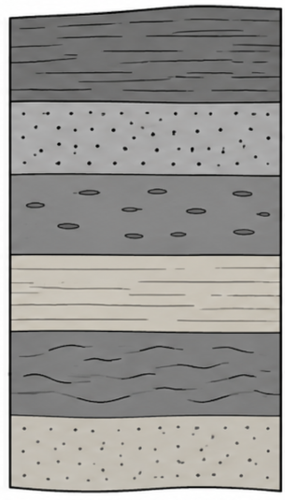
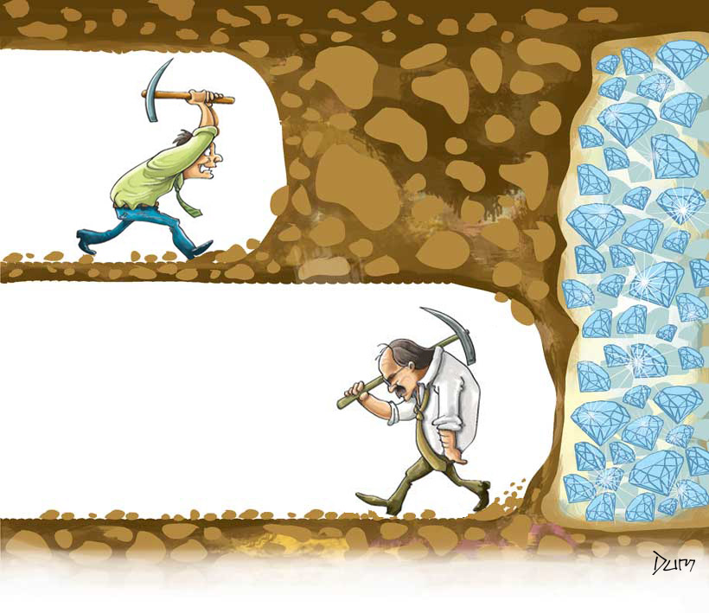
Working hypothesis:
Good palynological preservation is limited to short, less-weathered lenses.
Me recklessly spending processing money on red beds
Me missing out on some cool findings in red beds
Dum (2011) – Persistence (https://dumilustrador.blogspot.com/2011/04/ha-momentos-que-devemos-persistir-em.html)

Slide 17
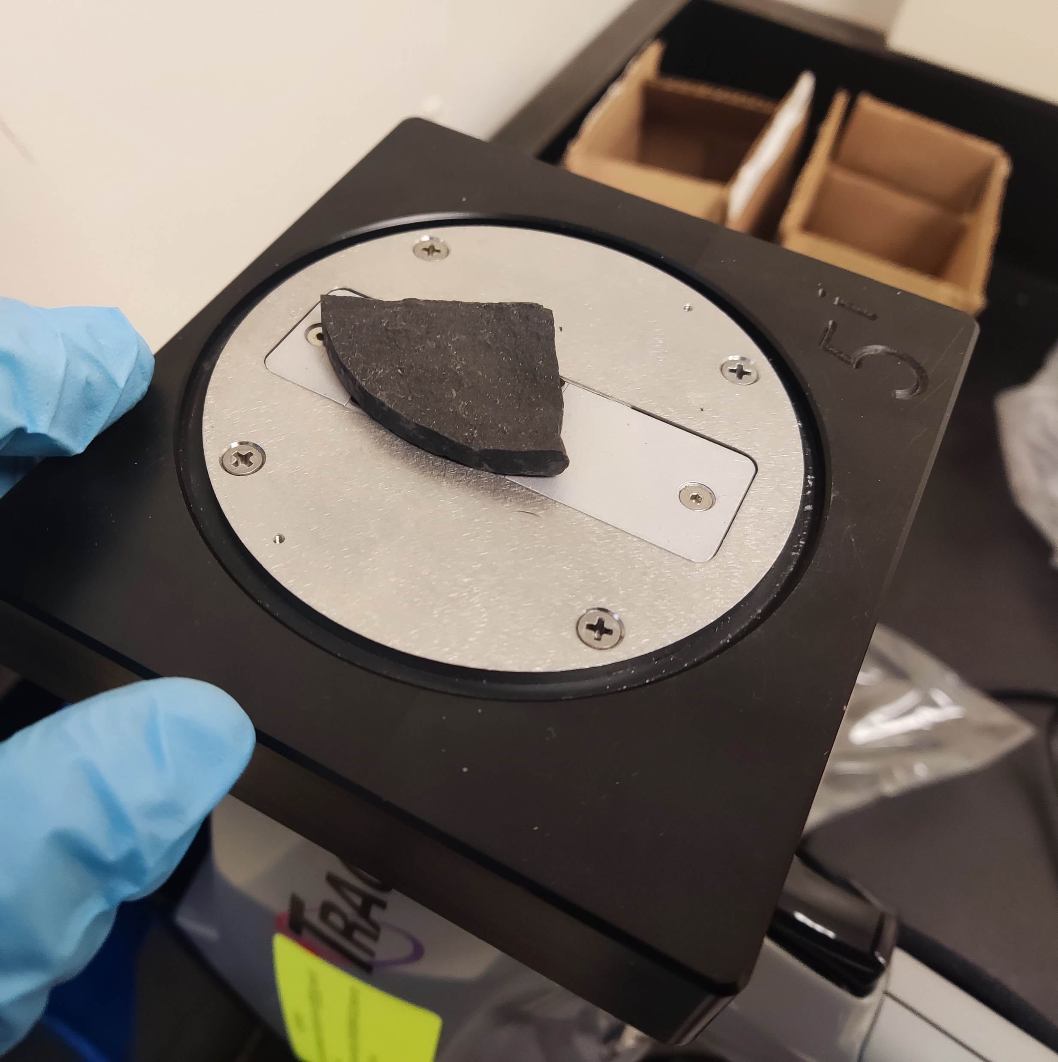
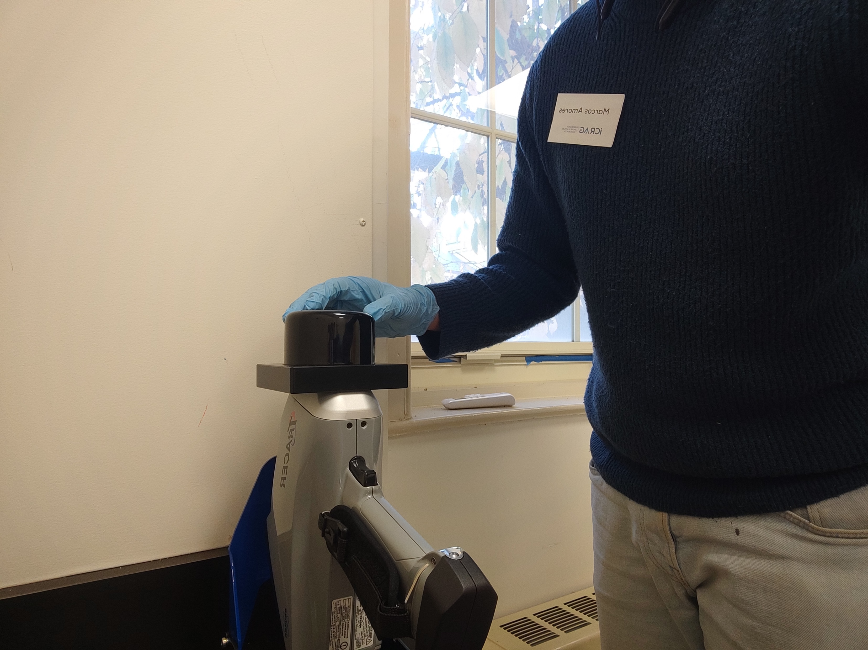
X-ray Fluorescence for elemental analysis
N = 28

Slide 18
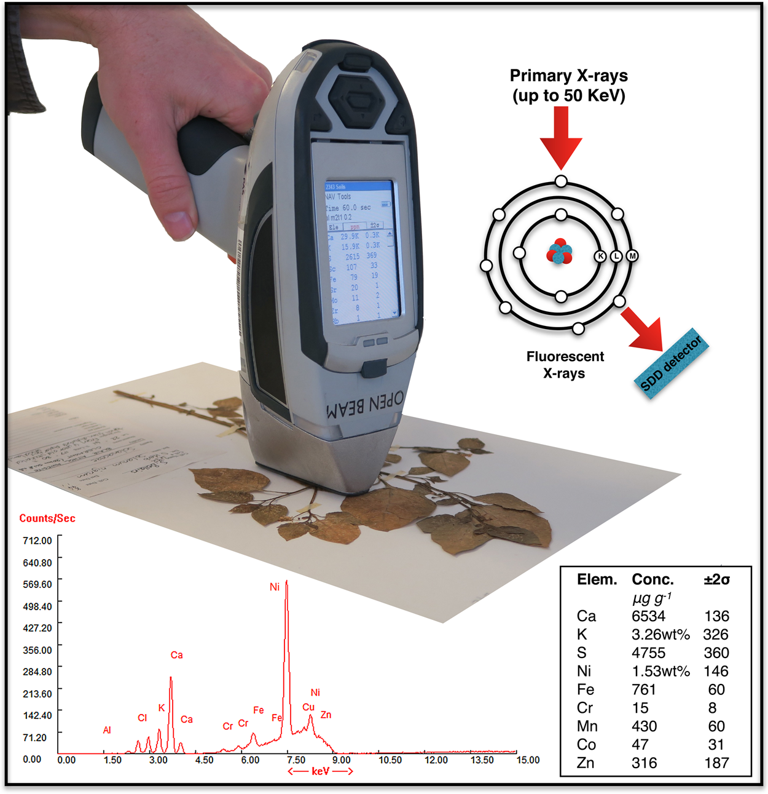
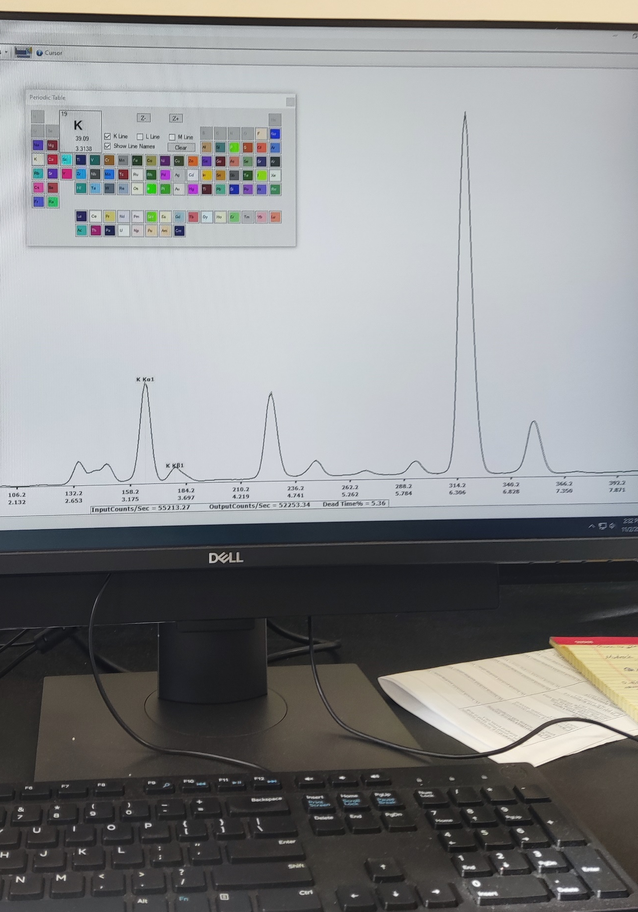
van der Ent et al. (2019),
Scientific Reports 9, 4746

Slide 19

Hyperspectral infrared analysis of clays
© NSW Resources

Slide 20

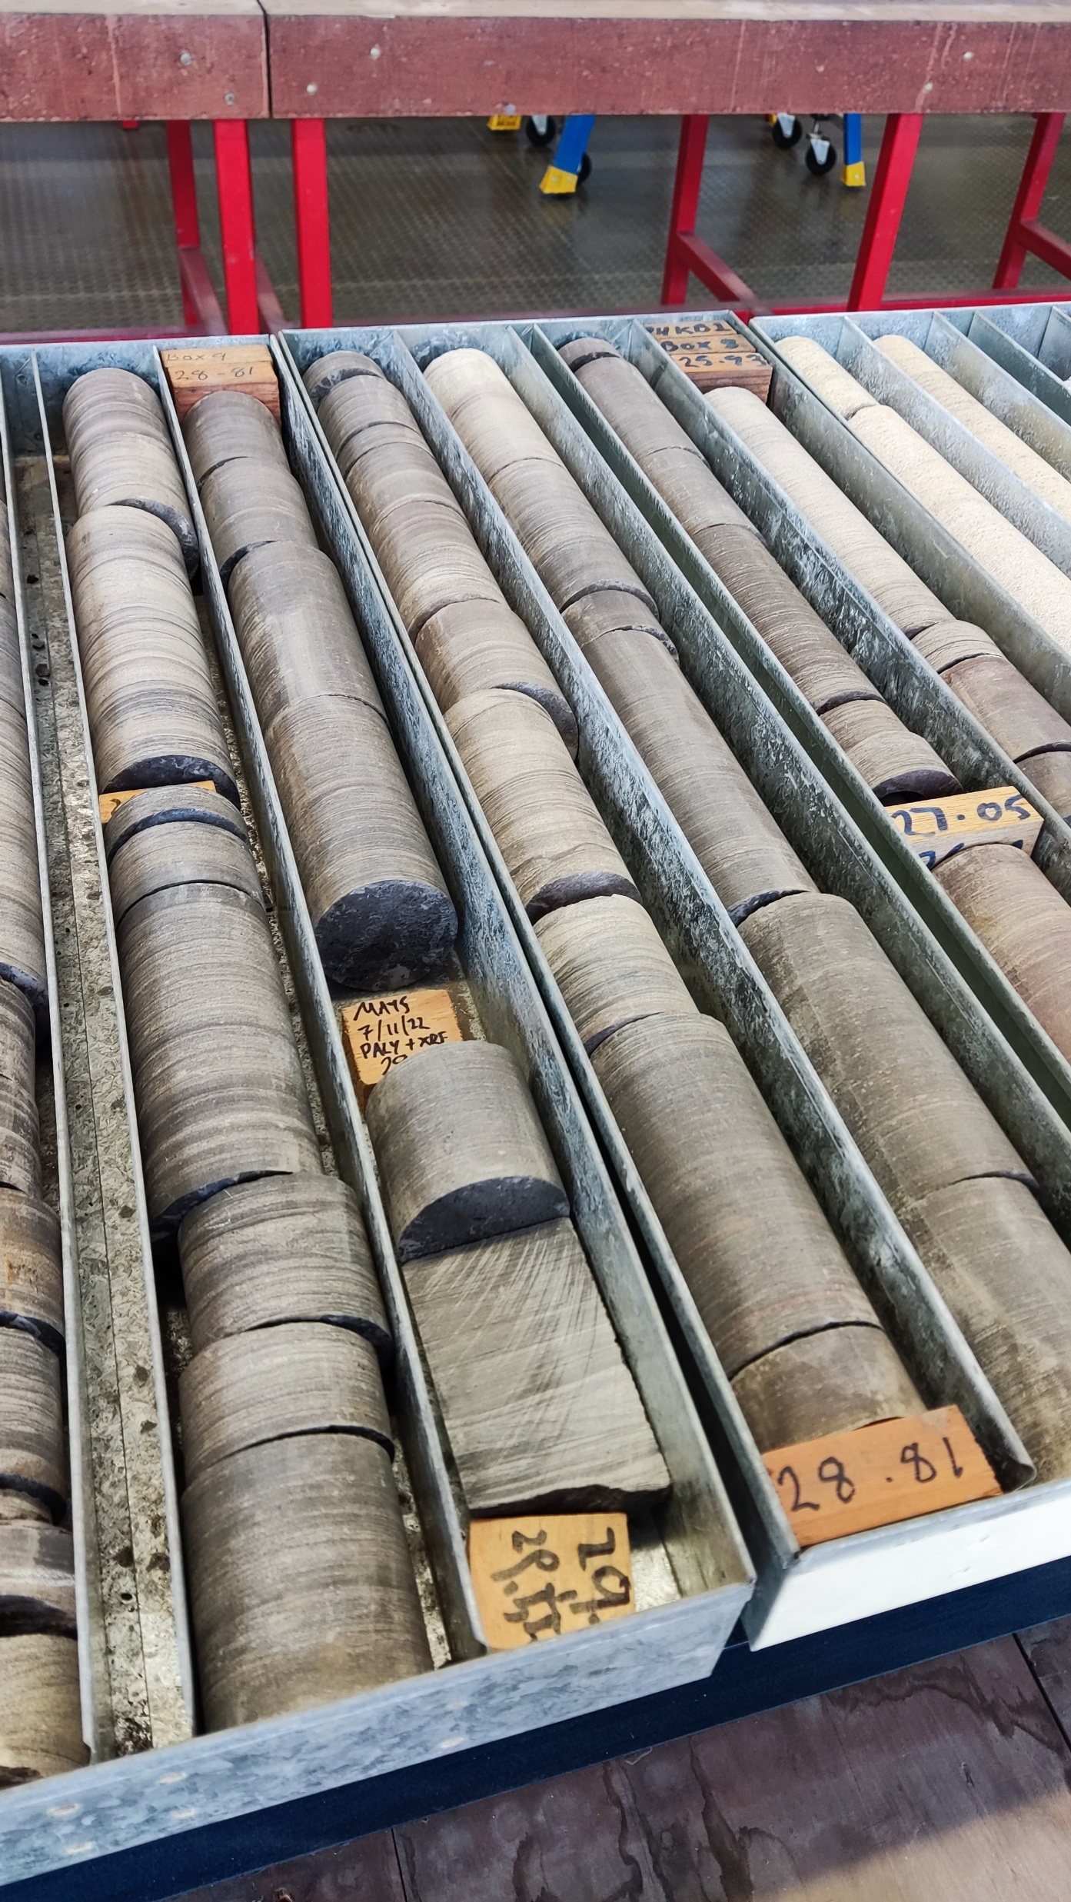
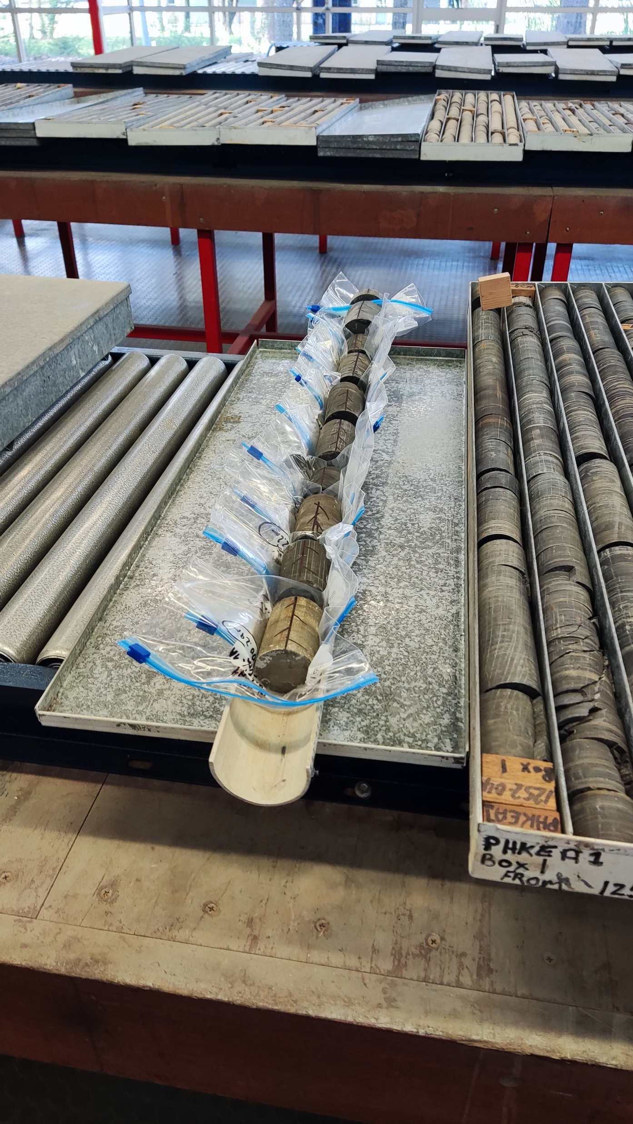
W.C. Clarke Londonderry core library (Sydney, Australia)

Slide 21
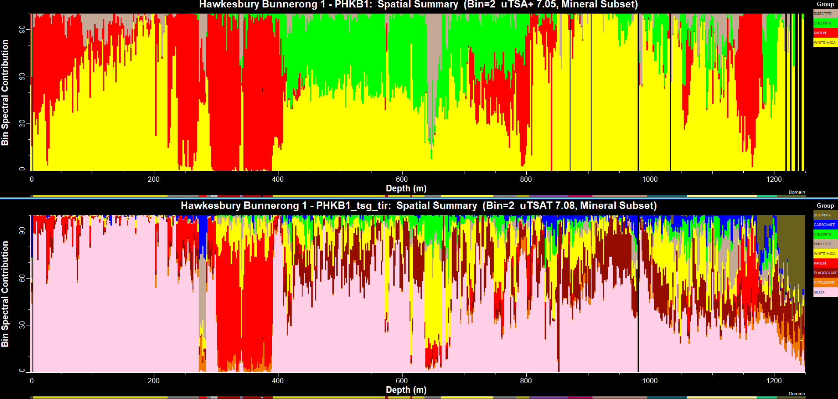
Short-wave infrared (SWIR)
Thermal infrared (TIR)

Slide 22
Results

Slide 23
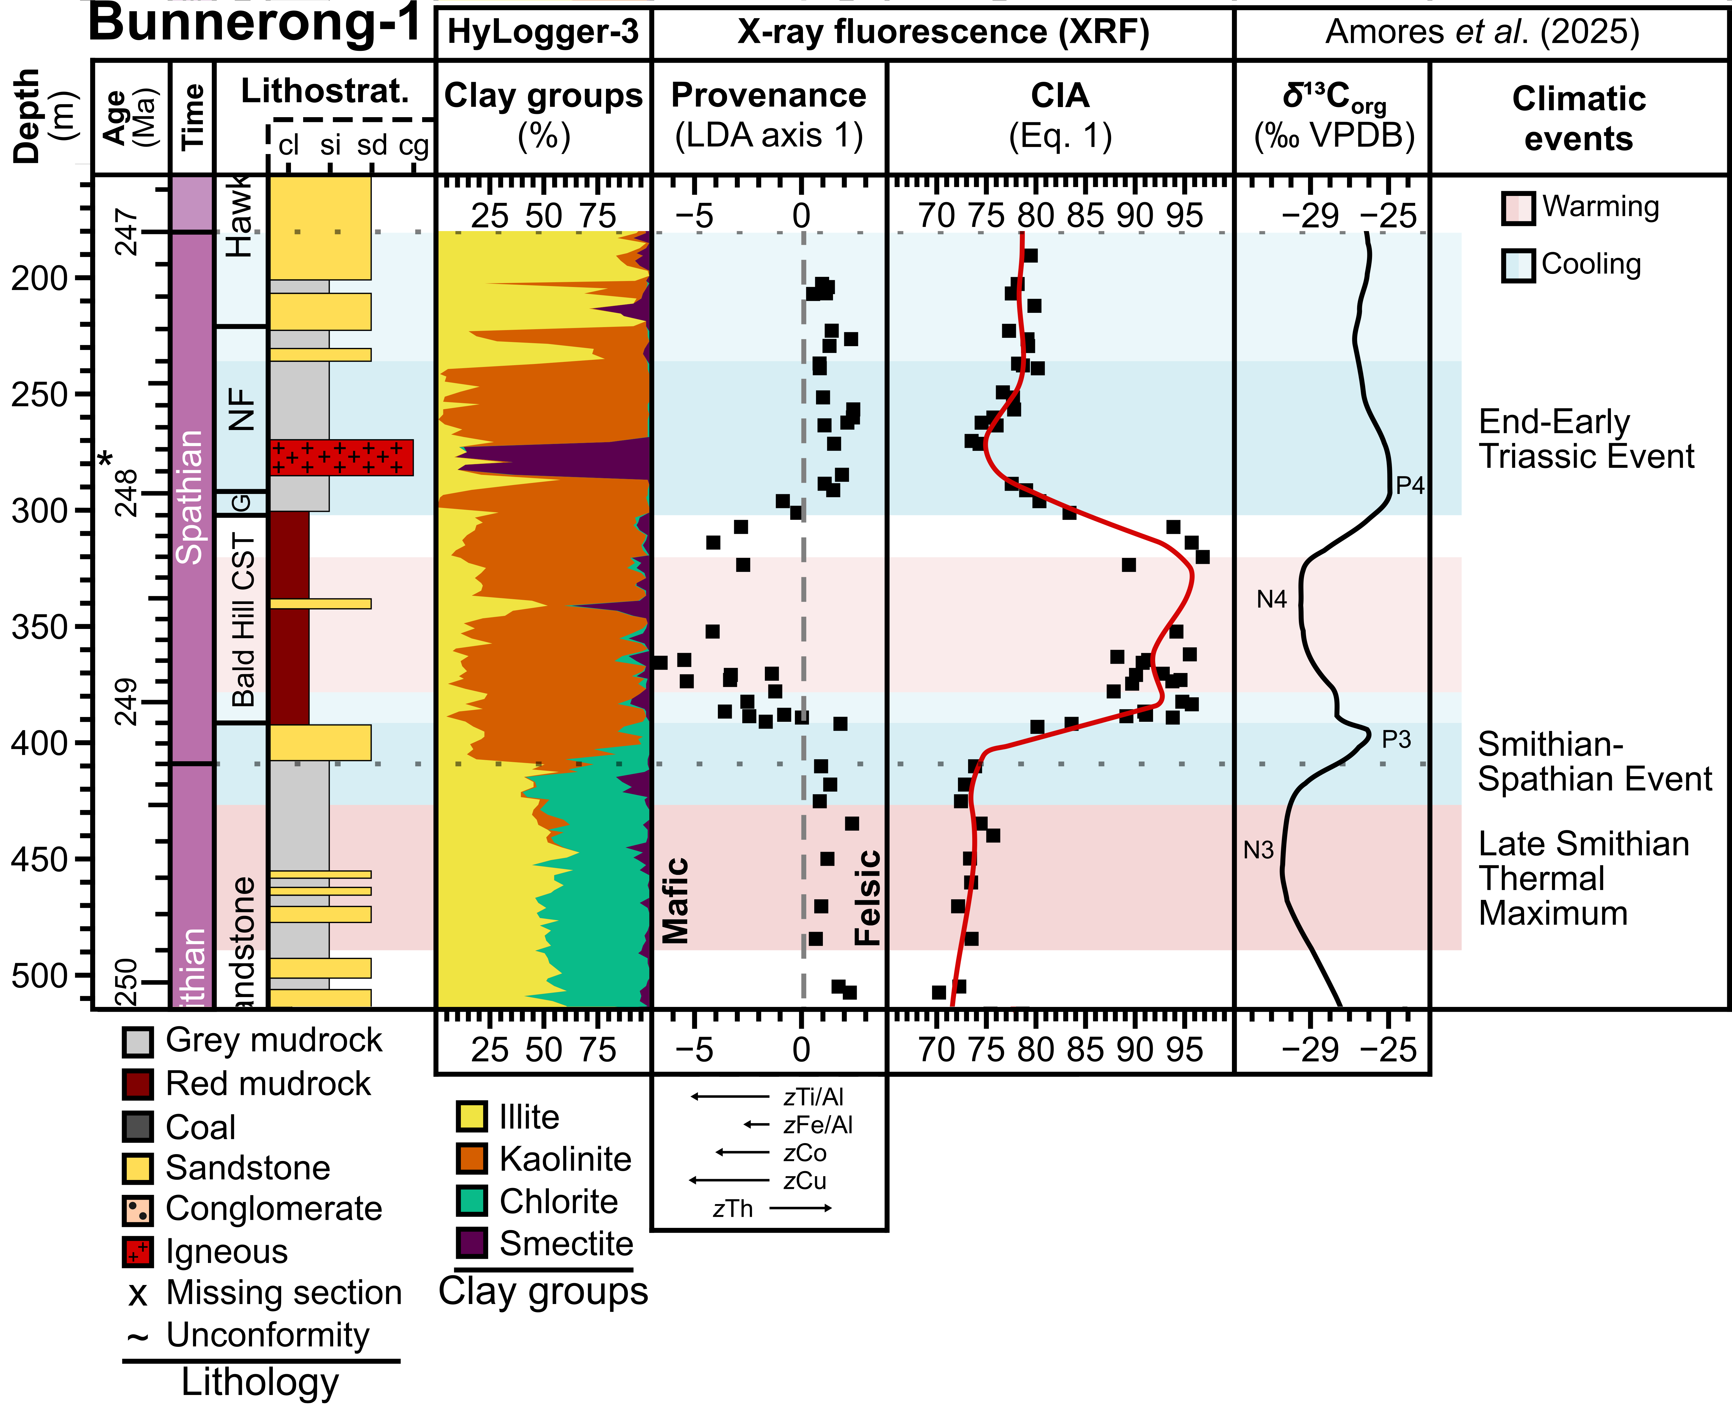
Modified from Ward (1972), Journal of the Geological Society of Australia 19(3), pp. 393–409
Amores et al. (in prep.)

Slide 24
Working hypothesis:
Good palynological preservation is limited to short, less-weathered lenses.
❌

Slide 25
Why?

Slide 26
Why are there well preserved palynomorphs in the Bald Hill Claystone?
The (mafic) source-rock province underwent exceptional chemical alteration.
Modified from Ward (1972), Journal of the Geological Society of Australia 19(3), pp. 393–409

Slide 27
Why are there well preserved palynomorphs in the Bald Hill Claystone?
The (mafic) source-rock province underwent exceptional chemical alteration.
Fresh sediment was already depleted in mobile elements (Na, K). → High base CIA.

Slide 28
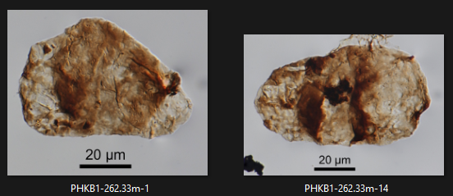
Why are there well preserved palynomorphs in the Bald Hill Claystone?
The (mafic) source-rock province underwent exceptional chemical alteration.
Bald Hill Claystone (CIA = 86.4–96.8)
Fresh sediment was already depleted in mobile elements (Na, K). → High base CIA.
Newport Formation (CIA = 73.5–82.0)
In situ alteration and oxidation had only a minor effect. → Good preservation.

Slide 29
Chemically weathered deposits can remain viable targets for palynological sampling.

Slide 30
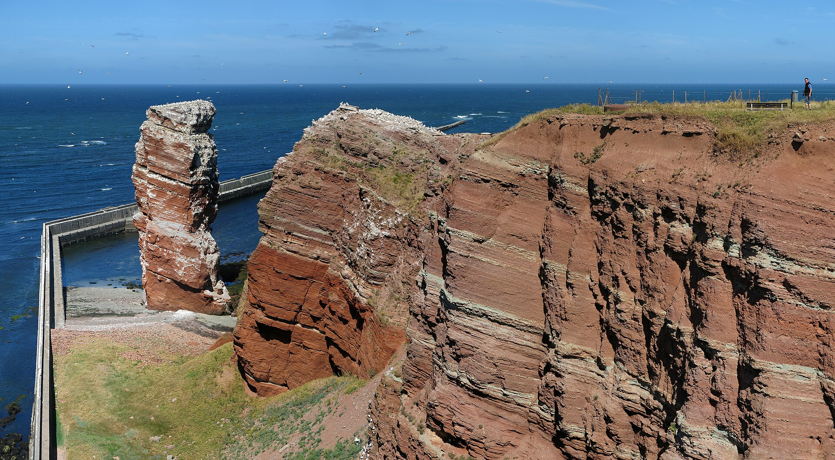
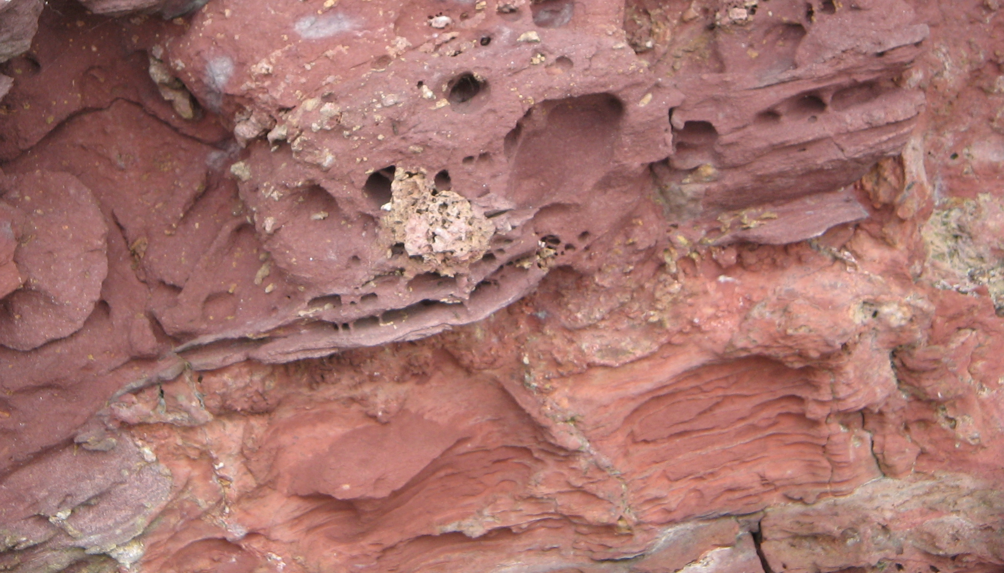
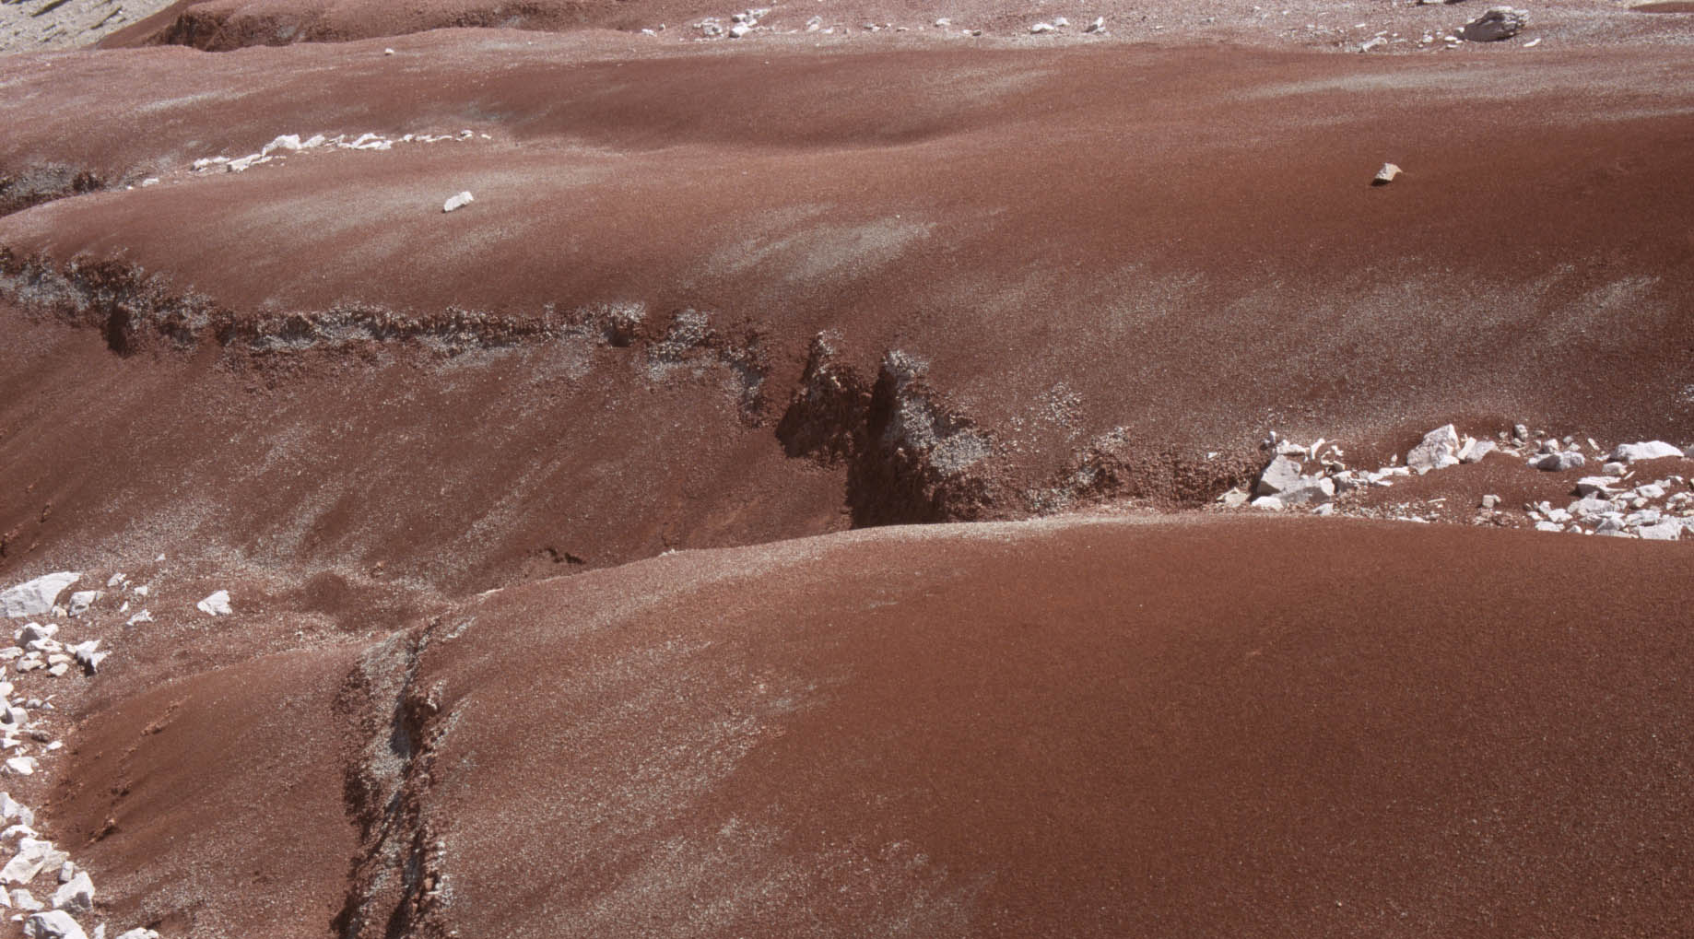
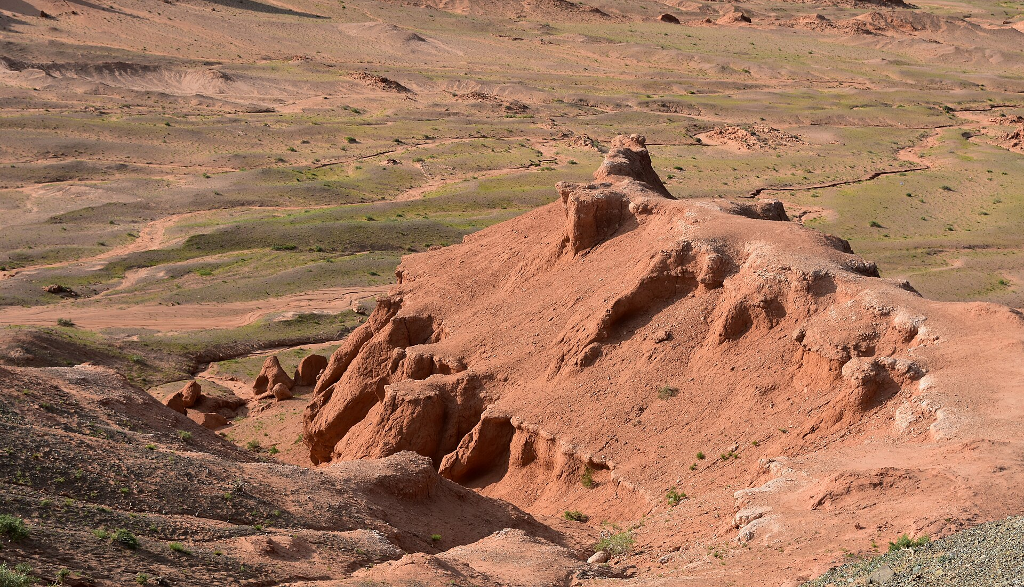
My challenge: other continental mudrock red beds
Buntsandstein. Heligoland, Germany (Lower Triassic)
By Jörg Braukmann
Old Red Sandstone. Laugharne, Wales (Devonian)
By GerritR
Travenanzes Formation. Dolomites, Italy (Carnian)
By Kaapitone
Djadochta Formation, Flaming Hills, Mongolia (Upper Cretaceous)
By Richard Mortel

Slide 31




Acknowledgments
Funders
Special thanks
(SEFS PGR Travel Bursary)
Urmi Ghosh (James Hutton Institute)
Stephen Hillier (James Hutton Institute)
Jon Huntington (CSIRO)
(Student Research Award, 2025)
(Elvira and Bob Gastaldo Deciphering Earth History Award in Applied Paleobotany)

