Slide 1
方向 Fāngxiàng
Directions
Nei Ching Lou

Slide 2
About this session
basic directional vocabulary

Slide 3
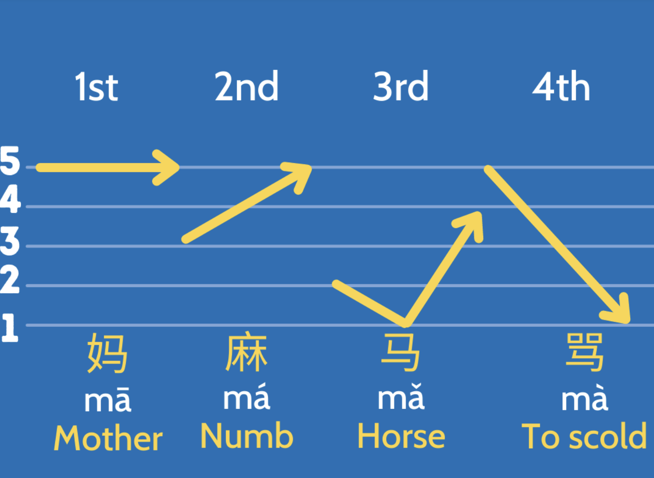
Tones (Introduction)

Slide 4
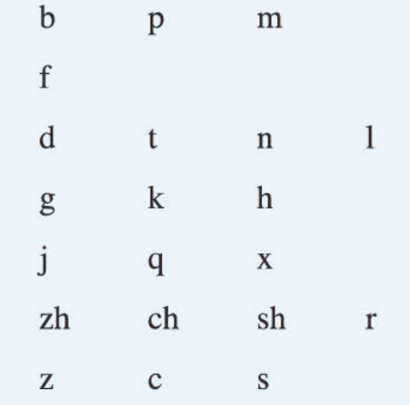
聲母Shēngmǔ
Consonants
Initials

Slide 5
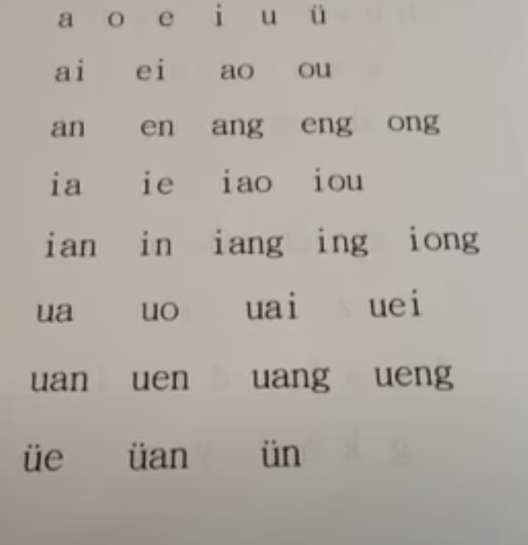
韻母Yùnmǔ
Vowels
Finals

Slide 6
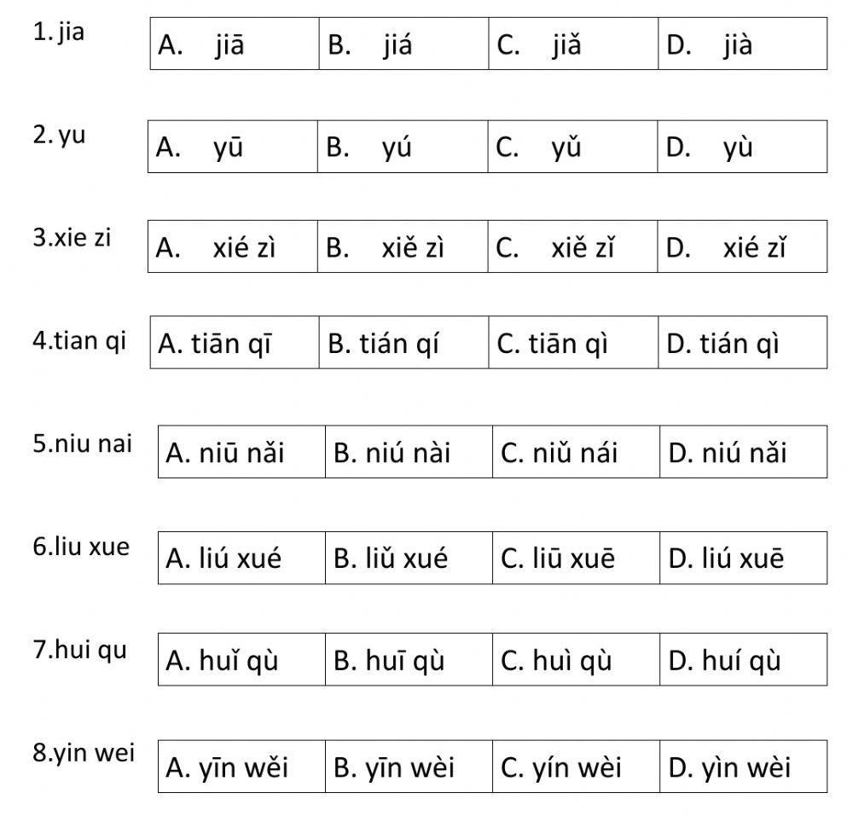
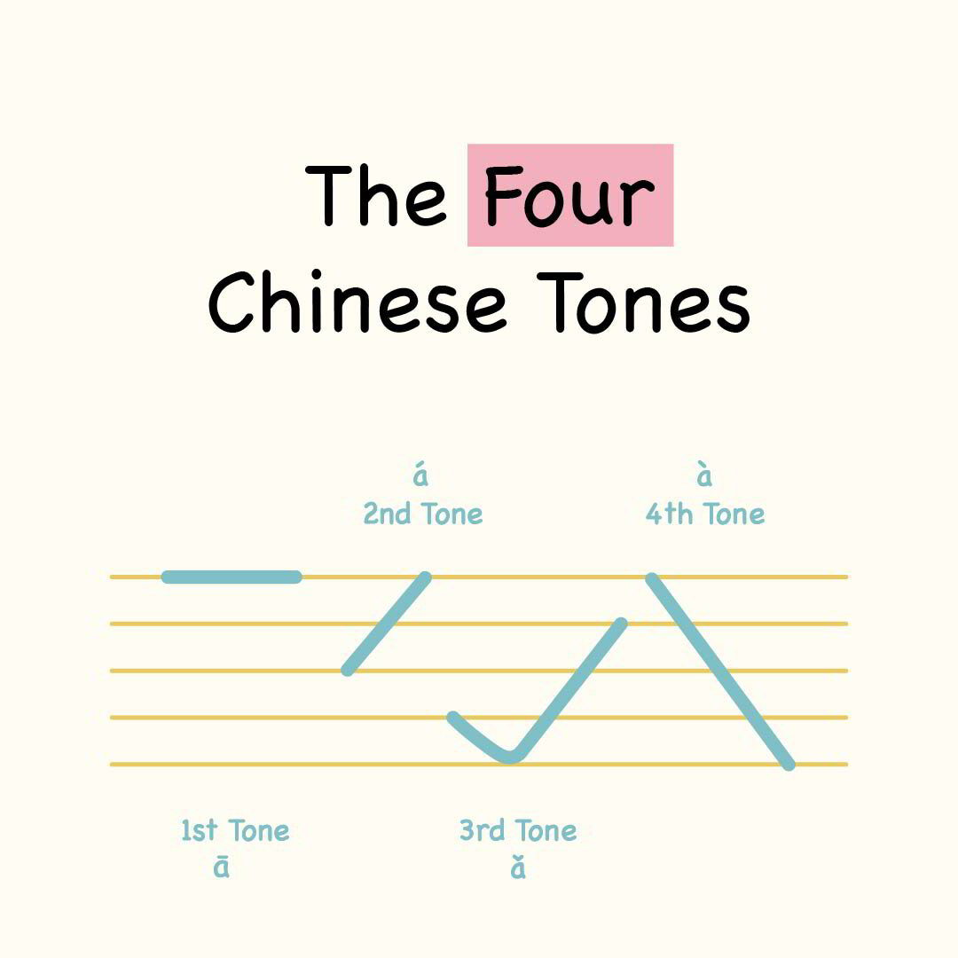
Test your listening
加
雨
寫字
天氣
牛奶
留學
回去
因為

Slide 7
Test your listening
加
雨
寫字
天氣
牛奶
留學
回去
因為

Slide 8
Let‘s move on

Slide 9
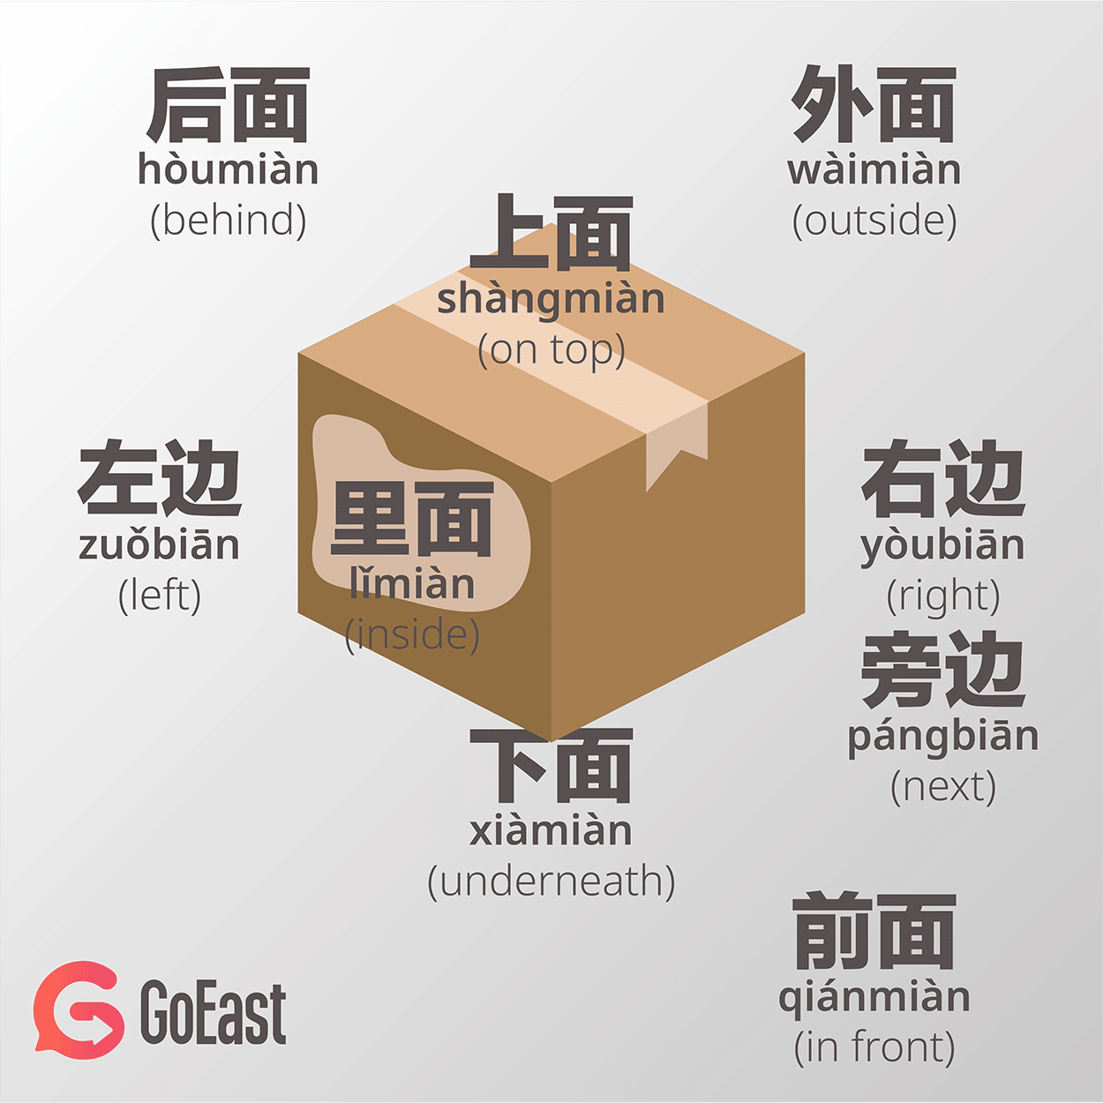

Slide 10
Colloquial
we also add words like “side” after position words
邊 (biān) and 面 (miàn)
For example
前面 (qiánmian) “front”
上面 (shàngmian) “up”
左面(zuǒmian) “left side”

Slide 11
Questions?

Slide 12
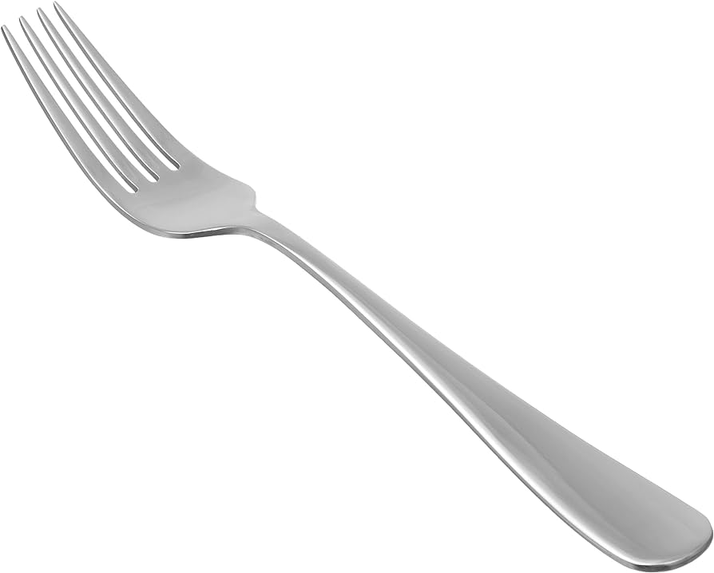
叉Chā
Fork

Slide 13
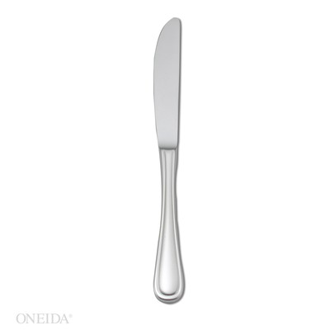
刀Dāo
knife

Slide 14
Let me draw different scenarios!
Meanwhile we learn how to write them

Slide 15
在 Zài
Verb for location
- To be located at…

Slide 16
Your turn to draw!

Slide 17
Game 1

Slide 18
Rules
Hold an object in one hand
Another person say the directions , the other person move the objects as fast as possible in 30 seconds
上Shàng
下 xià
左 zuǒ
右 yòu
前 qián
後 hòu

Slide 19
Game 2

Slide 20
Rules
One person closes their eyes
Another person tells directions so the blinded person can walk through the whole path
左 zuǒ
右 yòu
前 qián
後 hòu
停 Tíng （STOP）

Slide 21
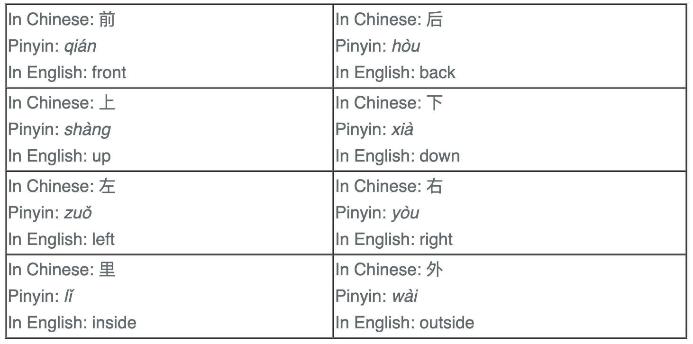

Slide 22
Questions?

Slide 23


Slide 24
Welldone! We have…
Learnt about directions
Revised

Slide 25
Questions?

Slide 26

One last thing…
Thank you and goodbye!
謝謝，再見！
Xièxiè zàijiàn

