Slide 1
餐廳 Cāntīng
Restaurant
Nei Ching Lou

Slide 2
During this session, we will…
Recap on dates, time, family, consonants and vowels
Vocab about restaurant
Ordering in restaurant

Slide 3
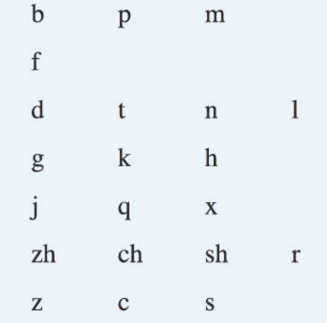
聲母Shēngmǔ
Consonants
Initials

Slide 4
Practise with the group!

Slide 5
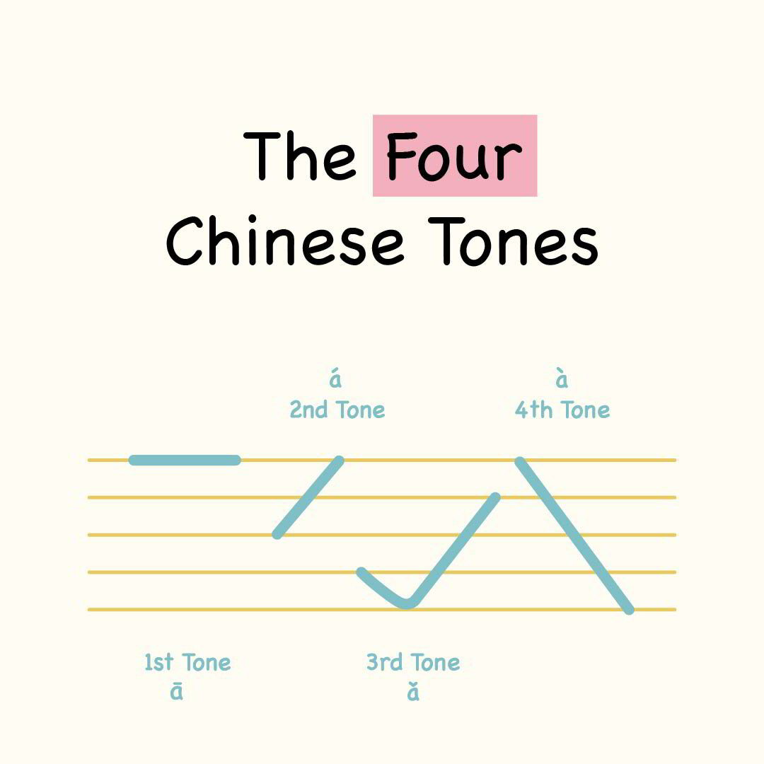
TONES!

Slide 6
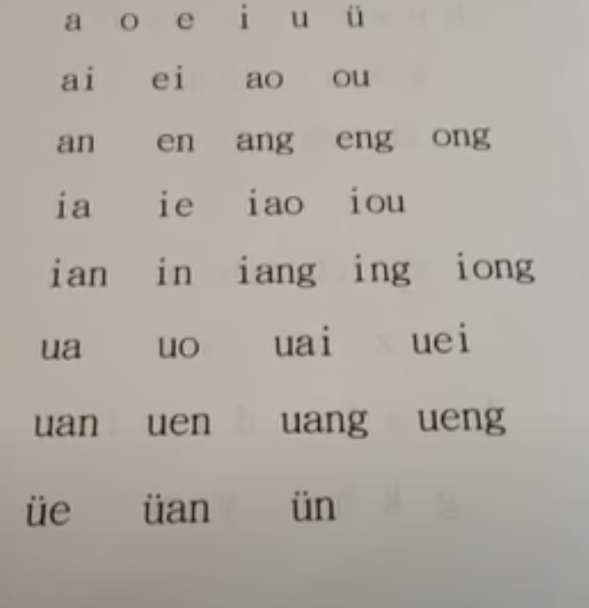
韻母 Yùnmǔ
Vowels
Finals

Slide 7
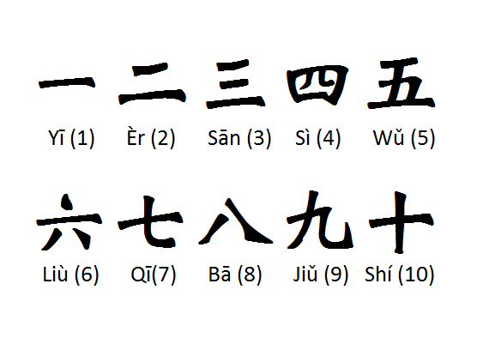
數字

Slide 8
Jīntiān jǐ hào?
今天是__月__日，
Jīntiān shì___ yuè___ rì.
也是星期__。
Yě shì xīng qí__.

Slide 9

幾點了？ Jǐ diǎn le?
正 Zhèng
What is the time?
__點__了。
__diǎn__le.
十五 Shíwǔ
半Bàn

Slide 10
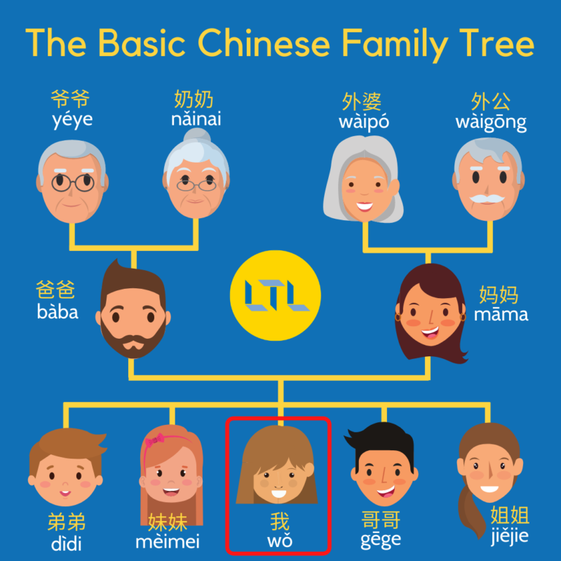

Slide 11
Practice
你有兄弟姐妹嗎？
Nǐ yǒu xiōngdì jiěmèi ma？
我有__個__，他們叫⋯
Wǒ yǒu ___ gè ____. Tāmen jiào… hé…
OR
不，我沒有⋯
Bù. Wǒ méi yǒu…

Slide 12
Questions?

Slide 13
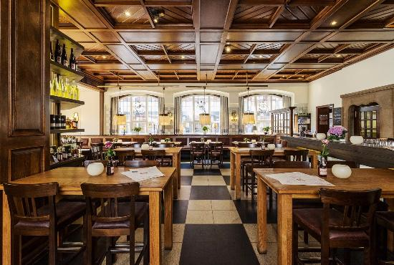
Cāntīng 餐廳
Restaurant

Slide 14
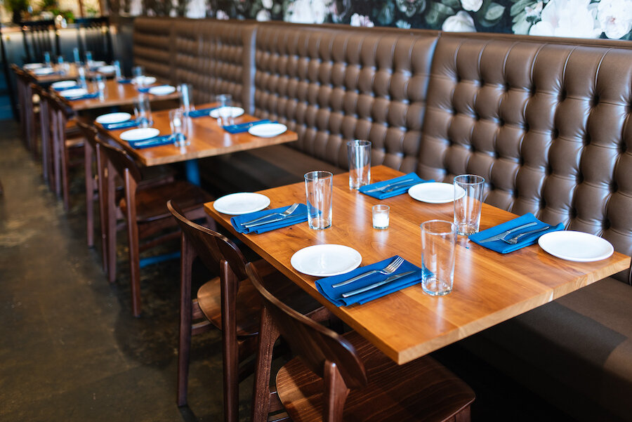
Nǐ kàn dào shénme? 你看到什麼？
看
kàn
To see

Slide 15

杯子Bēizi
Cup

Slide 16
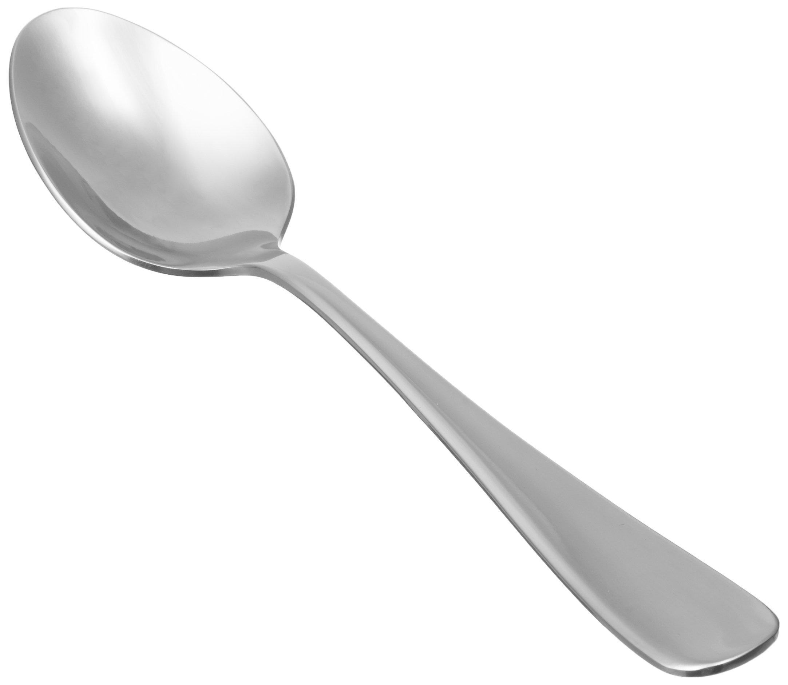
湯匙Tāngchí
Spoon

Slide 17
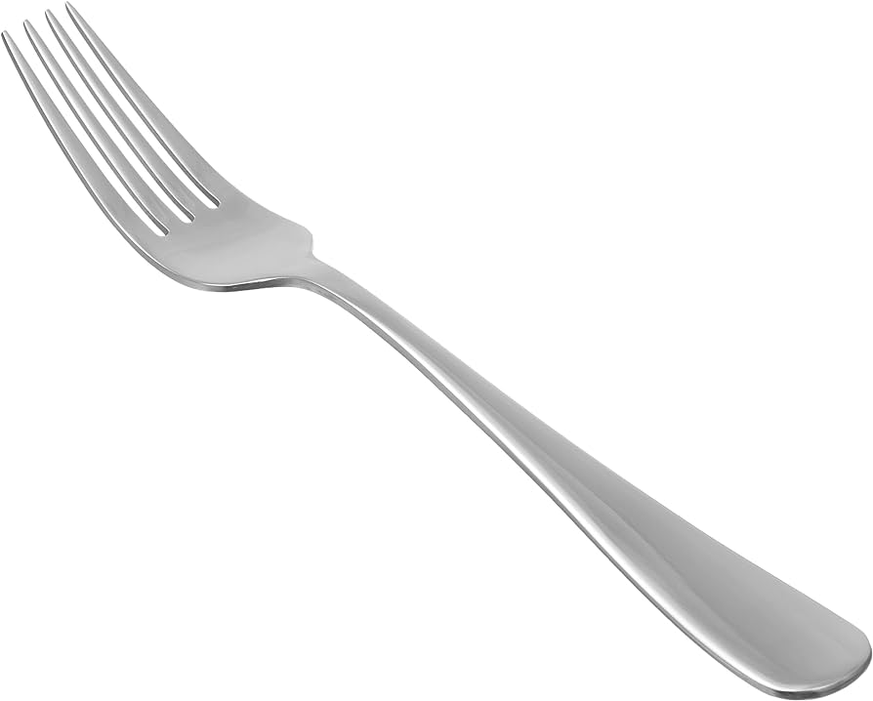
叉Chā
Fork

Slide 18
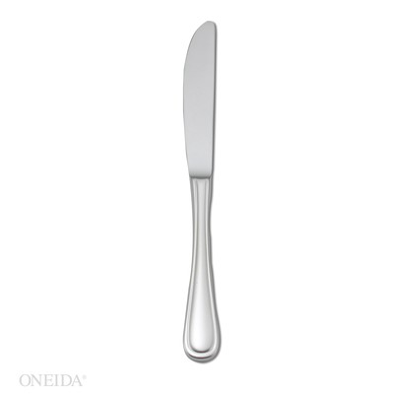
刀Dāo
knife

Slide 19
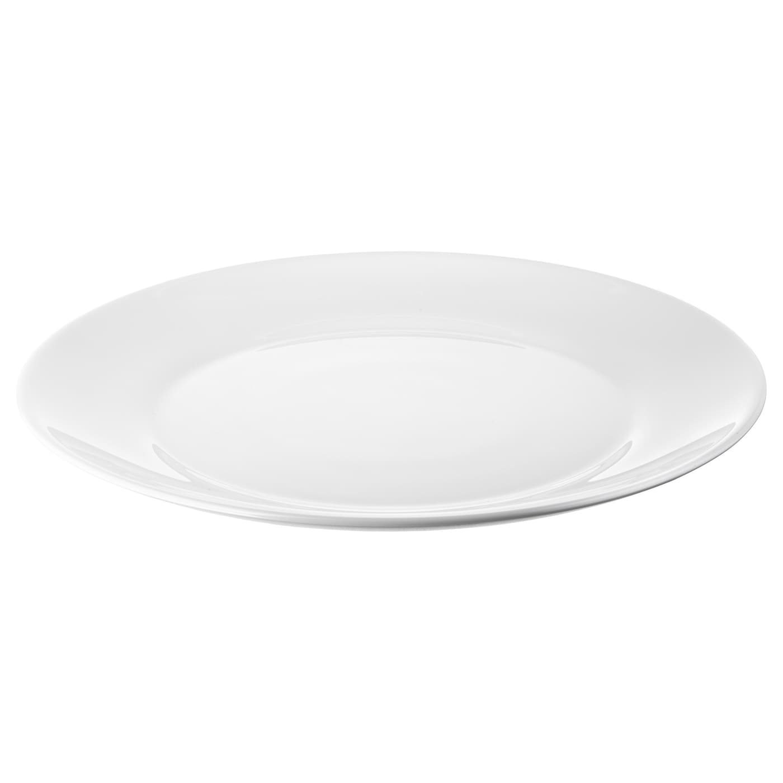
盤Pán
Plate

Slide 20
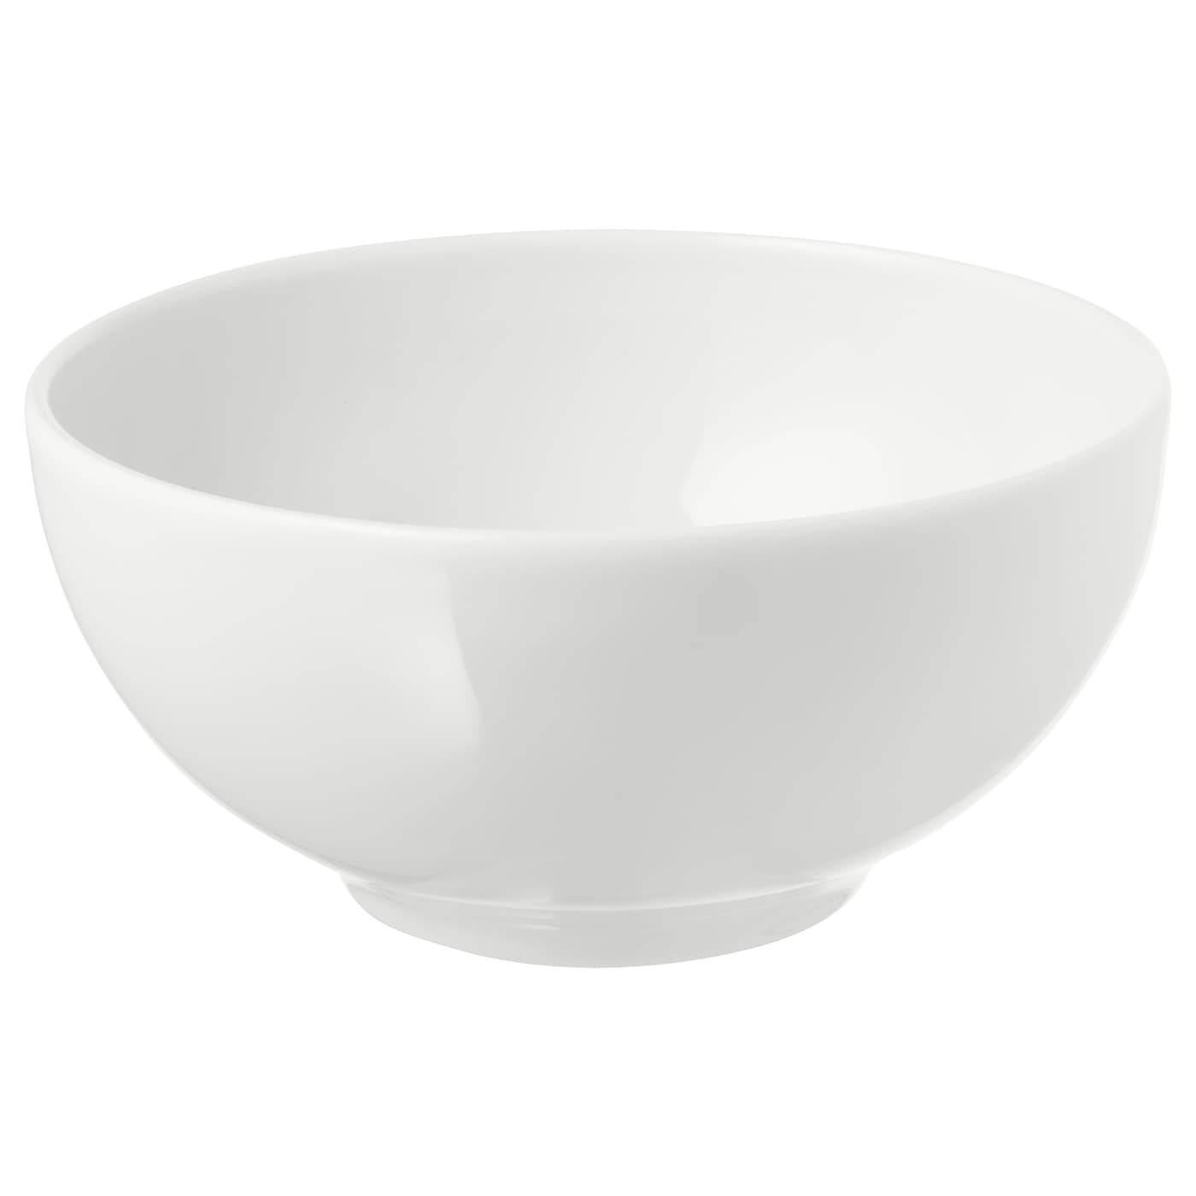
碗Wǎn
Bowl

Slide 21

餐巾Cānjīn
Napkin

Slide 22
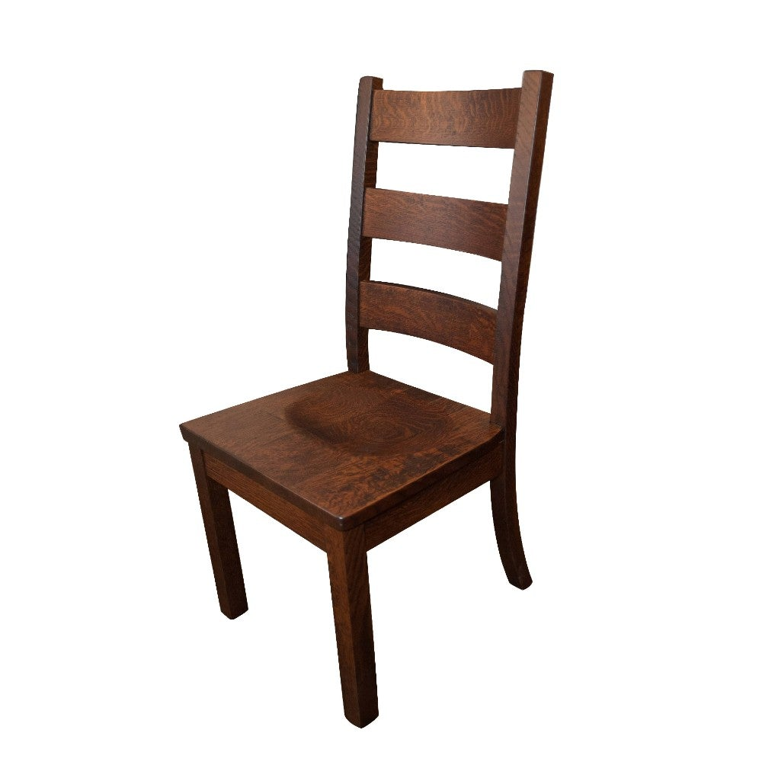
椅子Yǐzi
Chair

Slide 23
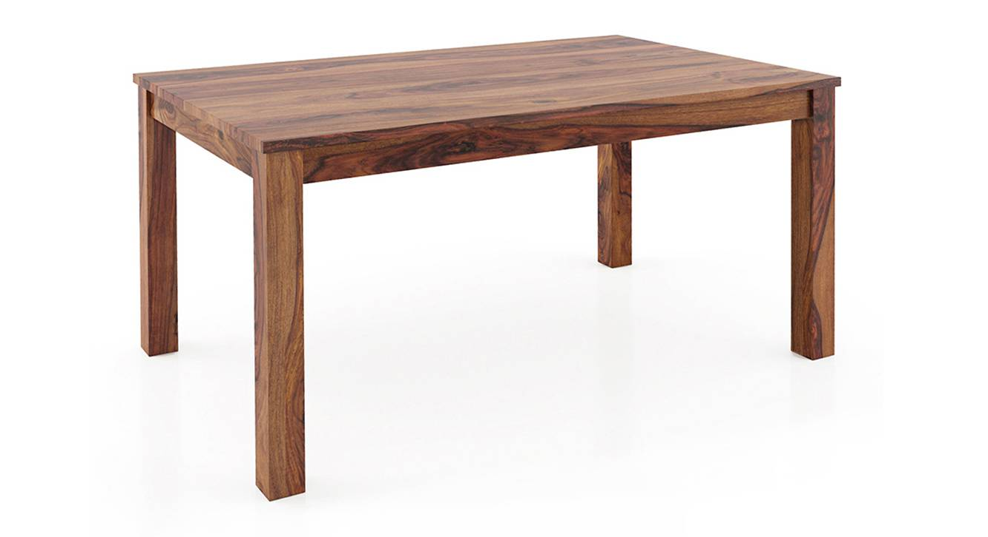
桌子Zhuōzi
Table

Slide 24
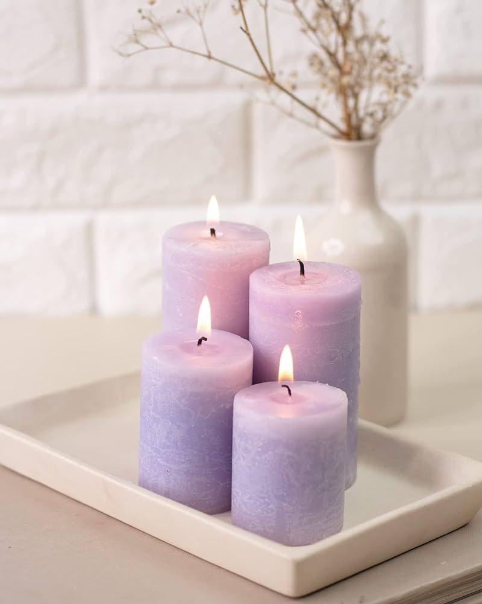
蠟燭Làzhú
Candle

Slide 25
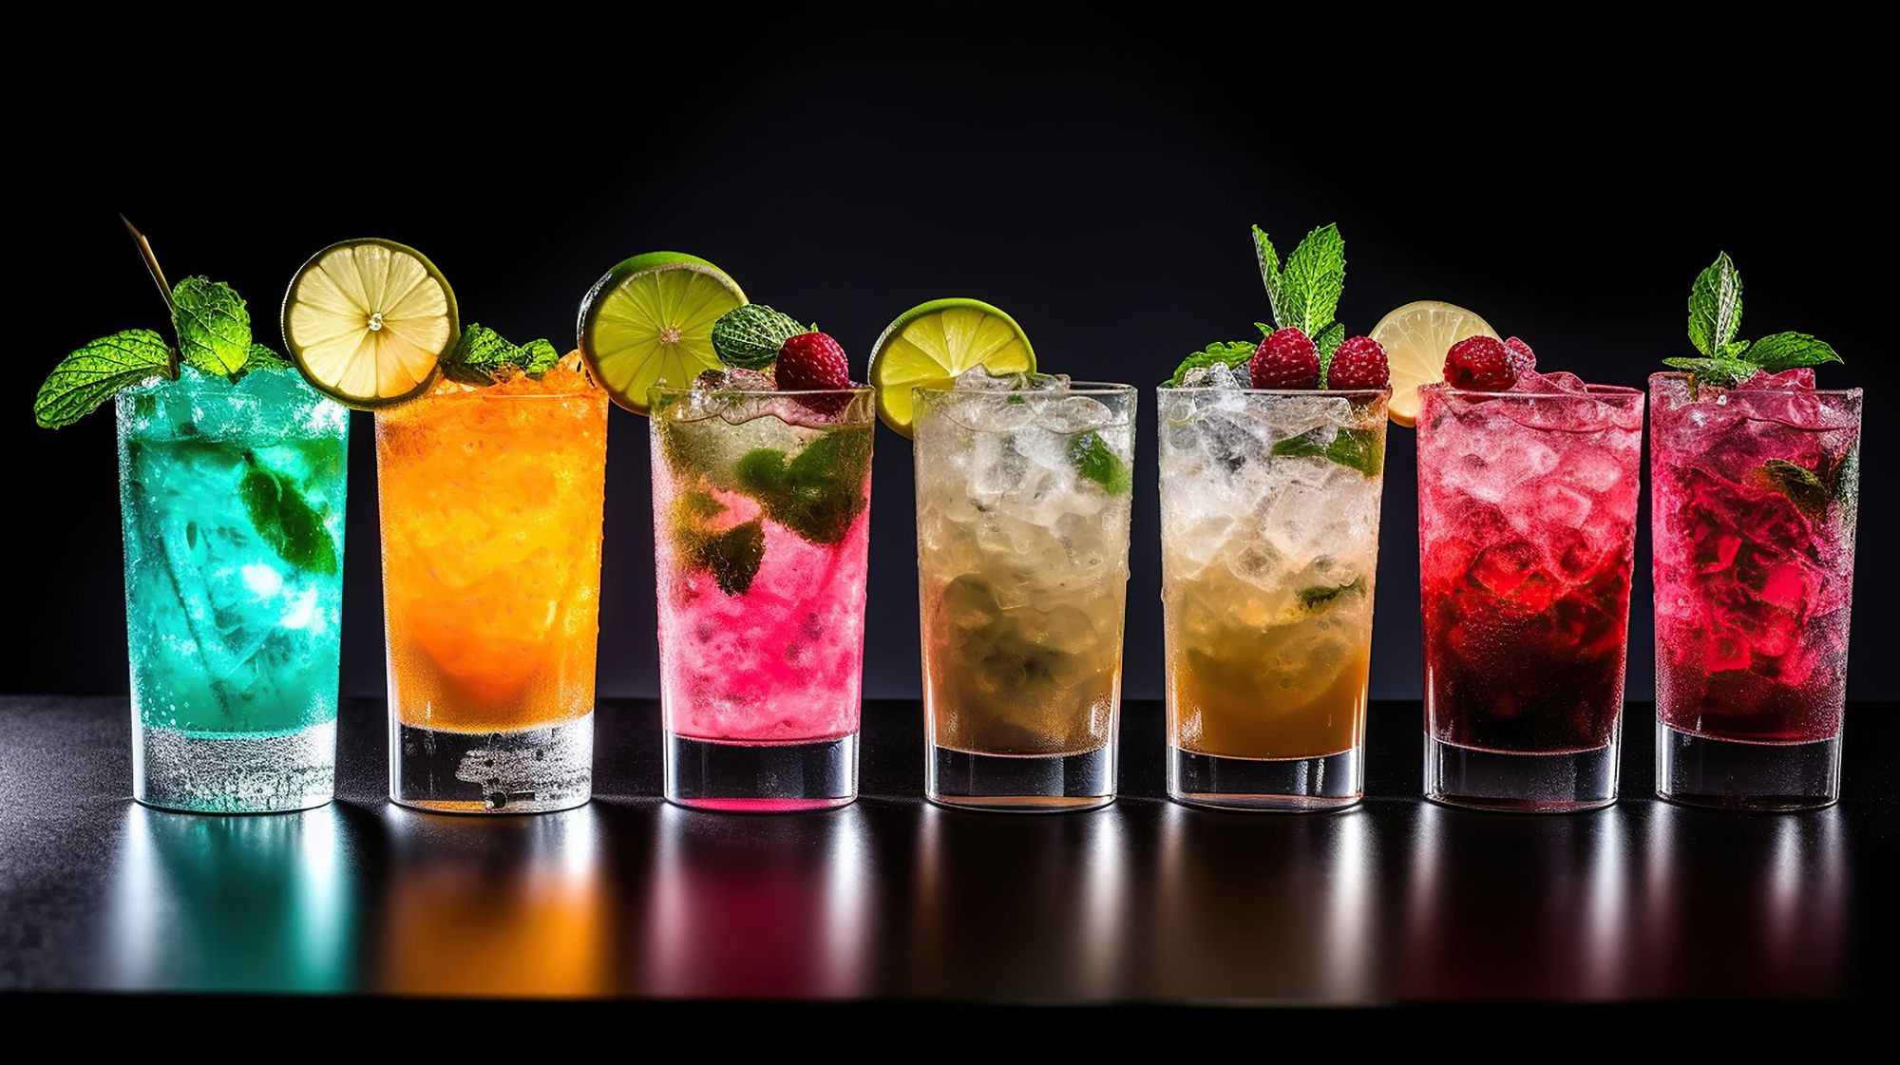
飲料Yǐnliào
Drinks

Slide 26
Practice with your groupmates!

Slide 27
Nǐ kàn dào shénme? 你看到什麼？
我看到____。
Wǒ kàn dào____.
你看到幾個___？
Nǐ kàn dào jǐ gè____?
我看到___個_____。
Wǒ kàn dào___gè_____.

Slide 28
Questions?

Slide 29
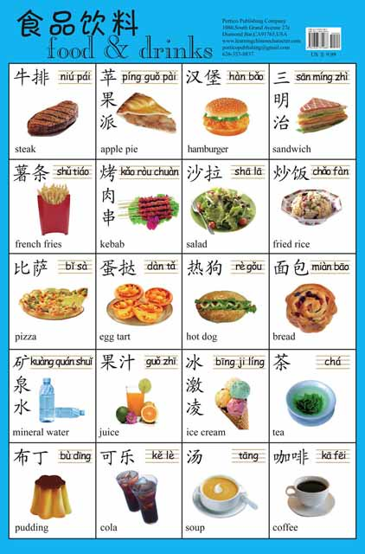
I will read them, and you tell me the corresponding food!

Slide 30
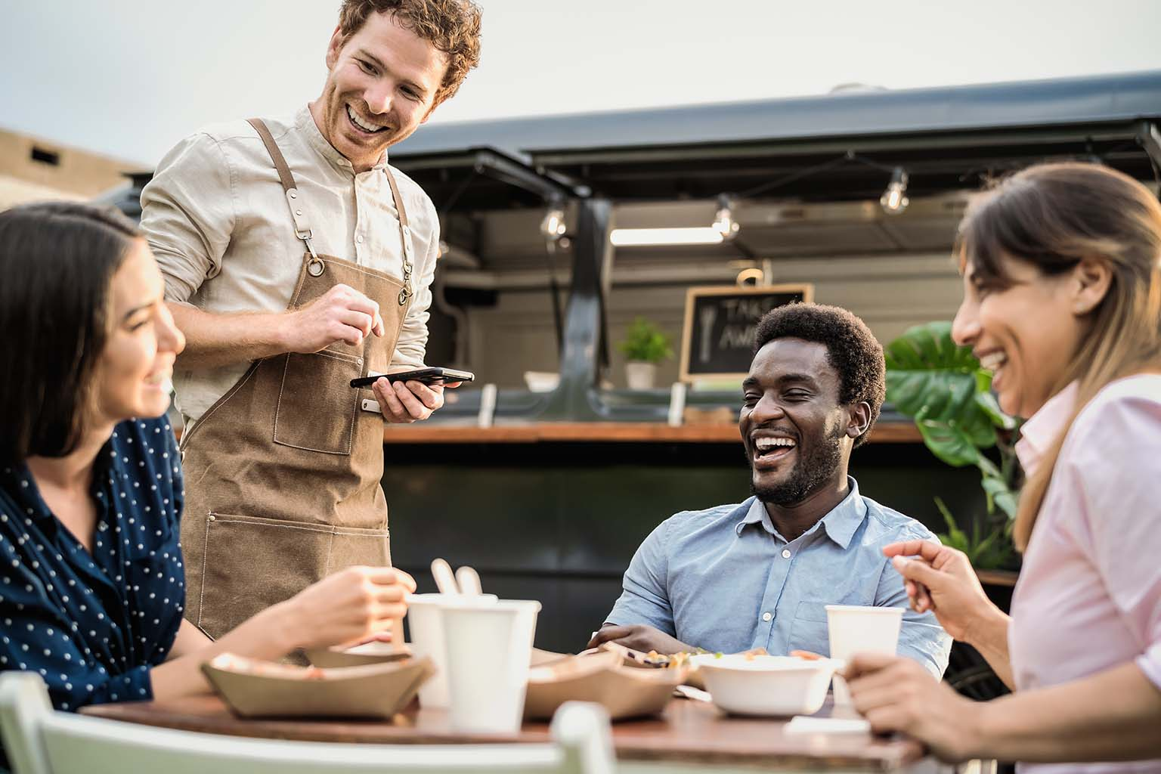
Nǐ hǎo, wǒ xiǎng yào… 你好，我想要⋯⋯
Hi, I would like…

Slide 31
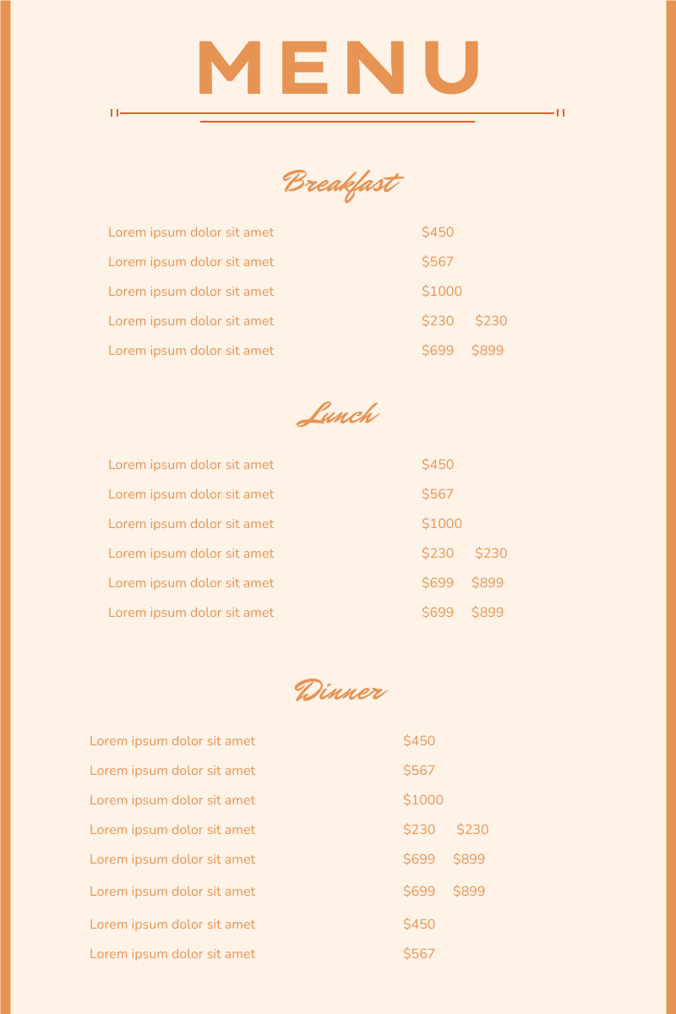
Hǎo de. Hái yǒu ne? 好的。還有呢？
Good. And?

Slide 32
Hǎo de. Yǐnliào ne? 好的。飲料呢？
Good, drinks?

Slide 33

Bù yàole. Xièxiè. 不要了。謝謝
Wouldn’t need that, thanks.

Slide 34
Practice!
Nǐ hǎo, wǒ xiǎng yào… 你好，我想要⋯⋯
Hǎo de. Hái yǒu ne? 好的。還有呢？
Hái yǒu…
還有…
Hǎo de. Yǐnliào ne? 好的。飲料呢？
(Bù yàole. Xièxiè.) (不要了。謝謝)

Slide 35
I will read them, and you tell me the corresponding food!

Slide 36
Questions?

Slide 37
Listening!
I will read the order, and you have to marker the food and drinks that I take.

Slide 38

Perfect! You have learnt…
Restaurant vocabularies
Ordering food in restaurant

Slide 39
One last thing…
Thank you and goodbye!
謝謝，再見！
Xièxiè zàijiàn

