Slide 1
你好，我叫⋯⋯ Nǐ hǎo wǒ jiào
Hello, my name is… Nei Ching Lou
Nei Ching Lou

Slide 2
During this session, we will…
Learn about tones
Group activities: Self introduce with Mandarin
4 parts: Hi, my name is… I come from… and you?

Slide 3
Who am I?
Nei Ching Lou, David
21 years old
Born and raised in Hong Kong
Second year in Germany
Studying Bsc. Human Movement in Sports and Exercise (WWU)
Mother tongue: Cantonese

Slide 4
Disclaimer
This course will be taught in English and Mandarin

Slide 5

My expectations…
Participate in the class activities
Feel free to ask questions
Your questions are probably your classmates‘ questions
„There are no wrong questions“

Slide 6
What do you know about Mandarin?

Slide 7
Questions?

Slide 8
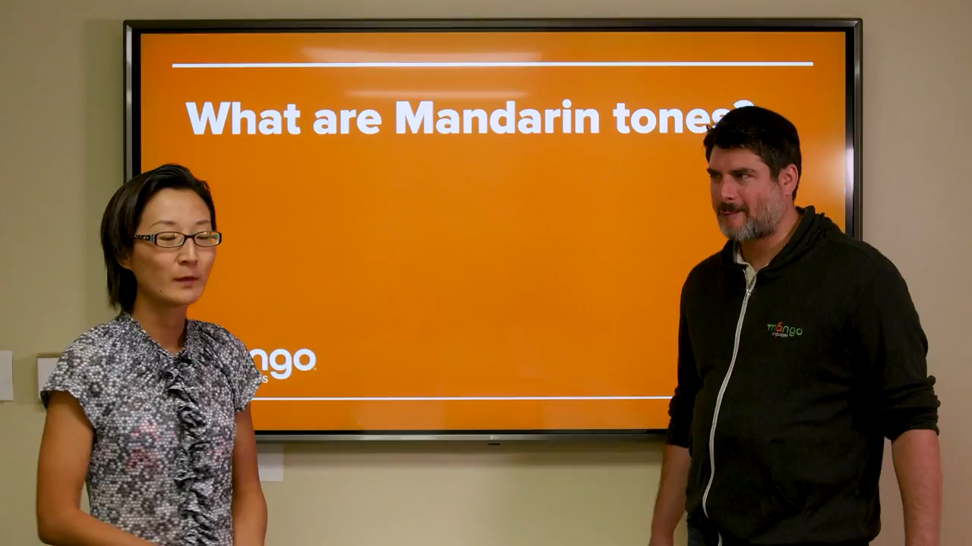

Slide 9
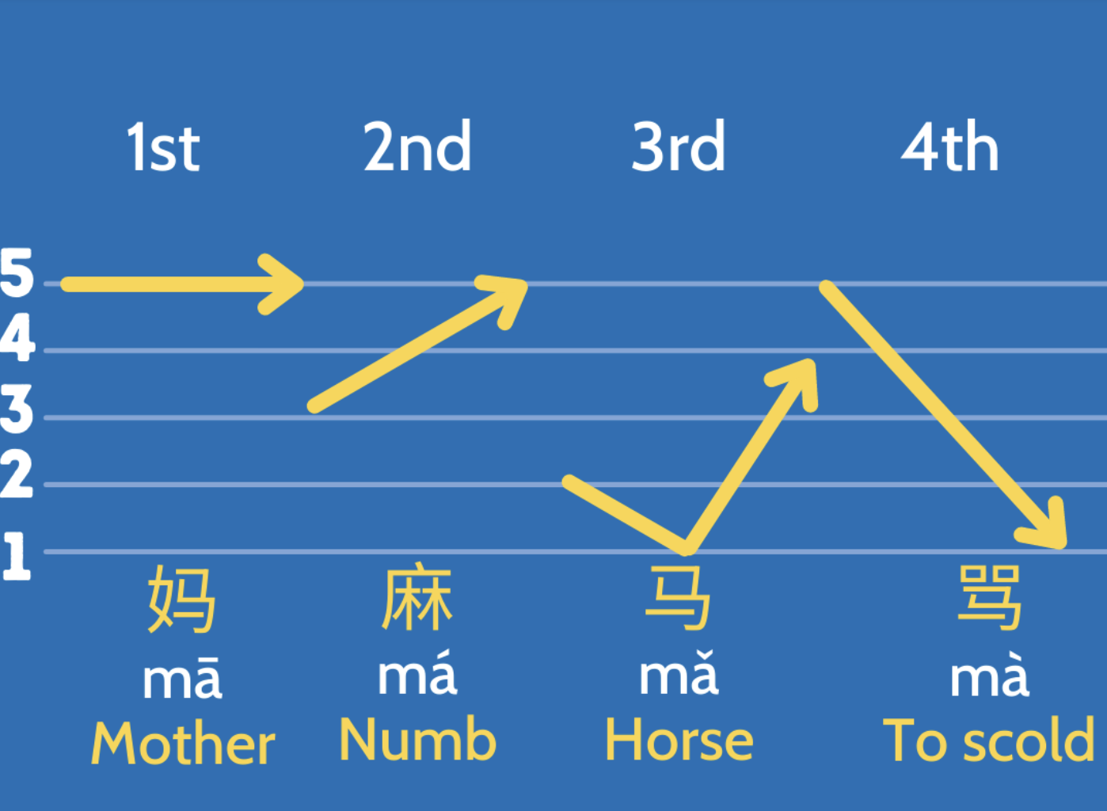
Tones (Introduction)

Slide 10
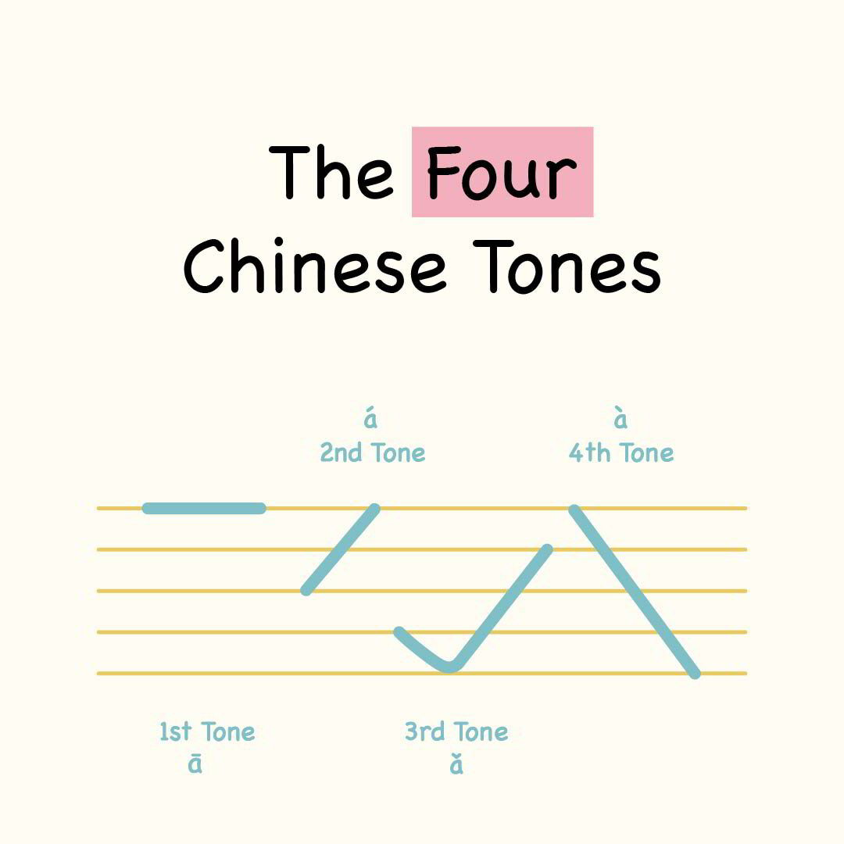
Tones
Different tones=different meaning!
Visualise the sound of tones with how you write it
Flat
Rising
Falling and rising
Falling

Slide 11
Let‘s practice
Hā há hǎ hà
Kā ká kǎ kà
Mā má mǎ mà
Wā wá wǎ wà
Sā sá sǎ sà
Pā pá pǎ pà

Slide 12
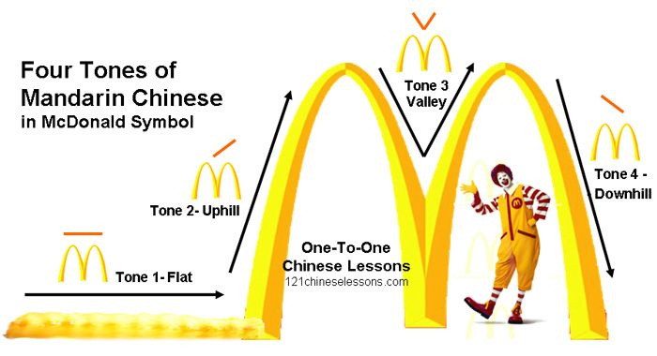
Tips

Slide 14
Questions?

Slide 15
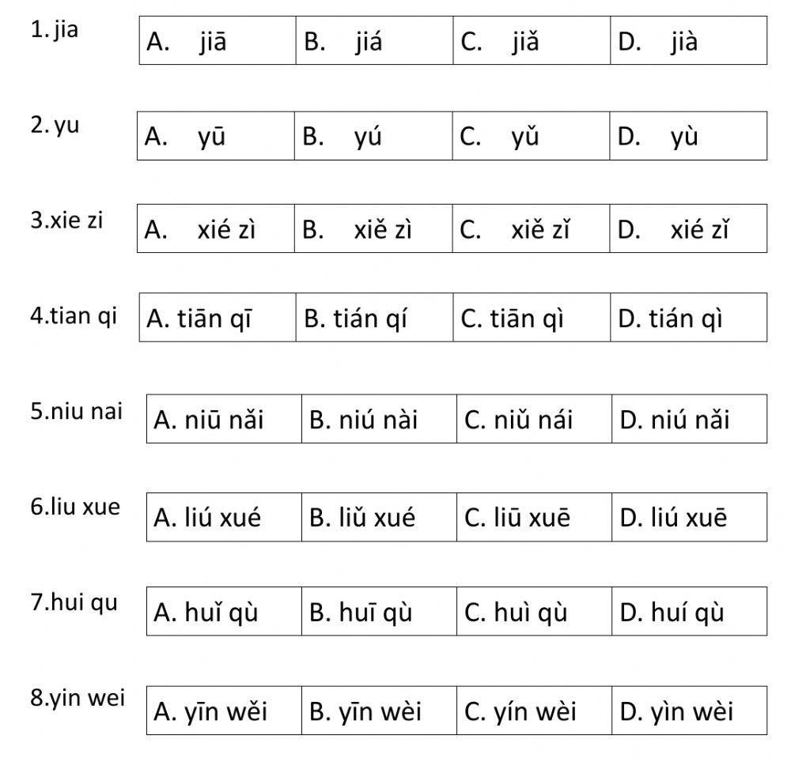
Test your listening
加
雨
寫字
天氣
牛奶
留學
回去
因為

Slide 16
Test your listening
加
雨
寫字
天氣
牛奶
留學
回去
因為

Slide 17
Questions?

Slide 18

1. 你好！Nǐ hǎo !
你 Nǐ：you
好 Hǎo：good
Special rule: when two third tones are put together,
the first character will be pronounced as the second tone,
but written as third tone (unchanged)
Pronounced as: Ní hǎo

Slide 19
Try to write it!

Slide 20
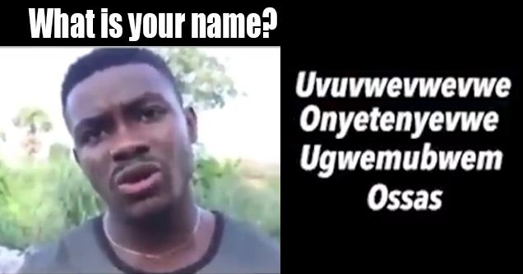
2. 我叫⋯⋯ Wǒ jiào
我 Wǒ ：I
叫 Jiào ：am called
Practical pronunciation: Rising part of the third tone is usually skipped, when followed by another word.
Keep it FLAT & LOW

Slide 21
Try to write it!

Slide 22
Questions?

Slide 23
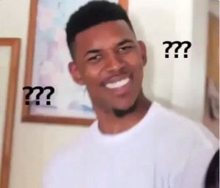
Small recap about the third tone
When followed by another third tone, the first character will be pronounced as the second tone.
When followed by any other tones, the first character will be pronounced as a half third tone.
(skip the rising part)
FLAT & LOW

Slide 24

Try both together
你 好 ! 我 叫 David。
Nǐ hǎo. Wǒ jiào David.
Pronounce the tones as written.
Try it with a practical pronunciation.

Slide 25
Group practice
Introduce yourselves with your groupmates. (repeat repeat repeat)
A: 你 好 ! 我 叫 (Your name)。
A: Nǐ hǎo. Wǒ jiào (Your name).
B: 你 好 ! (his/her name) ，我 叫 (Your name)。
B: Nǐ hǎo. (his/her name). Wǒ jiào (Your name).

Slide 26
Questions?

Slide 27

Perfect! Now you have learnt to say…
Hi! My name is…
What‘s next?

Slide 28


3. 我來自⋯⋯ Wǒ lái zì
我 Wǒ：I
來自 Lái zì ：come from
Remember how to pronounce the third tone practically?
德国Déguó
中国Zhōngguó

Slide 29
Try to write it!

Slide 30

4. 你呢? Nǐ ne?
你 Nǐ ：You
呢 Ne：question indicator
Fifth tone: neutral
Since it is before a question mark, it is pronounced in a higher tone

Slide 31
Try to write it!

Slide 32
Group practice
A: 你 好 ! 我 叫 (Your name)。 我 來 自⋯⋯ 你呢?
A: Nǐ hǎo. Wǒ jiào (Your name). Wǒ lái zì Nǐ ne?
B: 你 好 ! (his/her name) ，我 叫 (Your name)。 我 來 自⋯⋯ 你呢?
B: Nǐ hǎo. (his/her name). Wǒ jiào (Your name). Wǒ lái zì. Nǐ ne?
C: ……

Slide 33
Questions?

Slide 34
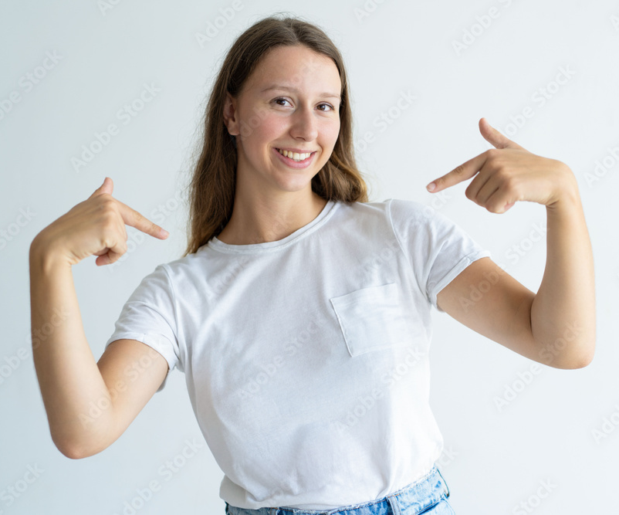
我Wǒ/我們Wǒmen
I / We

Slide 35

你Nǐ / 你們Nǐmen
You / you all

Slide 36

他Tā/他們tāmen
（他）He
（她）She
（它）It

Slide 37
Try to write it!

Slide 38
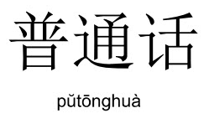



Practice 1
你好，我叫⋯⋯ 我來自⋯⋯（德国）
Nǐ hǎo. Wǒ jiào (Your name). Wǒ lái zì (Déguó).
他是⋯⋯他（也）來自⋯⋯
Tā shì (their name). Tā (yě) lái zì (Déguó).
我們喜欢普通話。
Wǒmen xǐhuān pǔtōnghuà.
Repeat

Slide 39

Well done! Today you learnt…
The five tones in Mandarin
Pronouns
Self introduction in Mandarin
Hi, my name is… I come from… and you?
Introducing your friends to others

Slide 40

How to type Chinese tones
How to Type Pīnyīn (with TONES!! ā á ǎ à)
by ABChinese (Youtube)
https://www.youtube.com/watch?v=4xxclxvrExI
0:25 Windows
1:42 Mac
3:10 Android
4:09 iOS

Slide 41
Reference
https://www.youtube.com/watch?v=TnwOEBISYqU&t=37s&ab_channel=MangoLanguages

Slide 42
One last thing…
Thank you and goodbye!
谢谢，再见！
Xièxiè zàijiàn

