Slide 1
餐廳
Cāntīng (2)
Food
Nei Ching Lou

Slide 2

Shàng
Up / previous

Slide 3
Xià
Down / next

Slide 4
Shàng xīngqí wǒmen xuéle
Yuē péngyǒu qù cāntīng
Yùdìng yī zhāng zhuōzi

Slide 5
Shàng xīngqí wǒmen xuéle
Qǐngwèn

Slide 6
Shàng xīngqí wǒmen xuéle
Jǐ hào hé jǐ diǎn ne?

Slide 7
Shàng xīngqí wǒmen xuéle
Duōshǎo rén ne?

Slide 8
Shàng xīngqí wǒmen xuéle
Guìxìng ne?

Slide 9
Zhè xīngqí wǒmen xué
Diǎn cān
Ordering meal

Slide 10
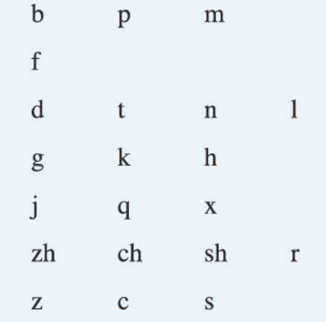
Shēngmǔ
Consonants
Initials

Slide 11
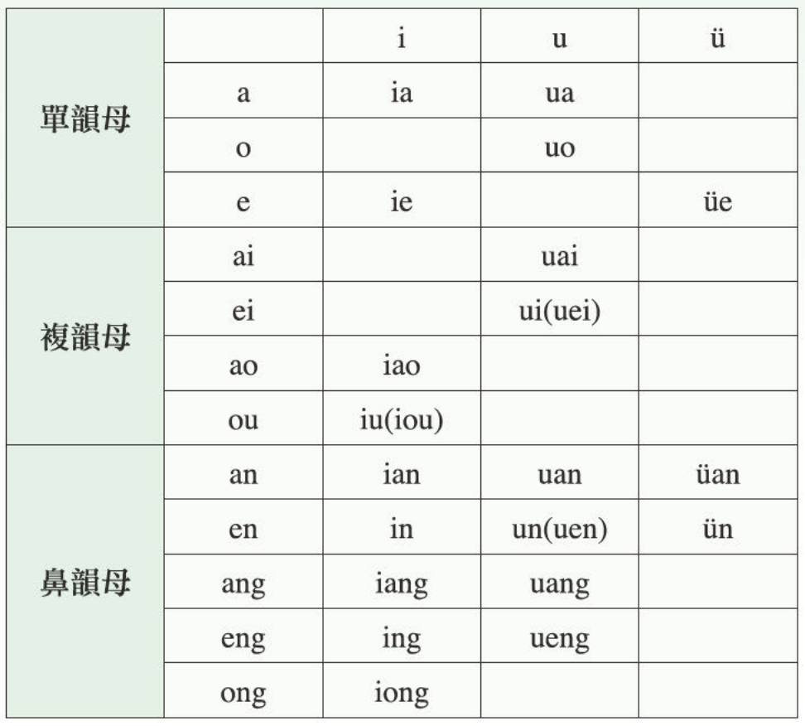
Yùnmǔ
Vowels
Finals

Slide 12
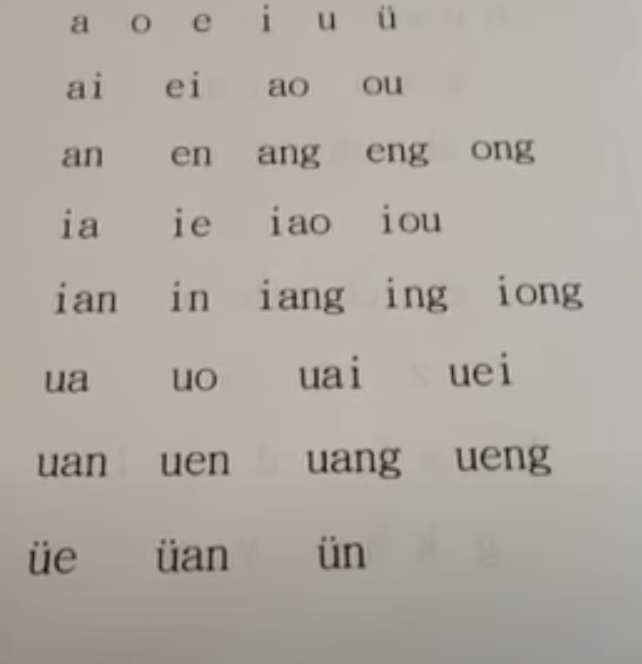
Yùnmǔ
Vowels
Finals

Slide 13
Questions?

Slide 14
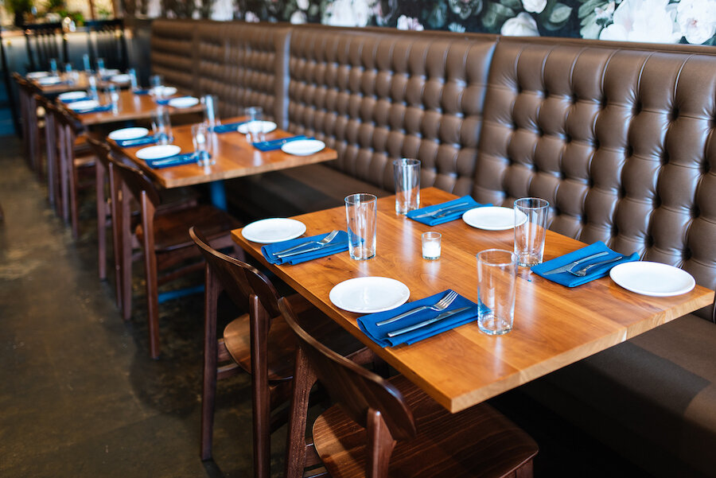
Nǐ kàn dào shénme?

Slide 15
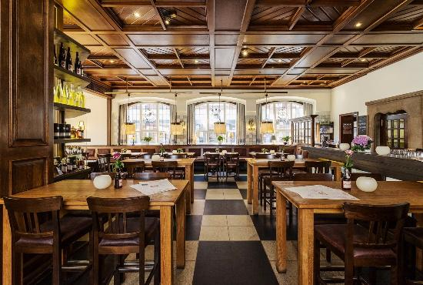
Cāntīng
Restaurant

Slide 16
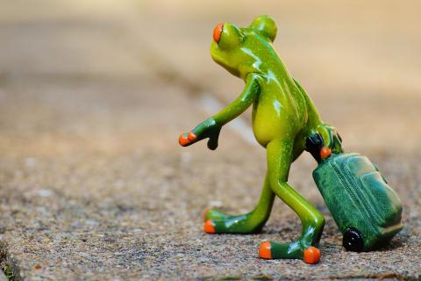
Qù
Go

Slide 17

Lái
Come

Slide 18

Dào
Arrive

Slide 19
Yǒu
To have

Slide 20

Yùyuē / Yùdìng
To reserve

Slide 21
Dào cāntīng
Nín hǎo, qǐngwèn yǒu yùyuē ma?
Nǐ hǎo, duì de.
Qǐngwèn guìxìng ne? Hái yǒu qǐngwèn jǐ diǎn ne?
_____ (name). Jīntiān wǎnshàng ___diǎn ___.
Hǎo de, qǐng gēn wǒ lái.
Hǎo de. Xièxiè.

Slide 22

Bēizi
Cup

Slide 23
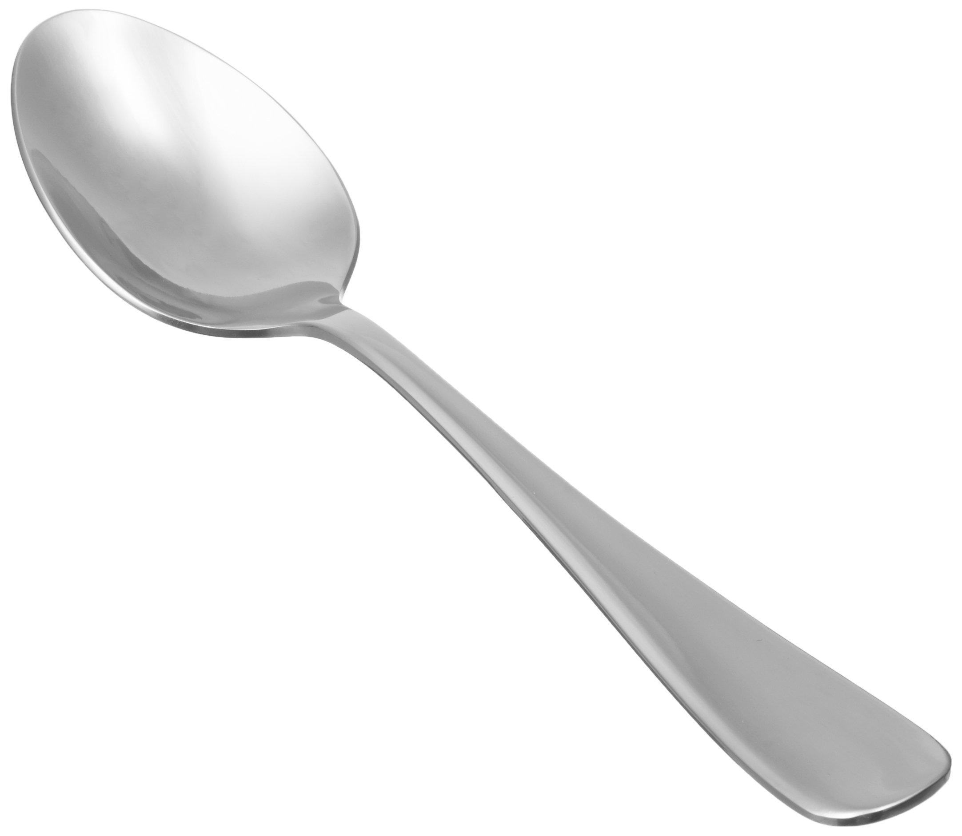
Tāngchí
Spoon

Slide 24
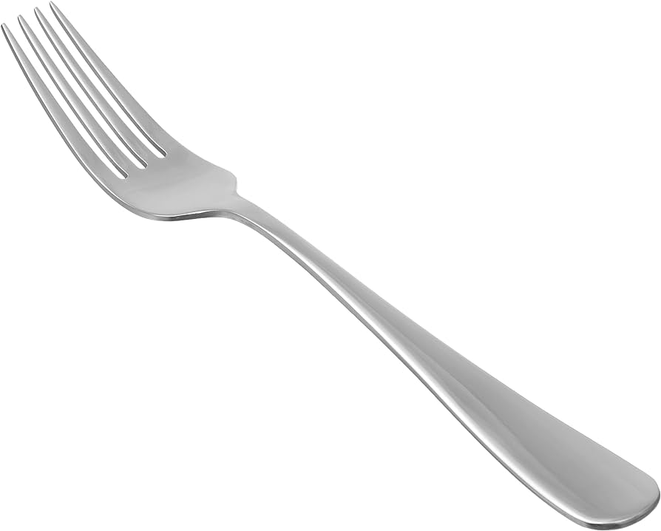
Chā
Fork

Slide 25
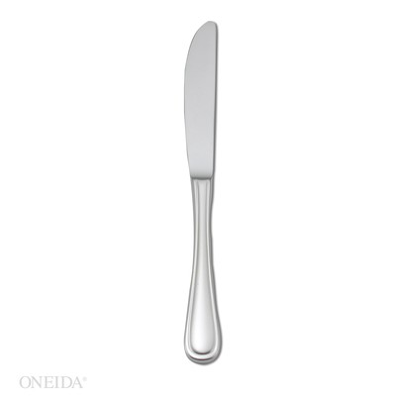
Dāo
knife

Slide 26
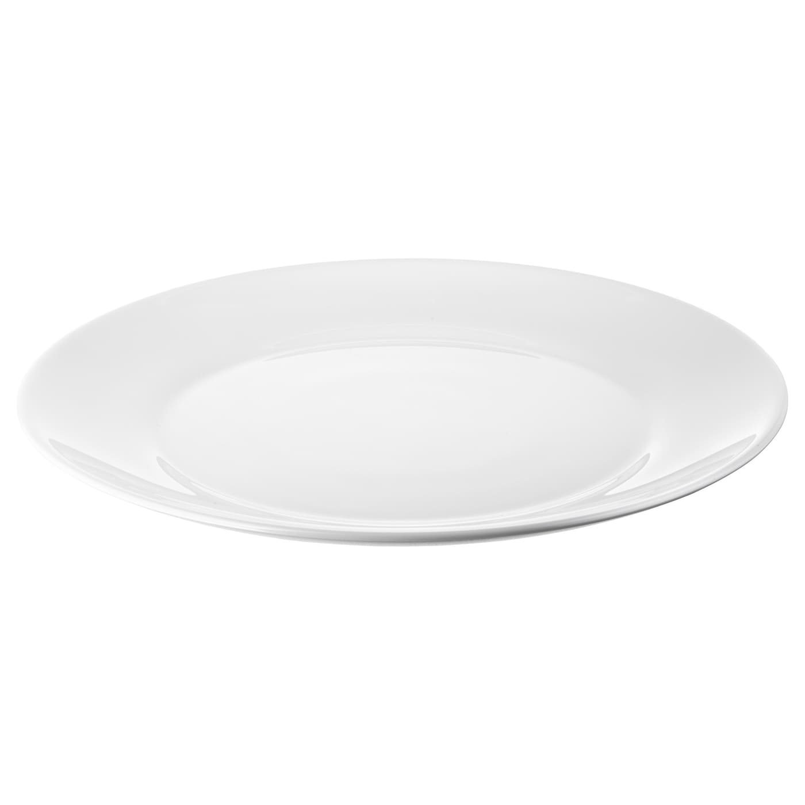
Pánzi
Plate

Slide 27
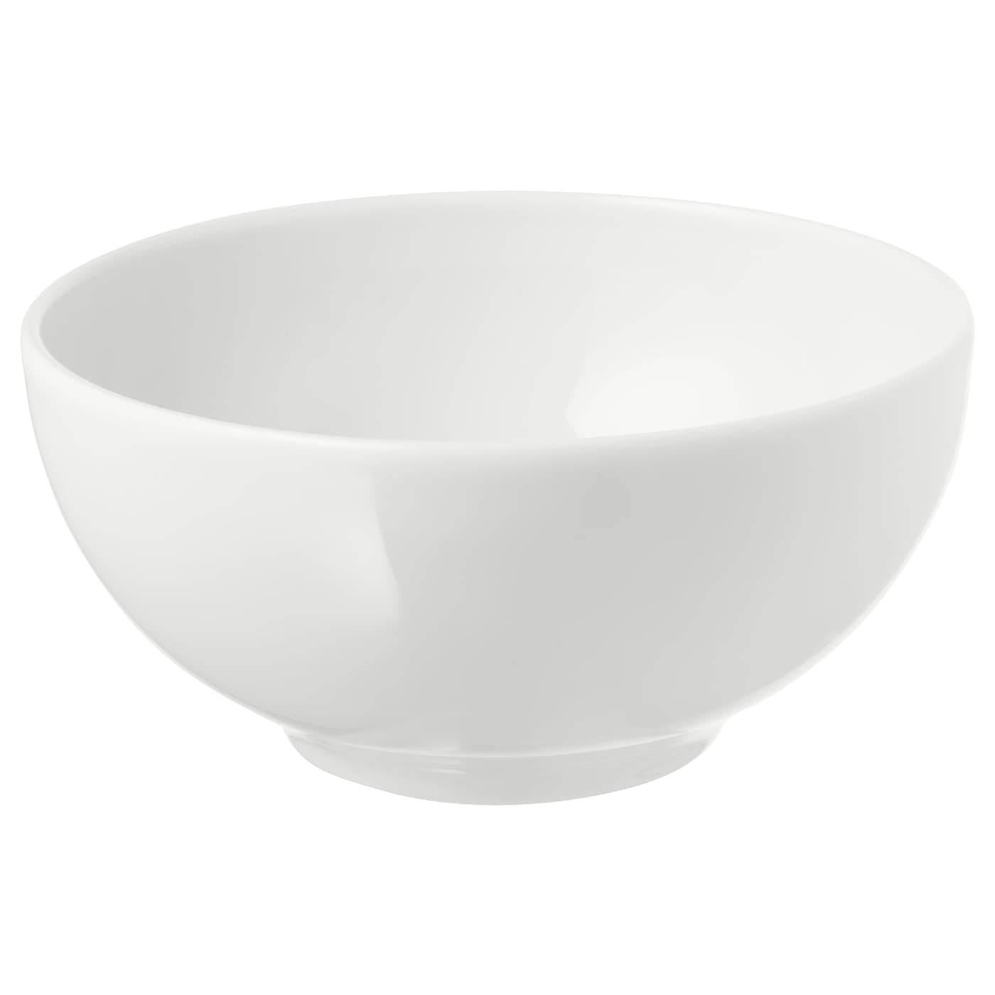
Wǎn
Bowl

Slide 28

Cānjīn
Napkin

Slide 29
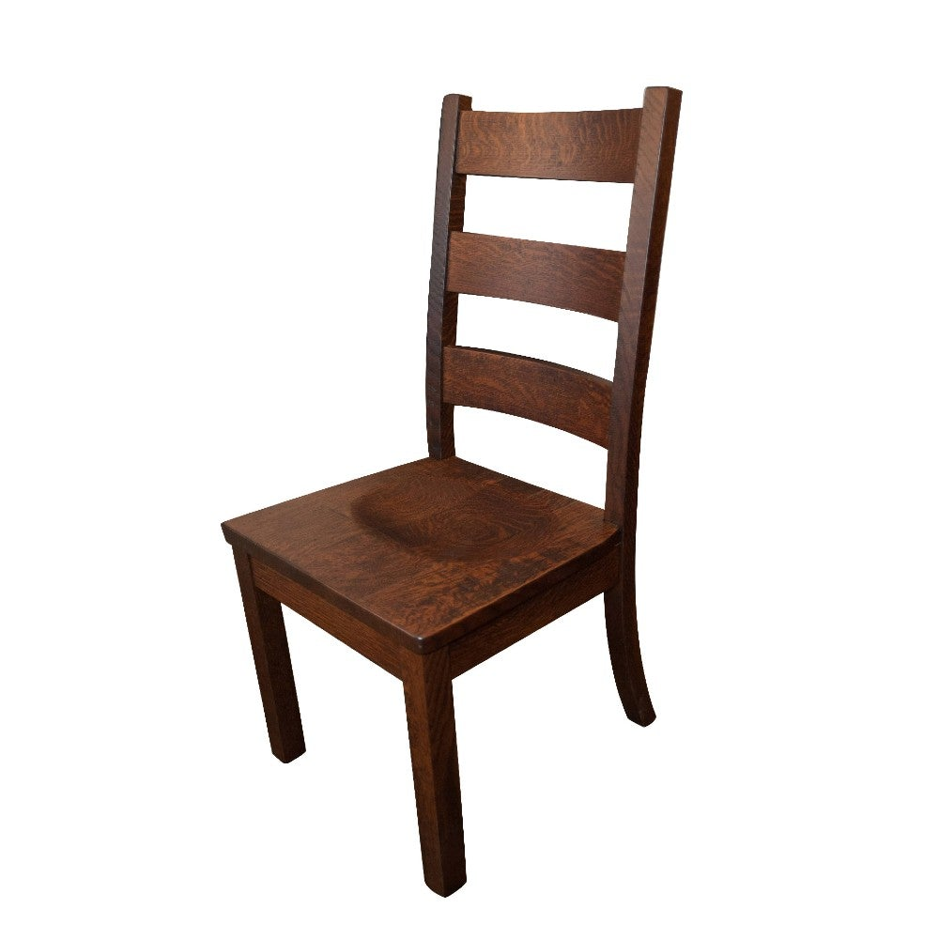
Yǐzi
Chair

Slide 30
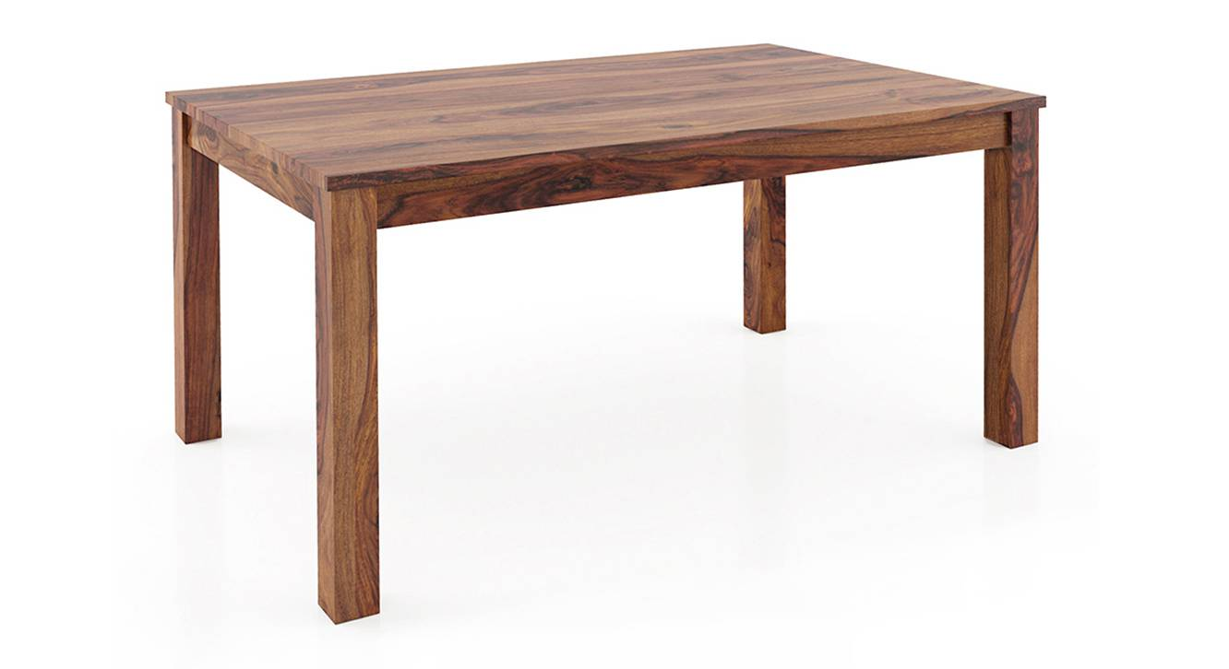
Zhuōzi
Table

Slide 31
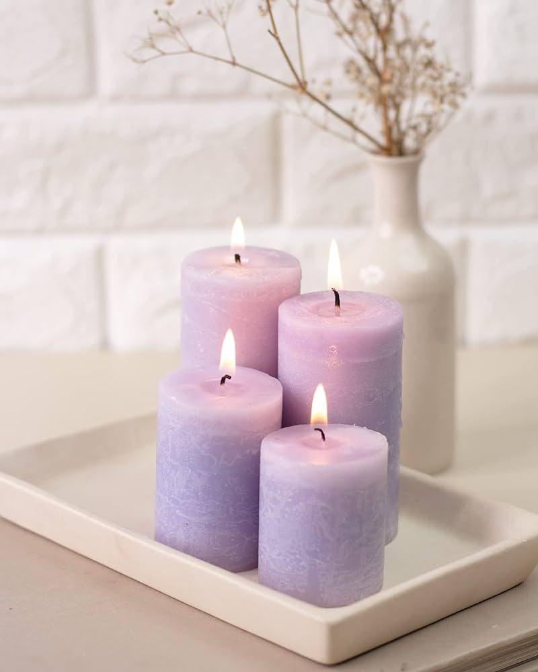
Làzhú
Candle

Slide 32
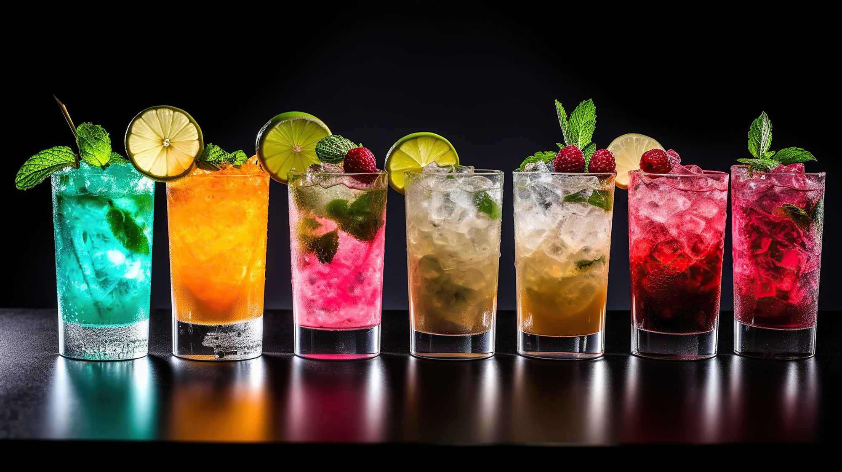
Yǐnliào
Drinks

Slide 33
Nǐ kàn dào shénme?

Slide 34
Nín hǎo, qǐngwèn nín xiǎng diǎn shénme?
Nǐ hǎo, wǒ xiǎng yào…
Hǎo de. Hái yǒu ne?
Hái yào…
Yǐnliào ne?
____ / Bù yàole.
Hái yǒu ne?
Méiyǒule
Hǎo de. Xièxiè.

Slide 35
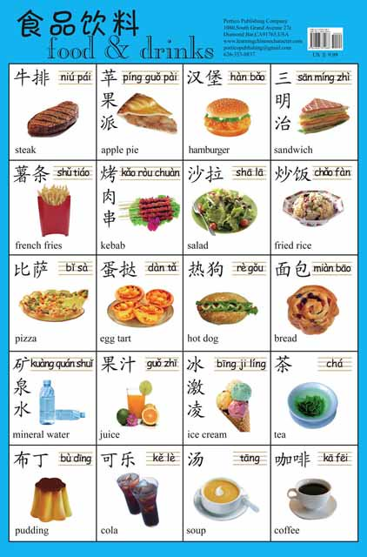
I will read them, and you tell me the corresponding food!

Slide 36
Questions?

Slide 37
Useful sentences
  你想吃什么? What would you like to eat? 我想吃 I would like to eat…
  Nǐ xiǎng chī shénme Wǒ xiǎng chī
  你想喝点什么吗？ Would you like something to drink? 我想喝 I would like to drink…
  Nǐ xiǎng hē diǎn shénme ma? Wǒ xiǎng hē
  對的，谢谢 Yes, thank you. 不，谢谢 No, thanks.
  Duì de, xièxiè. Bù, xièxiè
  还要别的吗 Anything else?
  Hái yào bié de ma

Slide 38
One last thing…
Thank you and goodbye!
谢谢，再见！
Xièxiè zàijiàn

