Slide 1
家庭
Jiātíng
Family
Nei Ching Lou

Slide 2
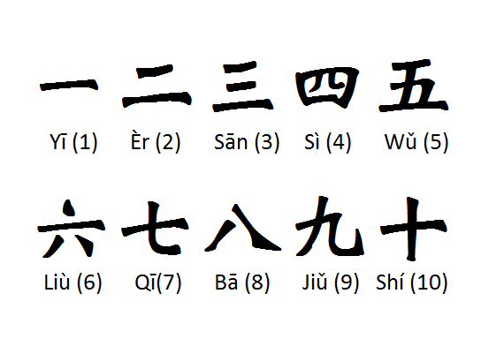
Recap: Numbers

Slide 3
Jīntiān jǐ hào?
Jīntiān shì___ yuè___ rì.

Slide 4

Jīntiān shì xīngqí jǐ?
Jīntiān shì xīngqí …
Zuótiān shì xīngqí …
Míngtiān shì xīngqí …

Slide 5
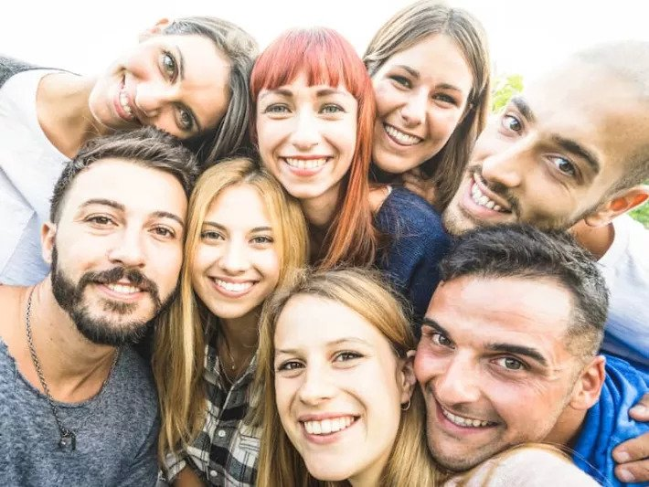
Wǒmen yǒu duōshǎo rén?
Wǒmen yǒu _____ gè rén

Slide 6
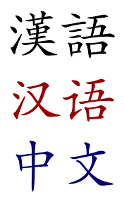
Wǒmen zài zuò shénme?
Wǒmen zhèngzài xuéxí pǔtōnghuà

Slide 7
During this session, we will…
Learn some mandarin phonics
Learn vocabs about family members
Introduce our families to others

Slide 8
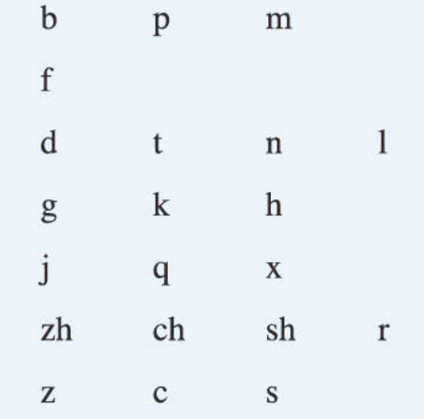
Shēngmǔ
Consonants
Initials

Slide 9
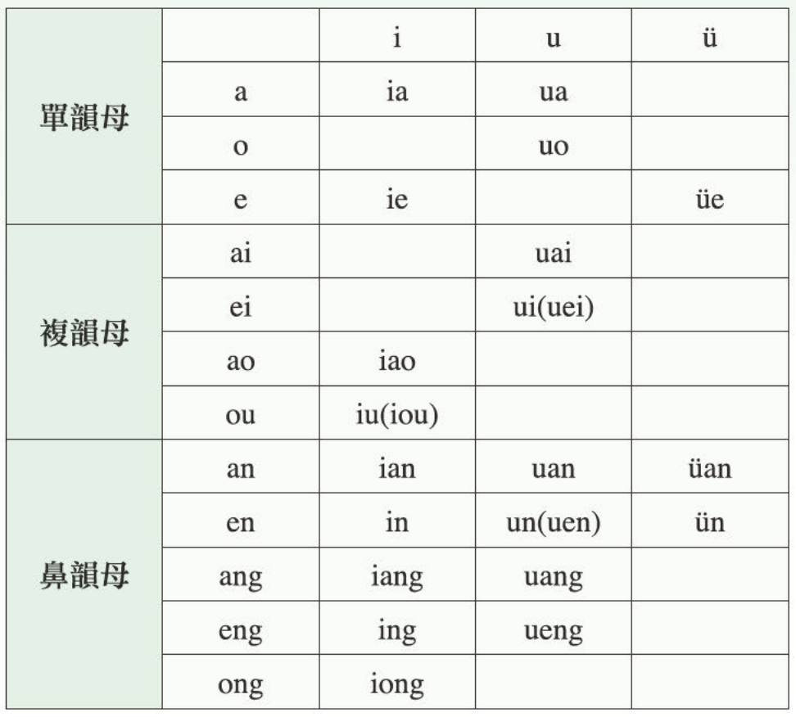
Yùnmǔ
Vowels
Finals

Slide 10
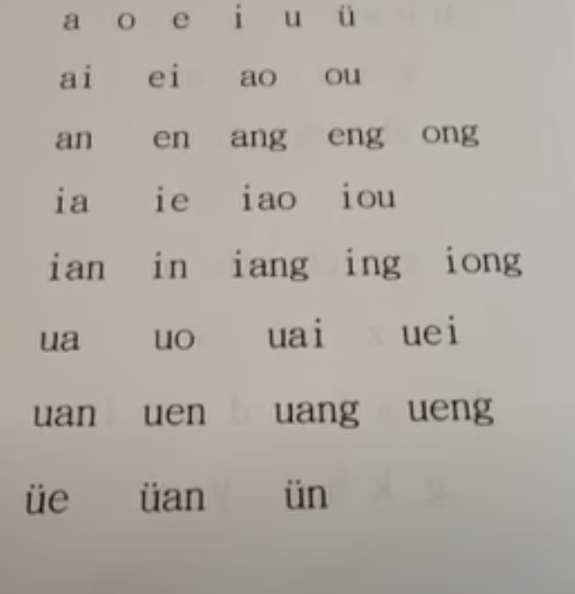
Yùnmǔ
Vowels
Finals

Slide 11
Questions

Slide 12
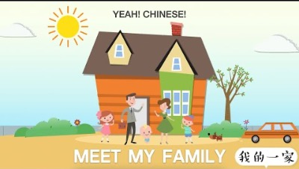

Slide 13
What did you understand?

Slide 14
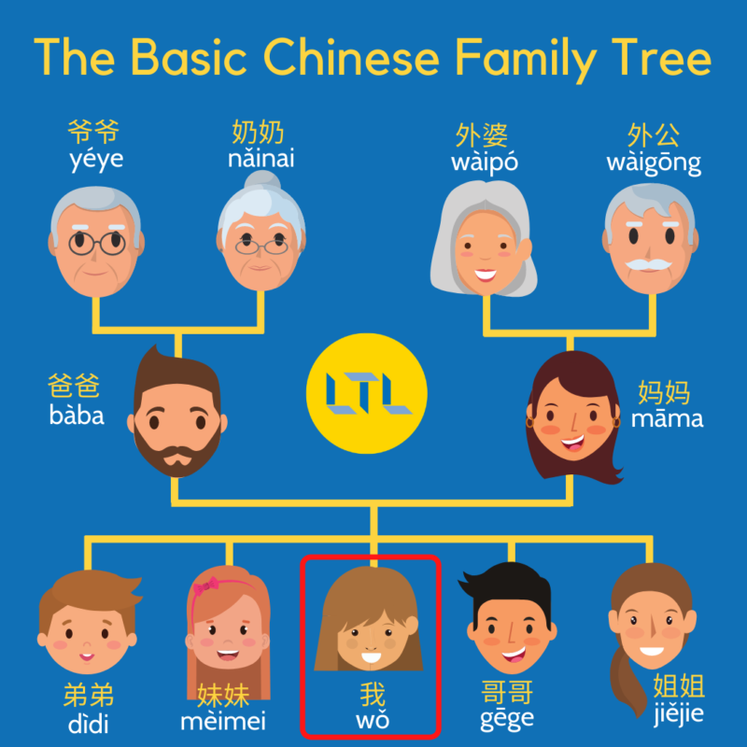
Family tree

Slide 15
Let‘s learn them one by one

Slide 16
Vocabs
我
Wǒ
I

Slide 17
Vocabs
姐姐/姊姊
Jiějie
Elder sister

Slide 18
Vocabs
妹妹
Mèimei
Younger sister

Slide 19
Vocabs
姐妹/姊妹
Jiěmèi
Sisters

Slide 20
Vocabs
哥哥
Gēge
Elder brother

Slide 21
Vocabs
弟弟
Dìdì
Younger brother

Slide 22
Vocabs
兄弟
Xiōngdì
Brothers

Slide 23
Vocabs
兄弟姐妹
Xiōngdì jiěmèi
Siblings

Slide 24
Vocabs
爸爸
Bàba
Father

Slide 25
Vocabs
妈妈
Māma
Mother

Slide 26
Group practice

Slide 27

Duōshǎo / Jǐ
How many?

Slide 28
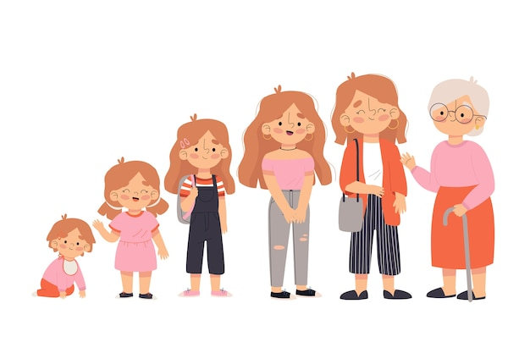
Suìshu
Age

Slide 29
Jǐ suì?
How old?

Slide 30

Yǒu
To exist / consist of (There is…)
To possess (I have…)

Slide 31
Méi yǒu
To NOT exist / consist of (There is…)
To NOT possess (I have…)

Slide 32

Bù
No

Slide 33
Practice
  Nǐ yǒu jǐ gè xiōngdì? Nǐ yǒu jiěmèi ma?
  Wǒ yǒu liǎng gè xiōngdì. Tāmen jiào… hé…
  Bù. Wǒ méi yǒu…

Slide 34
Practice
  Nǐ gēgē jǐ suì le?
  Wǒ gēgē _____ suì le.

Slide 36
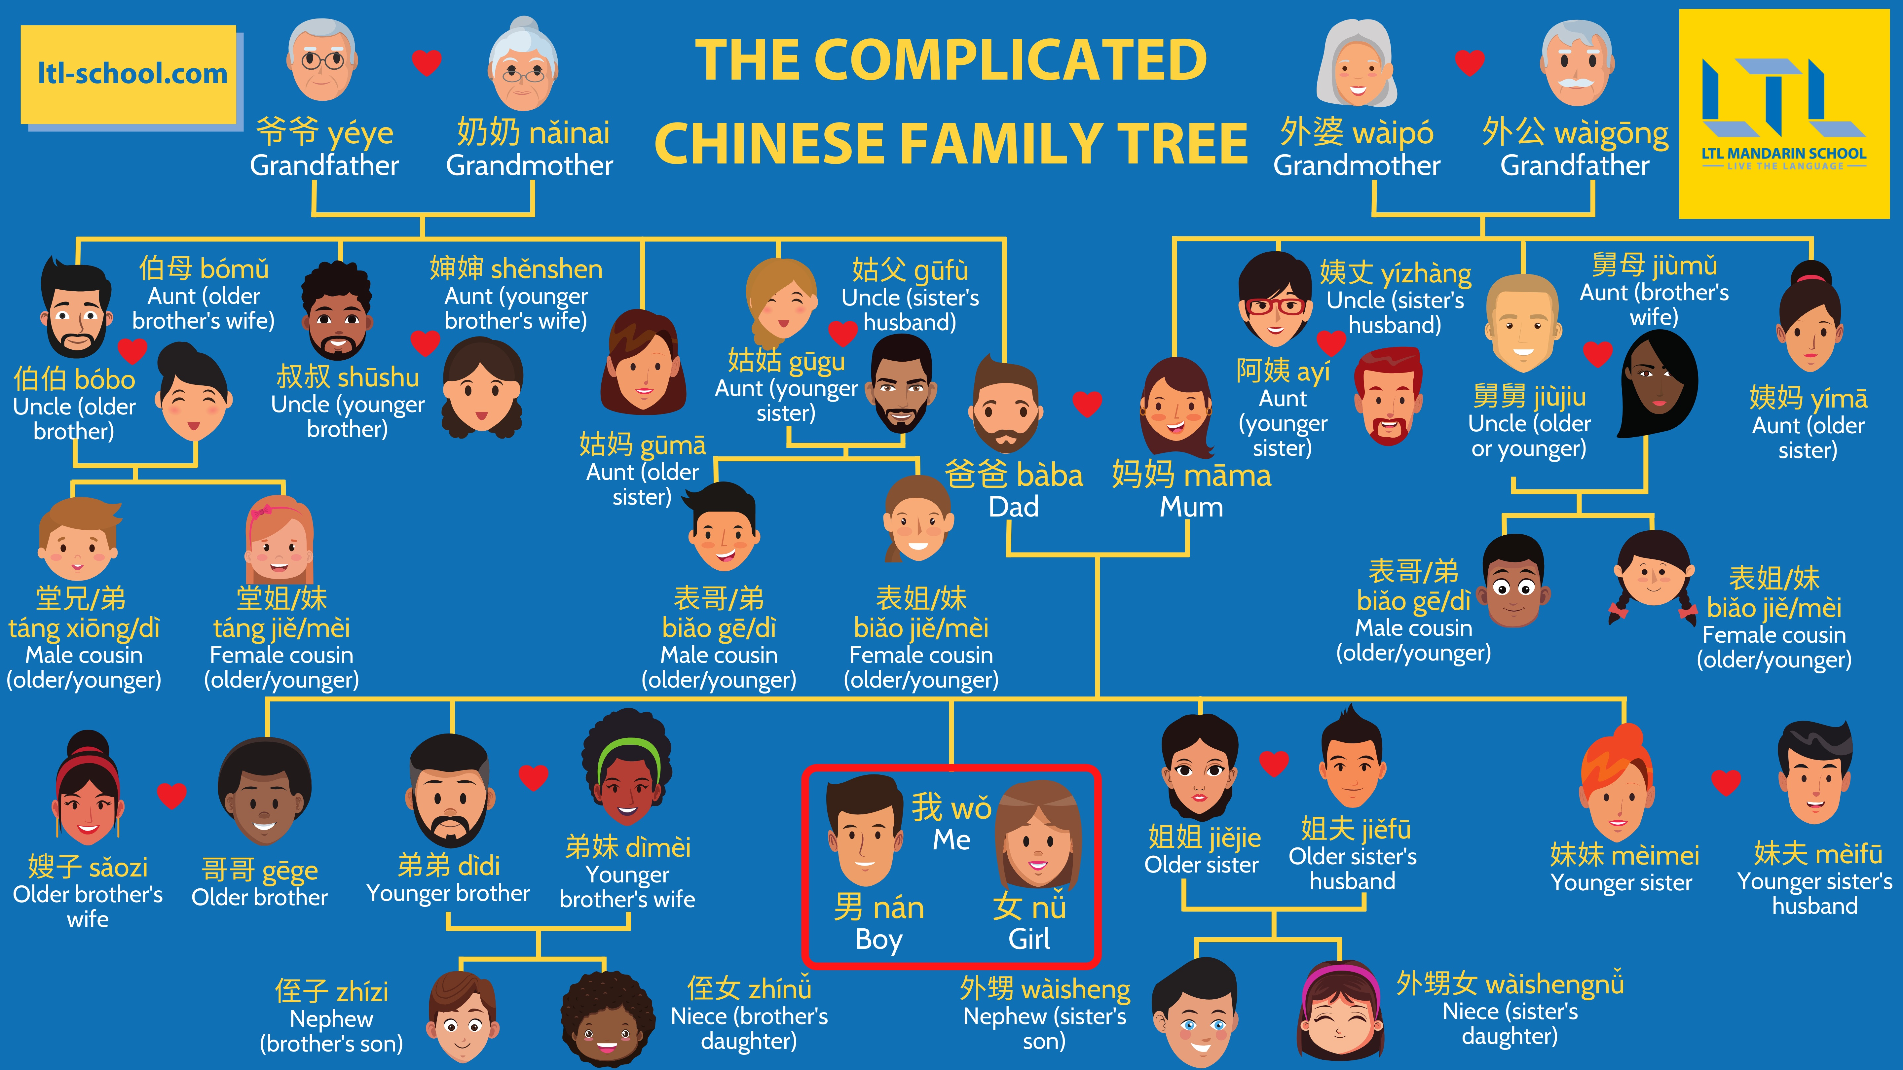
More?

Slide 37
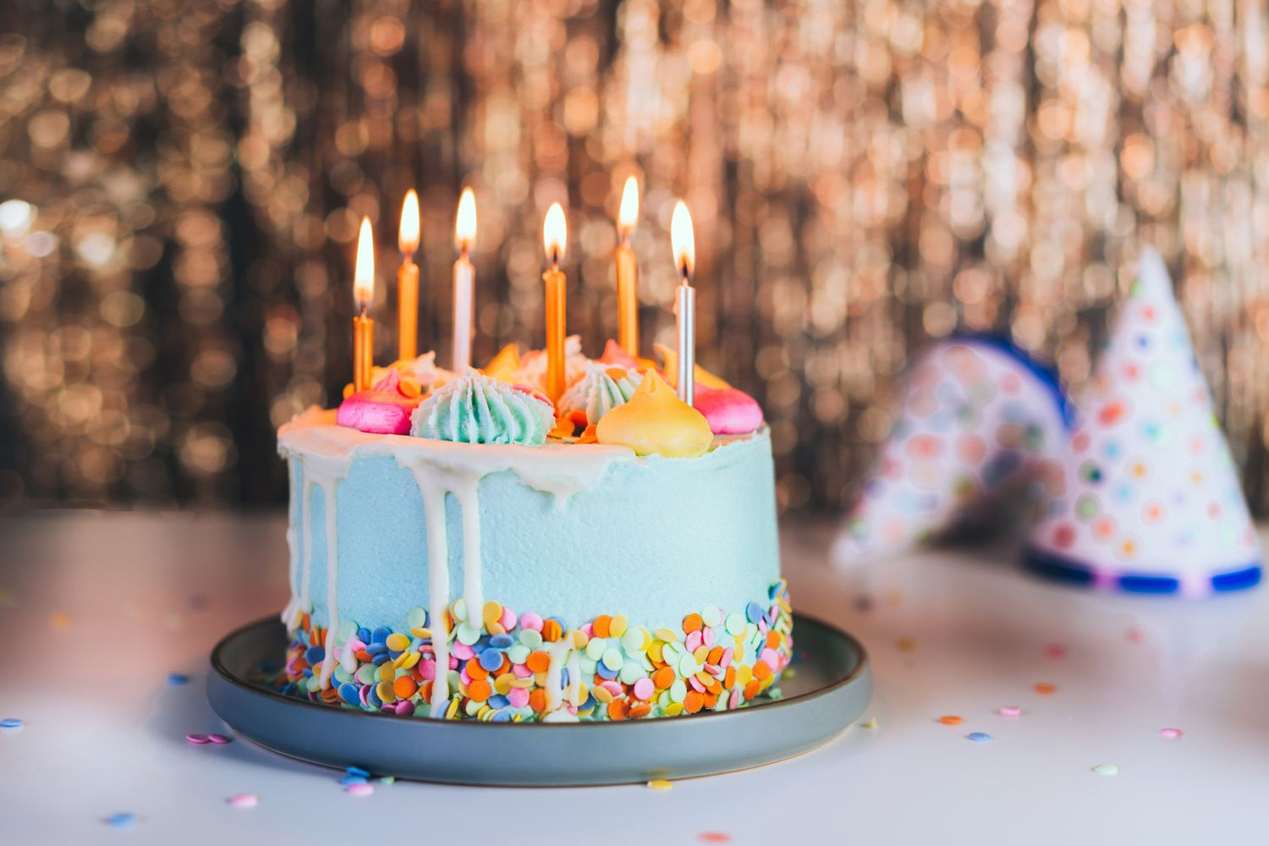
Shēngrì
Birthday

Slide 38
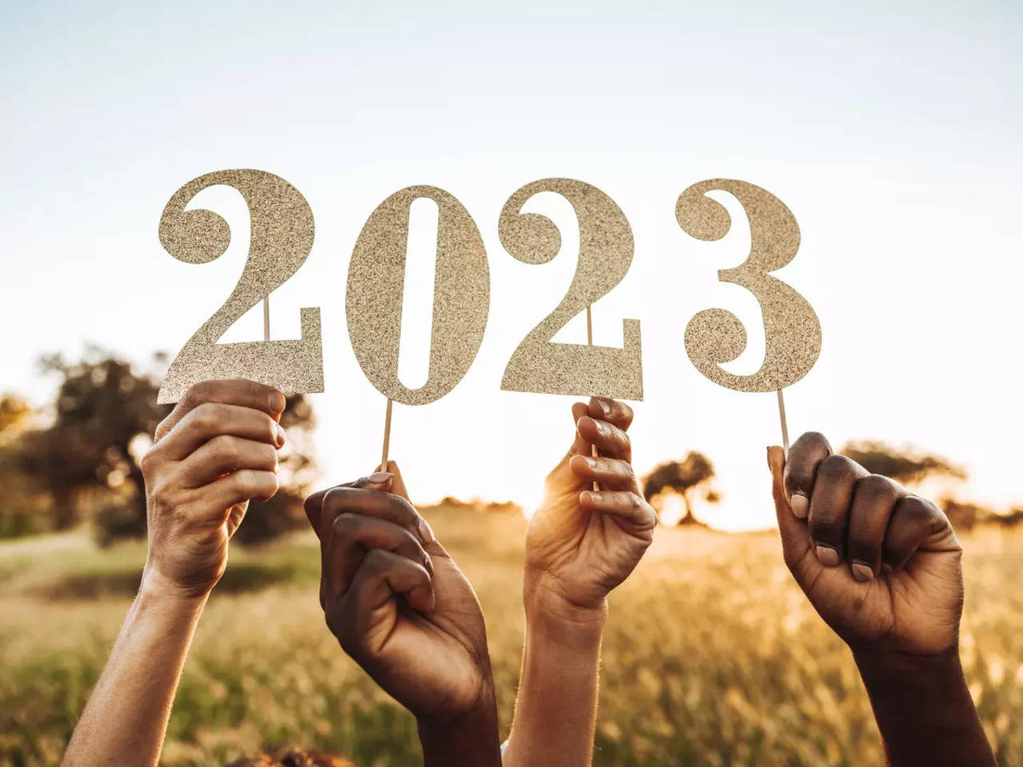
Nián
Year

Slide 39
Nǐ de shēngrì shì shénme?
Wǒ de shēngrì shì ____ yuè ____ rì

Slide 40
Nǐ gēgē shēngrì shì shénme?
Wǒ gēgē de shēngrì shì ____ yuè ____ rì.
  Tā jīnnián ____ suì le.

Slide 41
Questions?

Slide 42
Role play!

Slide 43

Péngyǒu
friends

Slide 44

Diǎn
O’clock

Slide 45
Xiànzài jǐ diǎn le?
What is the time now ?

Slide 46
Nǐ hǎo! (name) Nǐ hǎo! (name)
Zhè shì wǒ de gēgē. Tā jiào (name)
Zhè shì wǒ de péngyǒu (name)
Nǐ hǎo! (name) Nǐ hǎo! (name)
Nǐmen zài zuò shénme?
Wǒmen zài xuéxí pǔtōnghuà. Nǐ ne?
Wǒ yě shì!
Ai? Xiànzài jǐ diǎn le?
Xiànzài ____diǎn le.
Zánmen yīqǐ qù ba!
Hǎo de!

Slide 47
Questions?

Slide 49
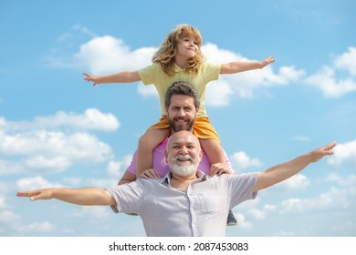
Jiā
Home/family

Slide 50

lǐ
Inside/within

Slide 51
Nǐ jiā lǐ yǒu duōshǎo rén?
Wǒ jiā yǒu ___ kǒu rén.
Yǒu bàba, māma… hé …
Dànshì
Wǒ méiyǒu…
Wǒ hěn (bù) ài tāmen

Slide 52
Welldone! We have…
Learnt vocabs about family members
Ask and answer about age, birthday, time and family

Slide 53
One last thing…
Thank you and goodbye!
谢谢，再见！
Xièxiè zàijiàn

