Slide 1
Shùzì
Numbers
Nei Ching Lou

Slide 2
Nǐ hǎo!
Wǒ hěn gāoxìng jiàn dào nǐmen!
Wǒmen zài xuéxí pǔtōnghuà.

Slide 3
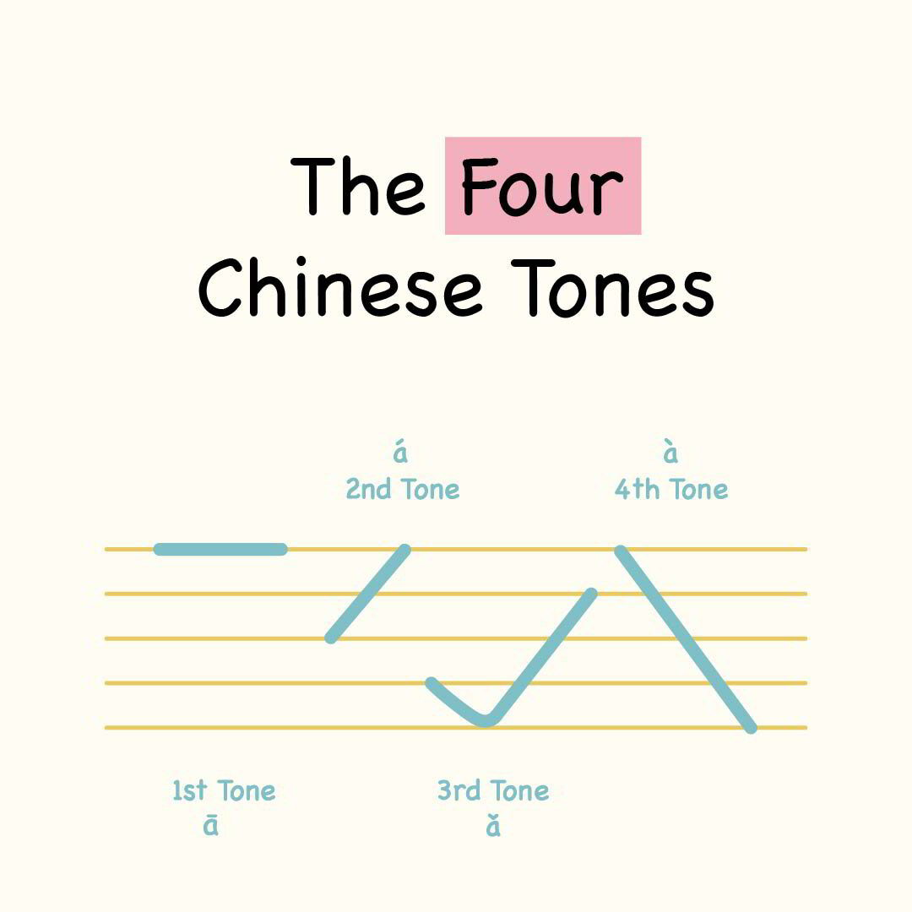
TONES!

Slide 4
Agenda
Warm-up minigame
Some vocabularies and practices
  1-10
  Classifiers
  Months and dates
  Weeks
Large numbers

Slide 5
Mini game (english version)
Objective: say all 10 numbers in sequence
Rules
  No one can say two numbers consecutively
  Anyone can speak anytime
  If two people say the same number at the same time
    Start from 1 again

Slide 6
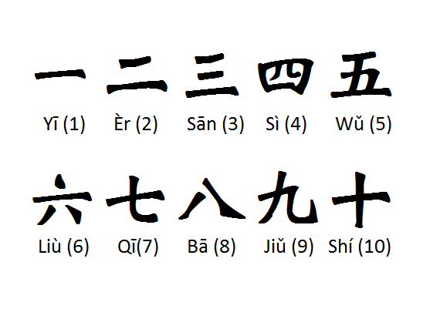

Slide 7
Mini game (Mandarin)

Slide 8
Questions?

Slide 9
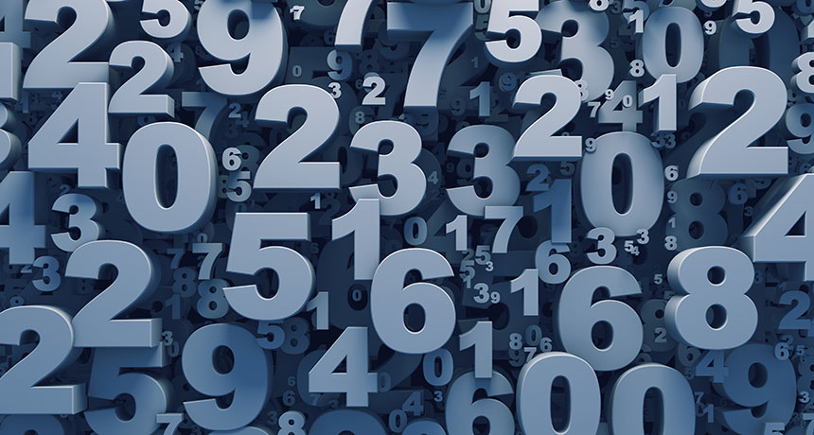
Shùzì
Numbers

Slide 10
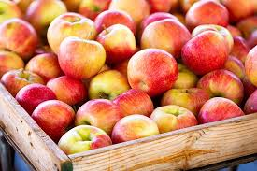
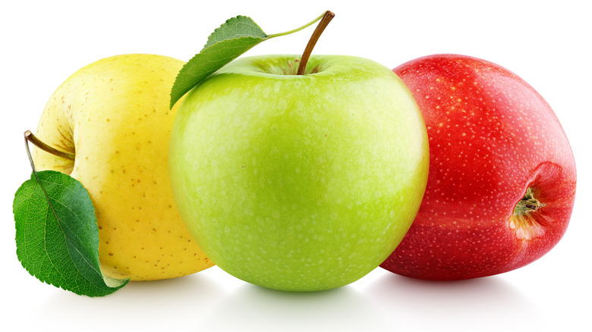
Duō Shǎo

Slide 11

Duōshǎo / Jǐ
How many?

Slide 12





Hěn shǎo Hěn duō
Fēicháng shǎo Fēicháng duō
Shǎo Duō

Slide 13
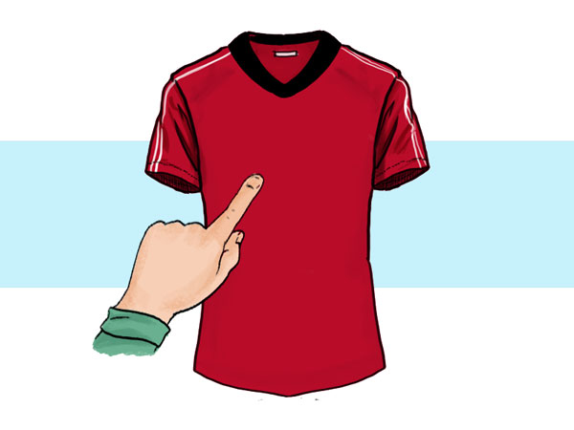
Zhèlǐ
Here

Slide 14

Rén
People

Slide 15
Questions?

Slide 17
Zhèlǐ shì duōshǎo?
Zhèlǐ shì…
Qī

Slide 18

Zhèlǐ shì duōshǎo?
Zhèlǐ shì…
Yī

Slide 19

Zhèlǐ shì duōshǎo?
Zhèlǐ shì…
Sān

Slide 20
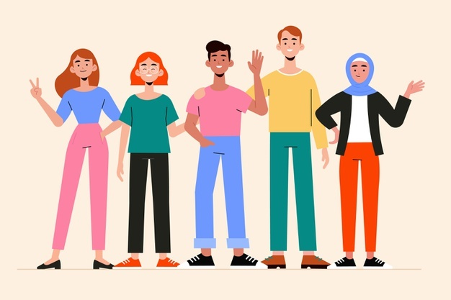
Zhèlǐ shì duōshǎo?
Zhèlǐ shì…
Wǔ

Slide 21

Zhèlǐ shì duōshǎo?
Zhèlǐ shì…
Sì

Slide 22

Zhèlǐ shì duōshǎo?
Zhèlǐ shì…
Liù

Slide 23
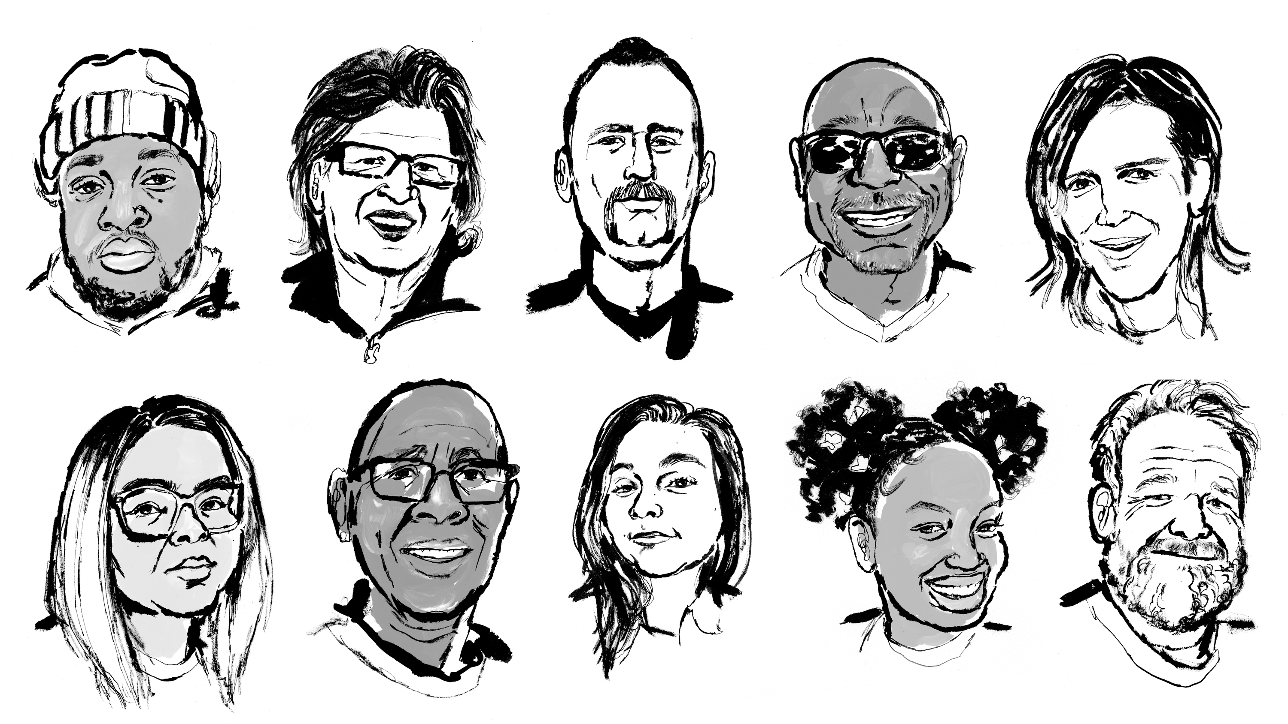
Zhèlǐ shì duōshǎo?
Zhèlǐ shì…
Shí

Slide 24
This time without table!

Slide 26
Zhèlǐ shì duōshǎo?
Zhèlǐ shì…
Wǔ

Slide 27
Zhèlǐ shì duōshǎo?
Zhèlǐ shì…
Qī

Slide 28
Zhèlǐ shì duōshǎo?
Zhèlǐ shì…
Yī

Slide 29
Zhèlǐ shì duōshǎo?
Zhèlǐ shì…
Liù

Slide 30
Zhèlǐ shì duōshǎo?
Zhèlǐ shì…
Shí

Slide 31
Zhèlǐ shì duōshǎo?
Zhèlǐ shì…
Sì

Slide 32
Zhèlǐ shì duōshǎo?
Zhèlǐ shì…
Sān

Slide 33
Questions?

Slide 34

Yǒu
To exist / consist of (There is…)
To possess (I have…)

Slide 35
Rén
People

Slide 36
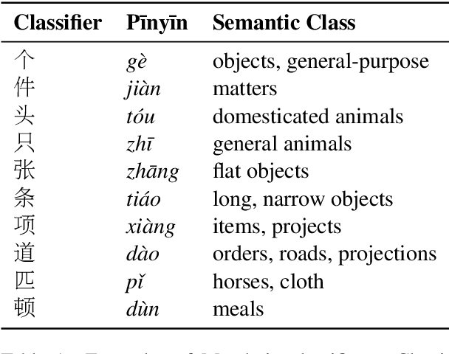
Measure words
  Zhè lǐ yǒu sān gè rén
  In English, we say, „two grains of salt“.
  But we can also say „two ___ books“ <-no classifiers
  In Chinese, always:
  Number, Classifier, Noun

Slide 38
Zhèlǐ yǒu duōshǎo rén?
Zhèlǐ yǒu …
gè rén.
Qī

Slide 39
Zhèlǐ yǒu duōshǎo rén?
Zhèlǐ yǒu …
gè rén.
Sān

Slide 40
Zhèlǐ yǒu duōshǎo rén?
Zhèlǐ yǒu …
gè rén.
Wǔ

Slide 41
Zhèlǐ yǒu duōshǎo rén?
Zhèlǐ yǒu …
gè rén.
Sì

Slide 42
Zhèlǐ yǒu duōshǎo rén?
Zhèlǐ yǒu …
gè rén.
Liù

Slide 43
Zhèlǐ yǒu duōshǎo rén?
Zhèlǐ yǒu …
gè rén.
Shí

Slide 44
Zhèlǐ yǒu duōshǎo rén?
Zhèlǐ yǒu …
gè rén.
Yī

Slide 45
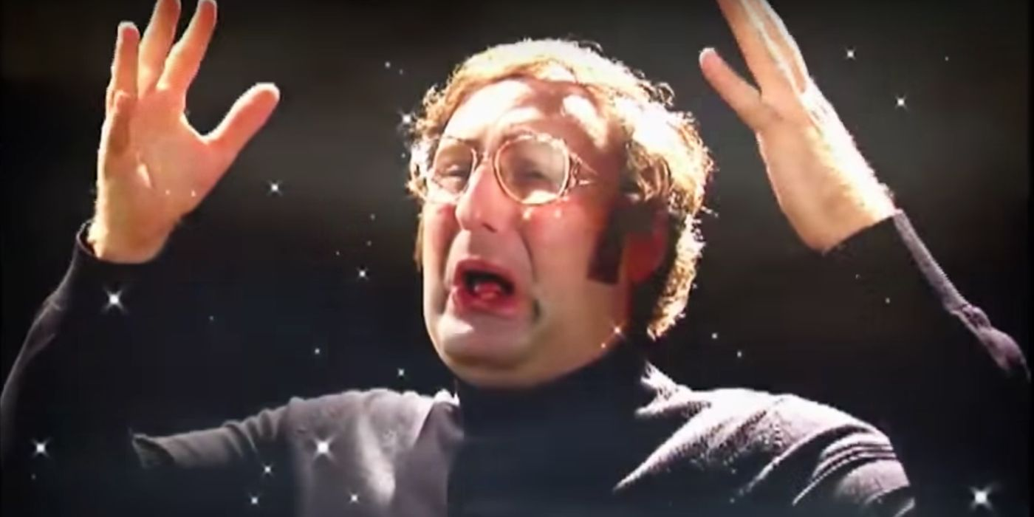
Tone changes of 一 (yī)
In isolation, or when used as an ordinal number, 一 is pronounced as a first tone.
Before a fourth tone - > second tone
Before anything but a fourth tone -> fourth tone
Zhèlǐ yǒu yī gè rén

Slide 46

Zhèlǐ yǒu duōshǎo rén?
Zhèlǐ yǒu …
gè rén.
Liǎng

Slide 47

Zhèlǐ yǒu duōshǎo rén?
Zhèlǐ yǒu …
gè rén.
Shíliù

Slide 48
Questions?

Slide 49

dì yī
dì èr
dì sān

Slide 50

Tú/Túpiàn/Zhàopiàn
Picture/photo

Slide 51
Zhè zhāng zhàopiàn lǐ yǒu duōshǎo rén?
1. Dì yī zhāng tú lǐ yǒu sān gè rén

Slide 52
Zhè zhāng zhàopiàn lǐ yǒu duōshǎo rén?
Liù
2. Dì èr zhāng tú lǐ yǒu gè rén

Slide 53
Zhè zhāng zhàopiàn lǐ yǒu duōshǎo rén?
Qī
3. Dì sān zhāng tú lǐ yǒu gè rén

Slide 54
Zhè zhāng zhàopiàn lǐ yǒu duōshǎo rén?
Sān
4. Dì sì zhāng tú lǐ yǒu gè rén

Slide 55
Zhè zhāng zhàopiàn lǐ yǒu duōshǎo rén?
Liǎng
5. Dì wǔ zhāng tú lǐ yǒu gè rén

Slide 56
Zhè zhāng zhàopiàn lǐ yǒu duōshǎo rén?
Shíliù
6. Dì liù zhāng tú lǐ yǒu gè rén

Slide 57
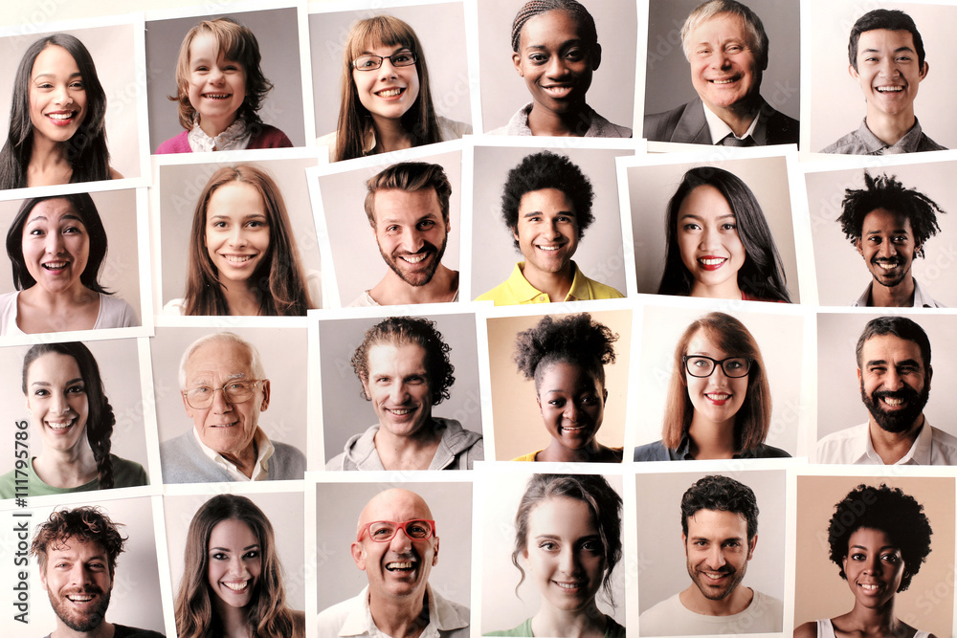
Zhè zhāng zhàopiàn lǐ yǒu duōshǎo rén?
Èrshísì
6. Dì liù zhāng tú lǐ yǒu gè rén

Slide 58
Questions?

Slide 59

Rì
Sun / Day

Slide 60
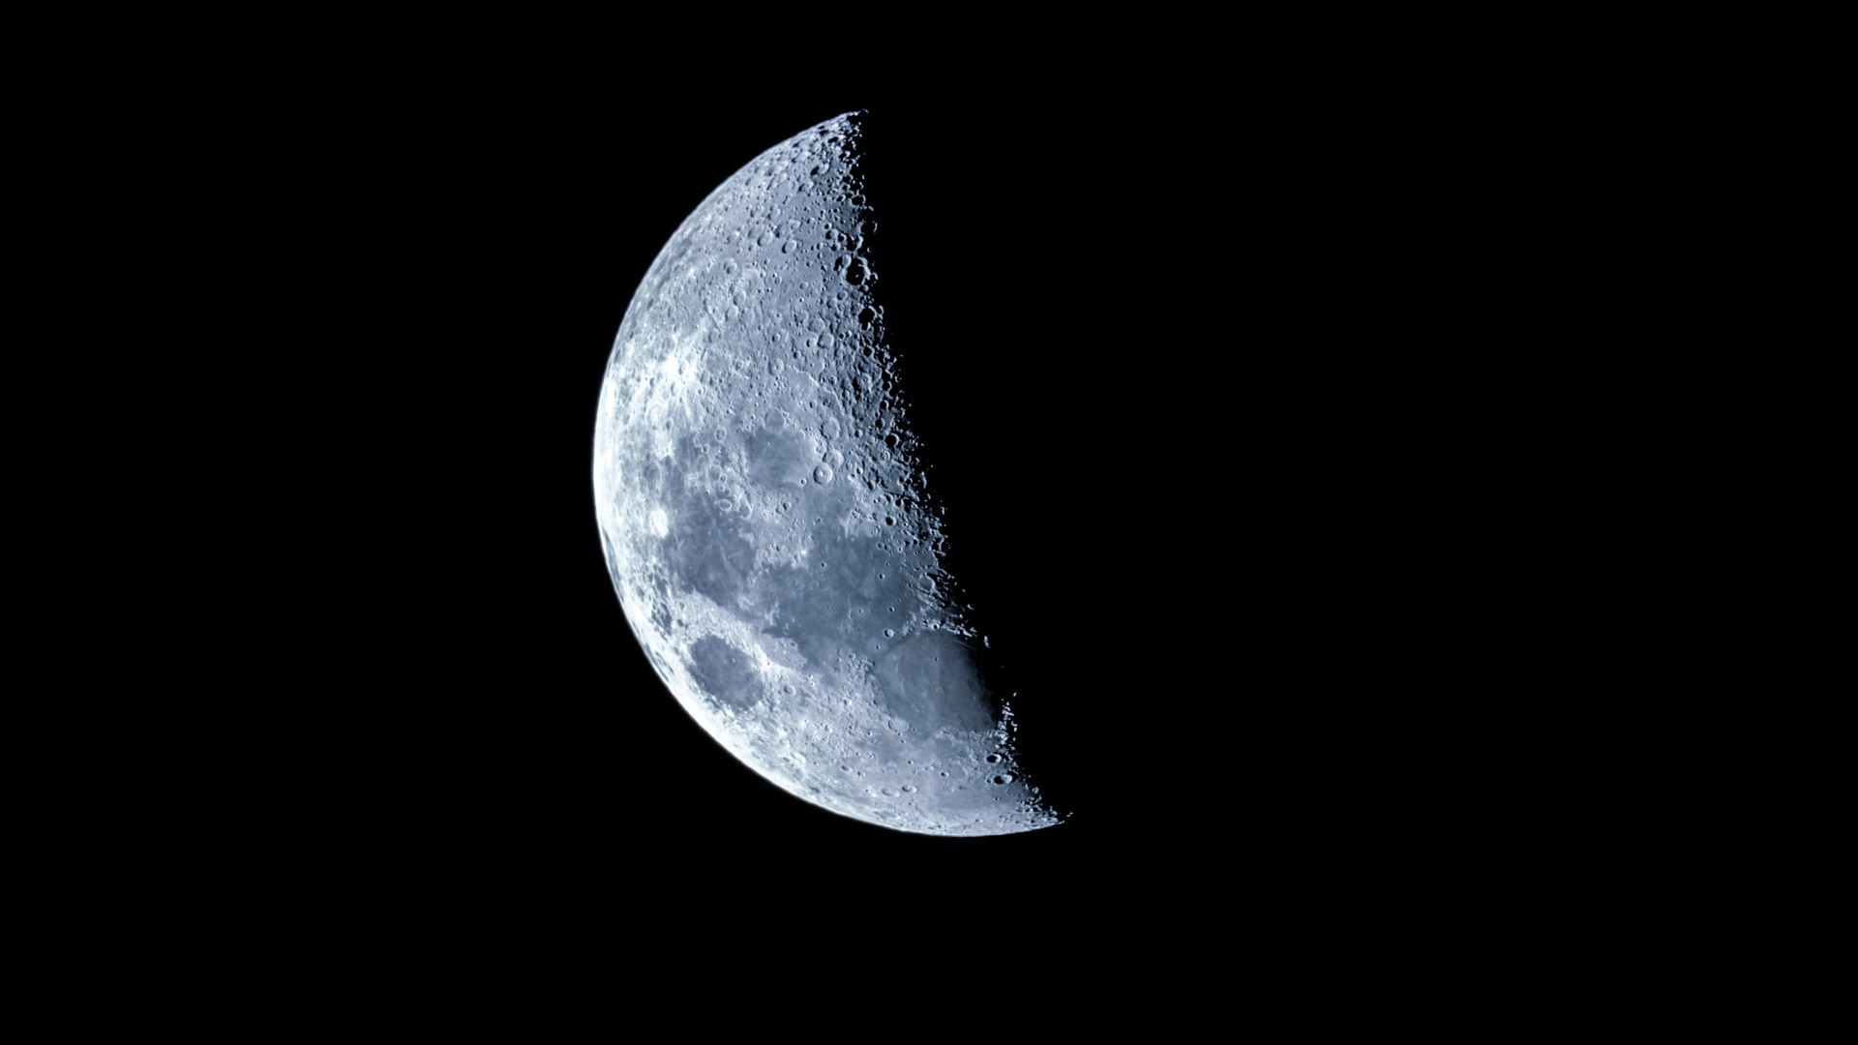
Yuè
Moon / Month

Slide 61
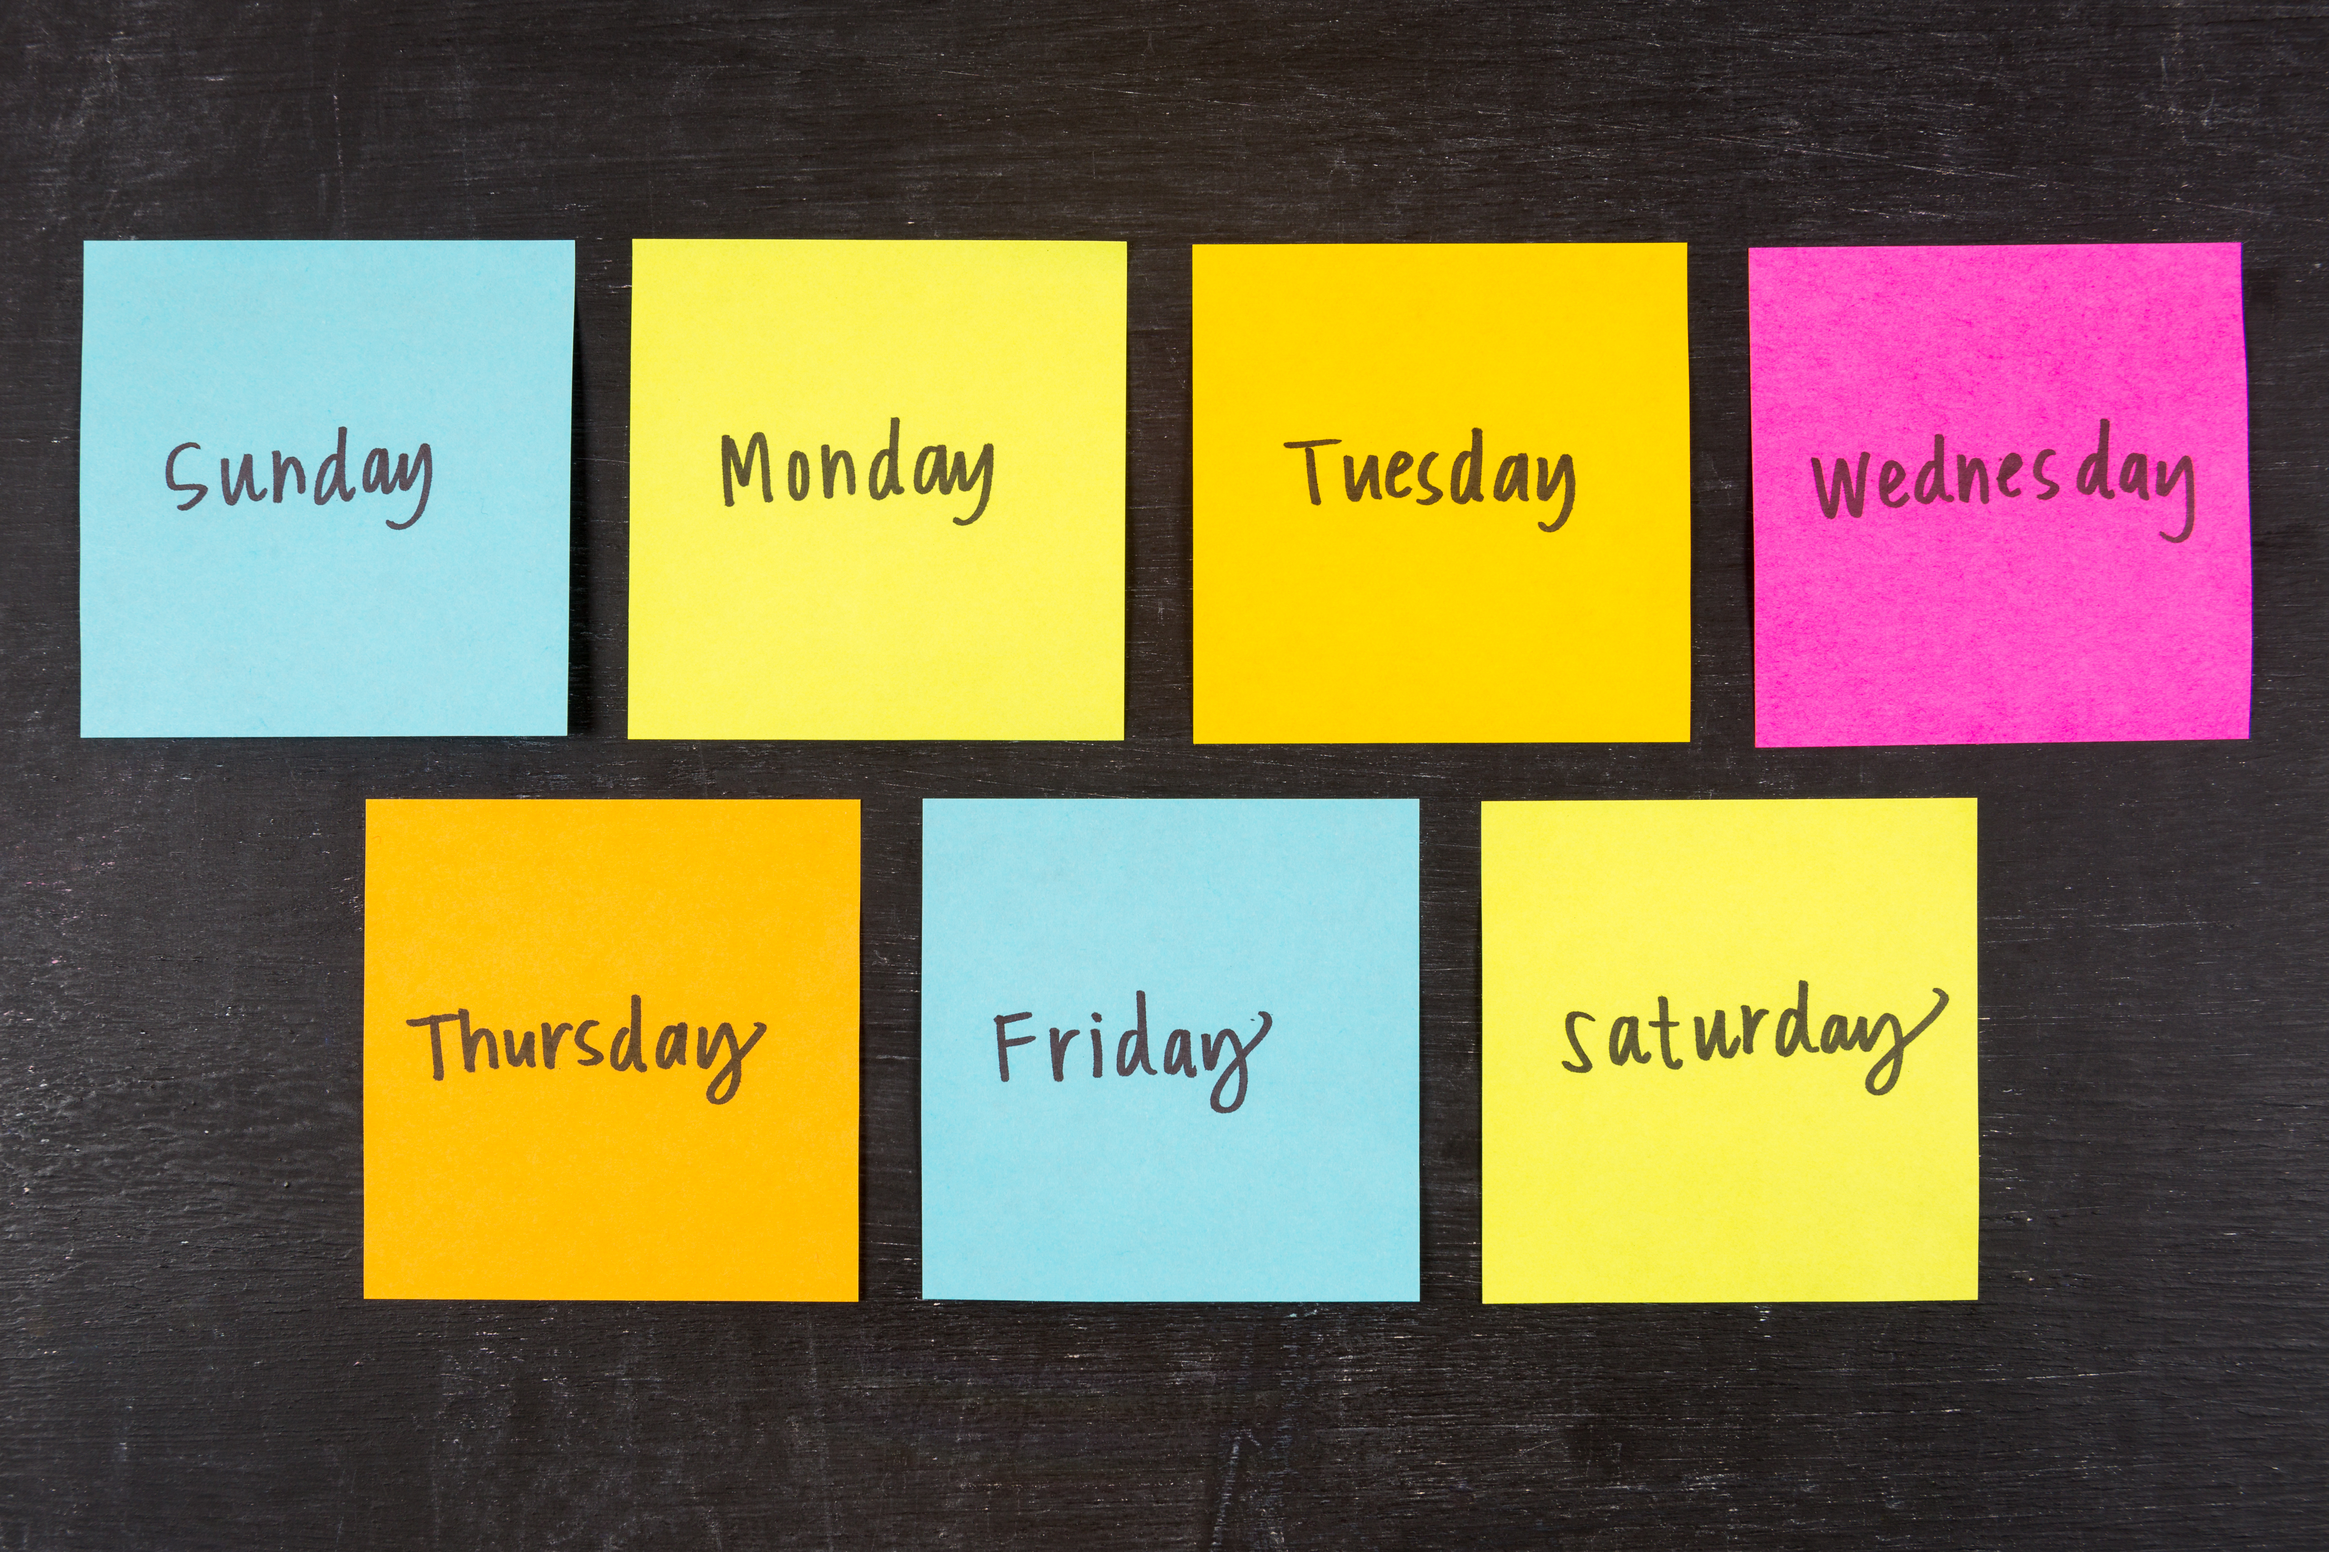
Xīngqí
Week

Slide 62

Jīntiān
Today

Slide 63
Months and dates
一月 | 二月 | 三月 | 四月 | 五月 | 六月 | 七月 | 八月 | 九月 | 十月 | 十一月 | 十二月
Jan | Feb | Mar | Apr | May | Jun | Jul | Aug | Sep | Oct | Nov | Dec
yī yuè | èr yuè | sān yuè | sì yuè | wǔ yuè | liù yuè | qī yuè | bā yuè | jiǔ yuè | shí yuè | shíyī yuè | shí'èr yuè

Slide 64
Let your groupmates guess
Jīntiān shì___ yuè___ rì.

Slide 65
Questions?

Slide 66
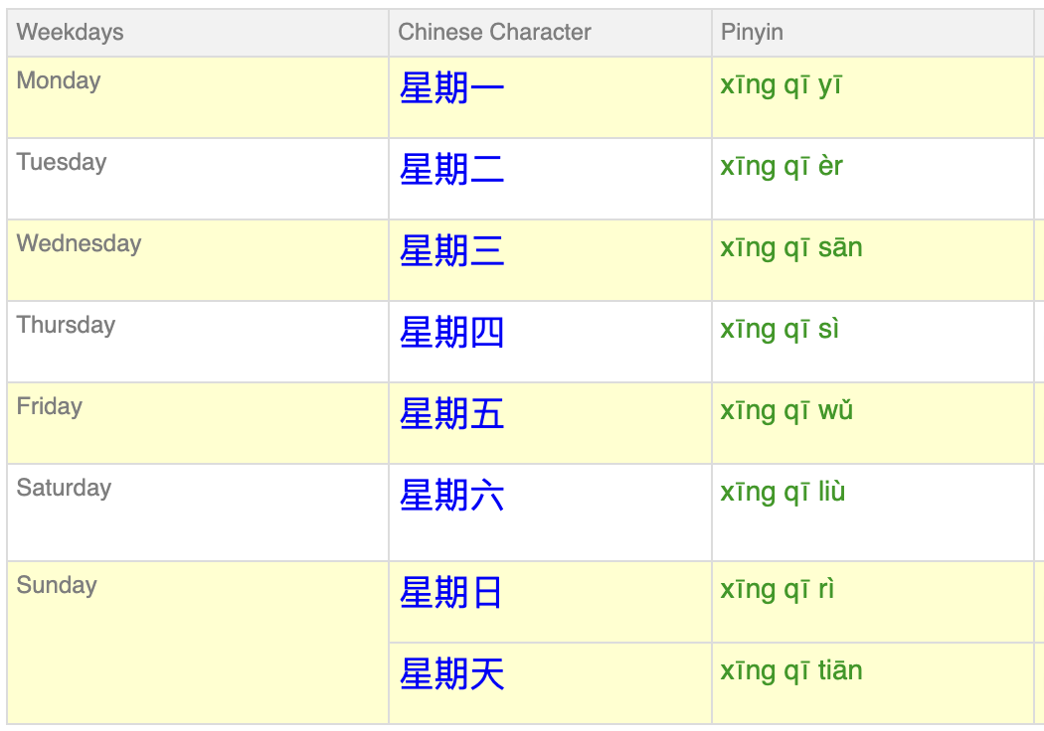
Xīngqí
Jīntiān shì…
Zuótiān shì…
Míngtiān shì…

Slide 67
Questions?

Slide 68
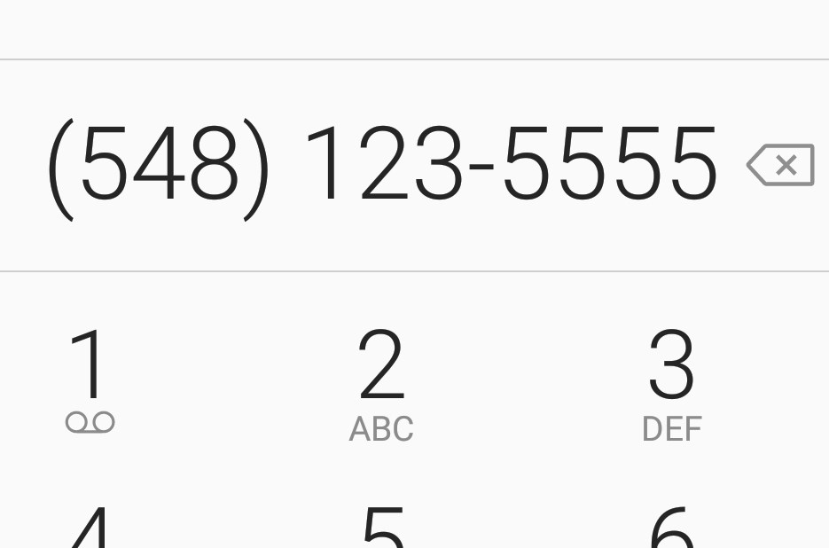
Other forms of numbers
Líng 0
Yāo 1, instead of yī
  room number/phone number

Slide 69
Guess the number from me!
百 Bǎi Hundred | 千 Qiān Thousand | 万 Wàn Ten thousand

Slide 70
Well done! Today you learnt…
  1-10
  Classifiers: gè, zhāng
  Tonal change of ‘‘yī‘‘
  Months and dates and weeks
Vocabs: Duōshǎo, Fēicháng, Hěn, Zhèlǐ, Rén, Yǒu, Jīntiān, Zuótiān, Míngtiān, yuè, rì, xīngqí

Slide 71
One last thing…
Thank you and goodbye!
谢谢，再见！
Xièxiè zàijiàn

