Slide 1
Tā shì… wǒmen shì…
He/she is… we are…
Nei Ching Lou

Slide 2
During this session, we will…
Recap on tones
Greetings and self-introduction (where are you from?)
Introduce others
Different ways to express

Slide 3

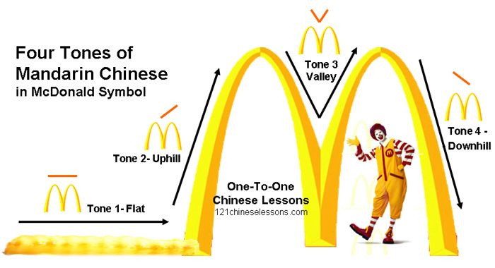
Recap: Tones

Slide 4

Small recap about the third tone
When followed by another third tone, the first character will be pronounced as the second tone.
When followed by any other tones, the first character will be pronounced as a half third tone.
(skip the rising part)
Keep it FLAT & LOW

Slide 5
Warm up
Video (2:01-2:35)

Slide 6
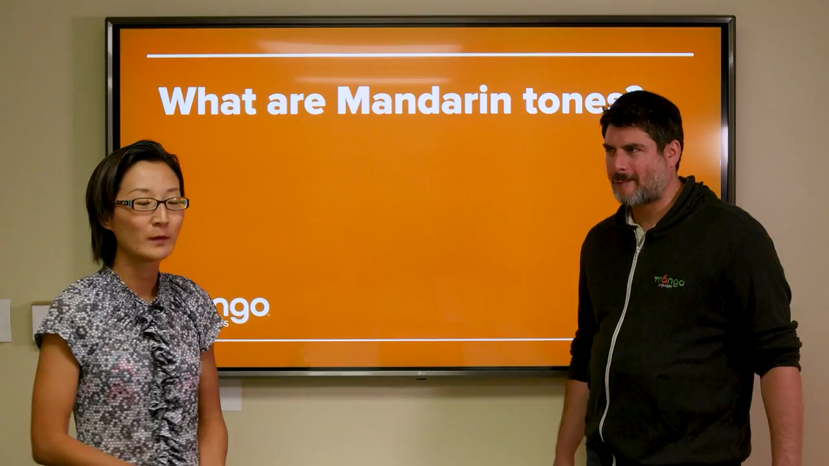

Slide 7
Recap 2
A: Nǐ hǎo. Wǒ jiào (Your name). Wǒ lái zì … Nǐ ne?
B: Nǐ hǎo. (his/her name). Wǒ jiào (Your name). Wǒ lái zì… Nǐ ne?
C: ……

Slide 8
Questions?

Slide 9
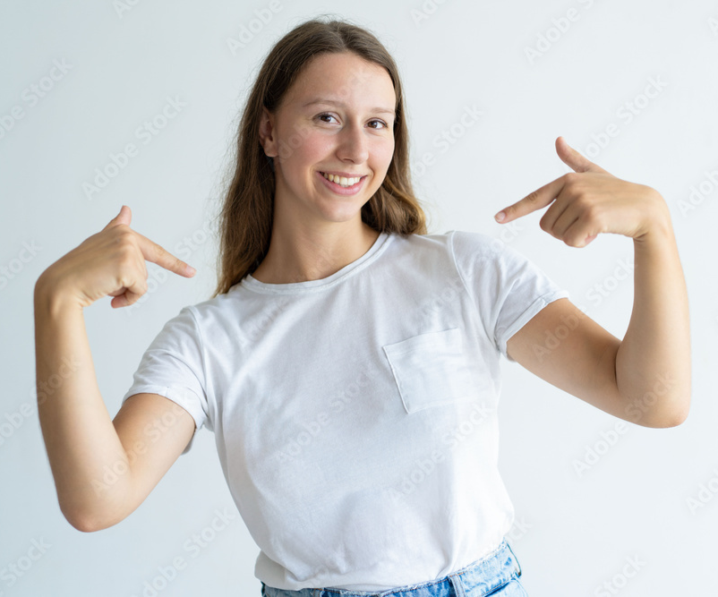
Wǒ
I

Slide 10

Nǐ / Nǐmen
You / you all

Slide 11

Tā/tāmen
He she it / they

Slide 12

Gāoxìng / kāixīn
Happy

Slide 13

Kàn / Jiàn
To look / to see

Slide 14

Qù / Zǒu
To go / walk

Slide 15

Guóyǔ / Zhōngwén / Pǔtōnghuà
Mandarin / Chinese

Slide 16

Xuéxí
To learn

Slide 17

Dàxuéshēng
University student

Slide 18

Practice
Dàjiā hǎo!
Wǒ shì… (name)
Wǒ lái zì … (Fǎguó / Déguó)
Wǒ hěn gāoxìng jiàn dào nǐmen!

Slide 19

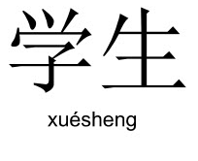
Practice 1
Nǐ hǎo. Wǒ jiào (Your name).
Wǒ lái zì (Fǎguó / Déguó).
Tā shì (their name).
Tā (yě) lái zì (Fǎguó / Déguó).
Wǒmen shì dàxuéshēng.
Wǒmen zài xuéxí pǔtōnghuà.
Repeat

Slide 20
Practice 2
Nǐ hǎo. (Their name)
Wǒ hěn gāoxìng jiàn dào nǐmen!
Wǒ jiào (Your name)
Wǒ (yě) lái zì (Fǎguó / Déguó).
Wǒ yě zài xuéxí pǔtōnghuà.
Zánmen yīqǐ qù ba.
Nǐ hǎo. (Their name)
Wǒ hěn gāoxìng jiàn dào nǐmen!
Tā shì (their name).
Tā lái zì (Fǎguó / Déguó).
Wǒmen zài xuéxí pǔtōnghuà.
Hǎo ya！

Slide 21

Well done! Today you learnt…
Pronouns
Some verbs
Introducing your friends to other people

Slide 22
Next week…
Numbers
Months
Weekdays
Birthday

Slide 23
Reference
https://www.youtube.com/watch?v=TnwOEBISYqU&t=37s&ab_channel=MangoLanguages

Slide 24
One last thing…
Thank you and goodbye!
谢谢，再见！
Xièxiè zàijiàn

