Slide 1
你好，我叫⋯⋯
Nǐ hǎo wǒ jiào
Hello, my name is… Nei Ching Lou
Nei Ching Lou

Slide 2
During this session, we will…
Learn about tones
Group activities: Self introduce with Mandarin
  4 parts: Hi, my name is… I come from… and you?

Slide 3
Who am I?
Nei Ching Lou, David
20 years old
Born and raised in Hong Kong
Second year in Germany
Studying Bsc. Human Movement in Sports and Exercise (WWU)
Mother tongue: Cantonese

Slide 4
Disclaimer
This course will be taught in English and Mandarin, because I don’t speak German ☹

Slide 5
What about you?
Why did you join this course?

Slide 6
Where are you from?
www.menti.com and use code:

Slide 7
Would you rather
Would you rather be able to order your favorite Chinese dish in Mandarin or ask for directions when you're lost in a Chinese-speaking country?

Slide 8
Would you rather
Would you rather learn how to write your name in beautiful Mandarin calligraphy or be able to sing a popular Mandarin song?

Slide 9
Would you rather
Would you rather have a conversation with a famous Mandarin-speaking celebrity or understand the jokes in a popular Mandarin comedy show?

Slide 10
Would you rather
Would you rather read a classic Mandarin poem and understand its deep meaning or watch a thrilling Mandarin action movie without subtitles?

Slide 11
Would you rather
Would you rather impress your friends by speaking Mandarin fluently or surprise your family by reading a Chinese New Year greeting in Mandarin during the holiday?

Slide 12
Would you rather
Would you rather write a postcard to a friend in Mandarin or order a special dish from a Chinese menu in a local restaurant?

Slide 13
Would you rather
Would you rather be able to introduce yourself and your interests in Mandarin or engage in a basic conversation with a native Mandarin speaker?

Slide 14
Would you rather
Would you rather read a Mandarin children's storybook or decode a fortune cookie message written in Mandarin?

Slide 15
Would you rather
Would you rather explore the beautiful Chinese characters and their meanings or learn common Mandarin phrases for traveling in China?

Slide 16

My expectations…
Participate in the class activities
Feel free to ask questions
  Your questions are probably your classmates‘ questions
  „There are no wrong questions“

Slide 17
Questions?

Slide 18
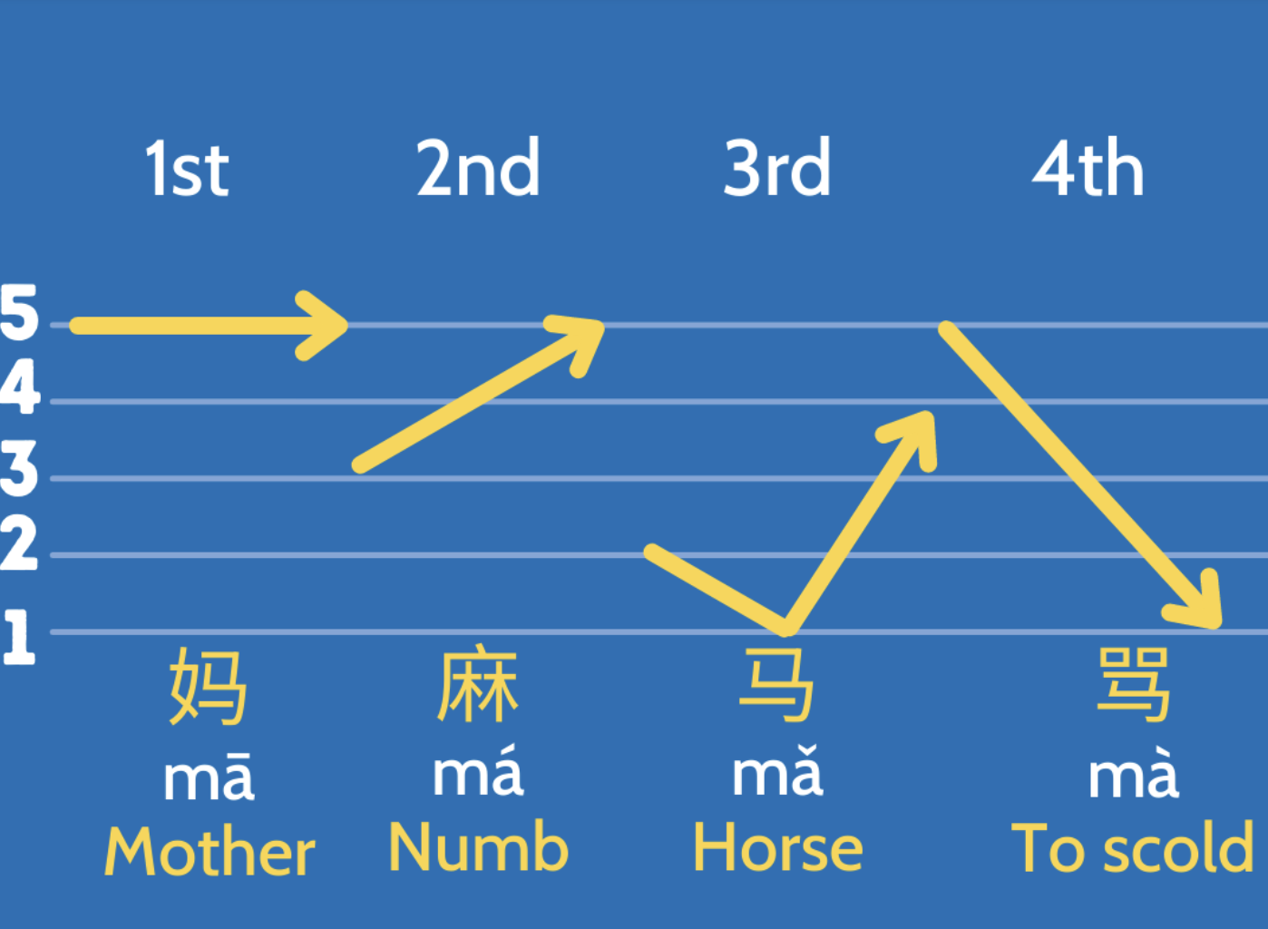
Tones (Introduction)

Slide 19
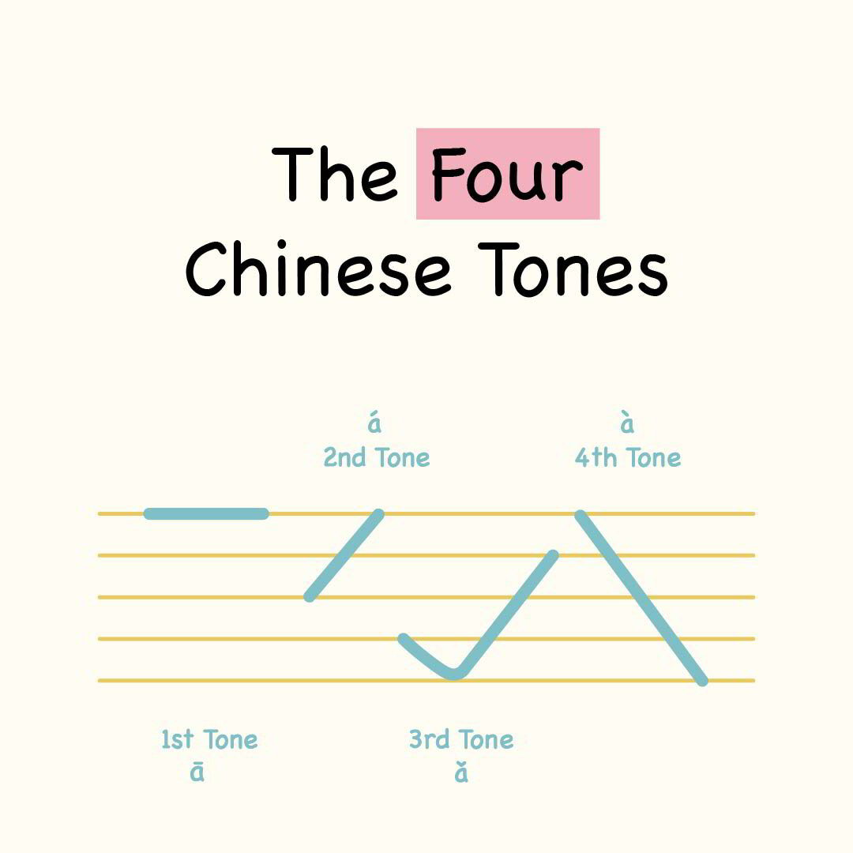
Tones
Different tones=different meaning!
5th neutral tone? (get into that later)
Visualise the sound of tones with how you write it
Flat
Rising
Falling and rising
Falling

Slide 20
Let‘s practice
Hā há hǎ hà
Kā ká kǎ kà
Mā má mǎ mà
Wā wá wǎ wà
Sā sá sǎ sà
Pā pá pǎ pà

Slide 21
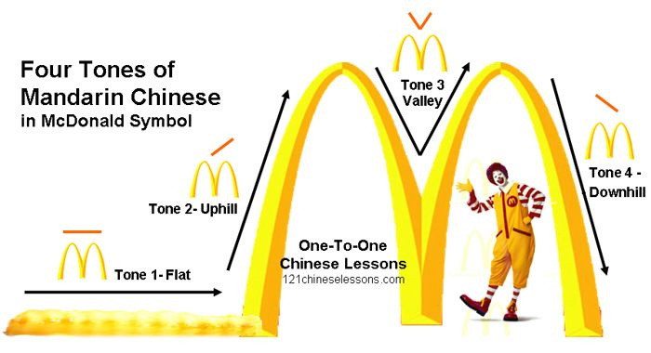
Tips

Slide 22
Questions?

Slide 23
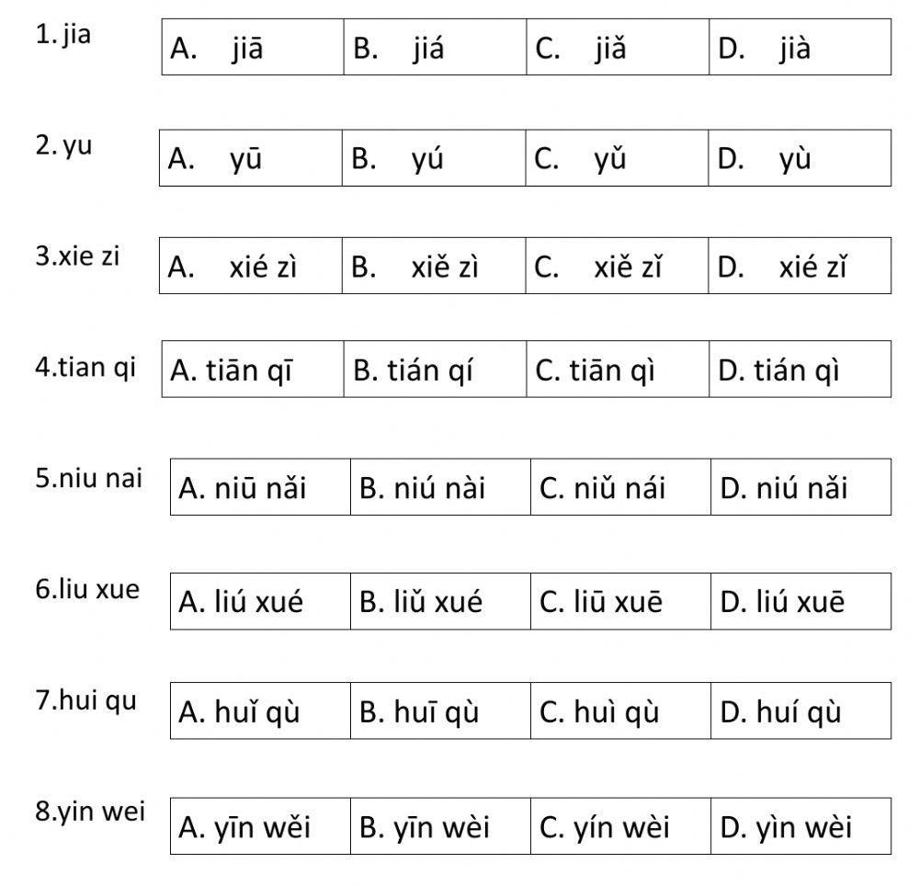
Test your listening
加
雨
寫字
天氣
牛奶
留學
回去
因為

Slide 24
Test your listening
加
雨
寫字
天氣
牛奶
留學
回去
因為

Slide 25
Questions?

Slide 26

1. 你好！Nǐ hǎo !
你 Nǐ：you
好 Hǎo：good
Meaning: Hello
Special rule: when two third tones are put together, the first character will be pronounced as the second tone, but written as third tone (unchanged)
Pronounced as: Ní hǎo

Slide 27
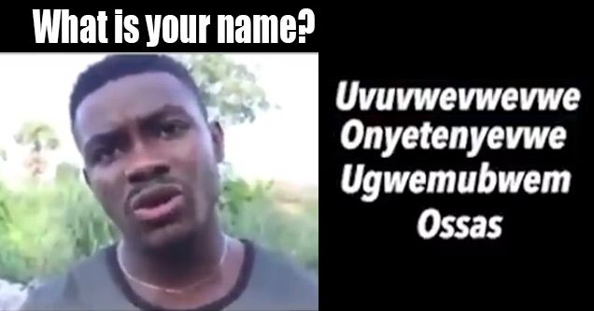
2. 我叫⋯⋯ Wǒ jiào
我 Wǒ ：I
叫 Jiào ：am called
Meaning: My name is…
Practical pronunciation: Rising part of the third tone is usually skipped, when followed by another word.
  Keep it FLAT & LOW

Slide 28
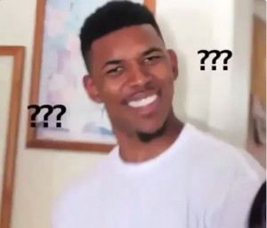
Small recap about the third tone
When followed by another third tone, the first character will be pronounced as the second tone.
When followed by any other tones, the first character will be pronounced as a half third tone.
  (skip the rising part)
  Keep it FLAT & LOW

Slide 29
Questions?

Slide 30

Combining the slides
你 好 ! 我 叫 David。
Nǐ hǎo. Wǒ jiào David.
Pronounce the tones as written.
Try it with a practical pronunciation.

Slide 31
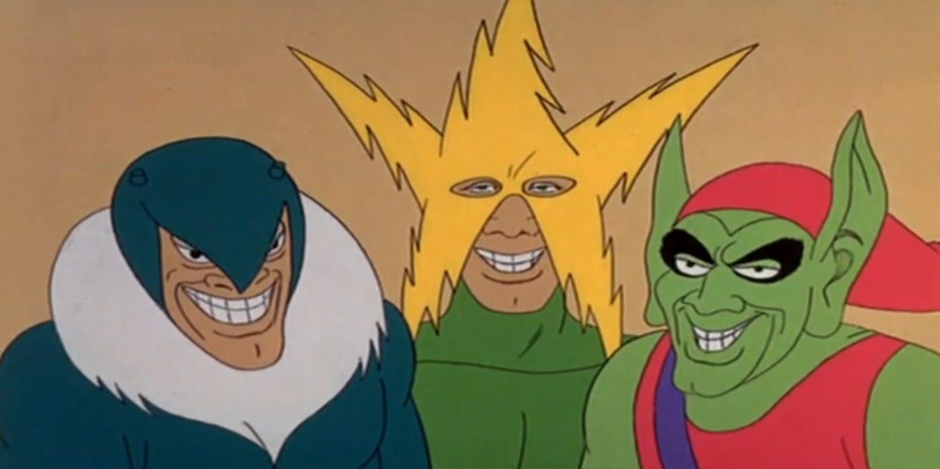
Group practice
Introduce yourselves with your groupmates. (repeat repeat repeat)
A: 你 好 ! 我 叫 (Your name)。
A: Nǐ hǎo. Wǒ jiào (Your name).
B: 你 好 ! (his/her name) ，我 叫 (Your name)。
B: Nǐ hǎo. (his/her name). Wǒ jiào (Your name).
Me and the boys practicing Mandarin together

Slide 32
Questions?

Slide 33

Perfect! Now you have learnt to say…
Hi! My name is…
What‘s next?

Slide 34

3. 我來自⋯⋯ Wǒ lái zì
我 Wǒ：I
來自 Lái zì ：come from
Meaning: I come from…
Remember how to pronounce the third tone practically?
德国Germany: Déguó
法国France: Fǎguó

Slide 35

4. 你呢? Nǐ ne?
你 Nǐ ：You
呢 Ne：question word
Meaning: And you?
Fifth tone: neutral
  In general: Quick stop at the end like „but“
  Since it is before a question mark, it is pronounced in a higher tone

Slide 36
Questions?

Slide 37
Group practice
A: 你 好 ! 我 叫 (Your name)。 我 來 自⋯⋯ 你呢?
A: Nǐ hǎo. Wǒ jiào (Your name). Wǒ lái zì Nǐ ne?
B: 你 好 ! (his/her name) ，我 叫 (Your name)。 我 來 自⋯⋯ 你呢?
B: Nǐ hǎo. (his/her name). Wǒ jiào (Your name). Wǒ lái zì. Nǐ ne?
C: ……

Slide 38
He / she / it
他 / 她 / 它
Tā tā tā

Slide 39

Well done! Today you learnt…
The five tones in Mandarin
Self introduction in Mandarin
  Hi, my name is… I come from… and you?
Practice more at home ☺

Slide 40

How to type Chinese tones (Not mandatory)
How to Type Pīnyīn (with TONES!! ā á ǎ à)
  by ABChinese (Youtube)
https://www.youtube.com/watch?v=4xxclxvrExI
0:25 Windows
1:42 Mac
3:10 Android
4:09 iOS

Slide 41
One last thing…
Thank you and goodbye!
谢谢，再见！
Xièxiè zàijiàn

