Slide 1


From high-momentum hadrons
and correlations to jets
Jana Bielcikova (CTU in Prague, Czech Republic)

Slide 2
A bit of history

Slide 3




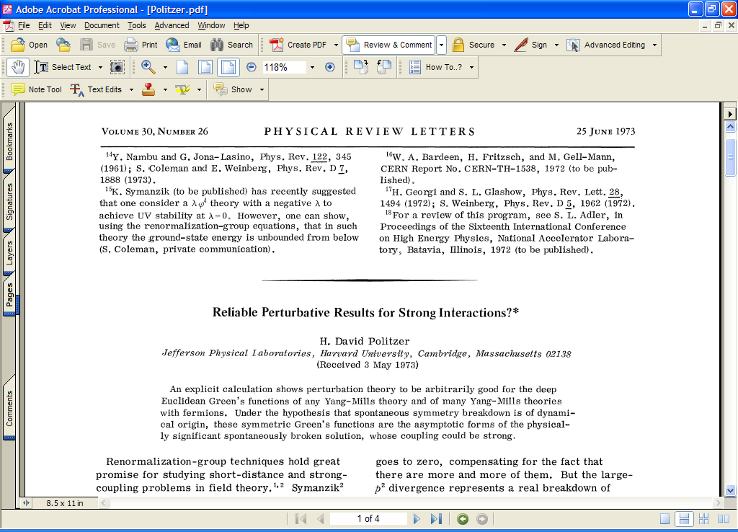
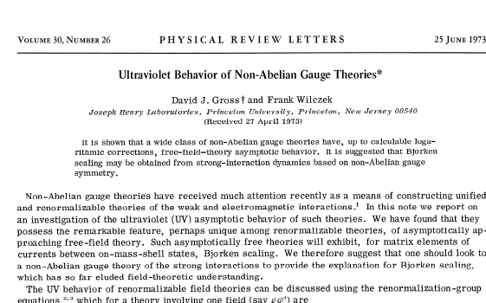
2023: 50th anniversary of QCD
QCD: Quantum ChromoDynamics
was born in 1973
Nobel Prize 2004:
Gross, Politzer, Wilczek:
"for the discovery of asymptotic freedom in the theory of the strong interaction"
David J. Gross
H. David Politzer
Frank Wilczek

Slide 4
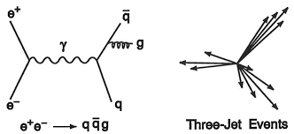
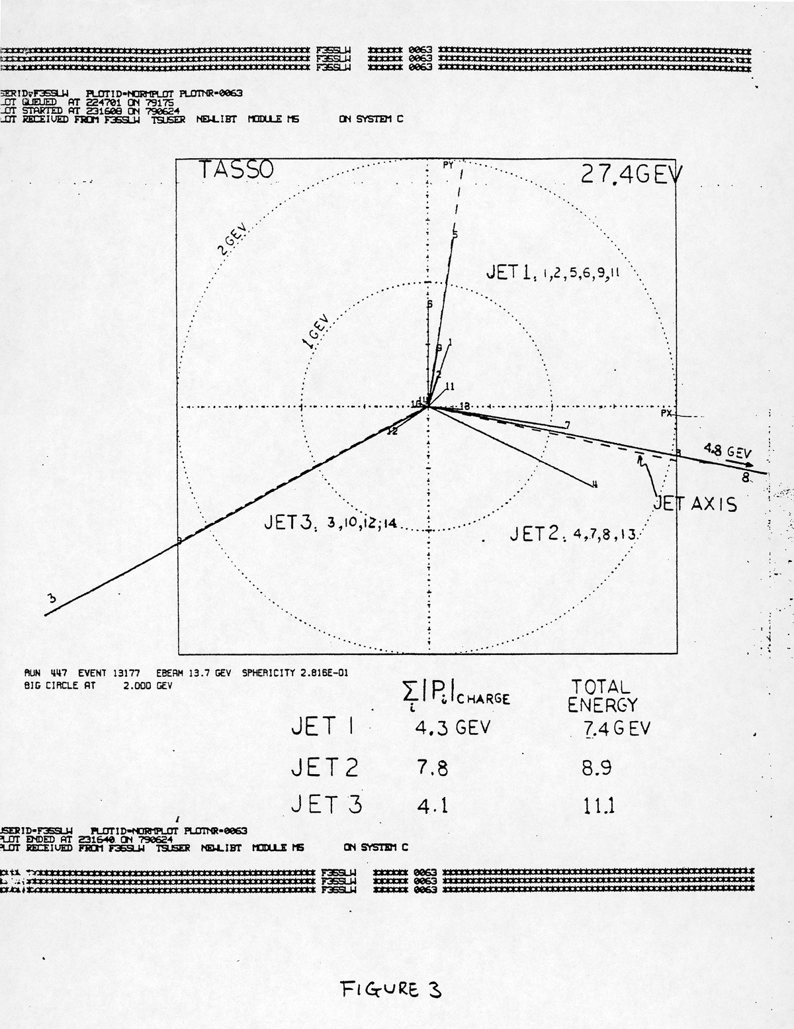
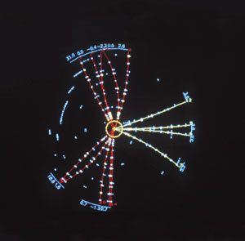
Gluon discovery (1979)
TASSO experiment: Event 13177, Run 447
the first evidence of the gluon
Physicists Sau Lan Wu and Georg Zobernig developed and programmed a method to search for planar three-jet events. At low collision energies, their searches produced no results. But when DESY’s PETRA accelerator began to produce collisions at 27.4 GeV, they succeeded. A week later (Jun 18) Bjørn Wiik presented the first event on behalf of the TASSO collaboration at the “Neutrino 79” conference in Norway and he placed it on the overhead projector as the last transparency:
the gluon had seen the light of (the scientific) day
Shortly after (Jun 26), Wu and Zobernig distributed the figure
in the internal TASSO Note No. 84.
3 jets of particles produced in
an electron-positron collision
https://www.desy.de/news/backgrounders/40_years_of_gluon/index_eng.html
https://home.cern/news/news/physics/four-decades-gluons

Slide 5
Gluon discovery
European Physical Society High Energy
and Particle Physics Prize, 1995.
The four prize recipients at the ceremony
in Brussels (Belgium).
Front row: Günter Wolf and Sau Lan Wu
Second row: Bjørn Wiik and Paul Söding

Slide 6
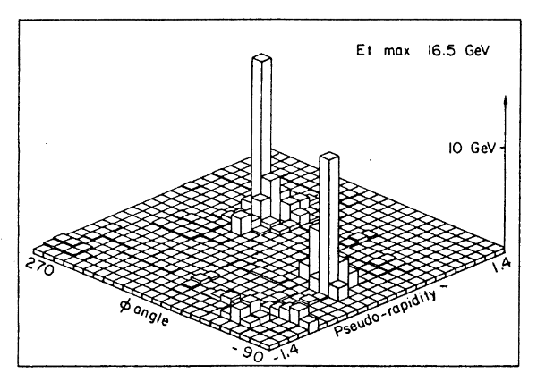
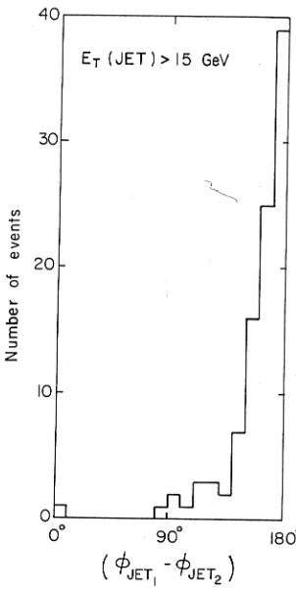
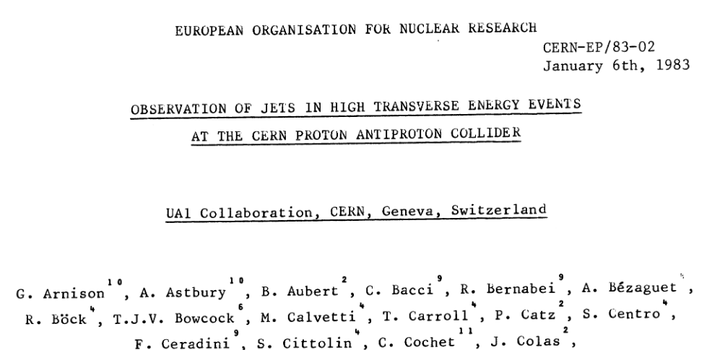
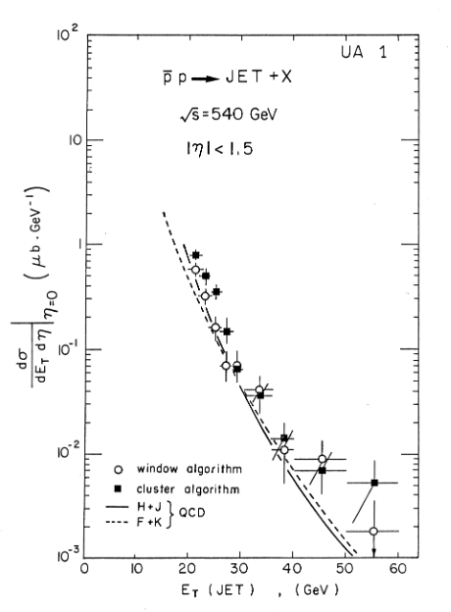
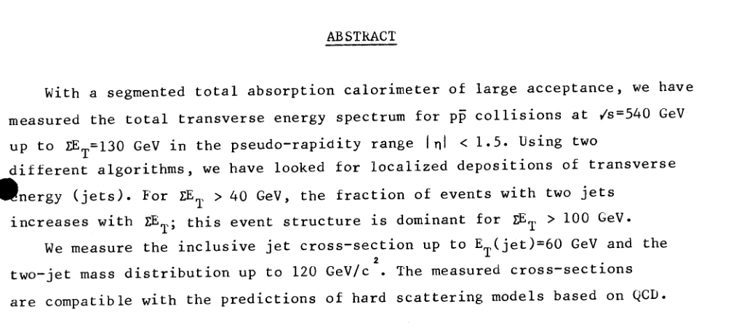
UA1: observation of jets
Back-to-back jets
Phys. Lett. B 123 (1983) 115-122

Slide 7
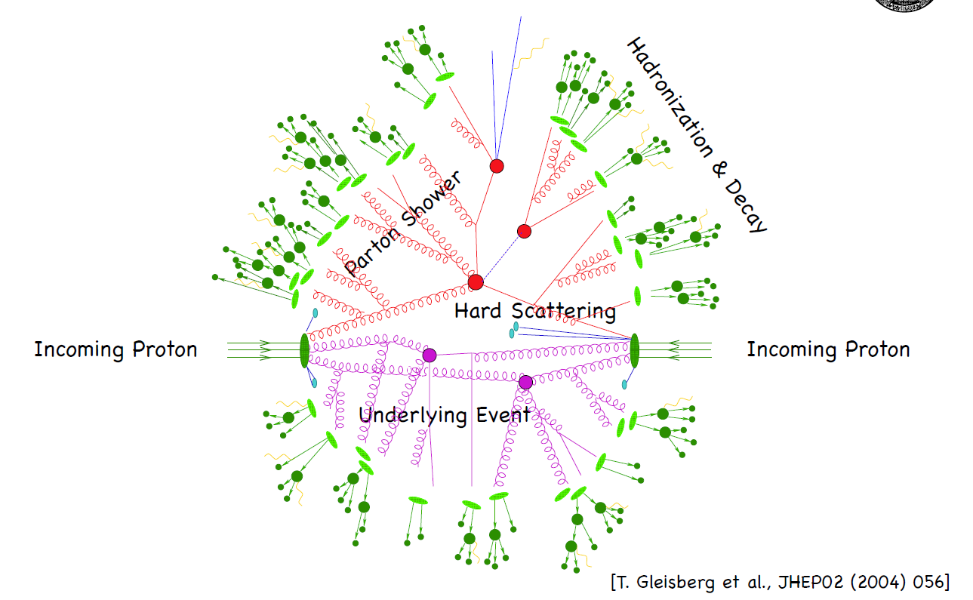
Q: What is a jet?
A: Jet is an image of the parent parton …
B: Jet is defined by an algorithm …
Hmm, but which one to use?

Slide 8

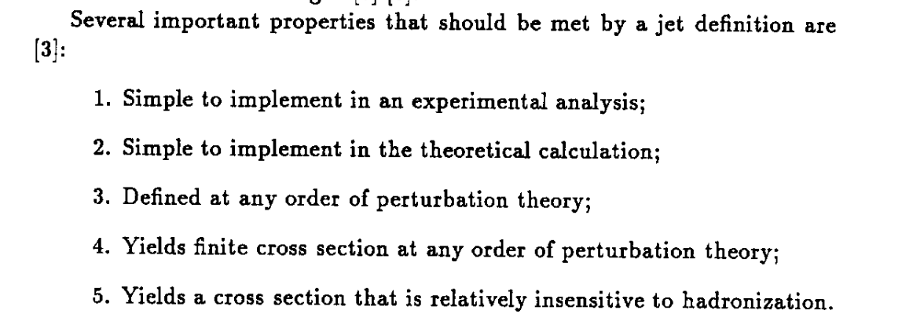
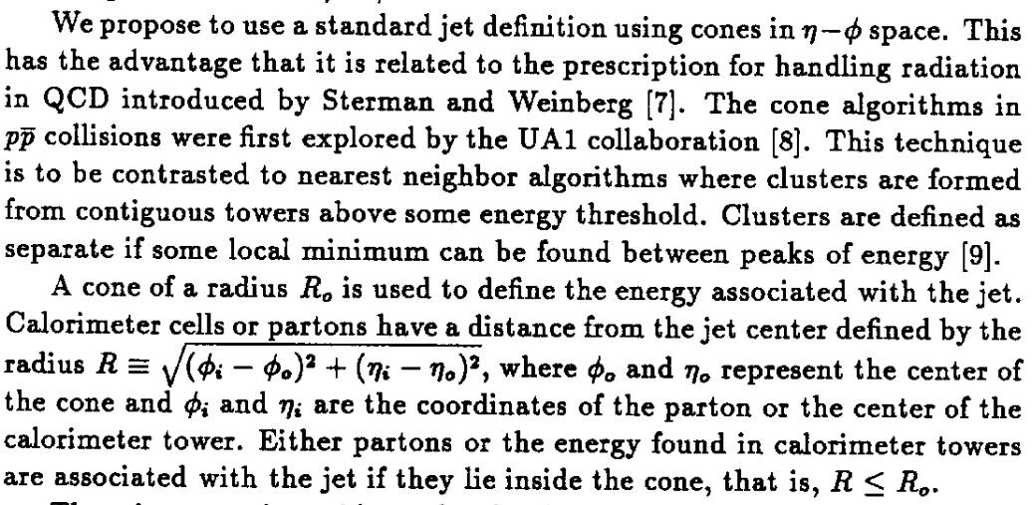
1990: the proposed standard …

Slide 9
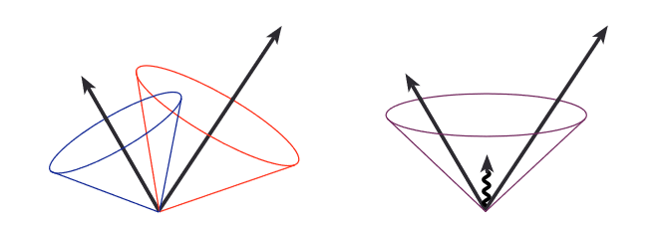
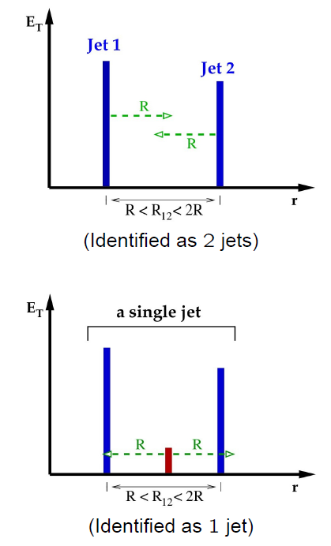
What should the jet algorithm fulfill?
From theoretical point of view:
Infrared (IR) safety:
→ algorithm should find jets that are not sensitive to addition of soft gluons
Cone clustering:
jet clustering begins around seed particles (arrows) with length proportional to energy.
JetClu algorithm
For example this potentialy dangerous
configuration is identified as 2 jets but
the addition of a soft gluon in the middle leads to a single jet!
courtesy Jay R. Dittmann
See also Blazey et al., hep-ex/0005012

Slide 10
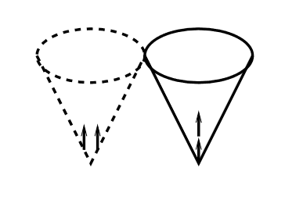
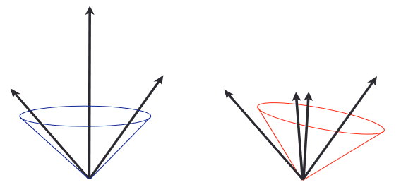
What should the jet algorithm fulfill?
2. Collinear safety:
→ jets should not be sensitive to collinear gluon emission
Left: configuration fails to produce a seed because its energy is split among several detector towers.
Right: this configuration produces a seed because its energy is more narrowly distributed
Seed dependence:
we can observe sensitivity to E_{T}
ordering of the particles that act as seeds.
courtesy Jay R. Dittmann
See also Blazey et al., hep-ex/0005012

Slide 11
What should the jet algorithm fulfill?
„boost“ invariance : algorithm should find the same jets independently of the boost along the beam
kinematic observables describing jets should be independent of details of the final state
algorithm should be equivalent on parton, particle and detector level
algorithm should be easily applicable in perturbative calculations
What about experimental aspects?
independence on detectors (segmentation, resolution, response to energy deposited)
algorithm should not increase effects of finite resolution of measurement (e.g. energy)
algorithm should be immune against multiple hard scatterings at high luminosity
(relevant for LHC and especially its high luminosity upgrade)
easy implementation and reasonable computational speed
possibility to identify all interesting jets

Slide 12
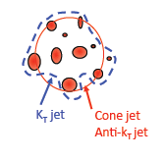
Jet reconstruction algorithms
In general, we divide jet algorithms to two classes“
A. Cone algorithms:
JetClu
Midpoint Cone
SISCone (Seedles Infrared Safe Cone)
Leading Order High Seed Cone (LOHSC)
typically with a „split-merge“ procedure
B. Sequential recombination algorithms:
cluster pair of objects relatively close in p_{T}
d_{ij} = min(p_{Ti}^{n},p_{Tj}^{n}) (Δη²+Δφ²)/R²,d_{i} = p_{Ti}^{n}
min(d_{i},d_{ij}): d_{i} -> a new jet, d_{ij} -> combine i,j
Recombination scheme needed:
E-scheme: simply adds the four-vectors
p-scheme: assumes zero particle mass
R: cone radius/resolution parameter
n = 2 : k_{T} (clustering starts from particles with small p_{T})
n = -2: anti-k_{T} (clustering starts from particles with high p_{T})
n = 0: Cambridge/Aachen (C/A)
(cares only about angular distance)

Slide 13
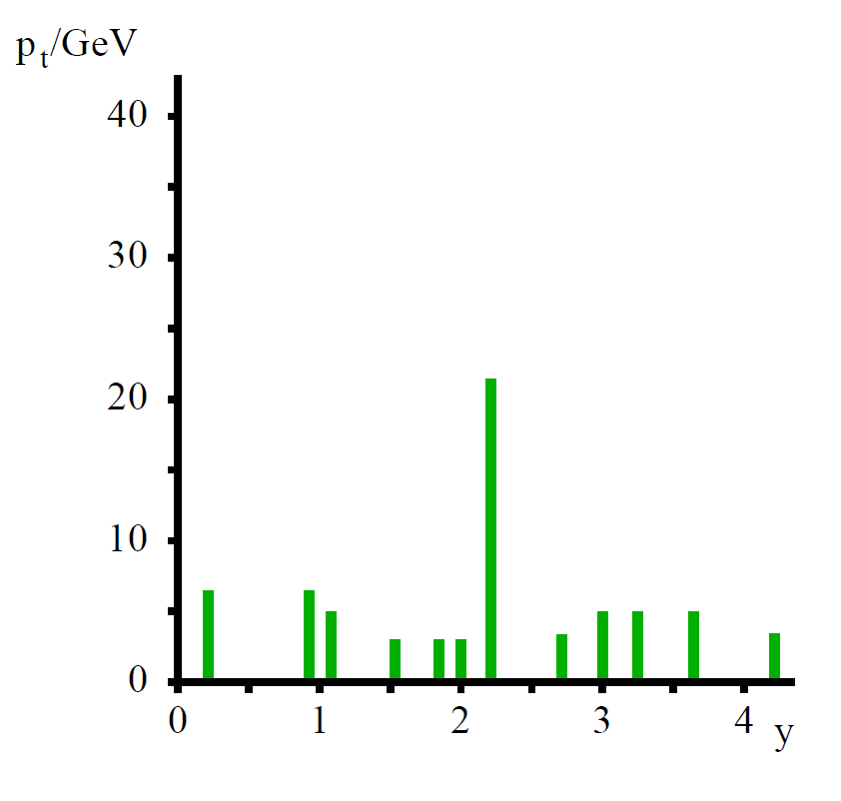
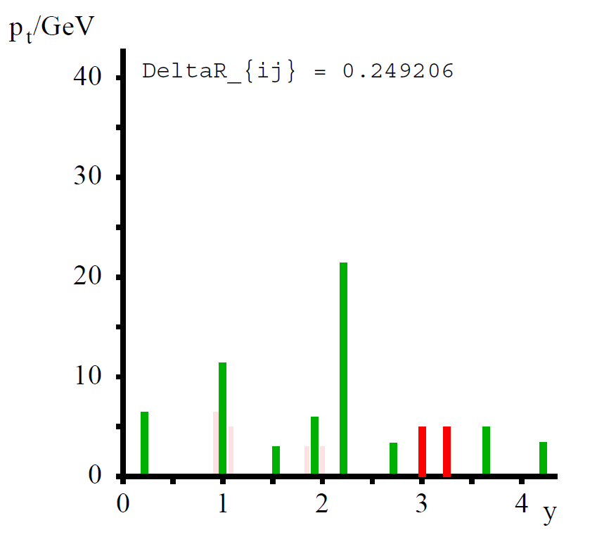
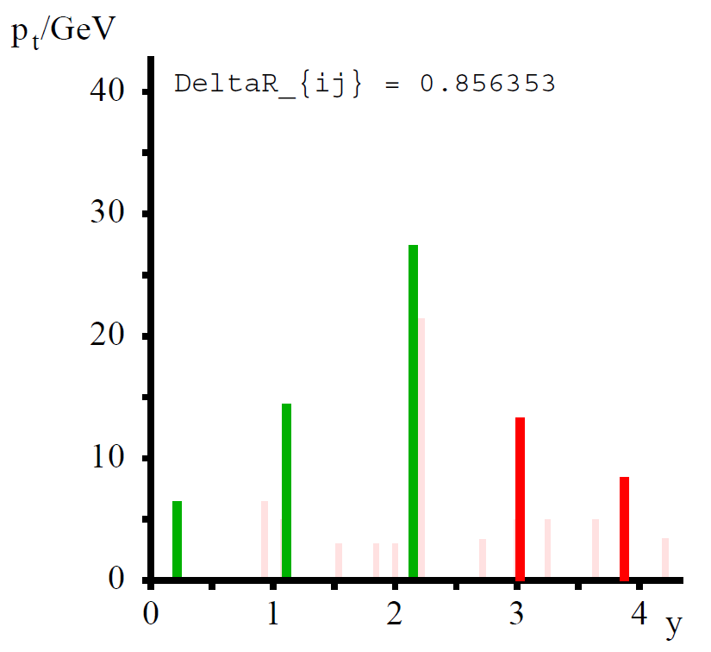
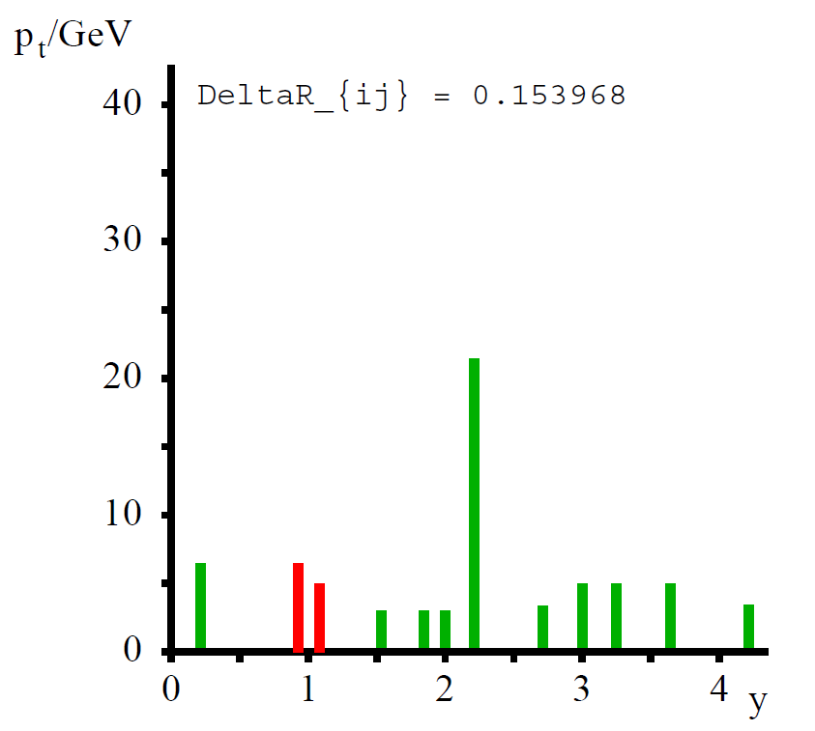
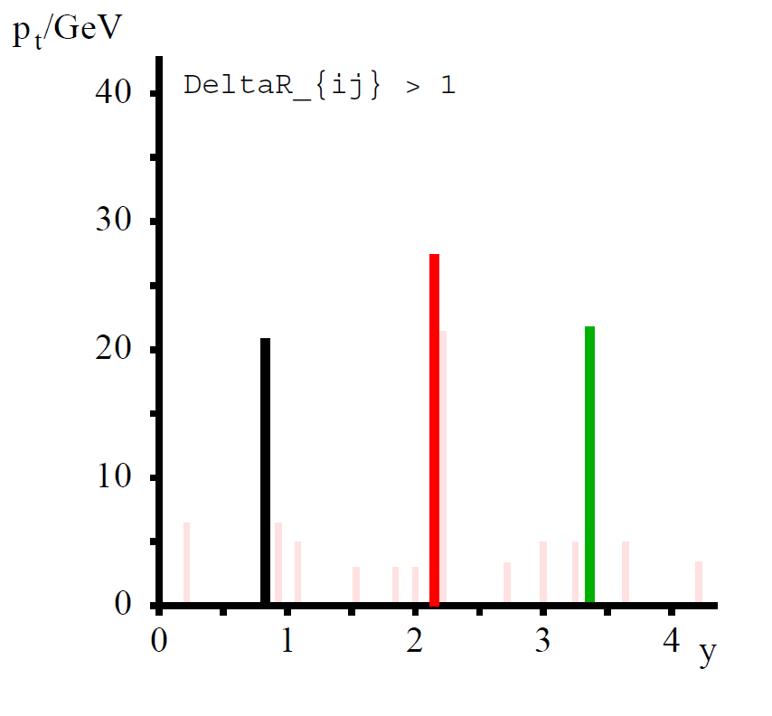
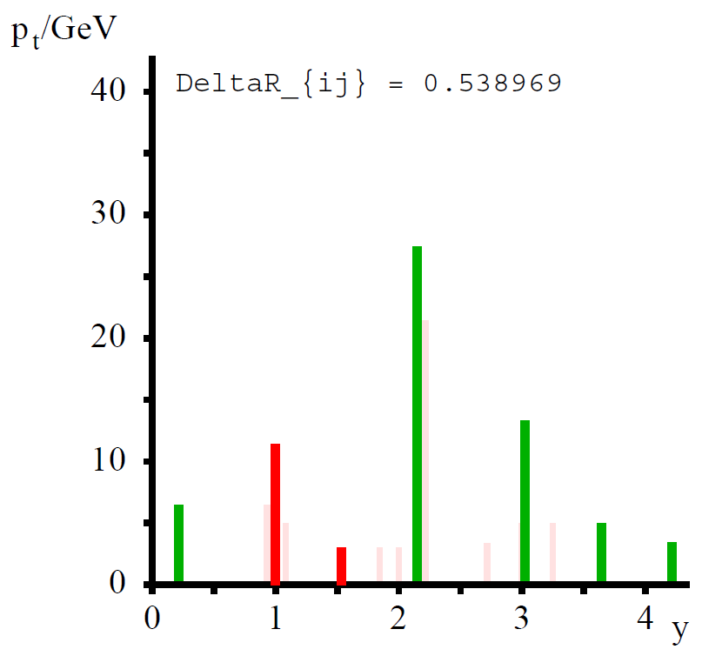
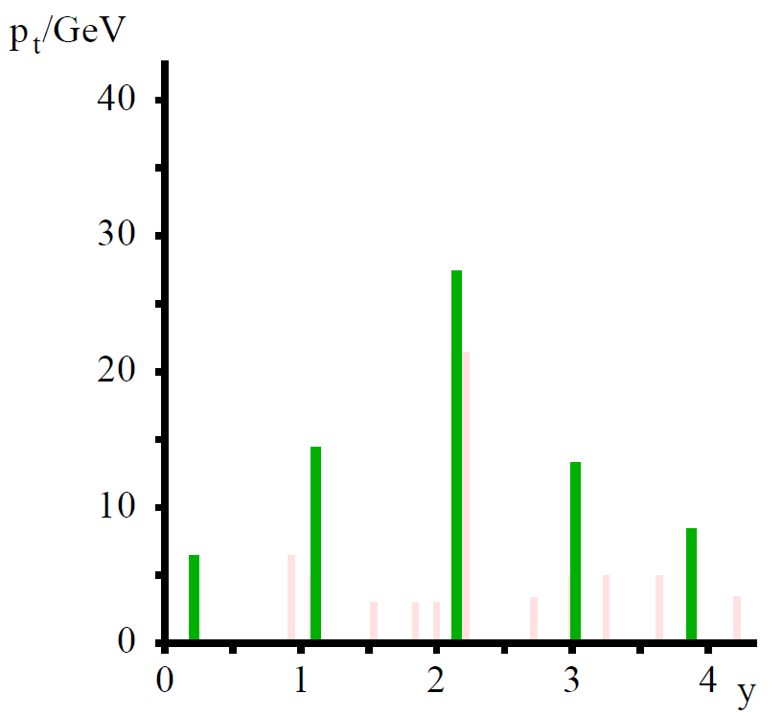
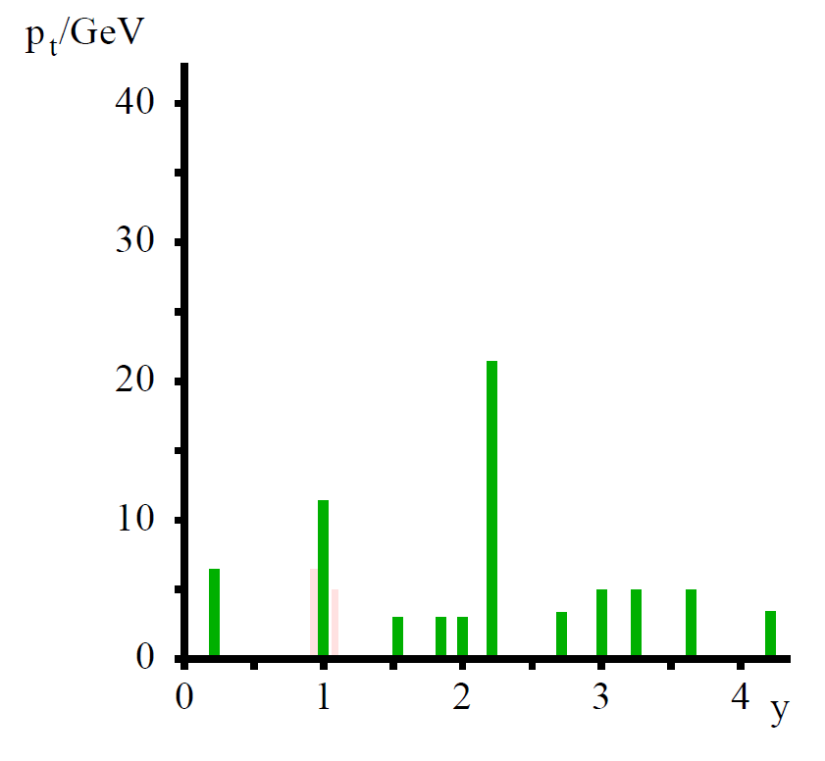
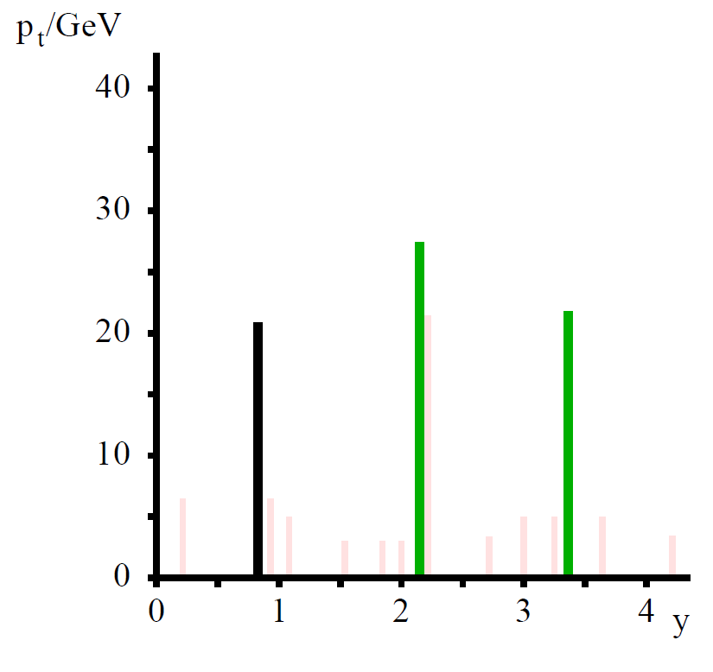
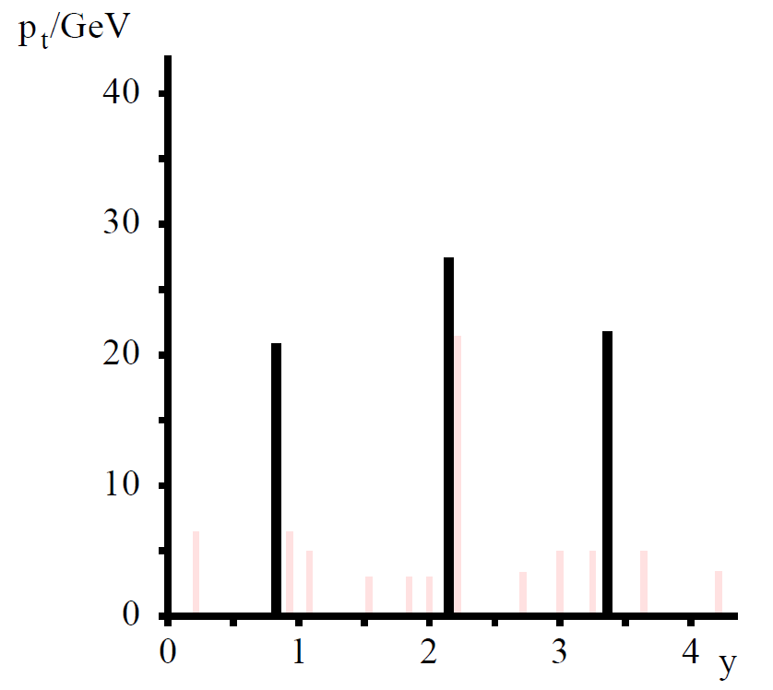
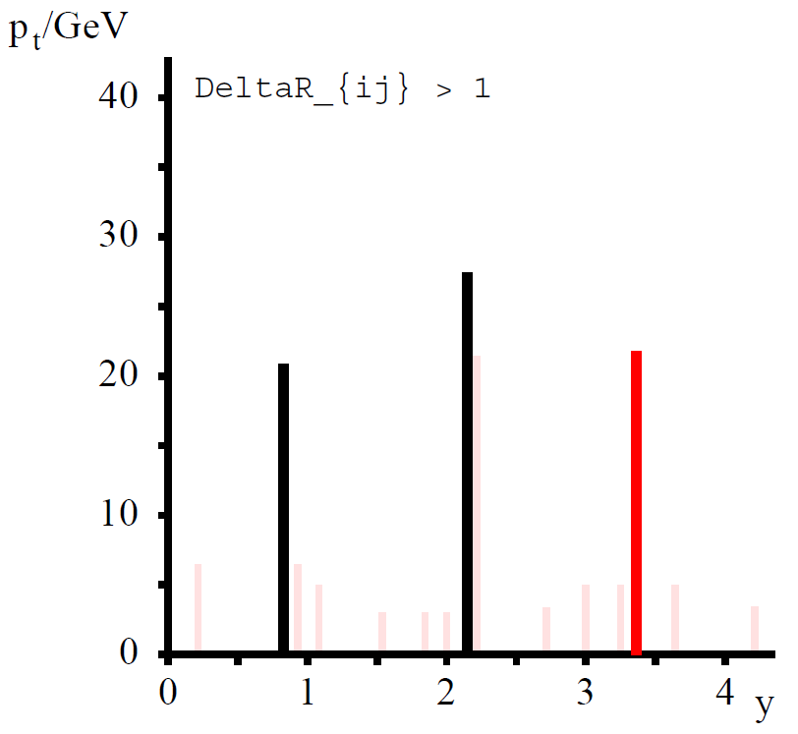
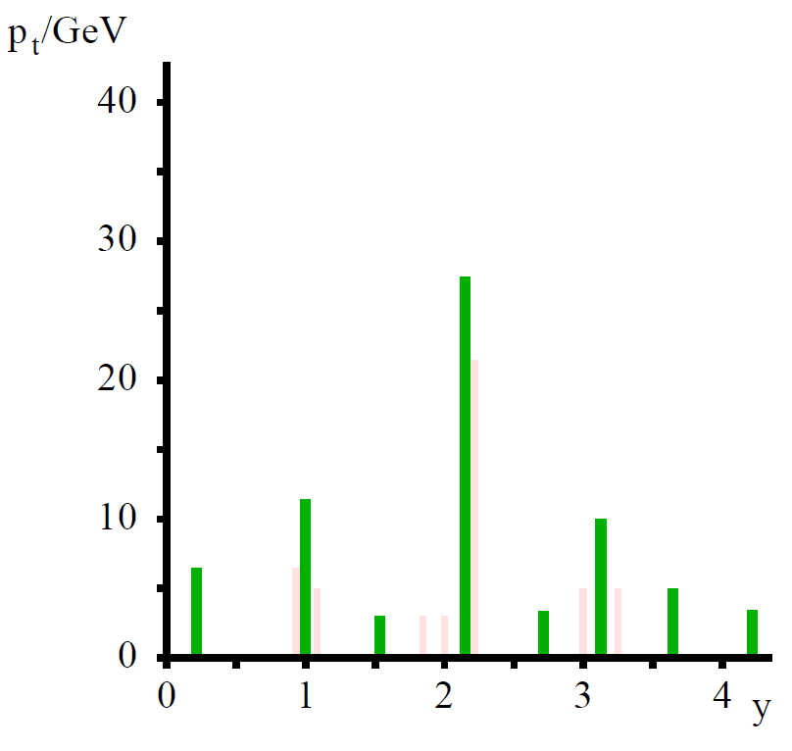
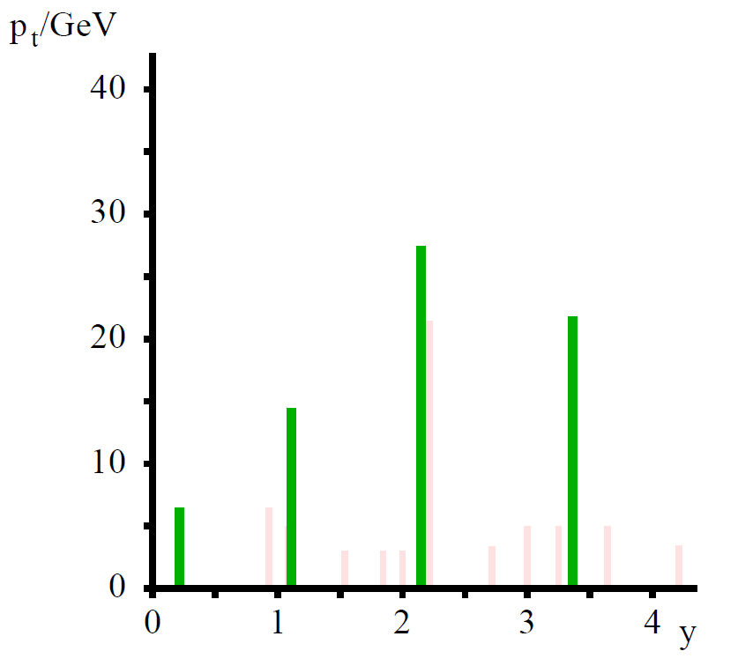
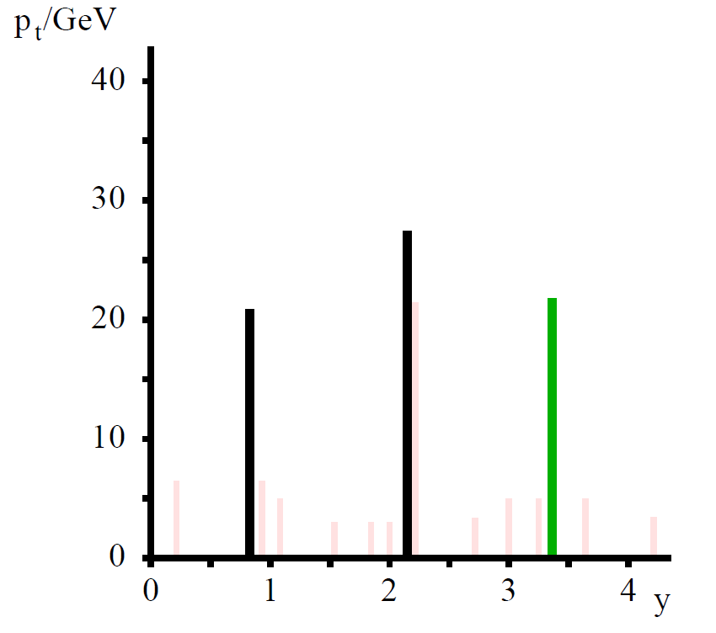
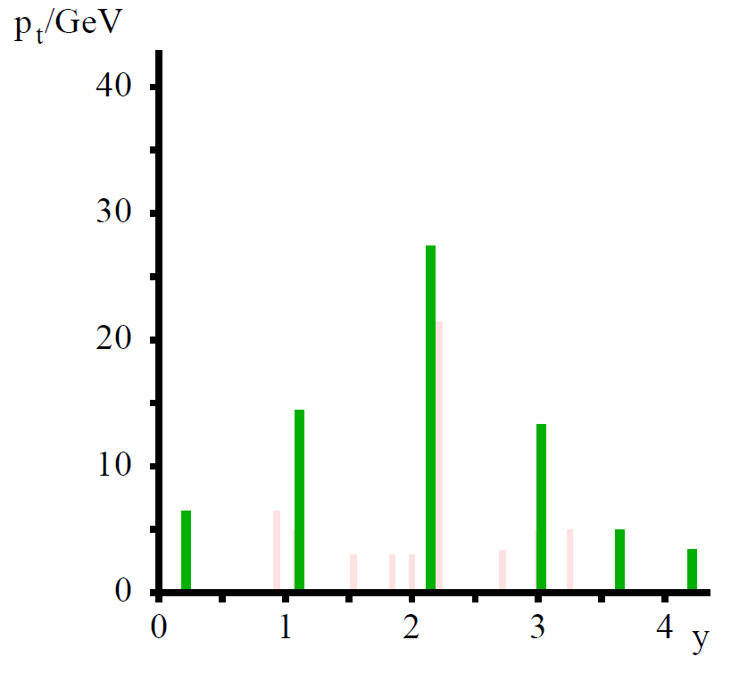
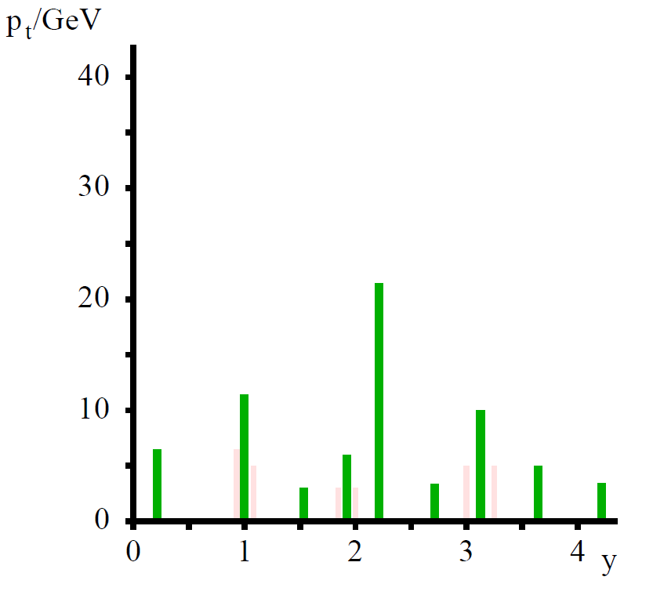
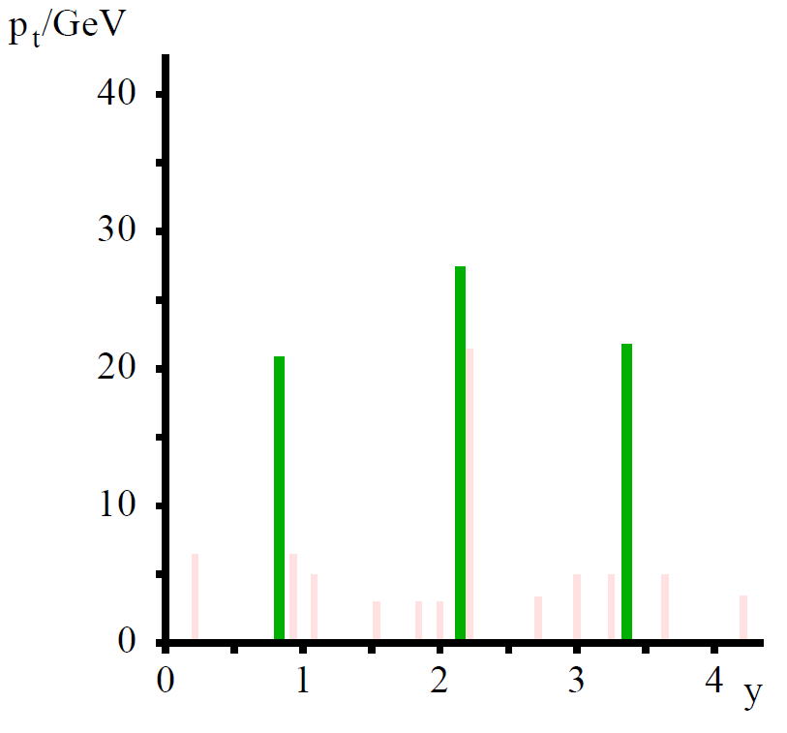
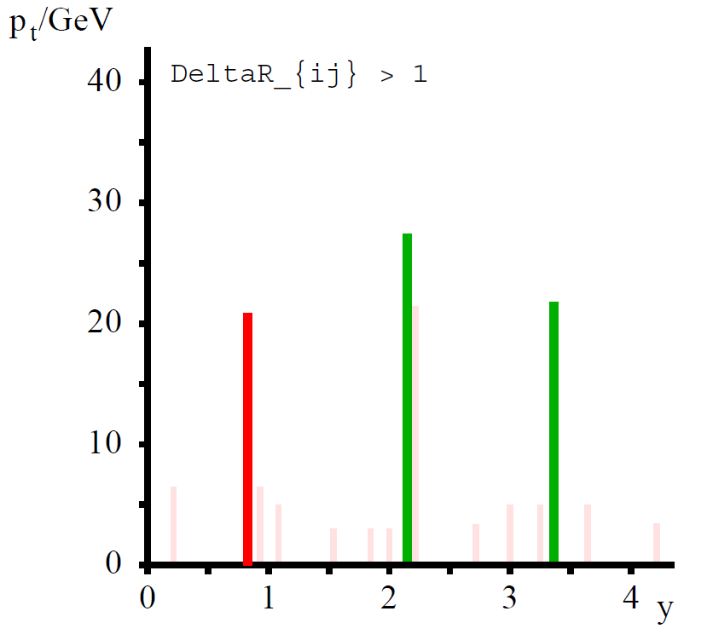
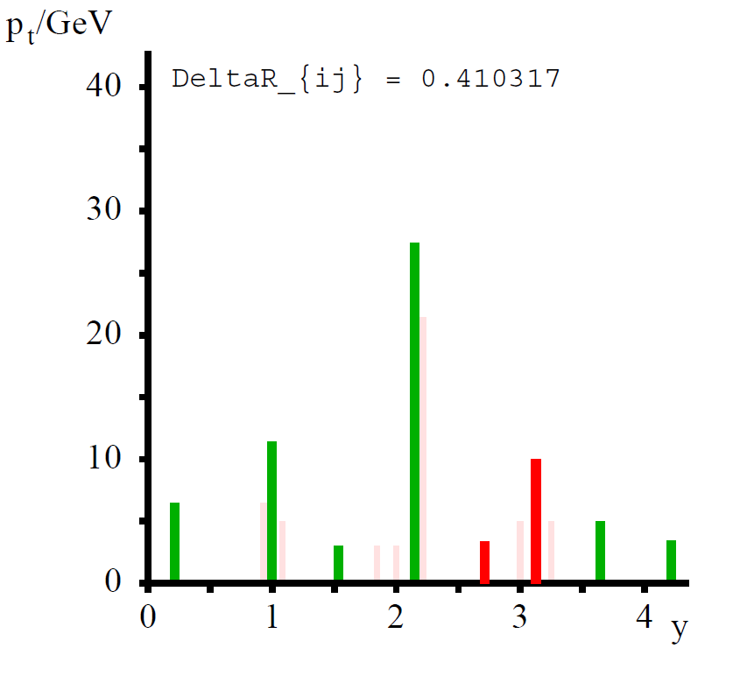
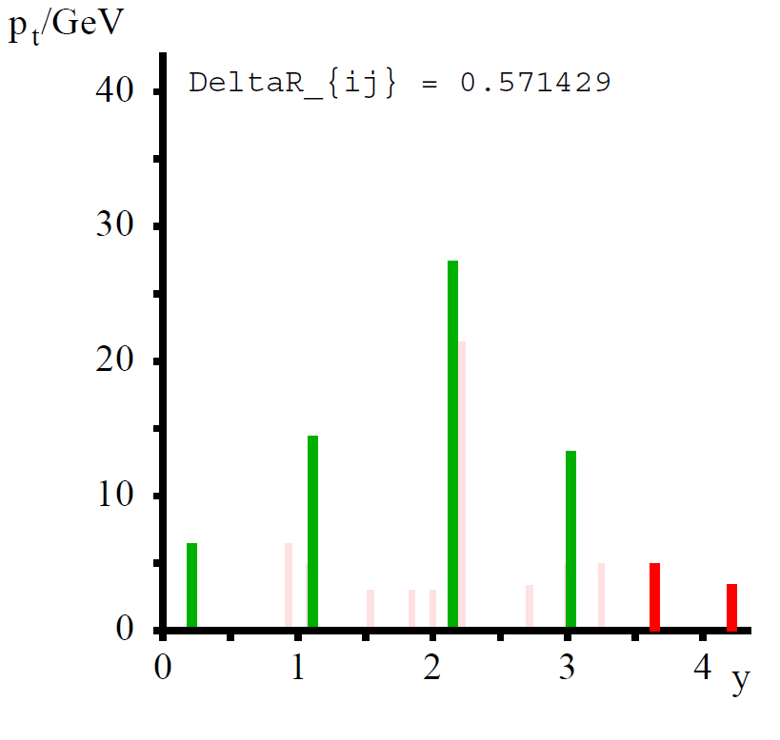
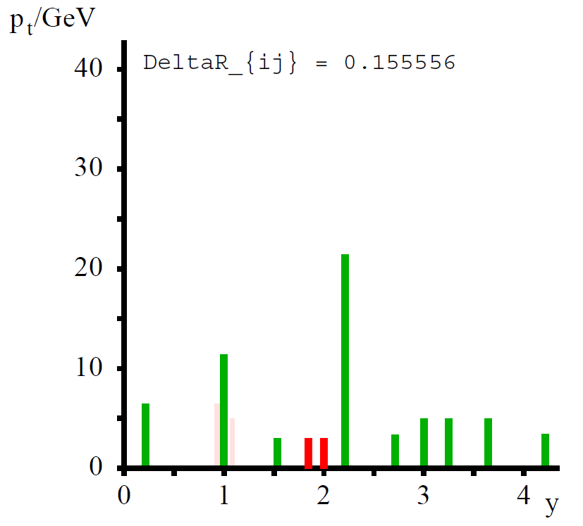
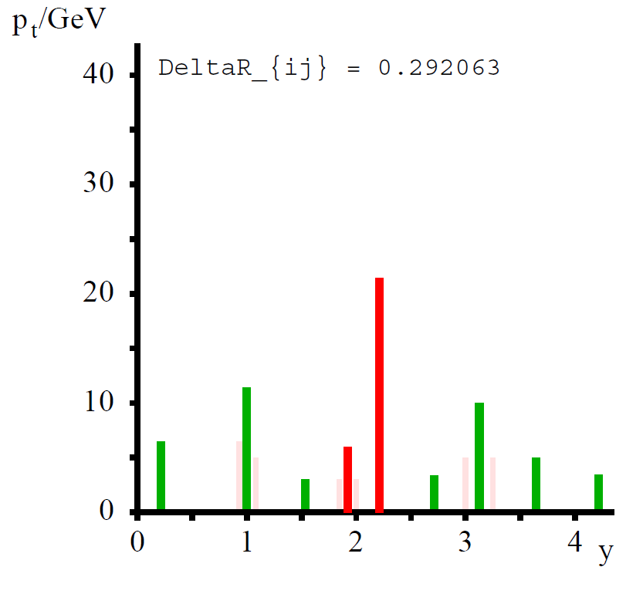
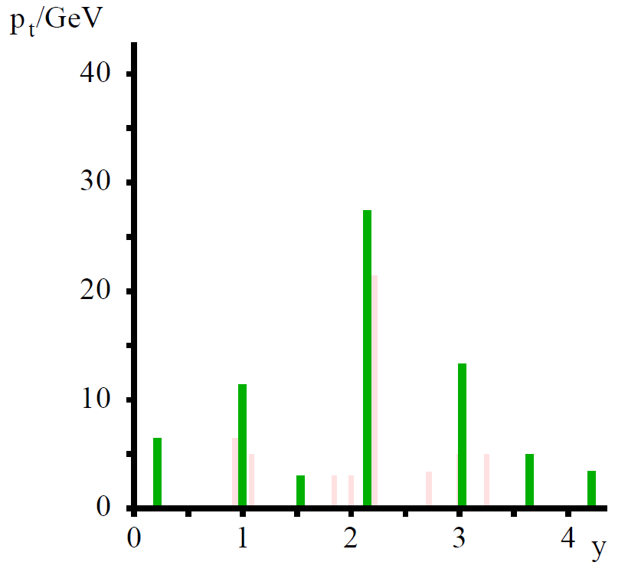
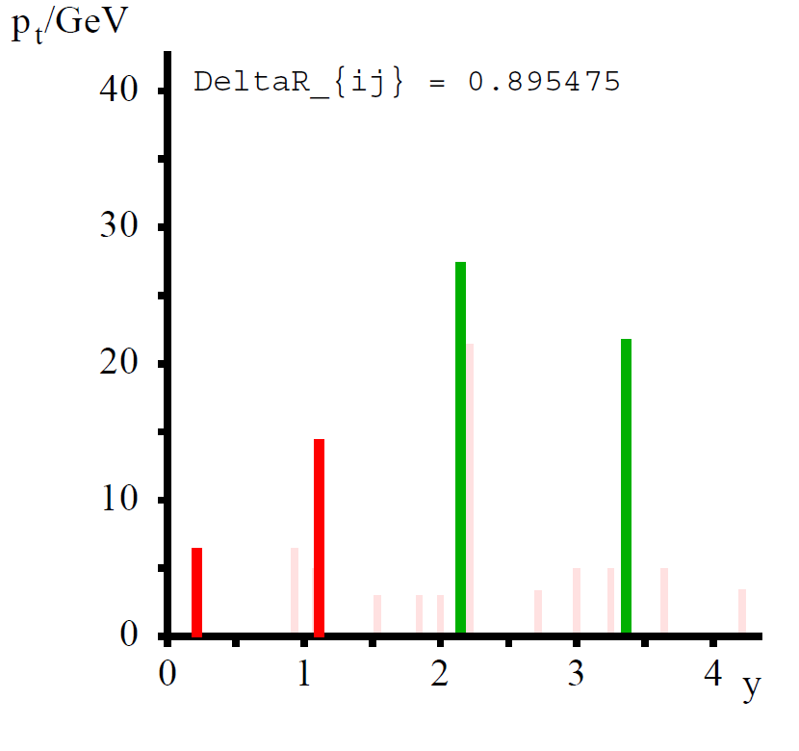
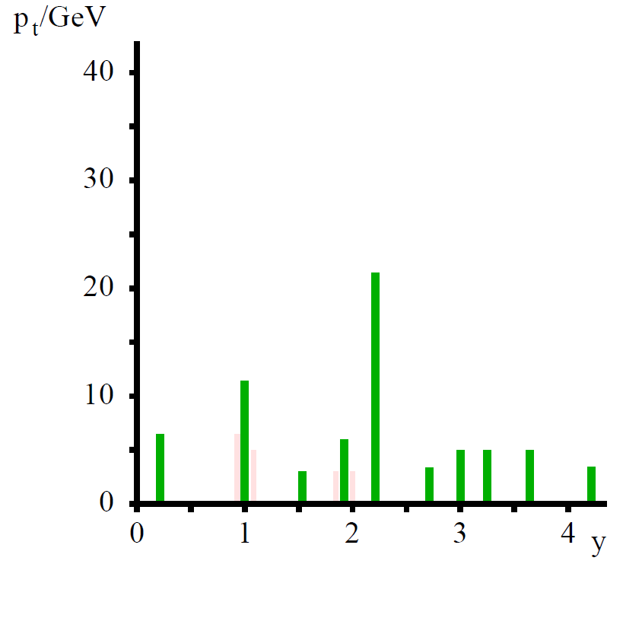
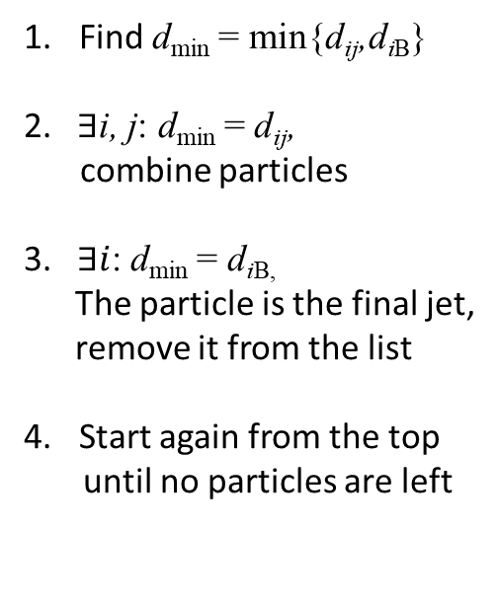


How does sequential recombination algorithm work?
$d_{ij}=\min\left(p_{ti}^{2p},p_{tj}^{2p}\right)ΔR_{ij}/R^{2}$ and $d_{iB }=p_{ti}^{2p}$
where$ΔR_{ij}^{2}={( y_{i}−y_{j})}^{2}+ {( φ_{i}−φ_{j})}^{2}$
Find d_{min} = min{d_{ij},d_{iB}}
2. $∃$i, j: d_{min} = d_{ij},
combine particles
3. $∃i$: d_{min} = d_{iB,}
The particle is the final jet,
remove it from the list
Start again from the top
until no particles are left
Courtesy M. Cacciari

Slide 14

Do I need to write the code myself?
No, just use:
M. Cacciari, G.Salam and G.Soyez, JHEP0804 (2008) 005
http://fastjet.fr/

Slide 15
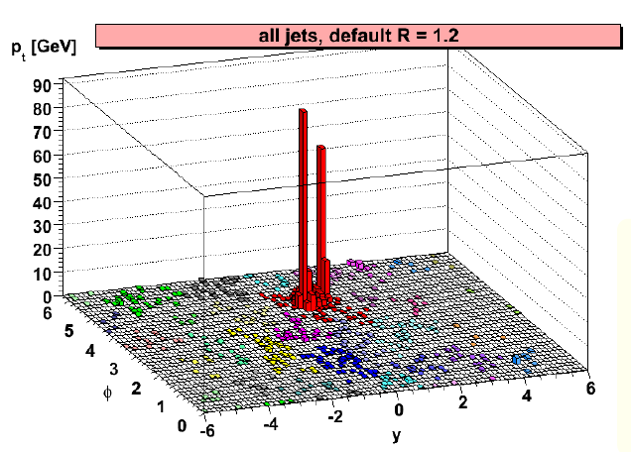
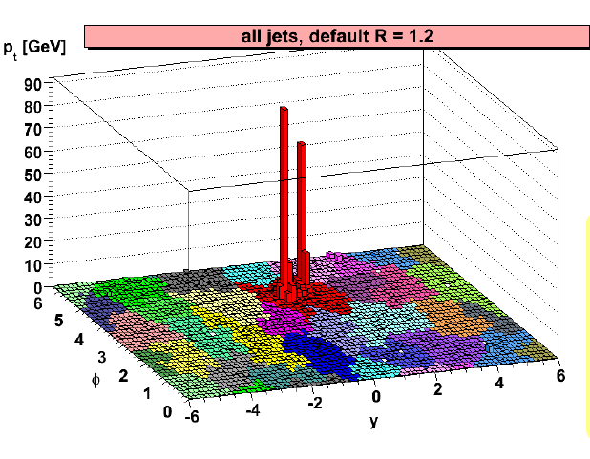
How to define jet area?
This is not that straightforward …
let us add to each event many „soft particles – ghosts“ (10⁻¹⁰⁰ GeV)
the jet area A is proportional to the number of particles in jet
Cacciari, Salam, Soyez (2008)

Slide 16
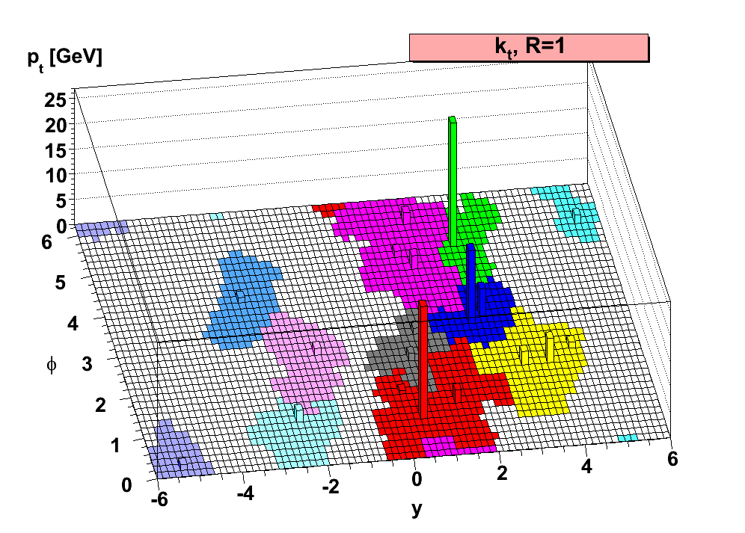
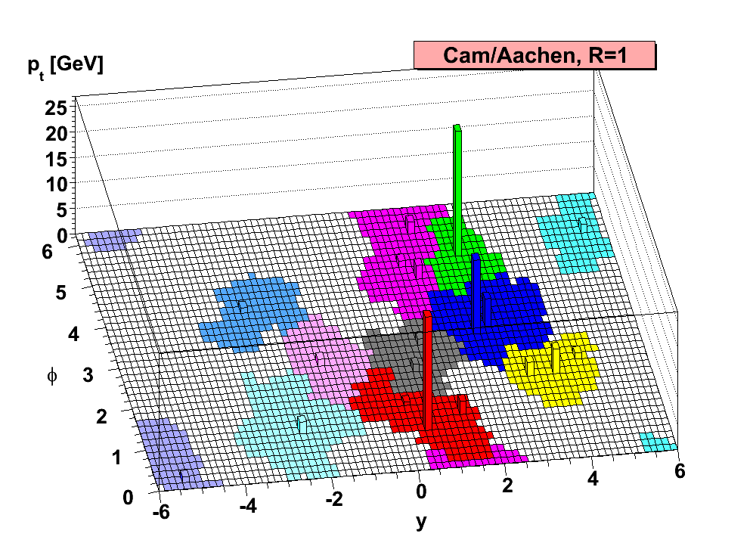
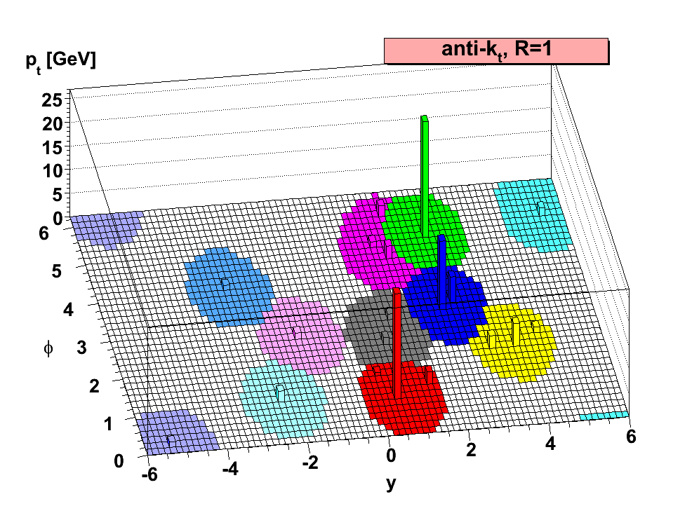
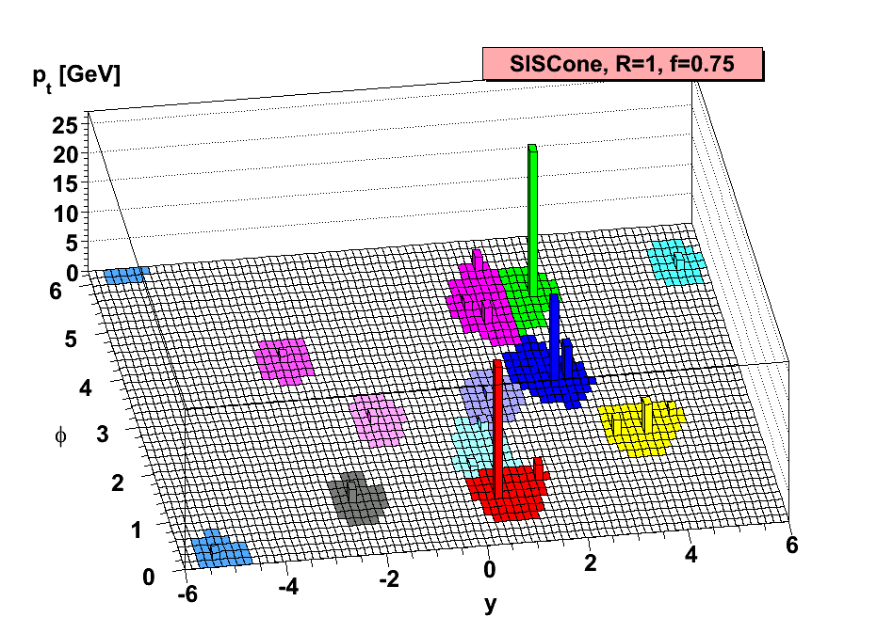
The same event seen by different jet algorithms…
M. Cacciari, G. P. Salam, G. Soyez: The anti-kt jet clustering algorithm,
JHEP 0804 (2008) 063, arXiv:0802.1189v2 [hep-ph]

Slide 17


Does the background influence jet?
YES, it is the so called „back-reaction“
no background
embedded in background
loss
gain
courtesy M. Cacciari

Slide 18

Sensitivity of jet algorithms to presence of background
courtesy M. Cacciari
The anti-k_{t} algorithm is the least sensitive to the „back-reaction“
from background → suitable to be used in A+A collisions
Cacciari, Salam, Soyez: Catchment Area of Jets, JHEP 0804 (2008) 005, arXiv:0802.1188ss

Slide 19
Let us now move to heavy-ion collisions and QGP exploration …

Slide 20

Tomography of QGP
Initial
state
Hard
collisions
QGP
phase
Expansion
Hadronization
and freeze-out
Time 0 ~ 0.5 fm/c 10 fm/c
… the lifetime of QGP is very short

Slide 21



QGP tomography
CT (Computed Tomography) in medicine
QGP lifetime is very short
in-situ probes needed
The probe enters to medium from outside
The probe is created together
with medium and propagates
through the medium
𝜏_{b}~ 0.02 fm/c < 𝜏_{c} ~0.07 fm/c < 𝜏_{QGP} ~1 fm/c
Photons, W and Z bosons:
do not carry color charge, bring information about initial state
Jets, heavy quarks, quarkonia :
originate from initial hard scattering
of partons, which carry a color charge, interact with nuclear matter

Slide 22

High-p_{T} particle production pp collisions
p+p:
Hard parton scattering: a large Q² process
→ initial phase of a collision << 1 fm/c
can be calculated in perturbative QCD
It is followed by a parton shower
→ partons eventually hadronize and form jets
Collinear factorization:
Parton distribution function
Matrix element
Fragmentation
function
measured in DIS
initial state (saturation?)
pQCD
e⁺e⁻

Slide 23

High-p_{T} particle production A+A collisions
Parton distribution function
Matrix element
Fragmentation
function
measured in DIS
initial state (saturation?)
pQCD
final state effects
I. Vitev, QM2008
Parton energy loss in medium:
elastic scatterings
gluon radiation
Depends on:
color charge
quark mass (dead cone effect)
path length in medium
Parton interaction with medium not trivial,
depends on strength of coupling, dynamics of fireball
… challenge for theorists
→ see talk by Carlos Salgado
Goal: Use in-medium parton energy loss
to quantify medium properties.

Slide 24


Slide 25
Models for medium response in a nutshell
Slide courtesy Y. Tachibana

Slide 26
JETSCAPE
Modular framework, allows for study of different physics concepts in a consistent environment.
Applicable to full range of HI phenomenology.
Bayesian analysis enables systematic
model-to-data comparison
JETSCAPE “PP19” tune provides reasonable agreement with experiments
and PYTHIA at mid-rapidity |y|<2.
slide courtesy C. Park
arXiv preprint arXiv:1903.07706 (2019), https://github.com/JETSCAPE/JETSCAPE

Slide 27


Sensitivity of different observables
jet
single h
Surface bias dependence:
single hadron and jet-hadron
observables: strong surface bias
di-hadron correlations: show less bias
γ or Z triggered: offer unbiased measurement
R
h
Renk, Eskola, PRC 75, 054910 (2007)
h - h
jet - h
γ - h
T. Renk, YaJEM
h

Slide 28

Dialing various physics phenomena:
collision system size
A + A
p + A
p + p
“hot/dense QCD matter”
final state effects
thermal and collective
particle production (flow)
“cold nuclear matter”
initial state effects
shadowing and gluon
saturation
“vacuum”
reference
Centrality:
level of overlap of the colliding
Lorentz contracted nuclei
A very interesting physics program on its own:
high multiplicity pp collision studies
to look for onset of QGP formation

Slide 29

Nuclear modification factor (R_{AA})
… the way to compare an observable in A+A
collisions to the reference (pp or peripheral A+A)
Glauber’s picture:
N_{part} = 7
N_{bin} = 12
N_{bin}/σ_{inel}^{NN}
R = 1: A+A collision is a
superposition of pp
collisions
R < 1: suppression of particle
production (quenching)
Soft processes scale with N_{part}
Hard processes scale with N_{bin}

Slide 30



About 20 years ago at RHIC: jet quenching observed
Single hadron
√s_{NN} = 200 GeV
Di-hadron correlations
Azimuthal correlations
of high-p_{T} particles
as a proxy of jet reconstruction
R_{AB}
Trigger
Associated
Δφ
4 < p_{T}(trig) < 6 GeV/c
Associated
STAR: PRL 91 (2003) 072304
STAR, PRL 90 (2003) 082302
Central Au+Au collisions at 200 GeV:
particle production at high p_{T} is suppressed
disappearance of away-side peak
at intermediate p_{T}
Suppression/disappearance not observed in d+Au
→ it is a final state effect
The matter created
in central Au+Au
collisions at RHIC is “opaque to jets”
A+A
flow
p+p

Slide 31




Jet-like correlations at RHIC
8 < p_{T}(trig) < 15 GeV/c
8 < p_{T}(trig) < 15 GeV/c
Near side:
no suppression
R_{AA}
increasing p_{T}(assoc)
Away side:
strongly suppressed
to level of R_{AA}
no dependence on z_{T}
STAR, PRL97 (2006) 162301
Is there a punch through? YES
- away-side yield is suppressed but finite and measurable
- suppression without angular broadening or medium
modification
Correlated yield is related to ratio
of di-hadron to single hadron
fragmentation functions
31

Slide 32


Collision energy dependence of hadron R_{AA}
2010: SPS + RHIC + LHC
LHC Run1 FINAL
ATLAS: JHEP 1509 (2015) 050
ALICE: PLB 720 (2013) 52
CMS: EPJ C72 (2012) 1945S
RHIC Beam Energy
Scan
Suppression of charged hadron production at large energies
R_{AA}(LHC) < R_{AA}(RHIC)
increase of R_{AA} with p_{T} but even at p_{T} ~ 100 GeV/c R_{AA}< 1
although R_{AA} is known to be limited in sensitivity
to models of quenching, data excluded some of them
The quenching disappears around √s_{NN} = 27 - 39 GeV

Slide 33



Di-hadron correlations at RHIC brought another surprise … existence of a ridge …
d+Au, 40-100%
STAR preliminary
Au+Au, 0-5%
1st Hard Probes conference: 2004
from D. Magestro (STAR)
talk
3 < p_{T}(trig) < 6 GeV
2 < p_{T}(assoc) < p_{T}(trig)
33

Slide 34




The ridge phenomenon in Au+Au collisions
d+Au 200 GeV
3+1D viscous hydro
STAR
participant
spectator
A
A
Alver, Roland,
PRC81 (2010) 054905
0-12% Au+Au 200 GeV
“jet”
Schenke, Jeon, Gale,
PRL 106 (2011) 042301
ridge
Additional near-side correlation in pseudorapidity observed in central
Au+Au collisions at RHIC in 2004.
STAR
Many physics scenarios have been suggested
(R. Hwa called it “ridgeology”)
Current interpretation: initial state fluctuations
give rise to a new „triangular flow“ (v₃).
p_{T}^{trig}=3-4 GeV/c, 2 GeV/c <p_{T}^{assoc}< p_{T}^{trig}
STAR: PRC80 (2009) 064912
34

Slide 35




LHC: ridge is present also in small systems!
High multiplicity pp @ 7,13 TeV
Common hydrodynamical origin?
But can hydrodynamical models be
reliably applied in small systems?
Initial state effects?
gluon saturation,
extended color connections
in longitudinal direction
Final-state parton-parton
induced interactions?
Important are studies of
multiparticle correlations
CMS, JHEP09 (2010) 091
p+Pb @ 5.02 TeV
CMS, PLB 718 (2012) 795
LHCb, Phys. Lett. B762 (2016)
ALICE, PLB 719 (2013) 29
35

Slide 36



Evidence for collectivity in p-Pb?
CMS, PLB 742 (2015) 200
Mass ordering in v₂ resembling hydro picture
observed earlier at low p_{T} in p, π and K
by ALICE.
Confirmed by the CMS data for Λ and K⁰_{S}.
ALICE: PLB 726 (2013) 164
CMS, PRL 115 (2015) 012301
Multiparticle correlations (4-8)
as well as Lee-Yang-Zero studies
give consistent “v₂” values.
Proof of collectivity in small systems.
Studies of high-multiplicity pp and p+A
Collisions remains still a very active area
also to look for jet quenching effects so far
no signals were found …
36

Slide 37
Reconstructed jets

Slide 38




LHC: the jet machine
CMS
ALICE
ATLAS
38

Slide 39



Dijet asymmetry in central Pb+Pb collisions
ATLAS: PRL 105 (2010) 252303
Dijet asymmetry observed in central Pb+Pb collisions, without angular decorrelation.
39

Slide 40





Where did the energy go?
CMS, PRC 84 (2011) 024906
φ₂
p_{T} of track
courtesy Y. J. Lee (CMS)
φ_{dijet}
φ₁
Missing p_{T}:
increases with A_{J}
in central Pb+Pb collisions is balanced
by particles with p_{T} < 2 GeV/c
Lost energy is distributed to large angles
(“out-of-cone”) and low-p_{T} particles.

Slide 41
How much more we know since these early heavy-ion jet measurements?
… Let us start with inclusive jet production

Slide 42


Jet reconstruction in heavy-ion collisions
jet reconstruction is performed with the anti-kt algorithm, background is estimated with the kt algorithm
Challenge for experimentalists:
large and fluctuating background:
<ρ> ≈ 180 GeV/c
in central Pb+Pb collisions at the LHC
→ limits jet resolution parameter R
to modest values R ~ 0.2-0.4
average background subtracted on jet-by-jet basis and fluctuations together with instrumental effects unfolded on statistical basis
Unfolding methods: Bayesian, SVD, Omnifold …
ALICE, JHEP 1203 (2012), 053
„Jets“ from the background
(majority in AA collision):
p_{T} ≈ A_{jet}
$$ρ≅median \left[\frac{p_{T,jet}}{A_{jet}}\right]$$
Experimentally more challenging
is to deal with its event-by-event fluctuations.
p_{T} cut on jet constituents can suppress background BUT introduces a bias!
42

Slide 43


Inclusive jet suppression in medium
CMS, JHEP 05 (2021) 284
ATLAS, PLB 790 (2019) 108
R = 0.4
R = 0.2
R = 0.3
R = 0.4
R_{AA} increases with jet p_{T}
R = 0.4 jets:
R_{AA} = 0.6 in central collisions at p_{T} = 1 TeV
R = 0.6
R = 0.8
R = 1.0
Can we recover the lost energy?
→ study jets with larger radius R
Jet R_{AA} shows only a modest increase with R and never reaches unity.
43

Slide 44


Constraints from R_{AA} ratio of large/small jet radii
CMS, JHEP 05 (2021) 284
Significant constraints
on models of jet quenching, medium response, wide angle radiation …
See the CMS paper for more comparisons
not all models that get the jet R_{AA} ratio get also
the inclusive jet R_{AA}
Models:
Hybrid: D. Pablos, PRL 124 (2020) 052301
MARTINI: B. Schenke, C. Gale and S. Jeon,
PRC 80 (2009) 054913
LBT: Y. He, S. Cao, W. Chen, T. Luo, L.-G. Pang, X.-N. Wang,
PRC 99 (2019) 054911
44

Slide 45




Large R reclustered jets with multiple sub-jets
ATLAS, arXiV 2301.05606
Reconstruct anti-kt jets with R = 1 by re-clustering
anti-kt R = 0.2 jets.
Large-R jet constituents are next re-clustered using kt.
Splitting parameters √d₁₂ (p_{T} scale) and ΔR₁₂ (angular separation) for the hardest splitting in the jet are studied.
Significant difference in quenching of large-R jets with single sub-jet and those with more complex substructure:
jets with hard internal splitings lose more energy
medium is not able to resolve partonic fragments
below a certain transverse scale
important input for understanding the role of
color decoherence in jet quenching
Casalderrey-Solana, Mehtar-Tani, Salgado, Tywoniuk, NPA 967 (2017) 564

Slide 46



Larger R and lower jet p_{T} ?
R = 0.2
R = 0.6
3x smaller
with ML
ML method: Haake, Loizides,
PRC 99, 064904 (2019)
Encouraging results using ML reported by ALICE:
improved precision and extended reach in p_{T} and R
data will enable to constrain model predictions and
allow for comparison with RHIC … see next slide
46

Slide 47


Jet suppression at RHIC energies
Jet suppression at RHIC is similar
to that at LHC energy
Current precision of R_{AA} at RHIC
does not allow to discriminate
between models
→ ongoing STAR studies +
future data from sPHENIX
STAR, PRC 102 (2020) 054913
47

Slide 48
Semi-inclusive recoil jet studies

Slide 49




Semi-inclusive recoil jet studies
p_{T}^{trig} > p_{T}^{jet}
p_{T}^{trig} ~ p_{T}^{jet}
p_{T}^{trig} < p_{T}^{jet}
recoil jet
Rising trend
Energy
recovery
Trigger particle: hadron, π⁰ , γ_{dir} …
A unique observable:
enables study of intra and inter-jet angular broadening
directly comparable to analytic pQCD calculation
large-angle jet deflection studies can probe the nature of quasi-particles in hot QCD matter (”QCD Molière scattering”)
Suppression
Interplay between hadron and jet energy loss?
D’Eramo, Rajagopal, Yin, JHEP 01 (2019) 172

Slide 50
R-dependence of jet yield suppression at RHIC
R=0.2/R=0.5
R= 0.2
R= 0.5
Semi-inclusive π⁰+jet and γ+jet suppression I_{AA}
suppression decreases with R
no difference between π⁰+jet and γ+jet
within uncertainties observed
Intra-jet broadening in Au+Au collisions
at RHIC energy present

Slide 51



Out-of-cone energy loss: RHIC vs LHC
PHENIX, PRC 87, 034911 (2013)
−∆p_{T} refers to suppression in p_{T}
Inclusive π⁰
Δp_{T} =2-3 GeV/c
In-medium energy loss smaller
at RHIC than at the LHC.
RHIC: various channels
consistent (π⁰, jet, trigger+jet)

Slide 52



Exploring microscopic structure of QGP: acoplanarity
LHC
RHIC
”QCD Molière scattering”:
large-angle jet deflection studies probe the nature of
the quasi-particles in hot QCD matter
D’Eramo, Rajagopal, Yin,
JHEP 01 (2019) 172
First measurements of acoplanarity down to low p_{T} of recoil jets.
Δφ broadening for larger R and small jet p_{T} observed at LHC and RHIC!

Slide 53


γ-tagged jets
ATLAS, arXiv:2303.10090
R_{AA} for γ-tagged jets is significantly higher than
that for inclusive jets
clear demonstration of sensitivity of energy loss
to the color-charge of the initiating parton
(quarks lose less energy than gluons)
Dialing q/g fraction with γ-tagging:
p_{T}^{γ} > 50 GeV/c → q/g fraction ~ 80%
53

Slide 54

γ-tagged jets
ATLAS, arXiv:2303.10090
The ratio of R_{AA}(γ-tagged jet)/R_{AA}(inclusive jet) has a good discriminating power!
Most calculations underpredict
the R_{AA} ratio of γ-tagged jet/inclusive jet.
Calculations:
Takacs, Tywoniuk, JHEP 10 (2021) 038
Ke, Xu, Bass, PRC 100 (2019) 064911,
PRC 98 (2018) 064901
Ke, Wang, JHEP 05 (2021) 041
Kang, Vitev, Xing, PRC 96 (2017) 014912,
Li, Vitev, JHEP 07 (2019) 148, PRD 101 (2020) 076020
He et al., PRC 99 (2019) 054911
Zapp, JEWEL, Eur. Phys. J. C 76 (2016) 695

Slide 55



γ-tagged jets: fragmentation, radial density
Small excess of low-p_{T} and depletion of high-p_{T} particles.
Medium back-reaction
in models improves data description.
CMS, PRL (2018) 242301
Small relative modification
of jet core and enhancement
of particles away from jet axis.
CMS, PRL 122 (2019) 152001
55

Slide 56



Flavor dependence of jet-medium interaction
p_{T}^{D} = 4 - 20 GeV/c
CMS, PRL 125 (2020) 102001
First measurements of the radial profile of heavy quarks in jets in heavy ion collisions.
ρ(r)
R=√Δy²+Δφ²
LHC
RHIC
Charm: hint of enhancement of D⁰ at large angles and
at lower p_{T}.
CMS-PAS-HIN-20-003
LHC
Quenching modifies b-jet shapes differently than inclusive jets:
→ relatively larger degree of
transverse momentum
shifted to large angles.
56

Slide 57
Path-length effects

Slide 58



Path-length dependence of jet energy loss
ATLAS, PRC 105 (2022) 064903
Jet v_{n}
v₂: maximal at ~0.05 in mid-central collisions, slow decrease with p_{T}
v_{3 ,} v₄ measured for the first time
set limits on initial-state fluctuations of energy loss
Dijet v_{n}
CMS-PAS-HIN-21-002
58

Slide 59




Di-jet asymmetry
ATLAS, arXiv:2205.00682
Dijet-yield-normalized x_{J} distributions:
increased fraction of imbalanced jets in PbPb compared to pp collisions.
Absolutely-normalized dijet rates:
balanced dijets significantly more suppressed than imbalanced ones.
R_{AA} pair: subleading jets more
suppressed than leading jets
central PbPb : 20% effect
peripheral PbPb: smaller,
but still significant
suppression of subleading
jets
leading di-jet
momentum balance
New information about path-length dependence
and fluctuations in jet energy loss.

Slide 60
Jet substructure

Slide 61

Jet grooming
Vacuum:
Parton shower is a multi-scale process with a given momentum and angular/virtuality scale.
Medium:
Angular/virtuality scale can be related to a “resolution scale”
at which the jet probes the medium.
Figure courtesy R. Kunnawalkam Elayavalli
Jet grooming algorithms:
Provide access to the hard parton splittings inside a jet by removing soft wide-angle radiation
→ mitigates non-perturbative effects
→ access to hard splittings in HI collisions
may help to constrain jet quenching effects
(color coherence, energy loss and p_{T} broadening)
Soft Drop:
Larkoski et al. JHEP 05 (2014) 146
Recursive Soft Drop:
Dreyer et al. JHEP 06 (2018) 093
Dynamical grooming:
Mehtar-Tani, Soto-Ontoso, Tywoniuk,
PRD 101 (2020) 034004

Slide 62



Soft Drop
Grooming condition:
• momentum scale: shared momentum fraction z_{g,}
• virtuality/angular scale: groomed radius R_{g}
- it is the first ΔR₁₂ that satisfies
the SD grooming condition
Soft Drop:
Larkoski et al. JHEP 05 (2014) 146
Recursive Soft Drop:
Dreyer et al. JHEP 06 (2018) 093
Figure courtesy M. Robotkova

Slide 63





Jet substructre in pp at the LHC
PYTHIA 8
HERWIG
SHERPA
MC event generators (PYTHIA 8, HERWIG, SHERPA):
PYTHIA 8 predictions describe best both the shape
of inclusive and differential distributions
r_{g} distributions in pp collisions peak at lower
values of r_{g} with increasing jet p_{T}
→ indicates stronger collimation with increasing jet p_{T}
ATLAS, arXiv 2211.11470

Slide 64



Jet substructre in pp at RHIC as a function of split
Cartoon courtesy M. Robotkova
With the increased split number along the shower:
z_{g} becomes flatter and R_{g} becomes narrower
→ collinear emissions get enhanced
The observed evolution is well captured by MC models in the accessible kinematic region at RHIC.

Slide 65




Jet substructure as a microscope: ALICE
z_{g} : no modification
θ_{g} : narrowing in Pb-Pb compared
to pp observed
→ direct evidence of the
modification of jet angular
structure in QGP.
Medium has resolving power
for splittings (promotes narrow splittings, filters out wider subjets).
ALICE: PRL 128 (2022) 10, 102001

Slide 66



Jet substructure as a microscope: ATLAS
JETSCAPE (MATTER+LBT):
captures r_{g}-dependent suppression but overestimates the R_{AA} for jets in the low r_{g} region, especially
at higher jet p_{T}
pQCD (Caucal et al.):
qualitatively describes the r_{g} dependent suppression, but predicts a sharper drop in R_{AA} around the critical angle beyond which incoherent jet energy loss sets in.
Medium q/g quenching effects (Ringer et al.):
describes the r_{g-}dependent jet suppression
q/g + p_{T}-broadening effects
significant suppression at low r_{g} + peak in R_{AA} at mid-r_{g} values, not observed in data
ATLAS, arXiv 2211.11470

Slide 67
Studies of hadronization mechanisms
with jets

Slide 68


Baryon/meson enhancement in p-Pb and Pb-Pb
relative to pp collisions
ALICE, PLB 728 (2014) 25, PLB 736 (2014) 196
arXiV: 1506.07287
High multiplicity p–Pb and Pb–Pb
collisions have many similarities
(see earlier slides) including also an
enhanced baryon-to-meson ratio
(e.g. p/π and Λ/K⁰S ratio)
What is physics origin of this enhancement?
radial flow
coalescence/recombination vs fragmentation
Measure baryon-to-meson ratios in jets
and compare to that in bulk …

Slide 69


Is baryon/meson composition different in jets?
p+p
p+Pb
Pb+Pb
ALICE, PLB 827 (2022) 136984
Λ/K⁰_{S} ratio in charged-particle jets in p-p, p-Pb and Pb-Pb
collisions is significantly lower than the inclusive one.
Jet composition is within uncertainties not influenced by the enhanced baryon/meson production in the bulk.

Slide 70




The future is bright …
full jet reconstruction,
b-jet tagging, quarkonia
more in L. Musa’s talk
RHIC in 2023-2025:
Simultaneous data taking for STAR (with new
forward capabilities) and a new sPHENIX experiment
unprecedented statistics to be collected
for pp, pAu and AuAu collisions at 200 GeV
→ completion of RHIC mission
sPHENIX
LHC:
Run 3 and Run 4 will enable to perform
microscopic studies of QGP properties
with upgraded LHC experiments
ALICE 3 Run5+
LHCb
LoI: CERN-LHCC-2022-009
More PbPb data
+ Fixed-target mode (SMOG)
70

Slide 71
Disclaimer:
Jets are rich objects and so are their studies, my apologies if you did not see your favourite observable being presented.
Thank you for your attention
and enjoy the conference!
71

Slide 72

The work was supported from European Regional Development Fund-Project
"Center of Advanced Applied Science"
No. CZ.02.1.01/0.0/0.0/16-019/0000778.

Slide 73
BACKUP SLIDES with more details

Slide 74

Z-tagged fragmentation
SCET_{G} PRD 93 (2016) 074030,
PRD 101 (2020) 076020
Hybrid JHEP 1410 (2014) 019
SCET_{G} with g=2.0 reasonable description of data
Hybrid model with medium wake undershoots intermediate p_{T} = 3-5 GeV, discrepancy even more pronounced in Δφ distributions
Similarly as for γ-tagged correlations
excess (depletion) of low (high)
momentum particles measured
Need to improve medium response
CMS-PAS-HIN-19-006, ATLAS-CONF-2019-052

Slide 75

Anisotropic flow
y
p_{y}
y
Reaction plane
A
x
p_{x}
x
A
Initial
spatial
anisotropy
Strong
pressure
gradients
Anisotropy
of produced
particles
Fourier analysis of particle distribution:
v₁ : directed flow
v₂: elliptic flow
v₃: triangular flow …
Sensitivity to
early expansion
$$\frac{\text{dN}}{d(φ−ΨR)}=A\left[1+\sum_{n}{\text{2}{\text{v}}_{n}}\text{cos}(n(φ−ΨR))\right]$$

Slide 76



Anisotropic elliptic flow
ALICE, arXiv:2206.04587
PbPb at 5.02 TeV
pPb at 5.02 TeV
AuAu at 19.6 GeV
Low p_{T}: mass ordering in line with hydrodynamics
High p_{T}: baryon and meson grouping
→ flow develops on quark level
The baryon/meson grouping is observed down
to low collision energies of RHIC + similar
observation also in pPb collisions at the LHC!
p_{T}(GeV/c)

Slide 77

Radiative energy loss in QCD
Salgado, Wiedemann PRD68 (2003) 014008
4 jet quenching schemes:
higher twist expansion
Qiu, Sterman, Wang, Wang, Zhang, Majumder,…
finite temperature field theory
Arnold, Moore,Yaffe (AMY)
opacity expansion:
- thin medium/single hard scattering
Gyulassy, Levai, Vitev,Djordjevic,… (GLV)
- thick medium/multiple soft scatterings
Baier, Dokshitzer, Mueller, Peigne, Schiff (BDMPS)
Armesto, Salgado, Wiedemann (ASW)
medium properties can be characterized by a single constant:
static medium: ΔE ∝ L² due to interference effects, expanding medium: ΔE ∝ L
Medium-induced radiation spectrum
GLV
BDMPS
energy loss
e.g. transport coefficient
‘average k_{T}-kick per mean-free-path’

Slide 78

Constraints from large jet R_{AA}
CMS, JHEP 05 (2021) 284
78

Slide 79


Collision of two protons or two Pb ions as seen by ALICE
An almost empty pp collision at 7 TeV …
It is a very challenging task to reconstruct tracks of individual particles,
but even more to quantify properties of the matter that is created.

Slide 80

Jet substructure as a microscope
ATLAS, arXiv 2211.11470
Jet suppression does not exhibit a strong variation with jet p_{T}
but increases steeply with r_{g}:
consistent with a picture of jet quenching arising from coherence
→ provides direct evidence in support of this approach

Slide 81

Di-jet asymmetry
leading di-jet
momentum balance
ATLAS, arXiv:2205.00682
Dijet-yield-normalized x_{J} distributions: increased fraction of imbalanced jets in PbPb compared to pp collisions.
Absolutely-normalized dijet rates:
balanced dijets are significantly more suppressed than imbalanced ones.
Central PbPb collisions: a broad maximum around x_{J} = 0.6 for “low” p_{T} = 100 -112 GeV
→ challenge for models to describe it … it would be interesting to see even lower p_{T}

Slide 82


Exploring microscopic structure of QGP:
hardest k_{T,g} splittings
Search for high k_{T} emissions as
signature of “Moliere” scattering
Use dynamically groomed jet substructure (1st time in PbPb collisions)
SD zcut = 0.2 removes soft component
Deflections off scattering centers are expected
to increase the relative k_{T} of subjets within a jet
in PbPb compared to pp collisions
→ data do not yet have the sensitivity
82

Slide 83

Predictions for large R jets and di-jets
non-eq.
…+QPG ridge
…+QPG trough
Pablos, PRL 124 (2020) 5, 052301
LHC
RHIC
dijet system
Hybrid strong/weak
coupling
Competition of effects results in a very mild
evolution of R_{AA} from small to large R
QGP trough effect more pronounced at RHIC
Jet suppression due to QGP trough is from
the wake of the recoiling jet → new observable
83

