Slide 1
Energy Loss in Small Collision Systems
W. A. Horowitz
University of Cape Town
March 29, 2023
Kolbé and WAH, PRC100 (2019) [1511.09313]
WAH and Du Plessis, PRD105 (2022) [2203.01259]
Faraday and WAH, in prep

Slide 2
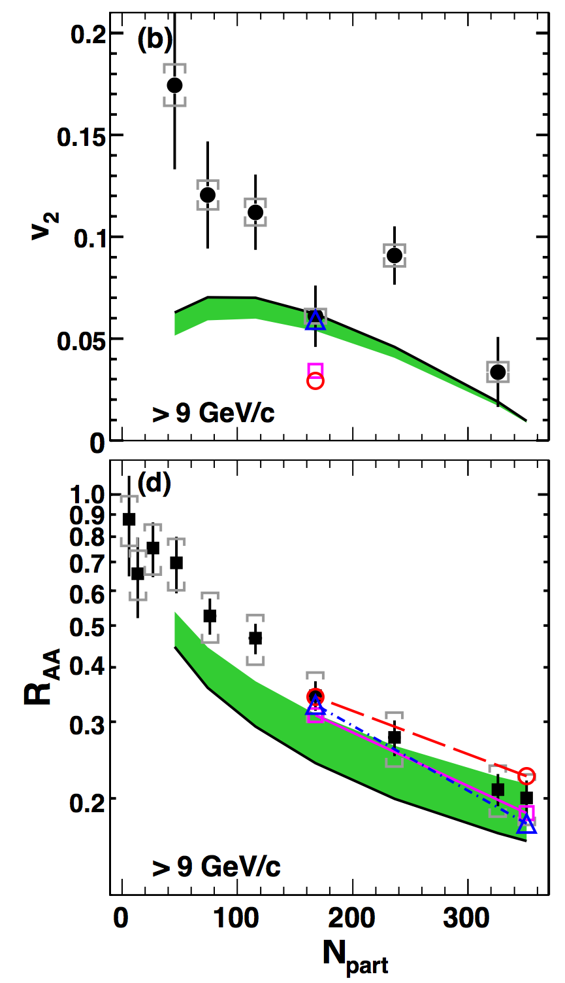
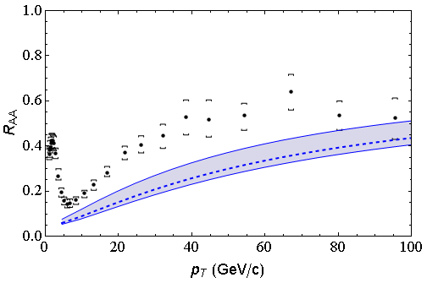
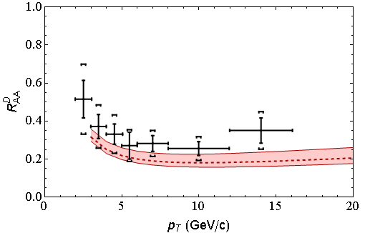
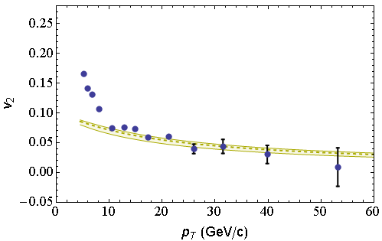
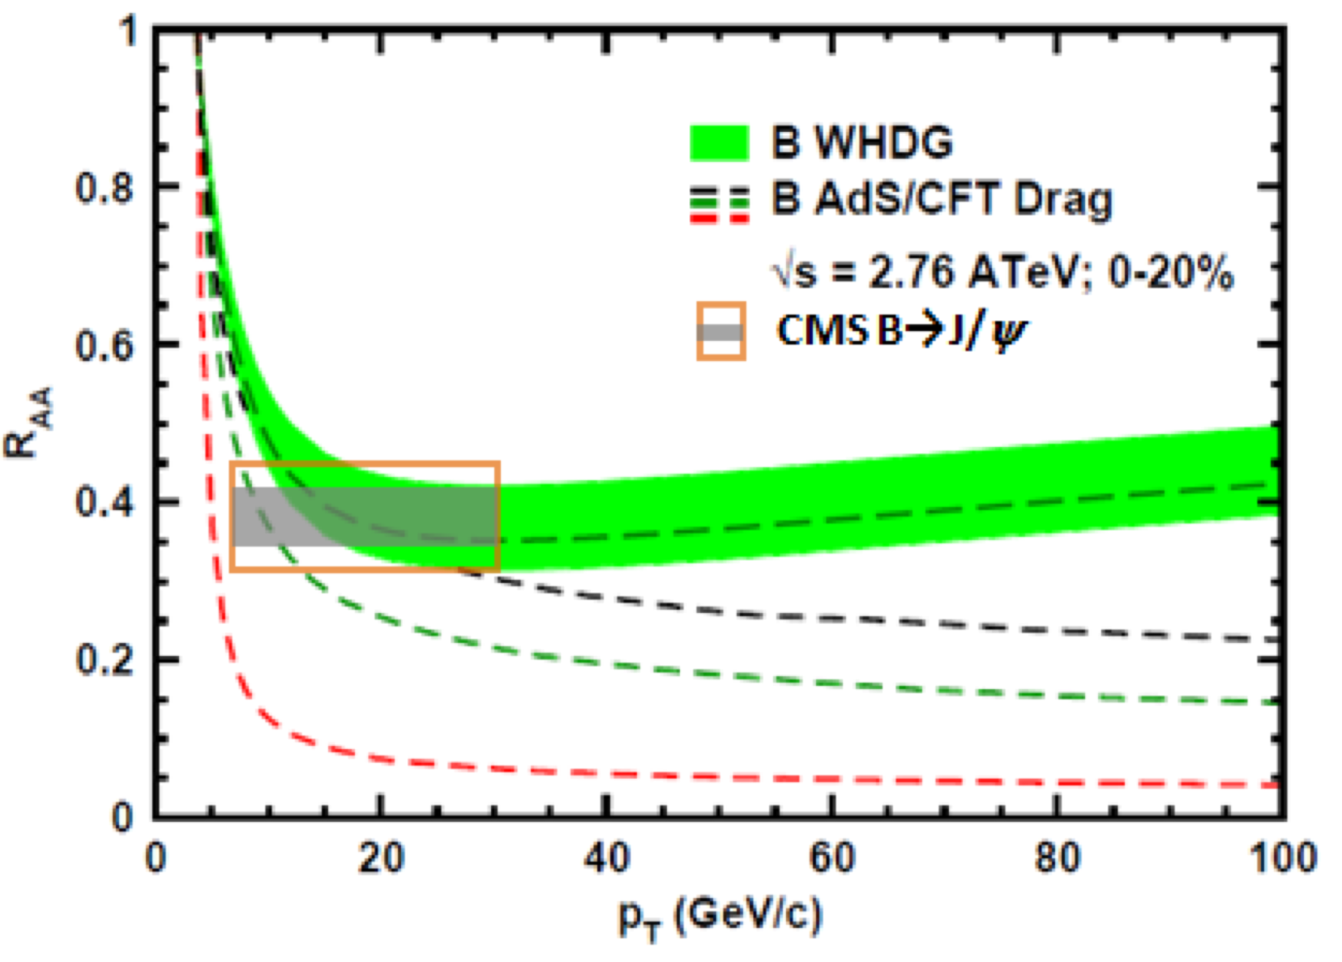
Qual. Success of “LO” Jet Tomo in AA
Rad + El, realistic geom AA correct to factor ~2
LHC
CMS h± 0-5%
WHDG π⁰
LHC
ALICE D
WHDG D
RHIC
RHIC
LHC
CMS h± 40-50%
WHDG π⁰
LHC
CMS, Eur.Phys.J. C72 (2012)
CMS, PRL109 (2012)
ALICE, JHEP1209 (2012) 112
CMS, JHEP 1205 (2012) 063
PHENIX PRL105 (2010)
Notes:
Number of qualitative successes of pQCD suggests worth investigating further

Slide 3
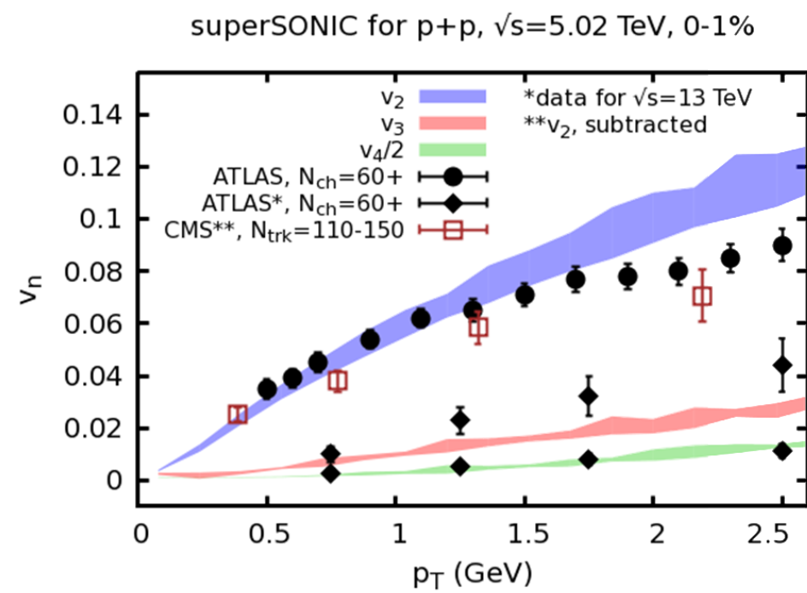
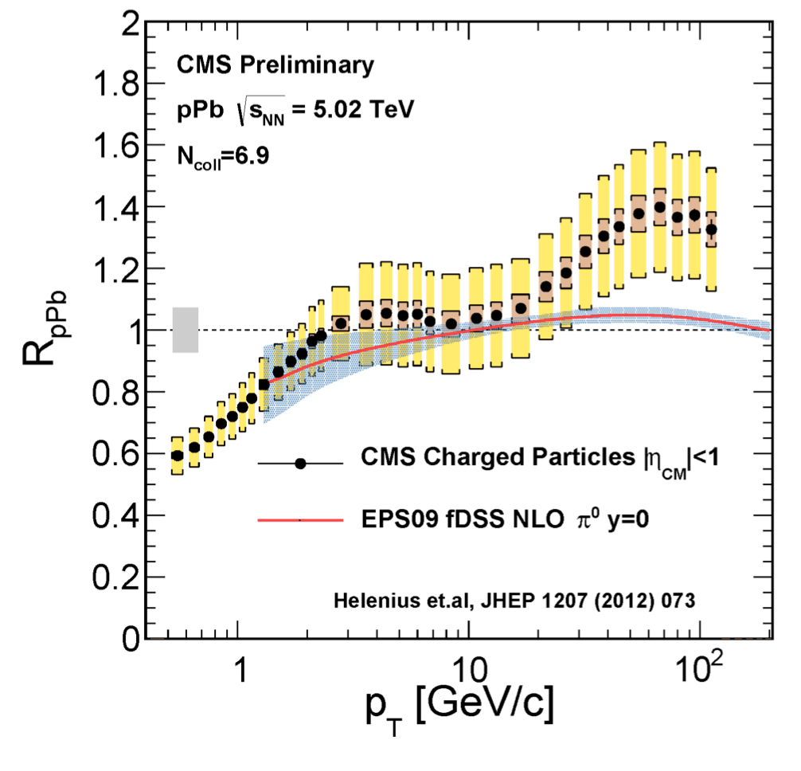
Correlations and Suppression in Small Systems
Flow (?) in p+p
E-loss (?) in pPb
Weller and Romatschke, PLB B 774 (2017)
CMS, HP’13

Slide 4
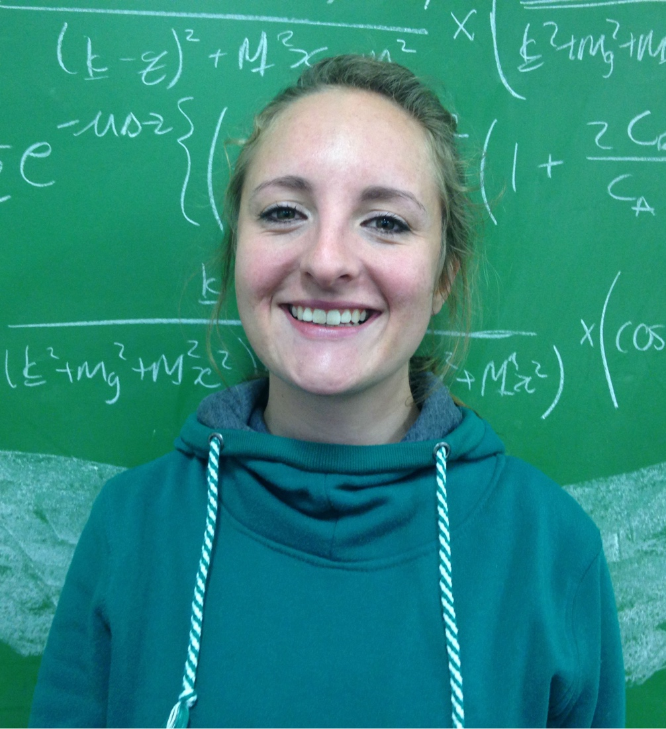
pQCD E-Loss in pA
Take seriously possibility of E-loss in small systems
Wish to apply DGLV to small systems
However, DGLV assumes an ordering of scales: 1/μ_{Debye} << λ_{mfp} << τ_{form} << L_{pathlength}
Desire: derive the 1/L corrections to DGLV 1st order in opacity
Requires reevaluation of all 11 diagrams, no longer neglecting certain poles originating from the Yukawa scattering potential
Calculated by Isobel Kolbé

Slide 5
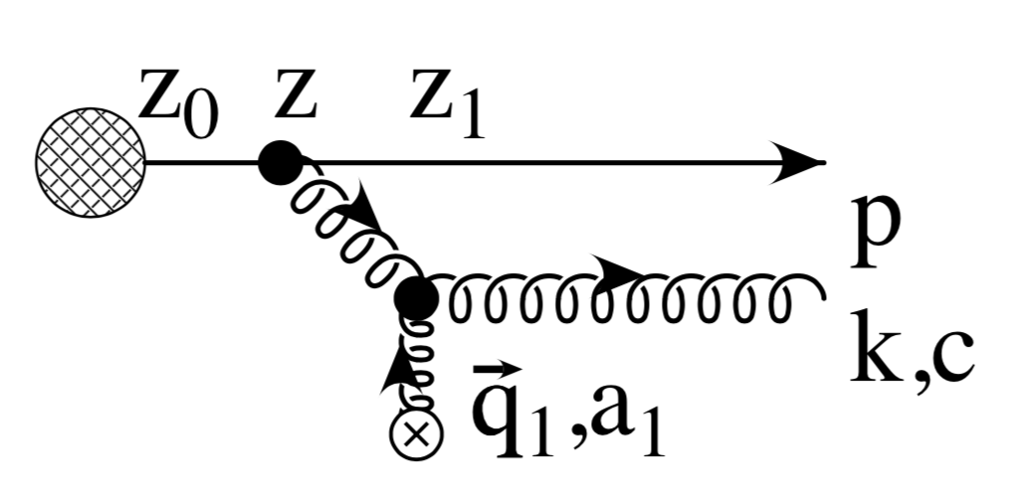
Neglected Poles
Notes:
Turns out in the large formation time limit, only two diagrams need to be re-computed

Slide 6
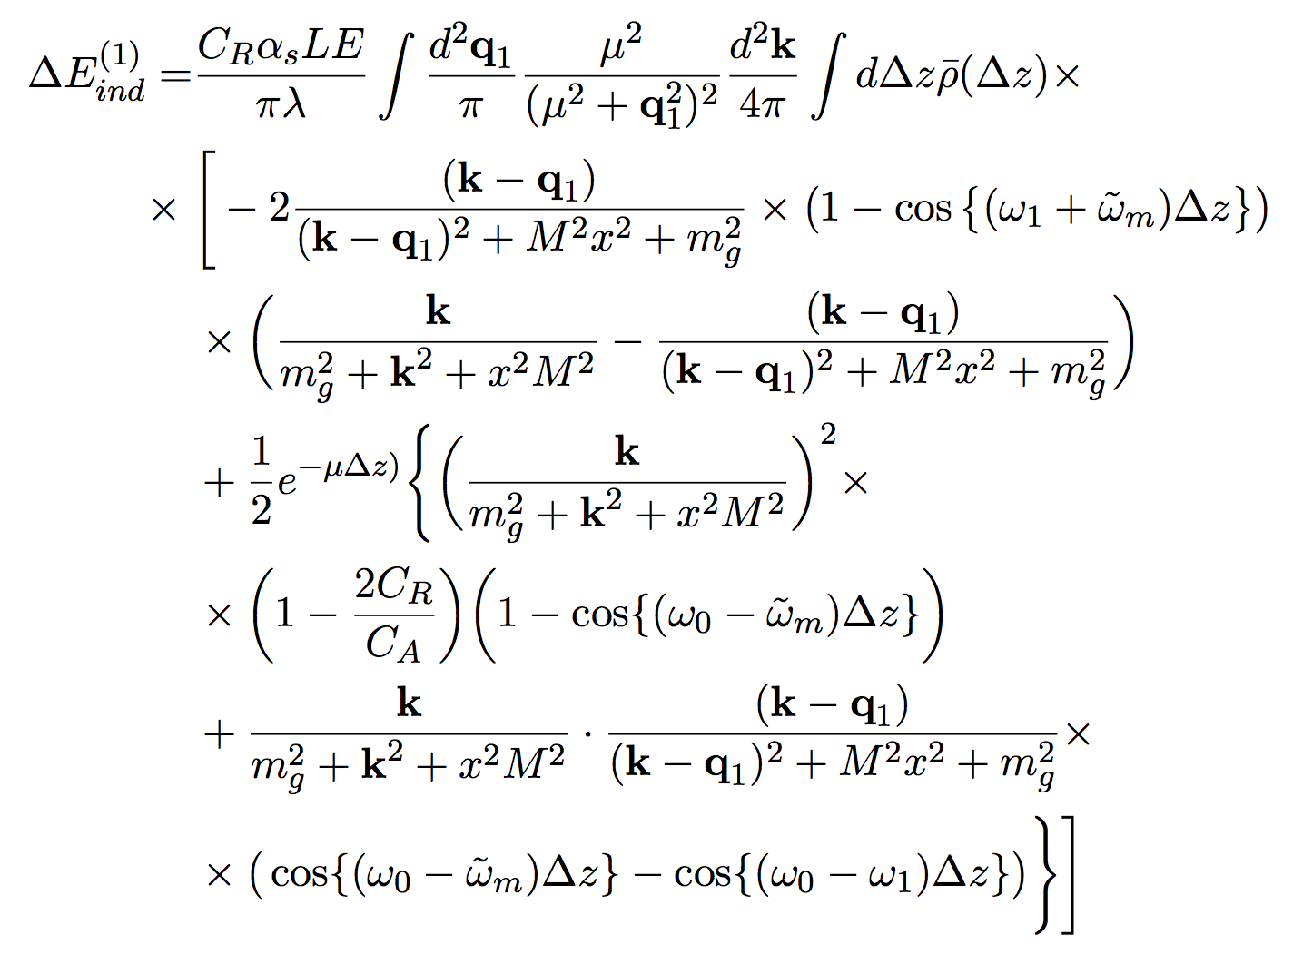
Summed, Squared Result
DGLV
“Small L”
Correction

Slide 7
Analyzing the Short Path Correction
Correction:
=> 0 as Δz => 0 (destructive interference)
=> 0 as μ => ∞ (all paths are long)
breaks color triviality

Slide 8
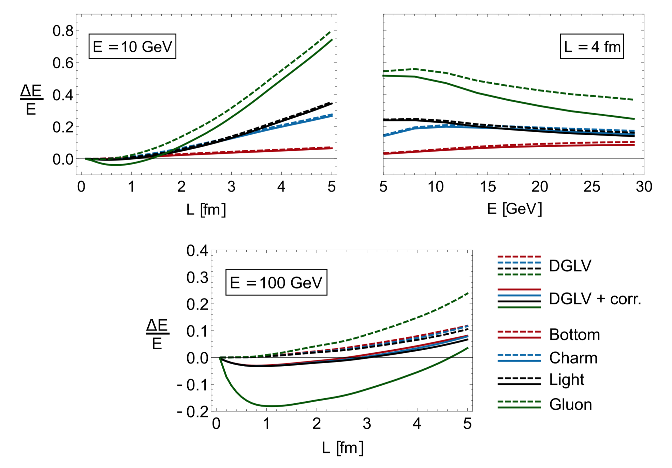
Num. Investigation of Correction
Kolbé and WAH, PRC100 (2019)
Surprise 1: Correction leads to reduction in E-loss
Surprise 2: Affects all pathlengths L
Due to integrating over all distances to scattering Δz in [0,L]
Surprise 3: Correction grows with p_{T}
Need to think more carefully re small systems?

Slide 9
Pheno Investigation
Reasons to be excited:
Destructive interference => R_{pA} > 1 similar to data?
E (vs ln E) dependence => faster rise in R_{AA}(p_{T})?
Modest ambition:
How important is short L corr. vs original WHDG in AA? pA? pp?
Serious comparison to data? Caveats:
Literally hot off the presses (plots from >1am today)
No nPDFs, no NLO, no NLL, no Bayesian, no new parameter extraction, mapping of hydro to bricks, time dependence of expansion, KKP/DSS π FFs not under full control for large p_{T}, limited by publicly available hydro backgrounds
Seek qualitative comparison; is correction important to include? Other important previously neglected physics?
Cole Faraday
Notes:
How important is

Slide 10
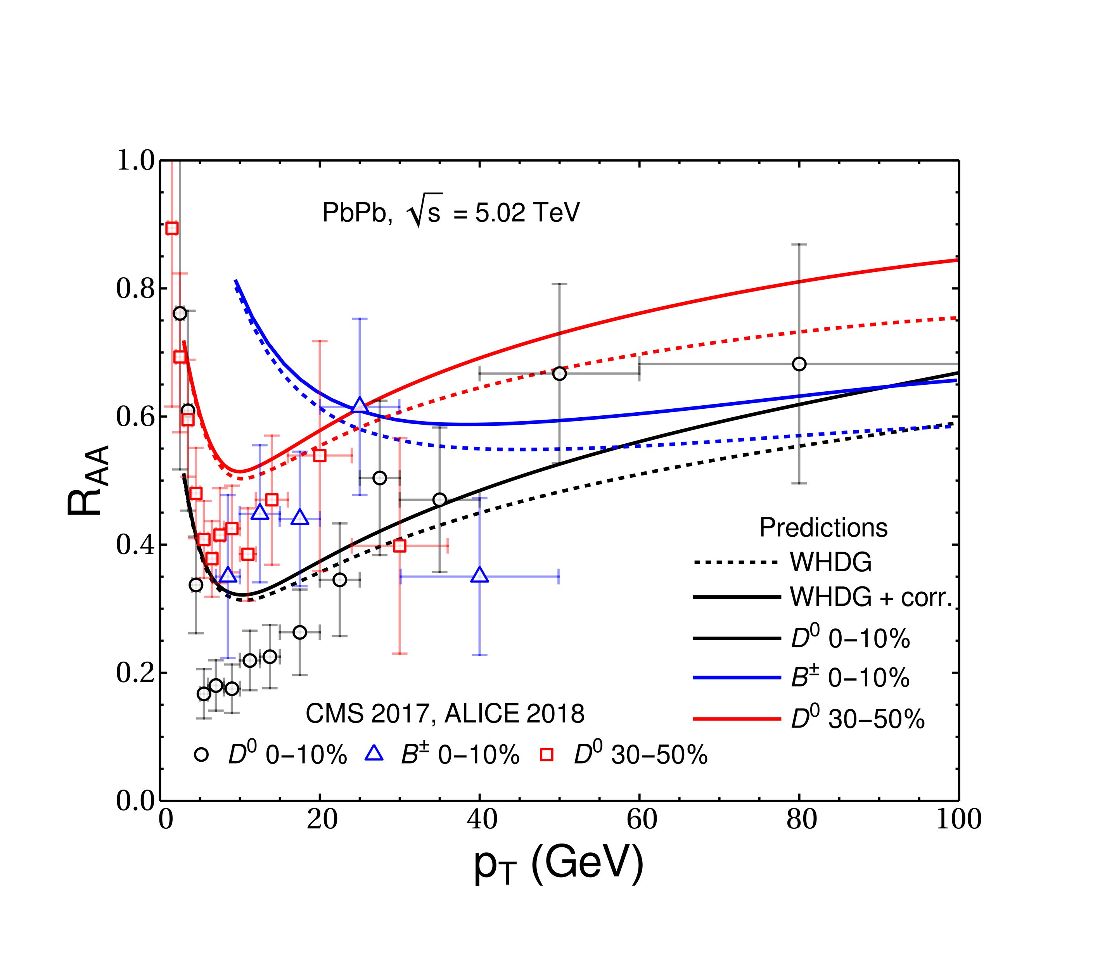
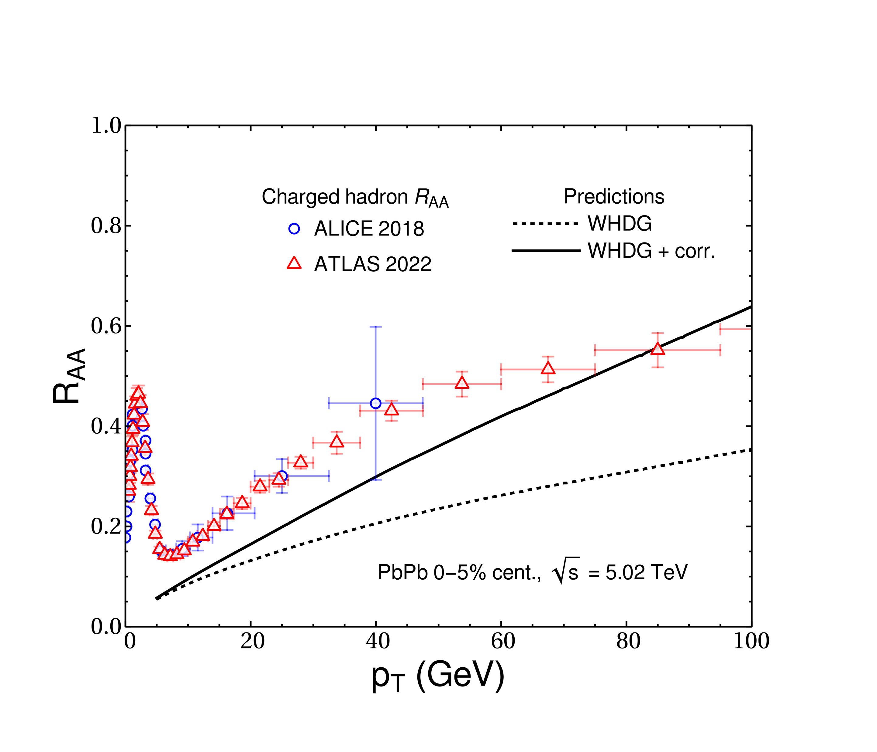
Effect on R_{AA}
Very preliminary first results:
Full Rad + Coll + Geom (fluc. IP-G into VISHNU)
Short path length correction to ΔE_{rad}:
reduces suppression
increases energy dependence
D and B Mesons
Pions vs Charged Hadrons
Faraday and WAH, in prep
FFs becoming questionable

Slide 11
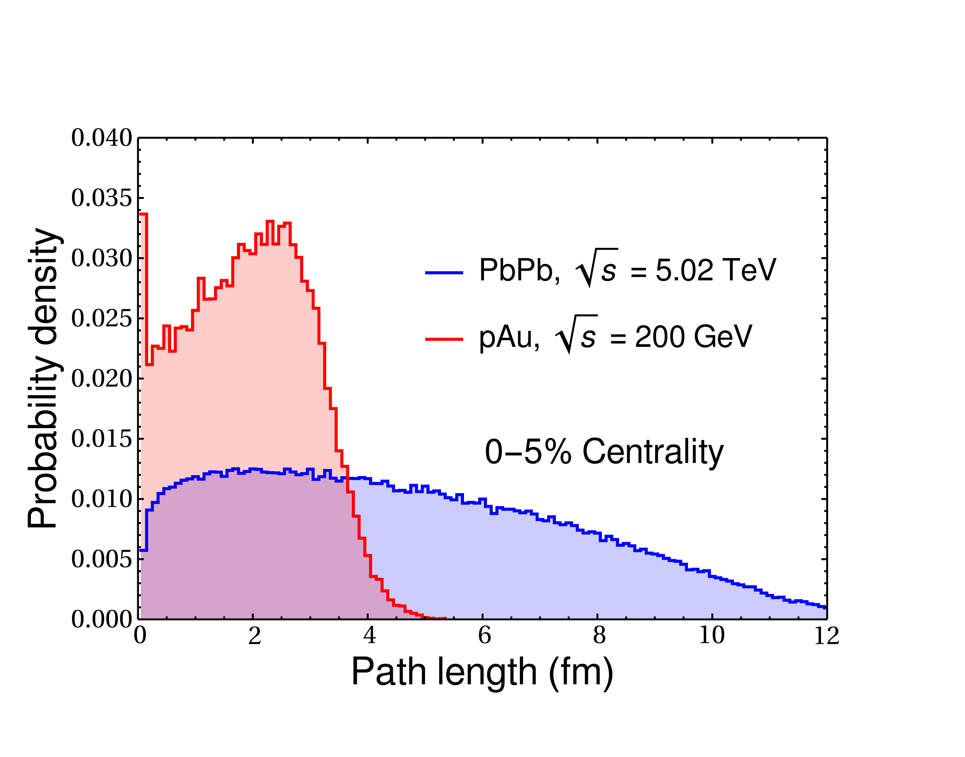
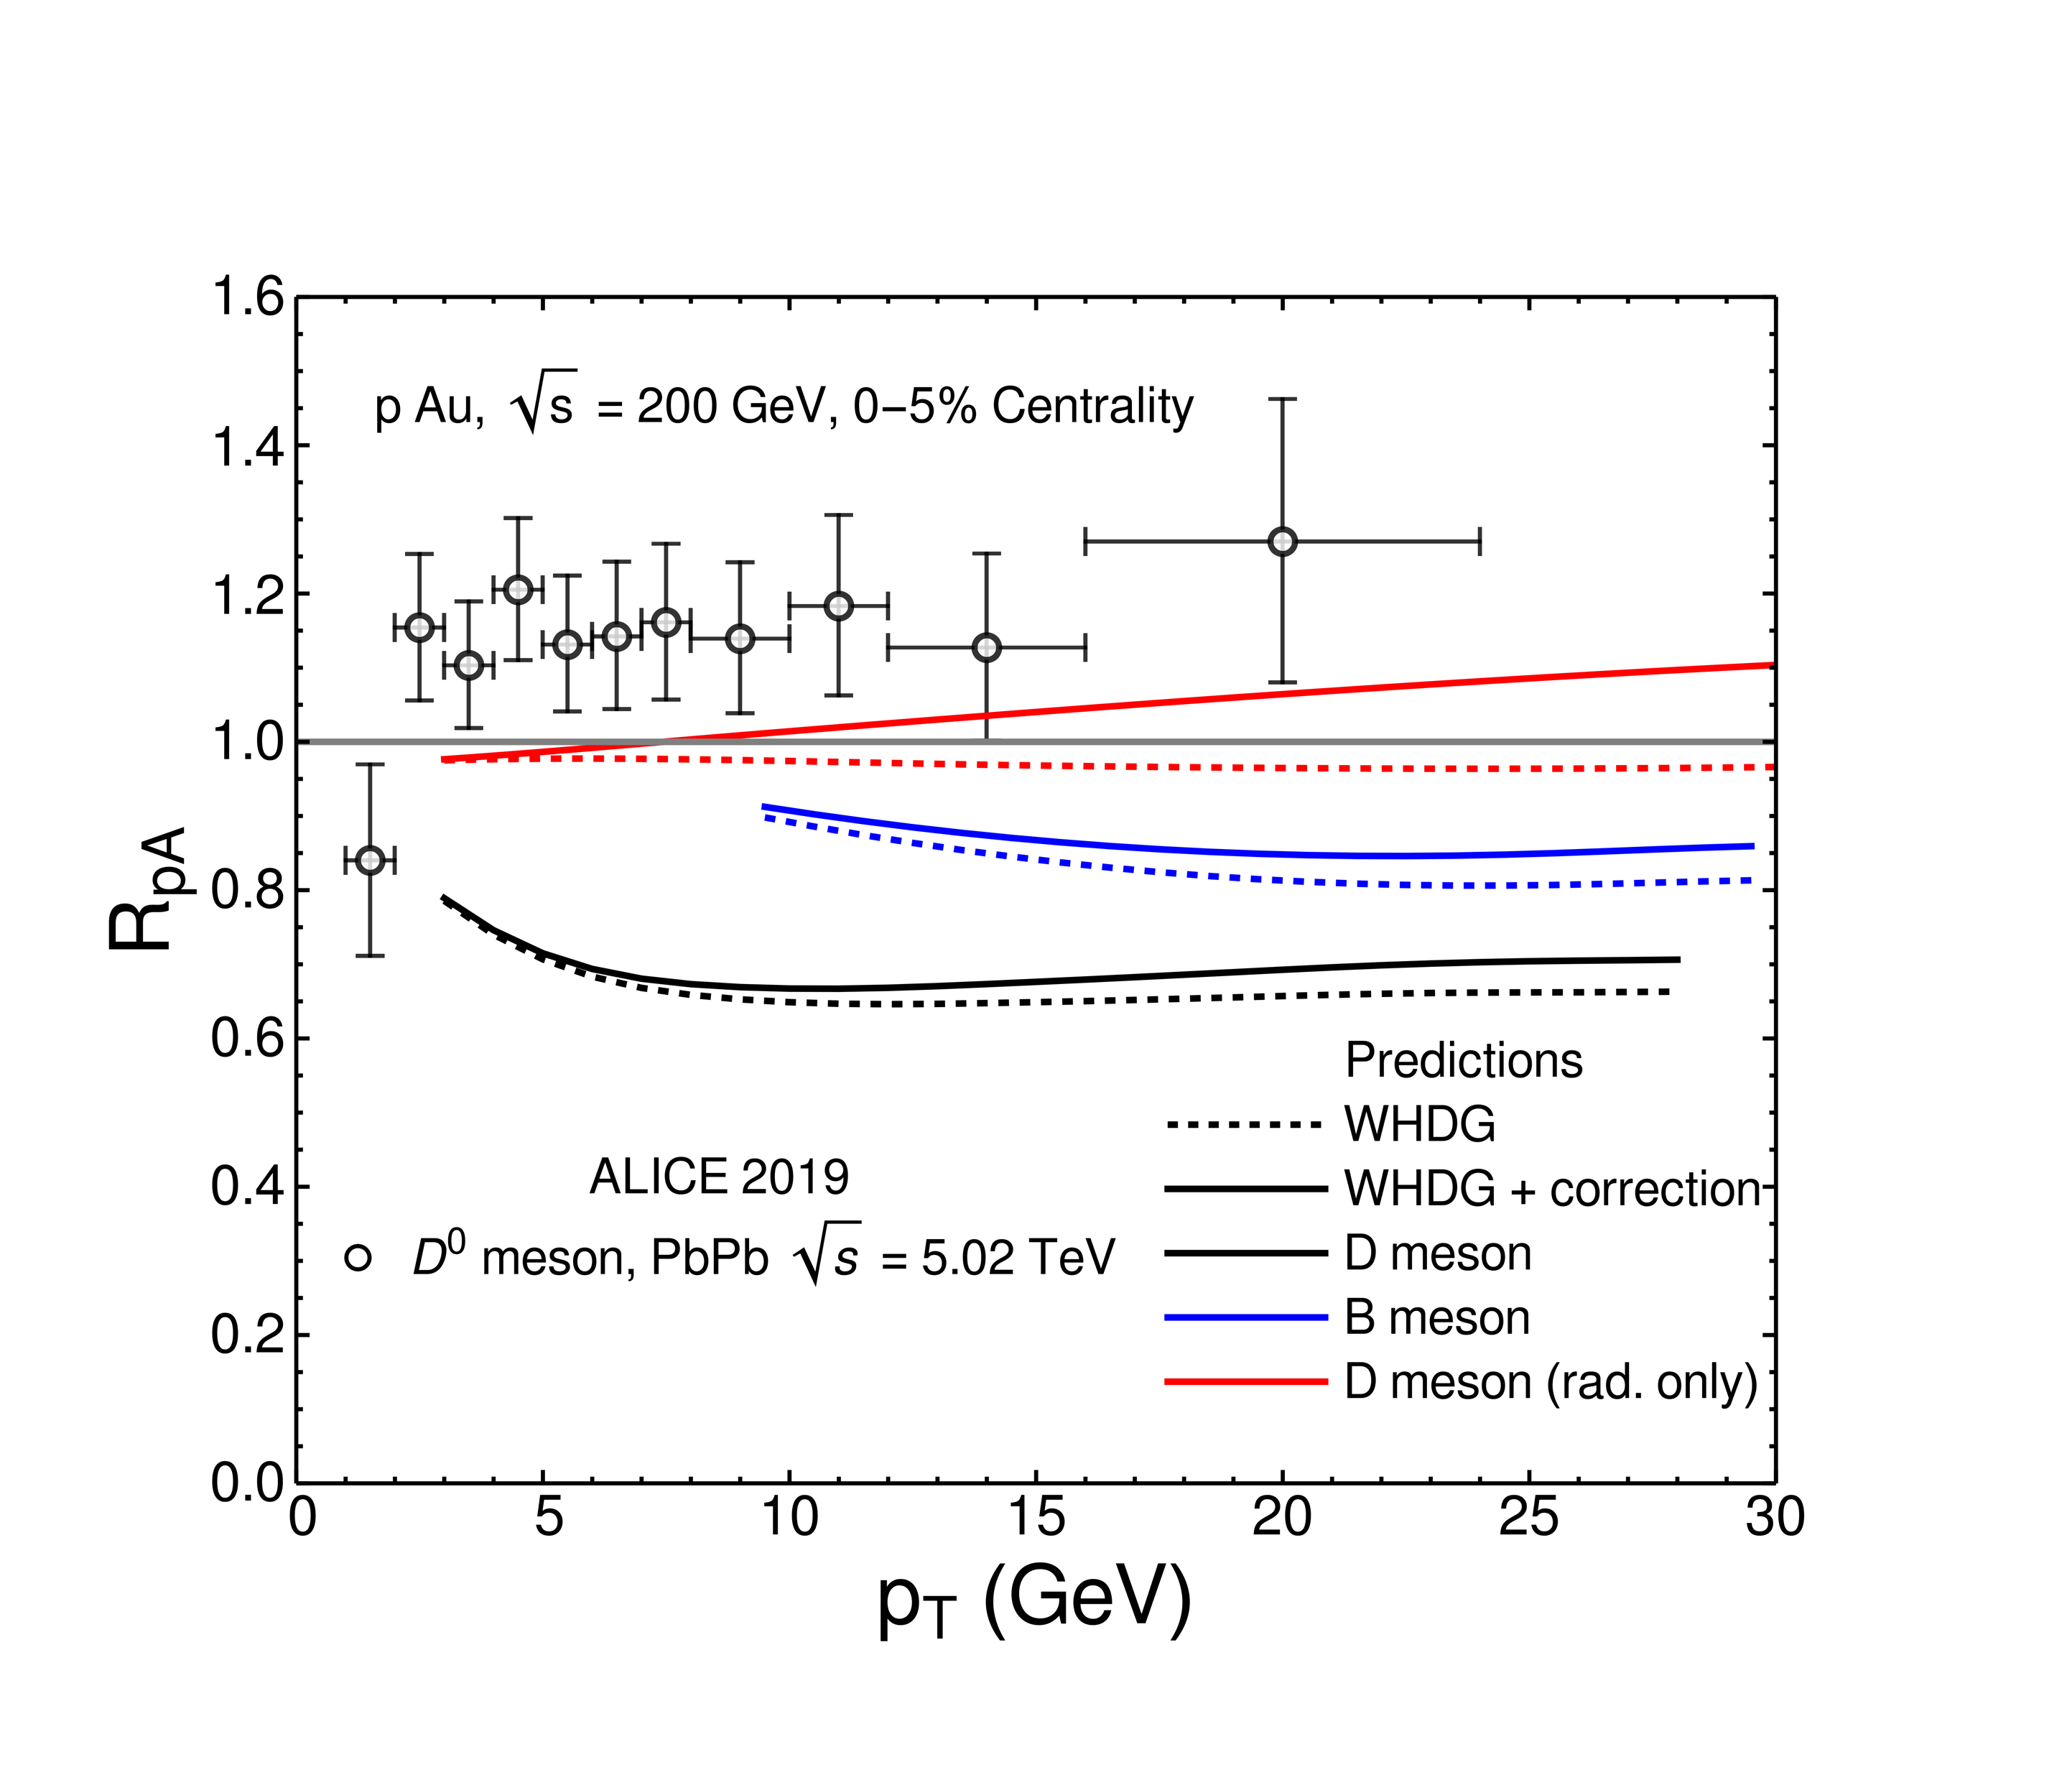
Effect on R_{pA}
Non-trivial pathlengths in pA collisions
Average elastic energy loss inappropriate for small systems
Tantalizing hints of R_{pA} > 1 and rising
Faraday and WAH, in prep
NB: pAu vs pPb
Notes:
<L> = 1.9 fm (pAu) and 4.7 fm (Pb Pb).

Slide 12
Thermodynamics of Small Systems

Slide 13
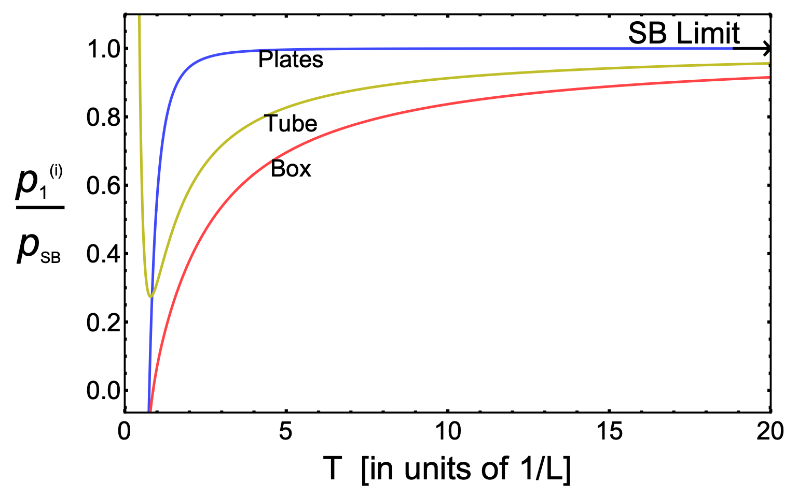
Does Finite Size Affect Thermodyn.?
Test using free scalar field theory
p decreases significantly as T decreases for fixed L, converging to T = 0 Casimir effect
~10% effect at 400 MeV
for ~1 fm system
Mogliacci, Kolbé, and WAH, PRD102 (2020)

Slide 14
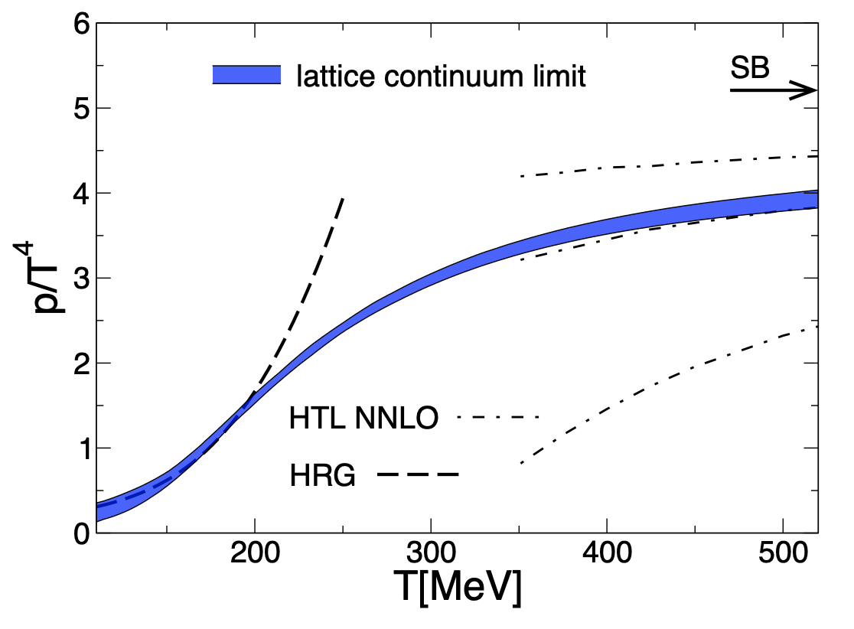
Does Finite Size Affect Thermodyn.?
Provocative qualitative T dependence:
Mogliacci, Kolbé, and WAH, PRD102 (2020)
Borsanyi et al., PLB730 (2014)
Notes:
Finite system size effects mimic some of the non-perturbative, phase transition reduction in pressure seen on lattice

Slide 15
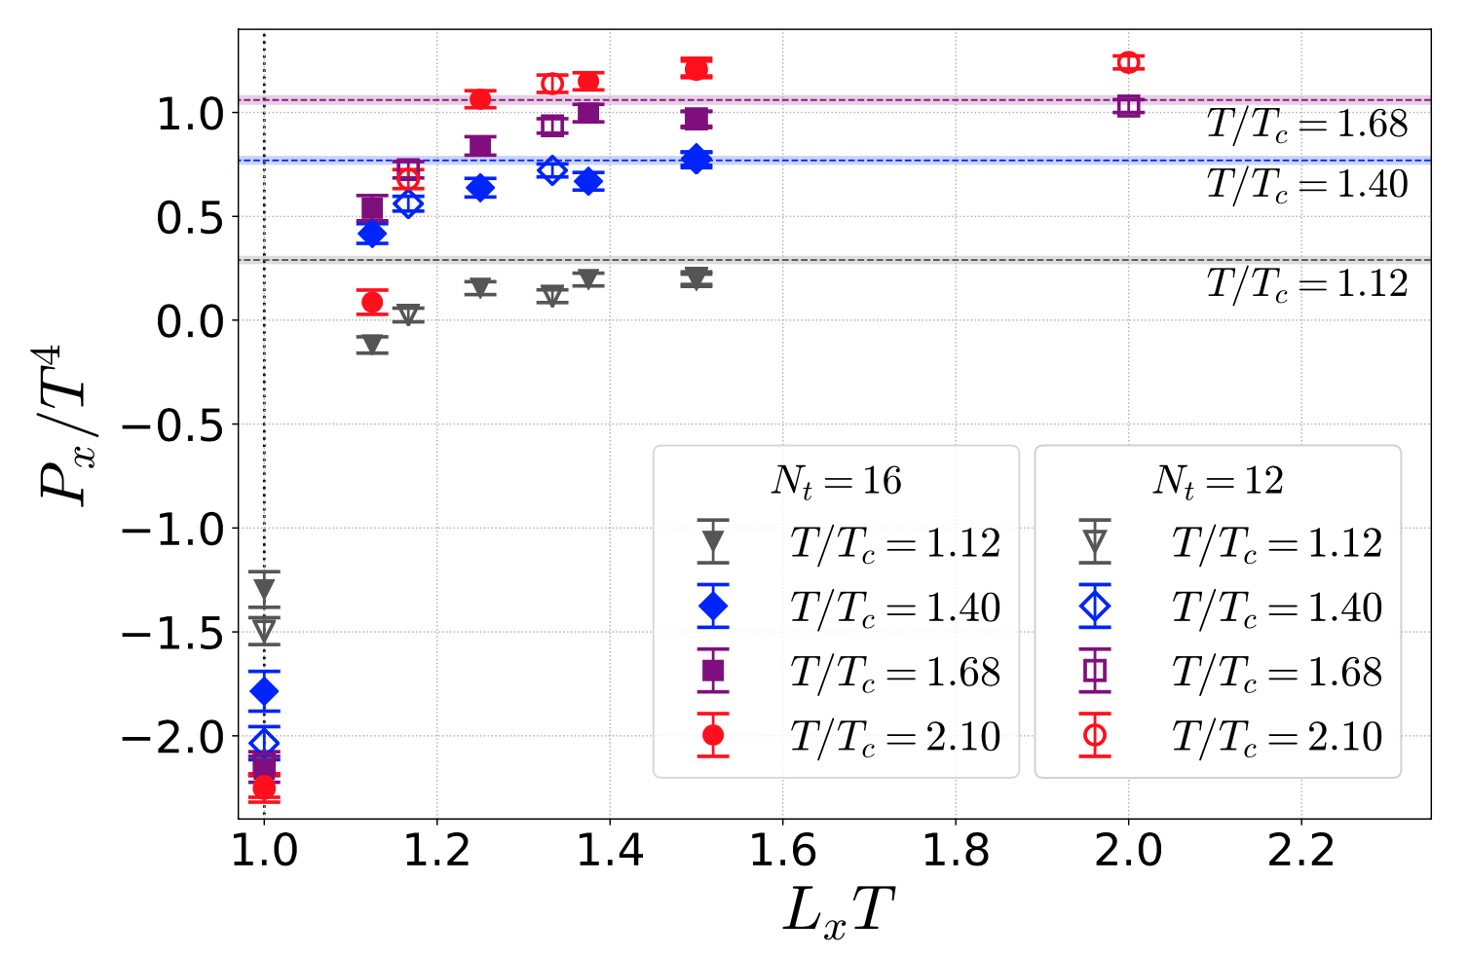
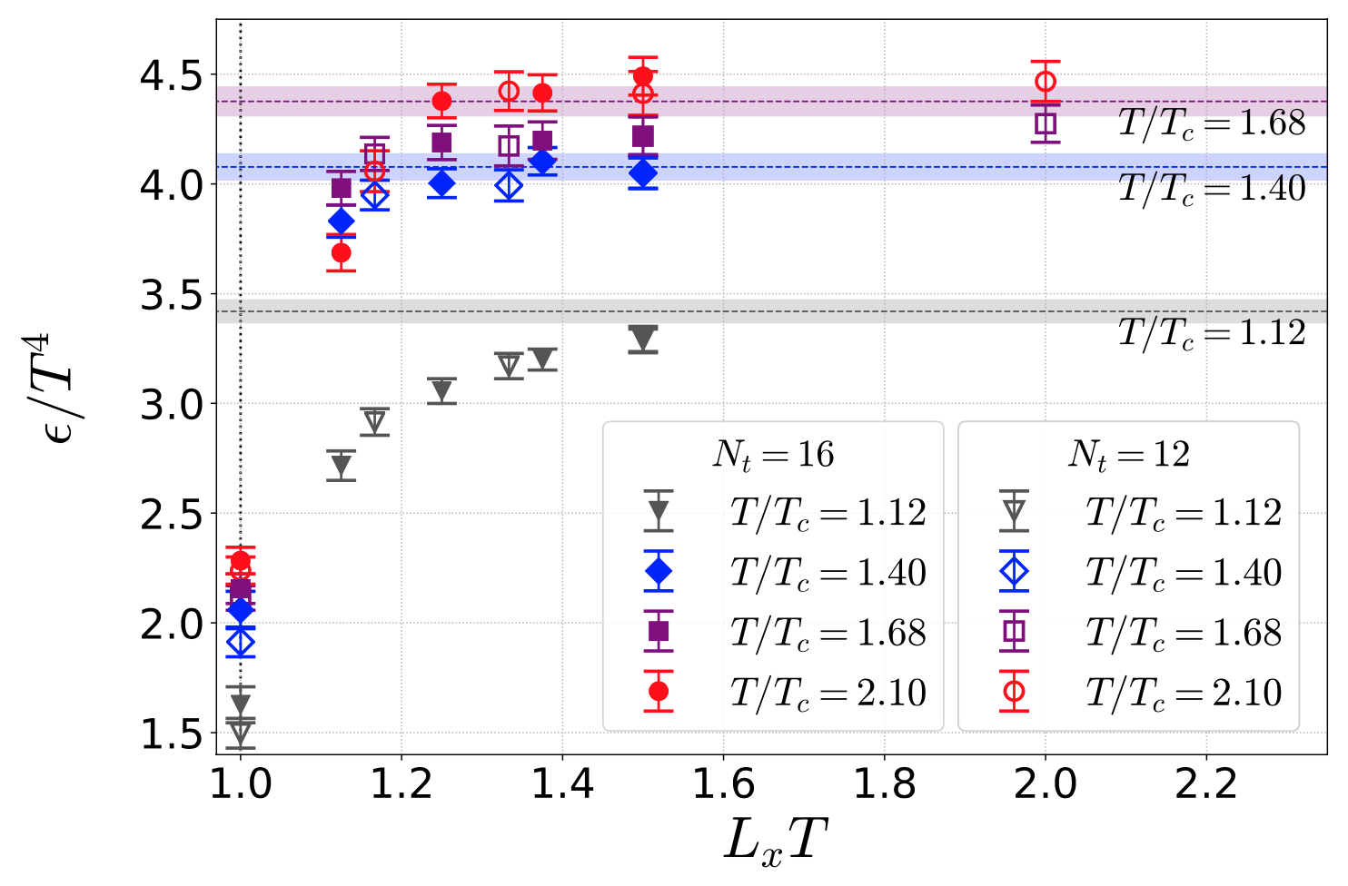
FS Effects in Quenched QCD
Thermodynamic quantities on anisotropic lattice with periodic boundary conditions
Reduction of p, e with T*L qualitatively similar to free, massless scalar theory
Kitazawa, Mogliacci, Kolbé, and WAH, PRD99 (2019)

Slide 16
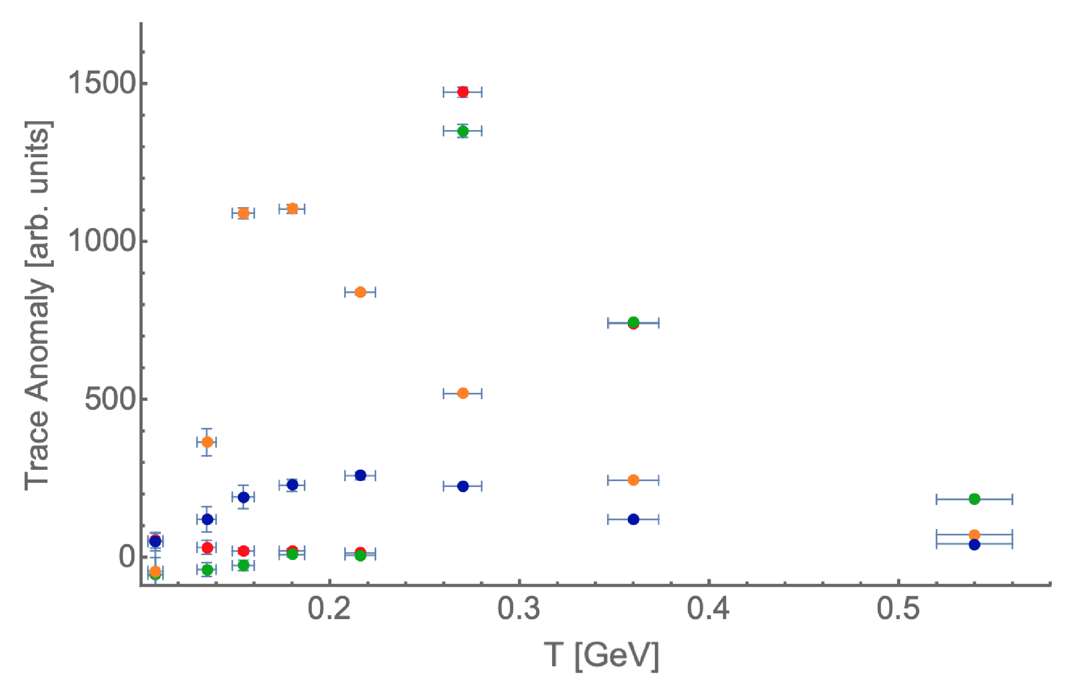
What about Trace Anomaly Δ?
Δ => c_{s} => η/s
From lattice QCD:
Decreasing system size:
decreases Δ
washes out phase transition
Quenched QCD
Periodic BCs
PRELIMINARY
WAH and Rothkopf, in progress
Notes:
Trace anomaly dictates the speed of sound, which dictates how strongly the system responds to pressure gradients. The whole viscosity story for heavy ion collisions could change if the trace anomaly changes significantly with system size

Slide 17
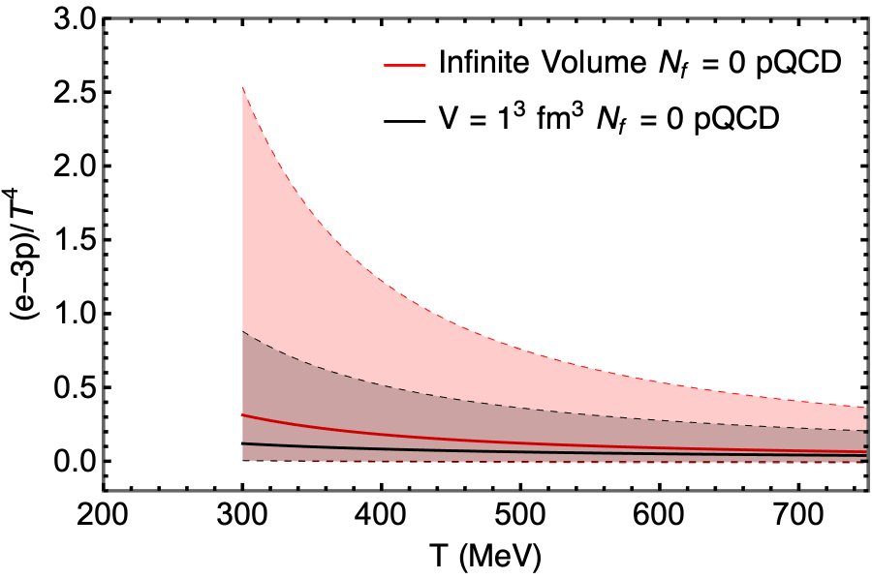
Analytic Results for Δ
Δ = 0 for massless, free scalar theory
Even when in a box!
Δ = 0 for HTL QCD
Even to g⁵!
Δ != 0 only when coupling runs
Estimate: use HTL QCD with lattice scalar running coupling
λ decreases and Δ significantly decreases from F.S.
WAH and Rothkopf, in progress
Notes:
Montvay and Munster. What happens in QCD? QCD has a different sign for the beta function than scalars, suggesting (?) that the coupling increases as the system gets smaller. But at the same time, the system size introduces a scale, and if the system is small enough, that small distance scale will push the theory to being weakly coupled (?)

Slide 18
Analytic FS Δ in QCD
What happens in QCD?
Does α_{s} grow or shrink as L => 0?
Non-trivial conceptual issues:
How to regularize and renormalize?
Dim reg difficult to generalize in F.S. setting
Torons
First examine F.S. effects for running coupling in 2 => 2 scattering in φ⁴ theory

Slide 19
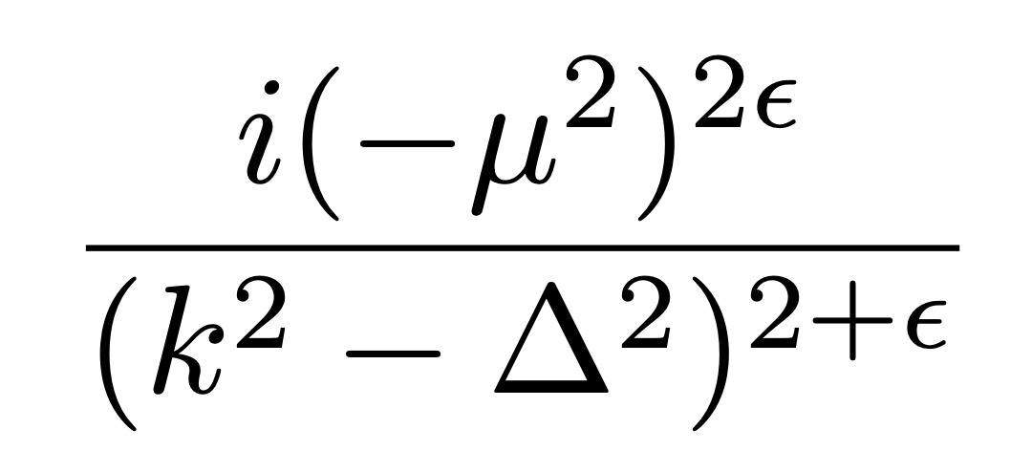
Define New Regularization Scheme
Denominator regularization (den reg) instead of dimensional regularization (dim reg)
Number of dimensions fixed
Feynman x combine propagators
Analytically continue the power of the single denominator
Introduce fictitious scale μ to maintain dimensions
Use instead:

Slide 20
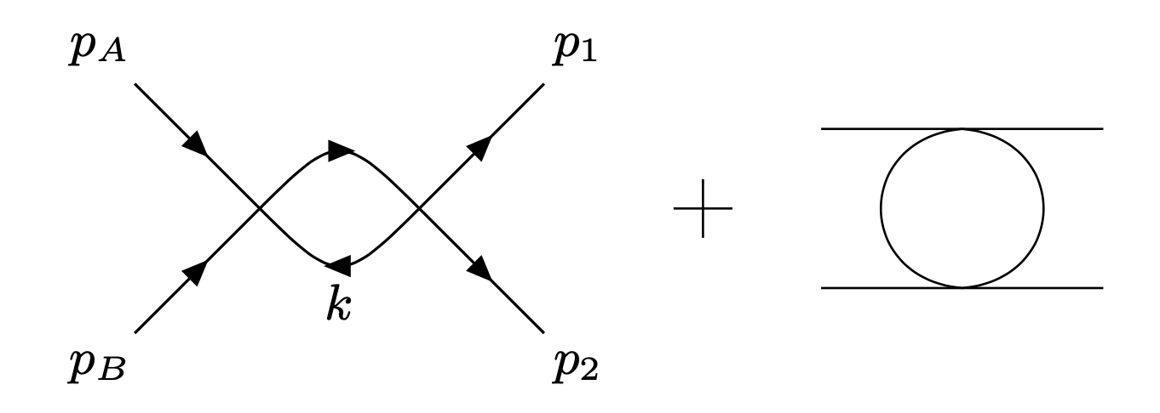
2 => 2 at NLO in φ⁴ in Finite System
Feynman Diagrams:
Define
Impose Periodic B.C.’s

Slide 21
Capture the Divergence
Result is a generalized Epstein Zeta fcn
Poisson Summation Formula:
Yields new analytic continuation for g.E.Z:

Slide 22
Finite Size Result at NLO
Found the pole! And the F.S. correction!
Correction
goes to 0 as L_{i}, p => infinity
satisfies unitarity/optical theorem
Optical thm check highly non- trivial
Requires generalization of a number theory result from Hardy/Ramanujan
Jean du Plessis
Notes:
Correction goes away for large L or large p

Slide 23
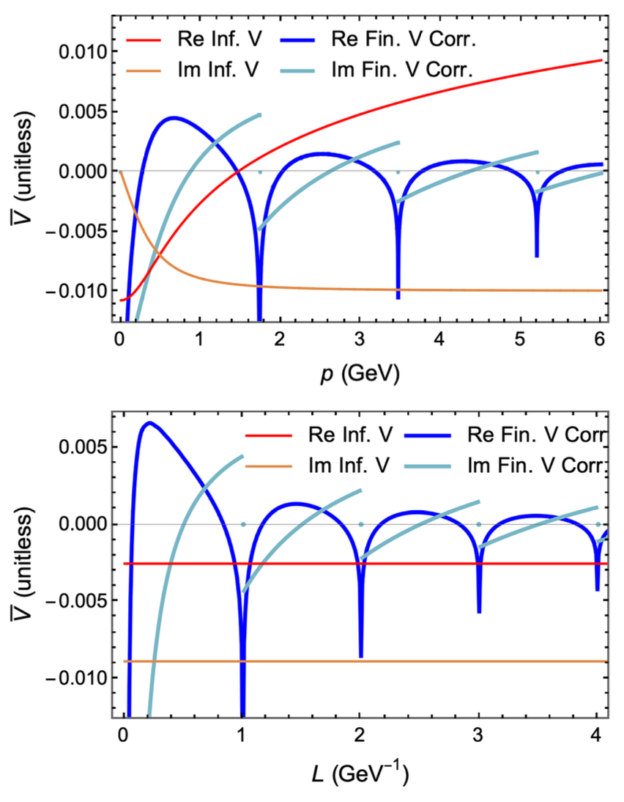
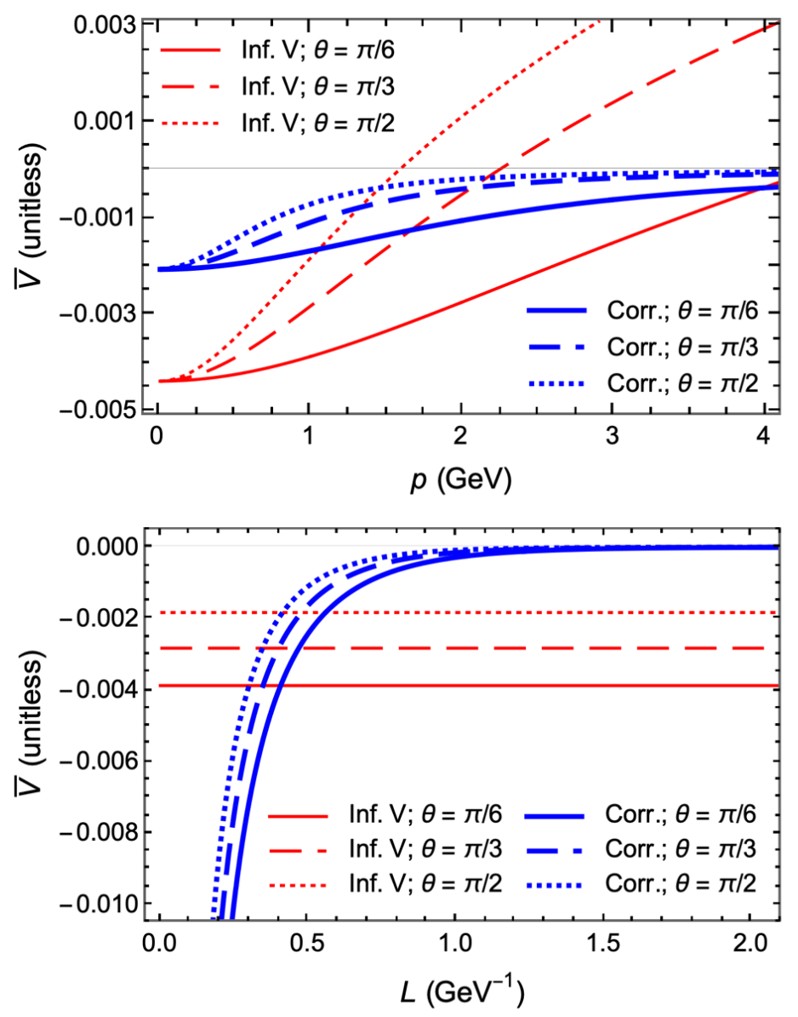
Numerical Results with 1 Compact D
s channel
Correction => 0 in L and p
Non-trivial behavior from x int over BesselK
t channel

Slide 24
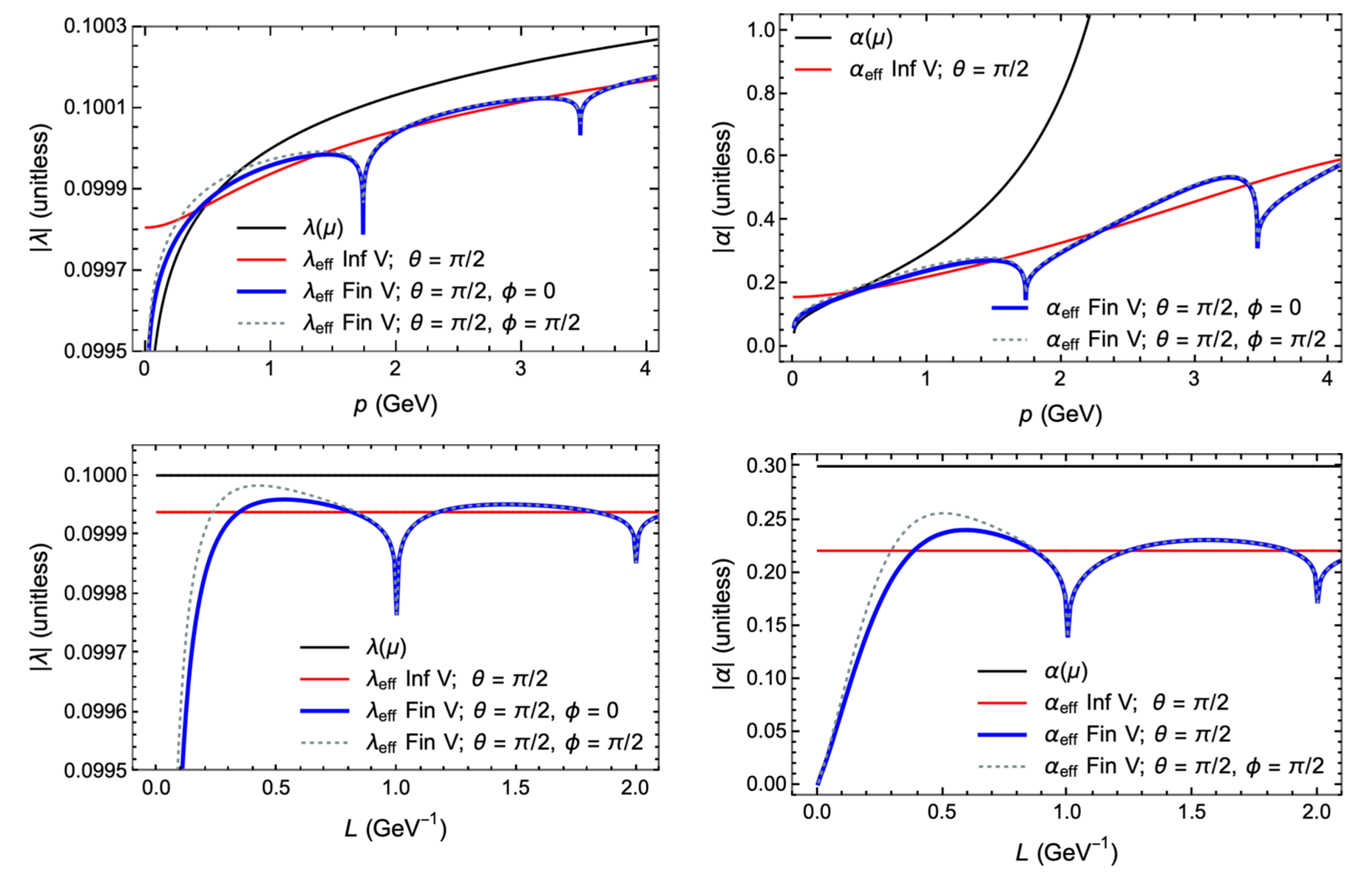
Running Coupling in 1 Compact D
Sum the geometric series of bubbles
Result depends on coupling at initial scale
No pole in full series; cf LL from beta fcn

Slide 25
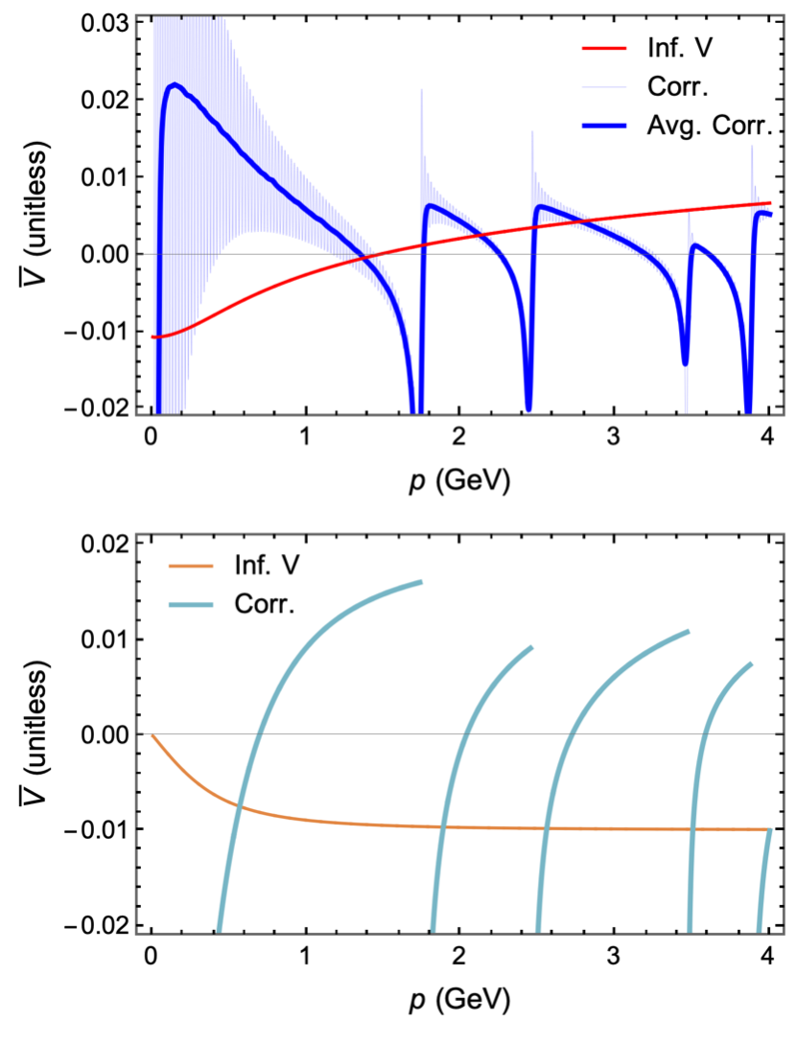
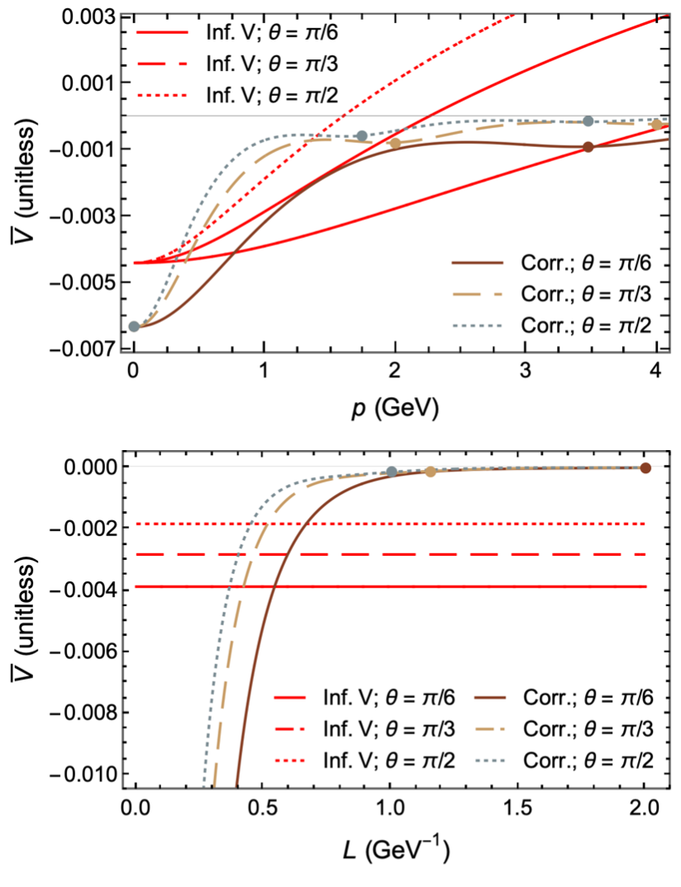
Numerical Results with 2 Compact D’s
s channel
Extremely difficult numerical problem for Re of s channel
3D compact is trivial
t channel

Slide 26
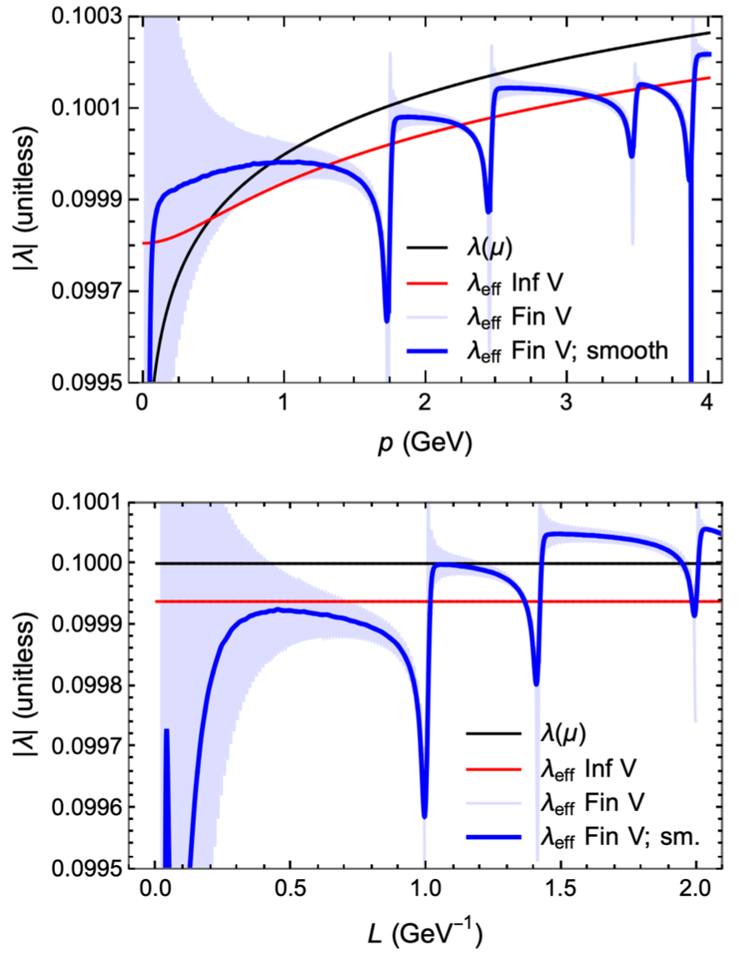
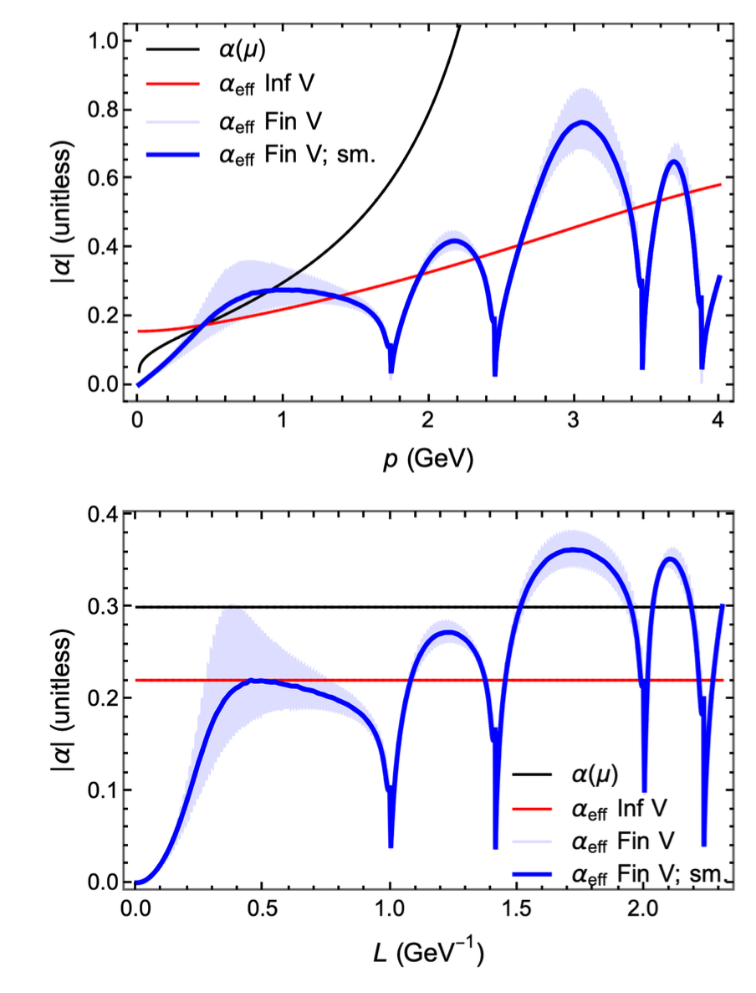
Running Coupling in 2 Compact D’s

Slide 27
Conclusions
Presented first (and only) analytic small L correction to E-loss derivation
Correction grows w 1/L, E; breaks color triviality
First pheno results. Small L correction:
Reduces suppression
Increases rise with p_{T}
~10% effect for heavy flavor R_{AA}
Broken color triviality => large effect for light hadrons
Significant pathlenths in pA; hints of R_{pA} > 1; must compute small pathlength corrections for elastic energy loss
To do: see caveats; then v_{n}’s for AA and pA, high multiplicity pp, …

Slide 28
Bonus Conclusions
Massive, free scalar field in a box
Thermodynamics significantly altered; mimics QCD
Quenched lattice confirms qualitative physics
NLO 2 => 2 scattering in φ⁴ in 1, 2, and 3 compact dim’s
Analytic continuation of the generalized Epstein zeta function
Captured finite size corrections
Checked unitarity
Showed first results for running coupling in 1, 2, and 3 compact dim’s
A lot of interesting work to do!!

Slide 29
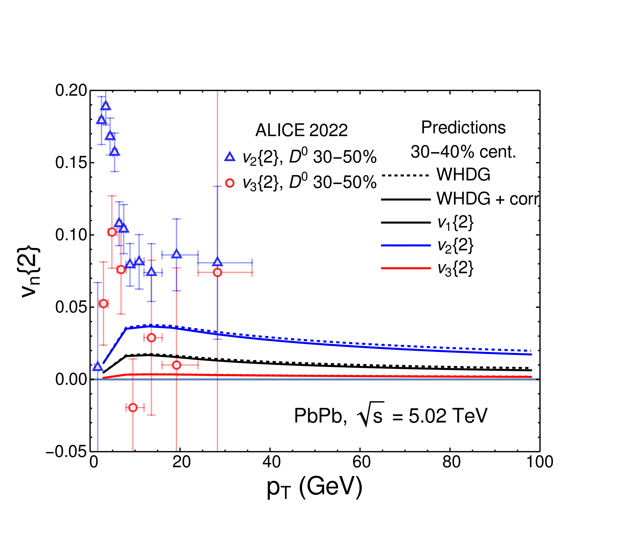
Very Preliminary v_{n}’s
Faraday and WAH, in prep

