Slide 1
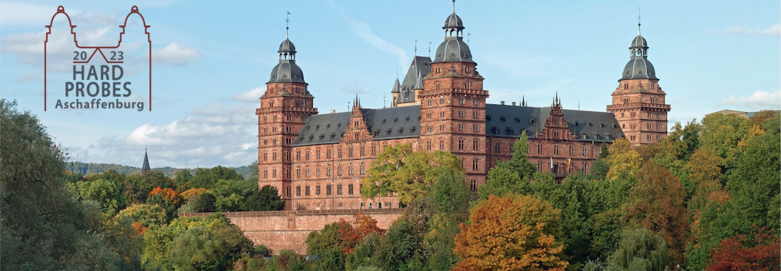
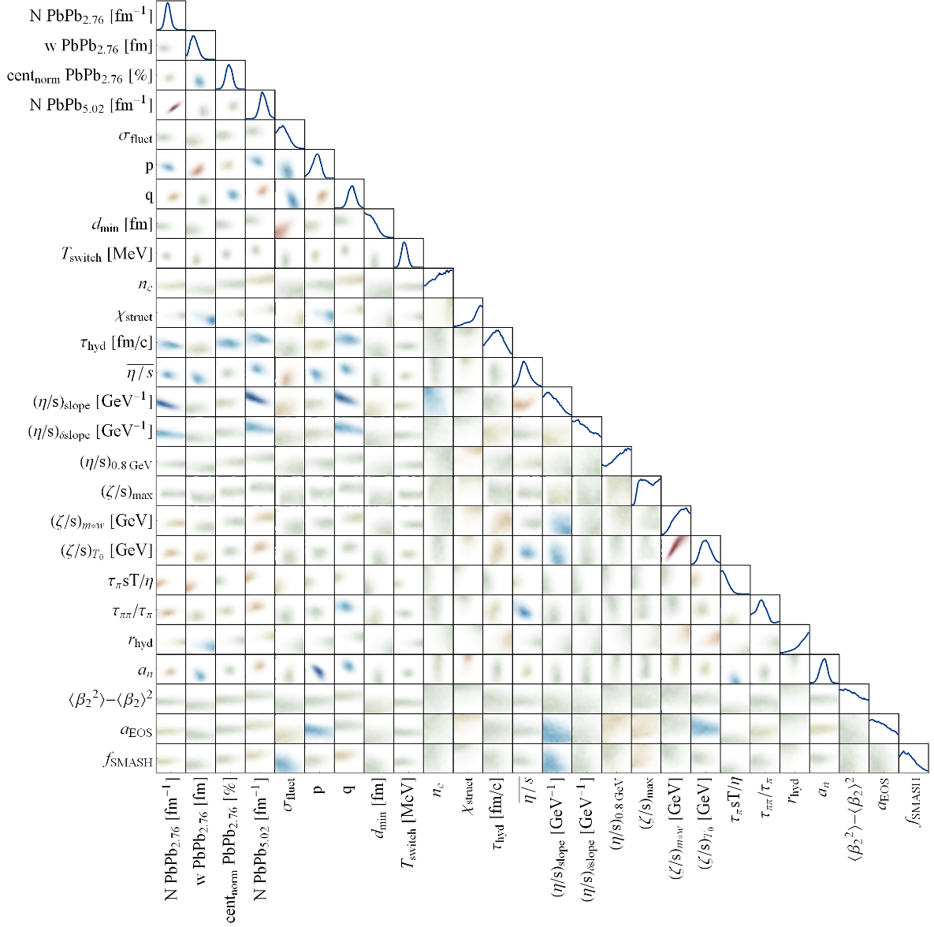
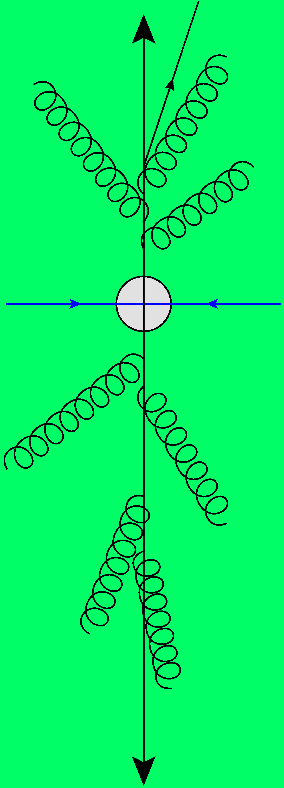
Anisotropic flow in small systems
Hydrodynamics at its limits
Together with Govert Nijs and Giuliano Giacalone
Wilke van der Schee
Hard Probes, Aschaffenburg
29 March 2023

Slide 2
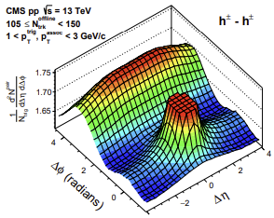
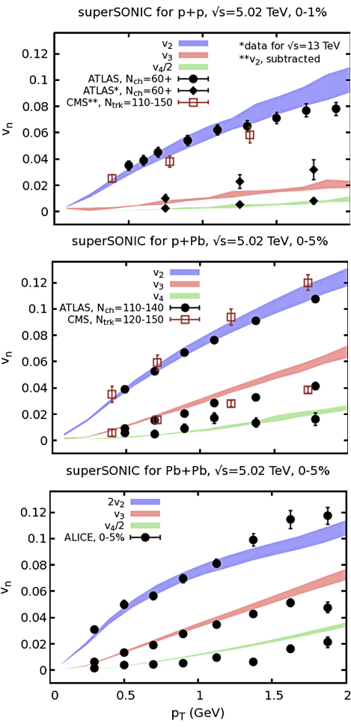
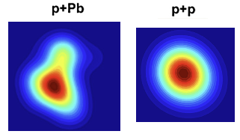
One fluid to rule them all --- Panta Rei
Wilke van der Schee, CERN/Utrecht
Long range rapidity correlations seen in near-side ridge
Most natural explanation in terms of a geometric effect --- hydro?
Low multiplicity: correlations dominated by `non-flow’ effects:
Momentum conservation (away side ridge)
Fragmentation (also: resonance decays)
Hydrodynamic models describe the data well (?)
In the case of superSONIC a relatively simple initial Glauber model (3 constituents)
CMS, Evidence for collectivity in pp collisions at the LHC (2016)
Ryan Weller and Paul Romatschke, One fluid to rule them all: viscous hydrodynamic description of event-by-event central p+p, p+Pb and Pb+Pb collisions at s√=5.02 TeV (2017)

Slide 3
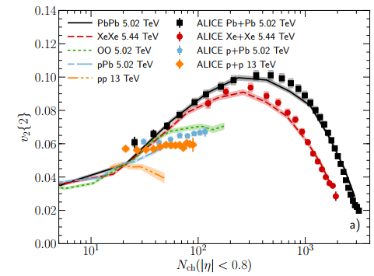
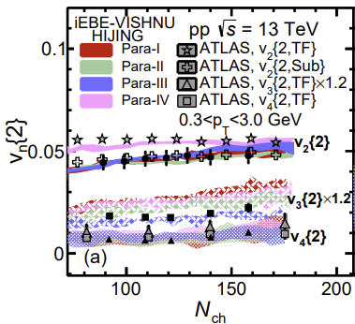
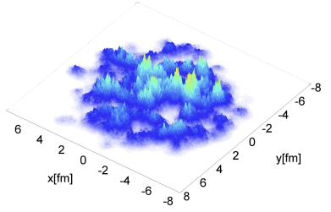
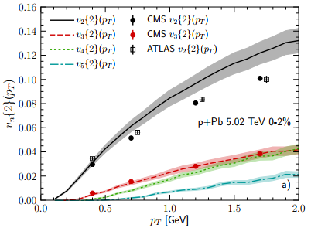
One fluid to rule them all --- Panta Rei
Wilke van der Schee, CERN/Utrecht
Similar results from IP-Glasma + MUSIC + UrQMD
Initial state in this case very `bumpy’
PbPb/XeXe elliptic flow larger than small systems at same small multiplicity
Similar results from HIJING/Trento + iEBE-VISHNU for pp collisions
Initial state is varied from HIJING to Trento
Describes data well
Wenbin Zhao, You Zhou, Koichi Murase and Huichao Song, Searching for small droplets of hydrodynamic fluid in proton–proton collisions at the LHC (2020)
Bjoern Schenke, Chun Shen and Prithwish Tribedy, Running the gamut of high energy nuclear collisions (2020)

Slide 4
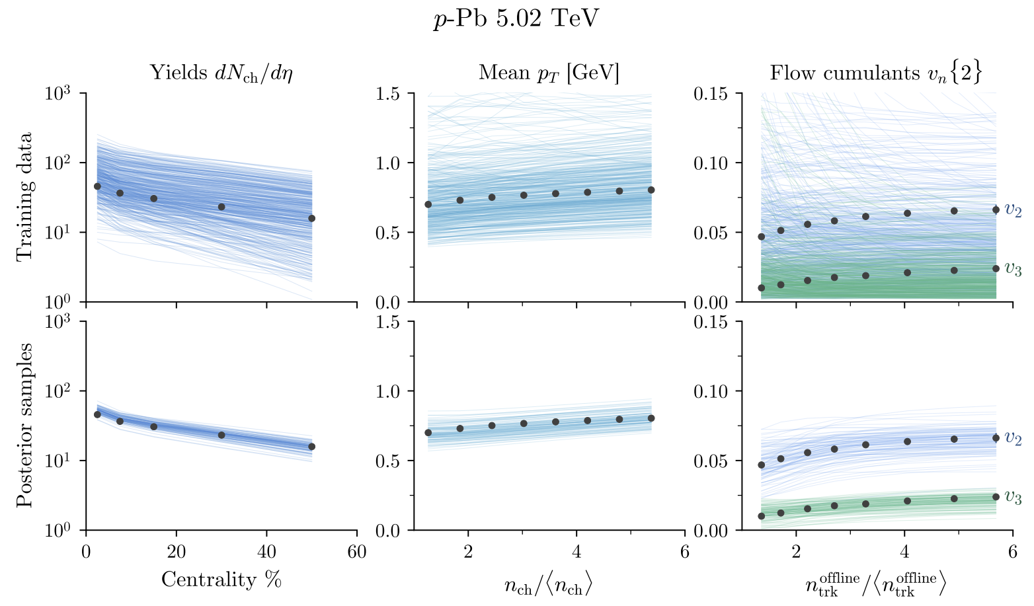
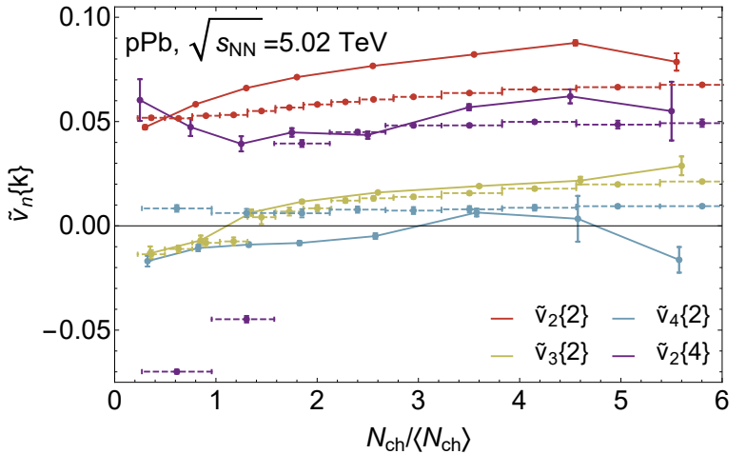
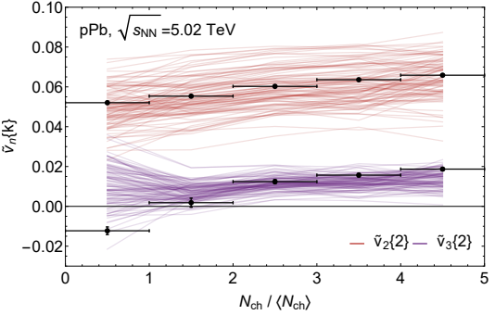
Bayesian analysis of p-Pb
Wilke van der Schee, CERN/Utrecht
Bayesian analysis including p-Pb collisions
Requires nucleon `substructure’: n constituents of width v
More challenging to emulate/compute than PbPb
MAP comparison of Trajectum in 2020
Reasonable agreement
Curious imaginary values both in theory and data of v₃{2}
Scott Moreland, Jonah Bernhard and Steffen Bass, Estimating initial state and quark-gluon plasma medium properties using a hybrid model with nucleon substructure calibrated to p-Pb and Pb-Pb collisions (2018)
Govert Nijs, WS, Umut Gürsoy and Raimond Snellings, Bayesian analysis of heavy ion collisions with the heavy ion computational framework Trajectum (2020)

Slide 5
Anisotropic flow in small systems
Wilke van der Schee, CERN/Utrecht
See also talk by Giuliano Giacalone Wed 12:10 same room
The success of hydro or anything goes?
Requires a systematic study: vary parameters consistent with PbPb data
Including changes in initial state and changes in viscosities
Do we do an apples-to-apples comparison?
Small multiplicity: need to understand `non-flow subtraction’
Resonance decays lead to non-trivial correlations
This talk: use Trajectum to study this in detail
Future aim: what are the limits of hydro?
The limits of hydrodynamics is a great motivation in theory and experiment: upcoming OO and pO runs in 2024 ☺. Possibility of Neon run in 2025?

Slide 6
The elephant in the room: `non-flow’ subtraction
Wilke van der Schee, CERN/Utrecht
Theory: almost always ignored in hydro (hydro does not have `non-flow’?)
Two notable exceptions: Zhao, Ko, Liu, Qin and Song (pp, 2001.06742) and Zhao, Ryu, Shen and Schenke (dAu, 2211.16376)
Experiment: almost always subtracted as much as possible (?) by imposing largest Δη gap
Δη gap depends on experiment and is rarely varied
Method 1: cumulants
First average: within acceptance all particle pairs i, j in a single event
Second average*: average over ensemble of events
Method 2: subevents
First average: within acceptance all particle pairs i (with η < γ/2) and j (with η > γ/2)
Second average*: average over ensemble of events
Note: not equivalent even for γ = 0 (!)
* In practice one first averages over small centrality classes and then averages over those results to obtain a larger bin. For some observables this is extremely important (SC, ρ(v₂{2}, p_{T})), but for v_{n}{2} it makes only a small difference. Often it is not explicitly mentioned how the third averaging is done.

Slide 7
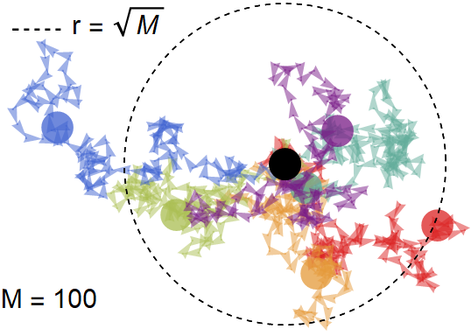
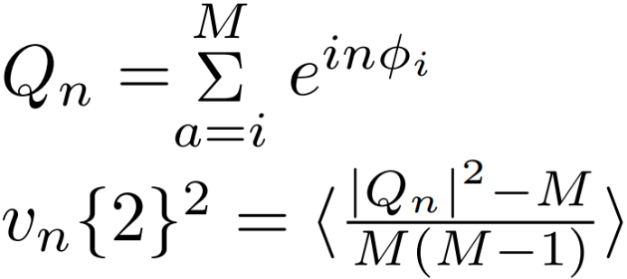
Cumulants
Wilke van der Schee, CERN/Utrecht
Method 1: cumulants
Efficient computation:
Requires M computations instead of M².
The – M subtracts i = j in double sum
Important theorem:
If φ_{i} are randomly drawn from f(φ) then v_{n}{2} will converge to the true Fourier coefficients of f(φ)
Easy to understand for f(φ) = constant: Q_{n} is a random walk, so for many events:
Important caveat:
φ_{i} are not drawn randomly
In this talk we focus on correlations due to resonance decays

Slide 8
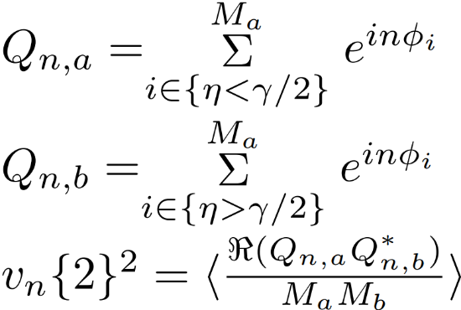
Subevent
Wilke van der Schee, CERN/Utrecht
Method 2: subevents
Efficient computation:
(for infinite # events the imaginary part vanishes anyway)
Three comments
Particles from different regions: less effect from resonances
Smaller phase space: fewer particles, harder statistically
For large γ event-plane decorrelation is important

Slide 9
Intuition: random walk with resonances
Wilke van der Schee, CERN/Utrecht
Method 1: cumulants
Efficient computation:
Requires M computations instead of M².
The – M subtracts i = j in double sum
Oversimplified ansatz: Zero intrinsic flow and every particle decays into two particles with the same transverse direction.
New `flow’ due to resonances:
When is can this be ignored?
For pPb and cumulants this can be the dominant effect
Also present in all hydro codes that include resonance decays (!)

Slide 10
Now more serious: using Trajectum
Straightforward to use
Fast and publicly available
Fully parallelized
Can run unlimited number of events
Resonance decays/interactions handled by SMASH
http://sites.google.com/view/govertnijs/trajectum
http://wilkevanderschee.nl/trajectum

Slide 11
Δη in PbPb collisions – MAP setting with varying cuts
Wilke van der Schee, CERN/Utrecht
Small but significant effects
Etagap always reduces v2, always increases v4 (even for Δη = 0)
Settings fit to method 1 (black), but etacut potentially improves agreement (important within ALICE uncertainties)
Larger effect for smaller detector acceptance (e.g. more important for ALICE than for ATLAS)
In ratio with data effects are constant versus centrality (however small absolute effect: percent level * percent level)

Slide 12
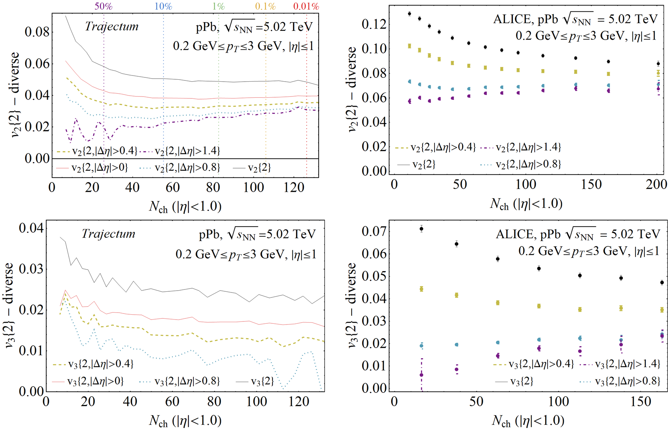
Δη in pPb collisions – MAP setting with varying cuts
Wilke van der Schee, CERN/Utrecht
Large and significant effects
Even Δη=0 decreases flow by ~20%
For low multiplicity Δη is dominant effect
Even in ‘hydro’
Relatively unique measurement from ALICE
Qualitative agreement
Does not agree quantitatively
Not fitted in Bayesian analysis
ALICE, Multiparticle azimuthal correlations in p-Pb and Pb-Pb collisions at the CERN Large Hadron Collider (2014)

Slide 13
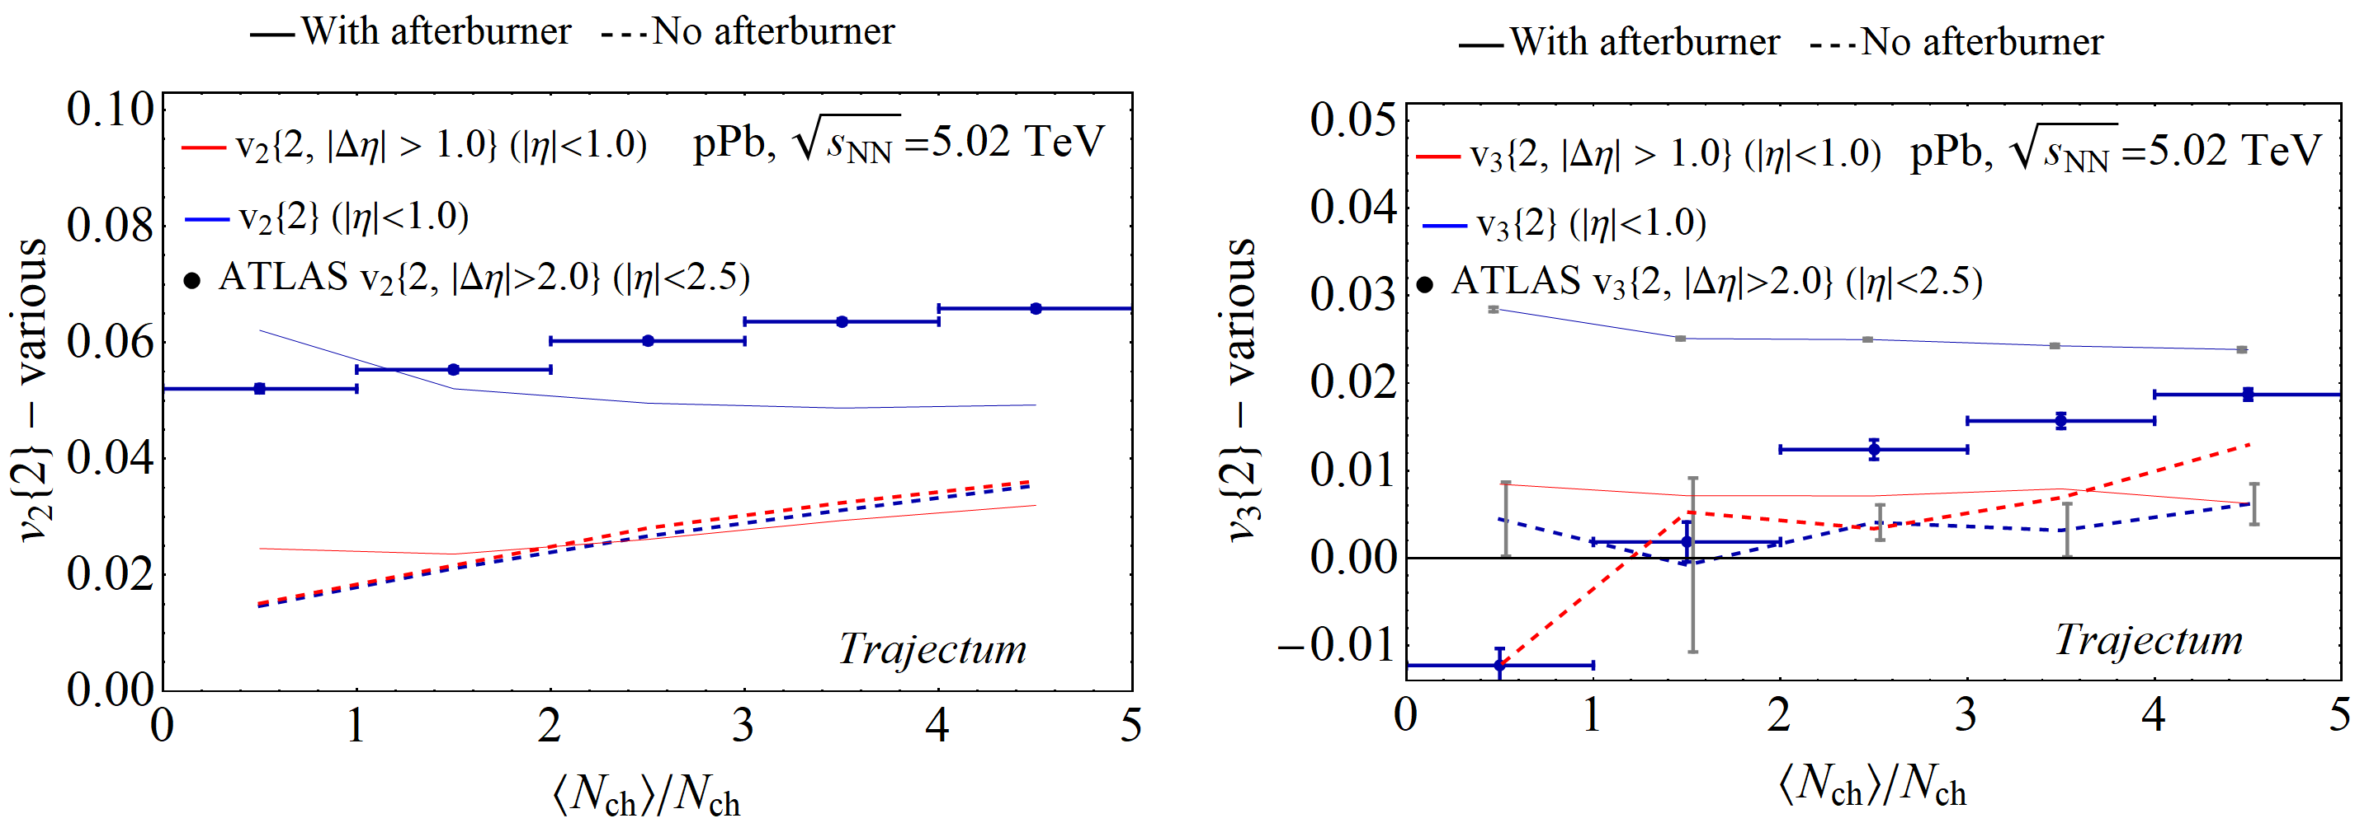
Δη in pPb collisions – Resonances and afterburner (SMASH)
Wilke van der Schee, CERN/Utrecht
Verification that effects are due to hadronic phase
Cumulants (blue) and Subevent (red)
Without afterburner the two methods agree (dashed)

Slide 14
Elliptic flow in pPb collisions – a systematic analysis
Wilke van der Schee, CERN/Utrecht
Ten likely settings from posterior distribution
Subevent method much smaller flow than cumulant method
Realistically typically a factor two too low
Points to caveat to all previous pPb flow studies that include an afterburner/resonances
One exception (next slide)

Slide 15
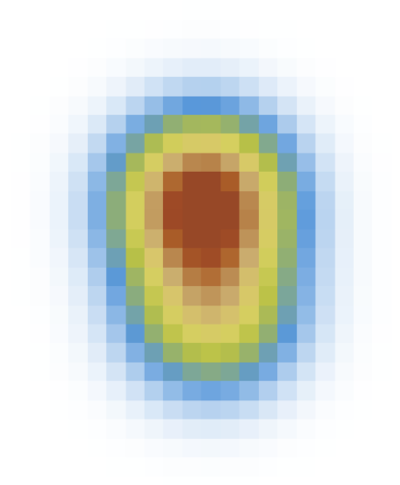
Elliptic flow in pPb collisions – two constituent model (?)
Wilke van der Schee, CERN/Utrecht
Guess based on previous parameters: two constituents with subwidth 0.3 fm (rest is MAP)
Clearly much more elliptic flow (even too much)
Effects from Δη gap smaller at large multiplicity (also because of higher flow: )

Slide 16
Exciting upcoming Oxygen run
Wilke van der Schee, CERN/Utrecht
See also talk by Giuliano Giacalone Wed 12:10 same room
Perfect system at moderate multiplicity: hydro at its limits
Δη=0 important for ALICE coverage, but not dominant
Important caveat: nuclear structure is not that well understood (fix this with Neon collisions?)
Curious: resonance decays lead to negative v₅{2} and v₆{2}
See also INT workshop on nuclear structure and HIC: https://www.int.washington.edu/program/schedule/1170/

Slide 17
Bonus slide
Wilke van der Schee, CERN/Utrecht
Several systems with MAP settings (systematic analysis with ratios for some to appear)

Slide 18
Important questions for small systems
Hydrodynamic signature is anisotropic flow
Flow is small, signal and hence need to be careful
pPb results depend sensitively on model parameters
A Bayesian fit should be able to describe most of pPb with hydro
Hard to conclude that `panta rei’; systematics is important
Also, 3D profile + fluctuations can be important (see talk by Govert Nijs, Tue 11:50)
Important: no discussion of `real non-flow’, e.g. jets and hard QCD
Useful to have a tool like Trajectum
Fast: each curve for pPb takes only about 5k CPU hours, Runs ~400M Trento IC, ~1M hydro runs and ~30M SMASH runs
Message both to theory + experiment: details and specifically cuts matter
Exciting time ahead with Oxygen and other small systems (Ne?);
let’s get the details right ☺

Slide 19
BACK-UP

Slide 20
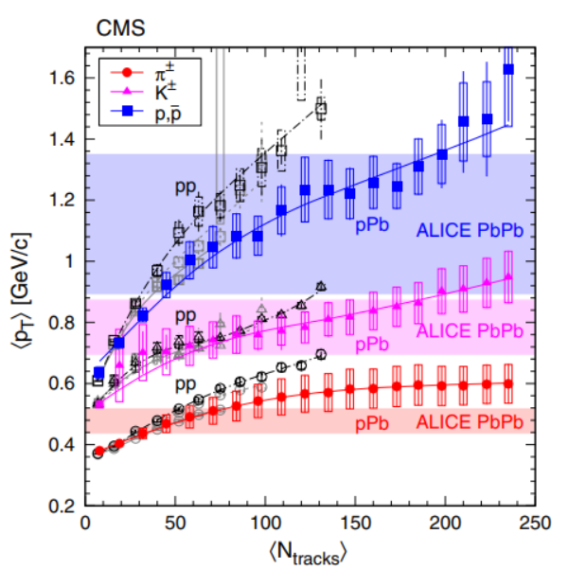
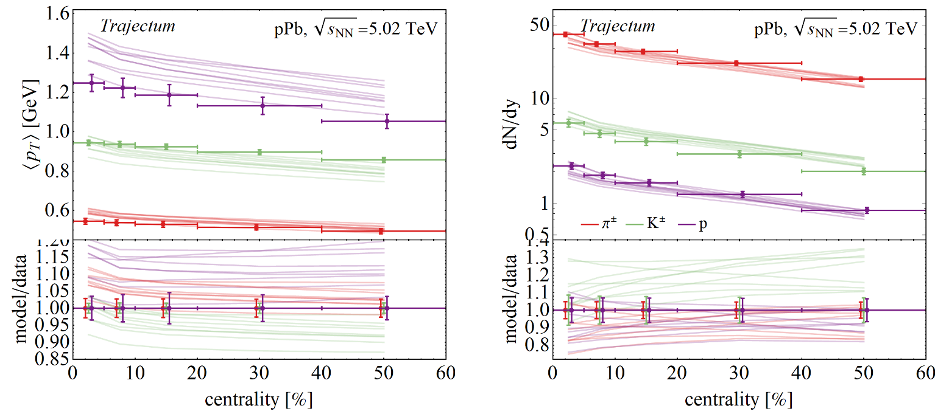
Yields and mean transverse momentum pPb
Wilke van der Schee, CERN/Utrecht
Check that 10 likely settings compare well with pPb
No new fitting parameters (uses norm of PbPb)
Proton mean p_{T} overestimated compared to ALICE (see however CMS)
Significant systematic uncertainty: constrain by Bayesian global analysis?
CMS, Study of the production of charged pions, kaons, and protons in pPb collisions at √s_{NN} = 5.02 TeV (2014)

Slide 21
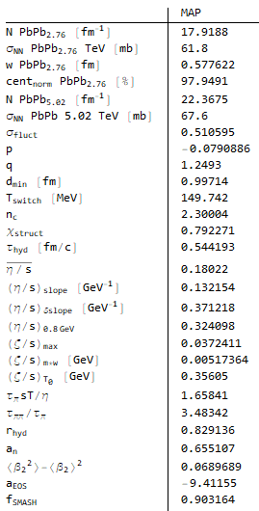
MAP settings
Wilke van der Schee, CERN/Utrecht
For reference the settings used for most runs
Except 10 settings drawn from posterior

