Slide 1

Medium-enhanced $c\overline{c}$ radiation
Jasmine Brewer
In collaboration with Maximilian Attems, Gian Michele Innocenti, Aleksas Mazeliauskas, Sohyun Park, Wilke van der Schee, and Urs Wiedemann
[2203.11241], [2209.13600], and ongoing work

Slide 2
  Building up a picture of a medium-modified jet from phenomenology
  hadrons
  Hadrons to splittings
Notes:
Unfortunately, the interpretation of jet modification observables often depends crucially on which proton-proton jets are taken to be a comparable baseline for a given heavy-ion measurement. In di-jet and inclusive jet studies, the standard answer is to compare heavy-ion jets to a proton-proton baseline with the same reconstructed pT. For example, comparing the jet production spectra for p-p and HI at the same reconstructed pT (as illustrated by the blue arrows) gives rise to the famous jet RAA.

Slide 3
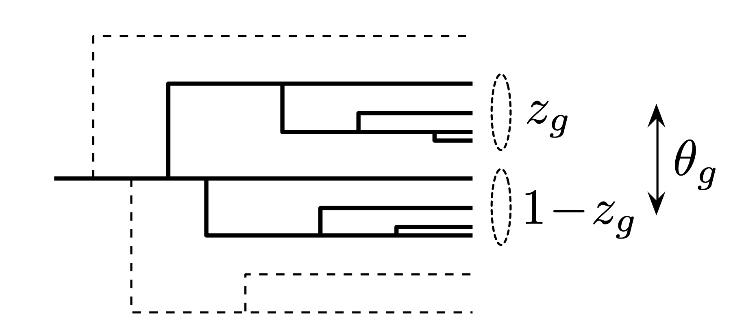
  Building up a picture of a medium-modified jet from phenomenology
  hadrons
  Hadrons to splittings
  Jet substructure:
  Use angular ordering of QCD to reconstruct emission history of shower from hadrons
Notes:
Unfortunately, the interpretation of jet modification observables often depends crucially on which proton-proton jets are taken to be a comparable baseline for a given heavy-ion measurement. In di-jet and inclusive jet studies, the standard answer is to compare heavy-ion jets to a proton-proton baseline with the same reconstructed pT. For example, comparing the jet production spectra for p-p and HI at the same reconstructed pT (as illustrated by the blue arrows) gives rise to the famous jet RAA.

Slide 4
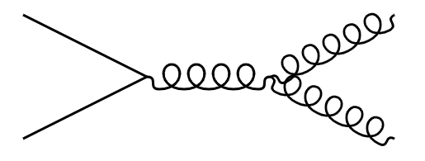
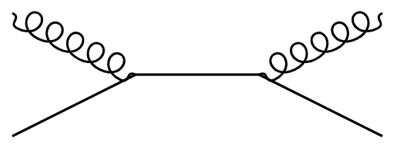
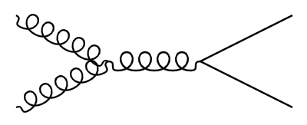
  Building up a picture of a medium-modified jet from phenomenology
  hadrons
  Hadrons to splittings
  Flavor-dependence of splittings
  hadrons
Notes:
Unfortunately, the interpretation of jet modification observables often depends crucially on which proton-proton jets are taken to be a comparable baseline for a given heavy-ion measurement. In di-jet and inclusive jet studies, the standard answer is to compare heavy-ion jets to a proton-proton baseline with the same reconstructed pT. For example, comparing the jet production spectra for p-p and HI at the same reconstructed pT (as illustrated by the blue arrows) gives rise to the famous jet RAA.

Slide 5
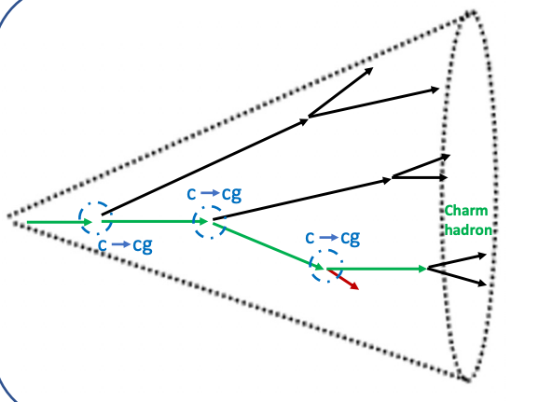



  Accessing heavy flavor splitting functions
$$\overline{c},\overline{b}$$
  Heavy flavor splittings:
$$c,b$$
$$c,b$$
  Advantages:
  Heavy flavor is preserved in the shower and not produced at hadronization
Used in ALICE [2106.05713]
  Access late (more modified) splittings in the shower
  At high energies, access light flavor splittings
  Focus of this talk: phenomenology of $g→c\overline{c}$
Notes:
Unfortunately, the interpretation of jet modification observables often depends crucially on which proton-proton jets are taken to be a comparable baseline for a given heavy-ion measurement. In di-jet and inclusive jet studies, the standard answer is to compare heavy-ion jets to a proton-proton baseline with the same reconstructed pT. For example, comparing the jet production spectra for p-p and HI at the same reconstructed pT (as illustrated by the blue arrows) gives rise to the famous jet RAA.

Slide 6
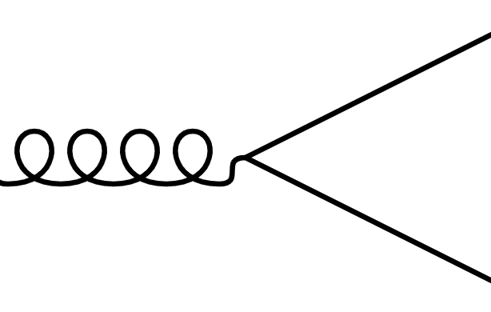




  Unique features of the modification of $g→c\overline{c}$
$$\overline{c}$$
  Signature of momentum broadening of $c\overline{c}$ pair
$$g$$
$$c$$
Notes:
Unfortunately, the interpretation of jet modification observables often depends crucially on which proton-proton jets are taken to be a comparable baseline for a given heavy-ion measurement. In di-jet and inclusive jet studies, the standard answer is to compare heavy-ion jets to a proton-proton baseline with the same reconstructed pT. For example, comparing the jet production spectra for p-p and HI at the same reconstructed pT (as illustrated by the blue arrows) gives rise to the famous jet RAA.

Slide 7
  Unique features of the modification of $g→c\overline{c}$
$$\overline{c}$$
  Signature of momentum broadening of $c\overline{c}$ pair
$$g$$
$$c$$
  Gluons have a “lifetime” depending on their energy
  time
Another time-delayed probe: Apolinario, Milhano, Salam, Salgado [1711.03105]
Notes:
Unfortunately, the interpretation of jet modification observables often depends crucially on which proton-proton jets are taken to be a comparable baseline for a given heavy-ion measurement. In di-jet and inclusive jet studies, the standard answer is to compare heavy-ion jets to a proton-proton baseline with the same reconstructed pT. For example, comparing the jet production spectra for p-p and HI at the same reconstructed pT (as illustrated by the blue arrows) gives rise to the famous jet RAA.

Slide 8
  Unique features of the modification of $g→c\overline{c}$
$$\overline{c}$$
  Signature of momentum broadening of $c\overline{c}$ pair
$$g$$
$$c$$
  Gluons have a “lifetime” depending on their energy
  Access modification of $c\overline{c}$ pair at later times in the QGP
  time
  time
  time
  Increasing gluon energy
Another time-delayed probe: Apolinario, Milhano, Salam, Salgado [1711.03105]
Notes:
Unfortunately, the interpretation of jet modification observables often depends crucially on which proton-proton jets are taken to be a comparable baseline for a given heavy-ion measurement. In di-jet and inclusive jet studies, the standard answer is to compare heavy-ion jets to a proton-proton baseline with the same reconstructed pT. For example, comparing the jet production spectra for p-p and HI at the same reconstructed pT (as illustrated by the blue arrows) gives rise to the famous jet RAA.

Slide 9

  Unique features of the modification of $g→c\overline{c}$
$$\overline{c}$$
  Signature of momentum broadening of $c\overline{c}$ pair
$$g$$
$$c$$
  Gluons have a “lifetime” depending on their energy
  Access modification of $c\overline{c}$ pair at later times in the QGP
  $∼$ $1−6 fm$ delay for $20−100 GeV$ gluons
  time
  time
  time
  Increasing gluon energy
Another time-delayed probe: Apolinario, Milhano, Salam, Salgado [1711.03105]
Notes:
Unfortunately, the interpretation of jet modification observables often depends crucially on which proton-proton jets are taken to be a comparable baseline for a given heavy-ion measurement. In di-jet and inclusive jet studies, the standard answer is to compare heavy-ion jets to a proton-proton baseline with the same reconstructed pT. For example, comparing the jet production spectra for p-p and HI at the same reconstructed pT (as illustrated by the blue arrows) gives rise to the famous jet RAA.

Slide 10
  Modification of the $g→c\overline{c}$splitting function
  Resum arbitrarily-many soft gluon interactions with a medium of length L
Attems, JB, Innocenti, Mazeliauskas, Park, van der Schee, Wiedemann [2203.11241]
Notes:
Unfortunately, the interpretation of jet modification observables often depends crucially on which proton-proton jets are taken to be a comparable baseline for a given heavy-ion measurement. In di-jet and inclusive jet studies, the standard answer is to compare heavy-ion jets to a proton-proton baseline with the same reconstructed pT. For example, comparing the jet production spectra for p-p and HI at the same reconstructed pT (as illustrated by the blue arrows) gives rise to the famous jet RAA.

Slide 11

  Modification of the $g→c\overline{c}$splitting function
  Resum arbitrarily-many soft gluon interactions with a medium of length L
  Results of the calculation:
  Depletion at small $k_{c}^{2}$
  broadening
Attems, JB, Innocenti, Mazeliauskas, Park, van der Schee, Wiedemann [2203.11241]
Notes:
Unfortunately, the interpretation of jet modification observables often depends crucially on which proton-proton jets are taken to be a comparable baseline for a given heavy-ion measurement. In di-jet and inclusive jet studies, the standard answer is to compare heavy-ion jets to a proton-proton baseline with the same reconstructed pT. For example, comparing the jet production spectra for p-p and HI at the same reconstructed pT (as illustrated by the blue arrows) gives rise to the famous jet RAA.

Slide 12
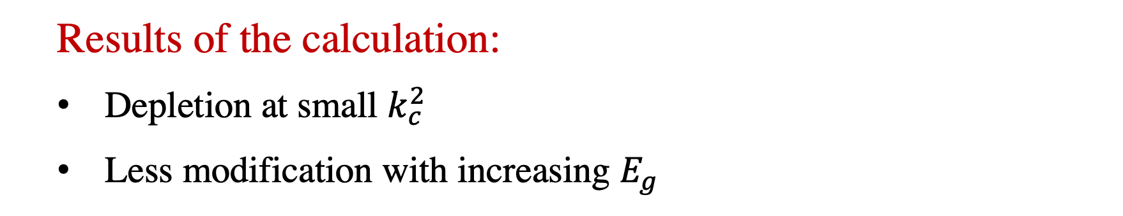
  Modification of the $g→c\overline{c}$splitting function
  Resum arbitrarily-many soft gluon interactions with a medium of length L
  Results of the calculation:
  Depletion at small $k_{c}^{2}$
  Less modification with increasing $E_{g}$
  broadening
  formation-time dependence
Attems, JB, Innocenti, Mazeliauskas, Park, van der Schee, Wiedemann [2203.11241]
Notes:
Unfortunately, the interpretation of jet modification observables often depends crucially on which proton-proton jets are taken to be a comparable baseline for a given heavy-ion measurement. In di-jet and inclusive jet studies, the standard answer is to compare heavy-ion jets to a proton-proton baseline with the same reconstructed pT. For example, comparing the jet production spectra for p-p and HI at the same reconstructed pT (as illustrated by the blue arrows) gives rise to the famous jet RAA.

Slide 13
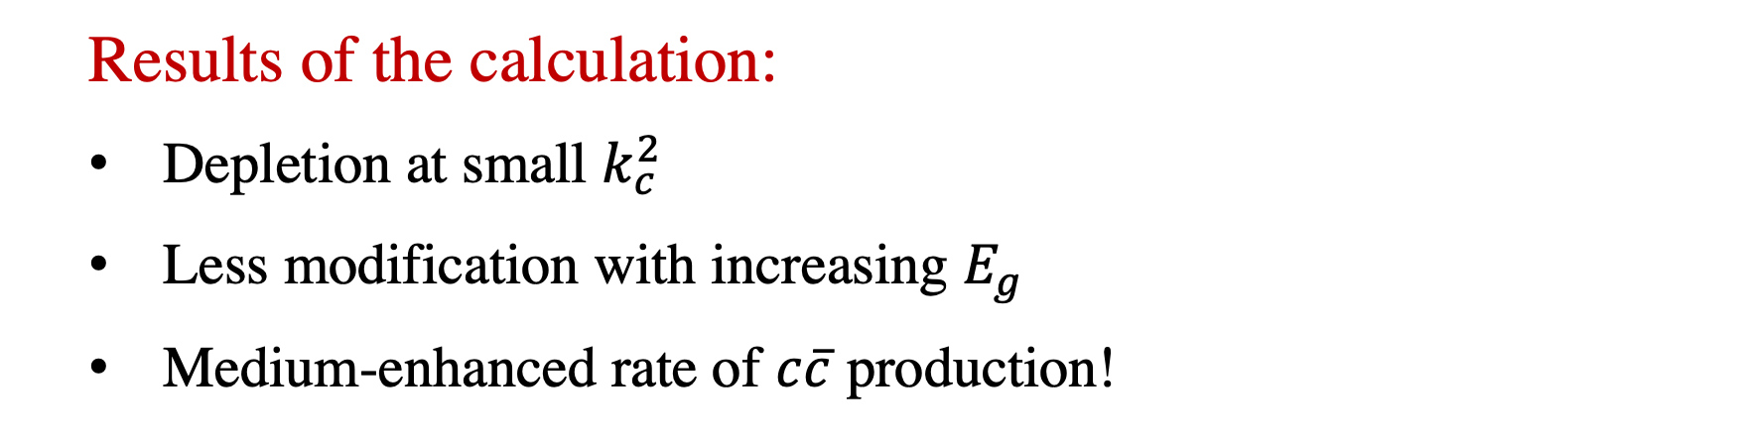
  Modification of the $g→c\overline{c}$splitting function
  Resum arbitrarily-many soft gluon interactions with a medium of length L
  Results of the calculation:
  Depletion at small $k_{c}^{2}$
  Less modification with increasing $E_{g}$
  Medium-enhanced rate of $c\overline{c}$ production!
  broadening
  formation-time dependence
  gluons promoted above threshold
Attems, JB, Innocenti, Mazeliauskas, Park, van der Schee, Wiedemann [2203.11241]
Notes:
Unfortunately, the interpretation of jet modification observables often depends crucially on which proton-proton jets are taken to be a comparable baseline for a given heavy-ion measurement. In di-jet and inclusive jet studies, the standard answer is to compare heavy-ion jets to a proton-proton baseline with the same reconstructed pT. For example, comparing the jet production spectra for p-p and HI at the same reconstructed pT (as illustrated by the blue arrows) gives rise to the famous jet RAA.

Slide 14
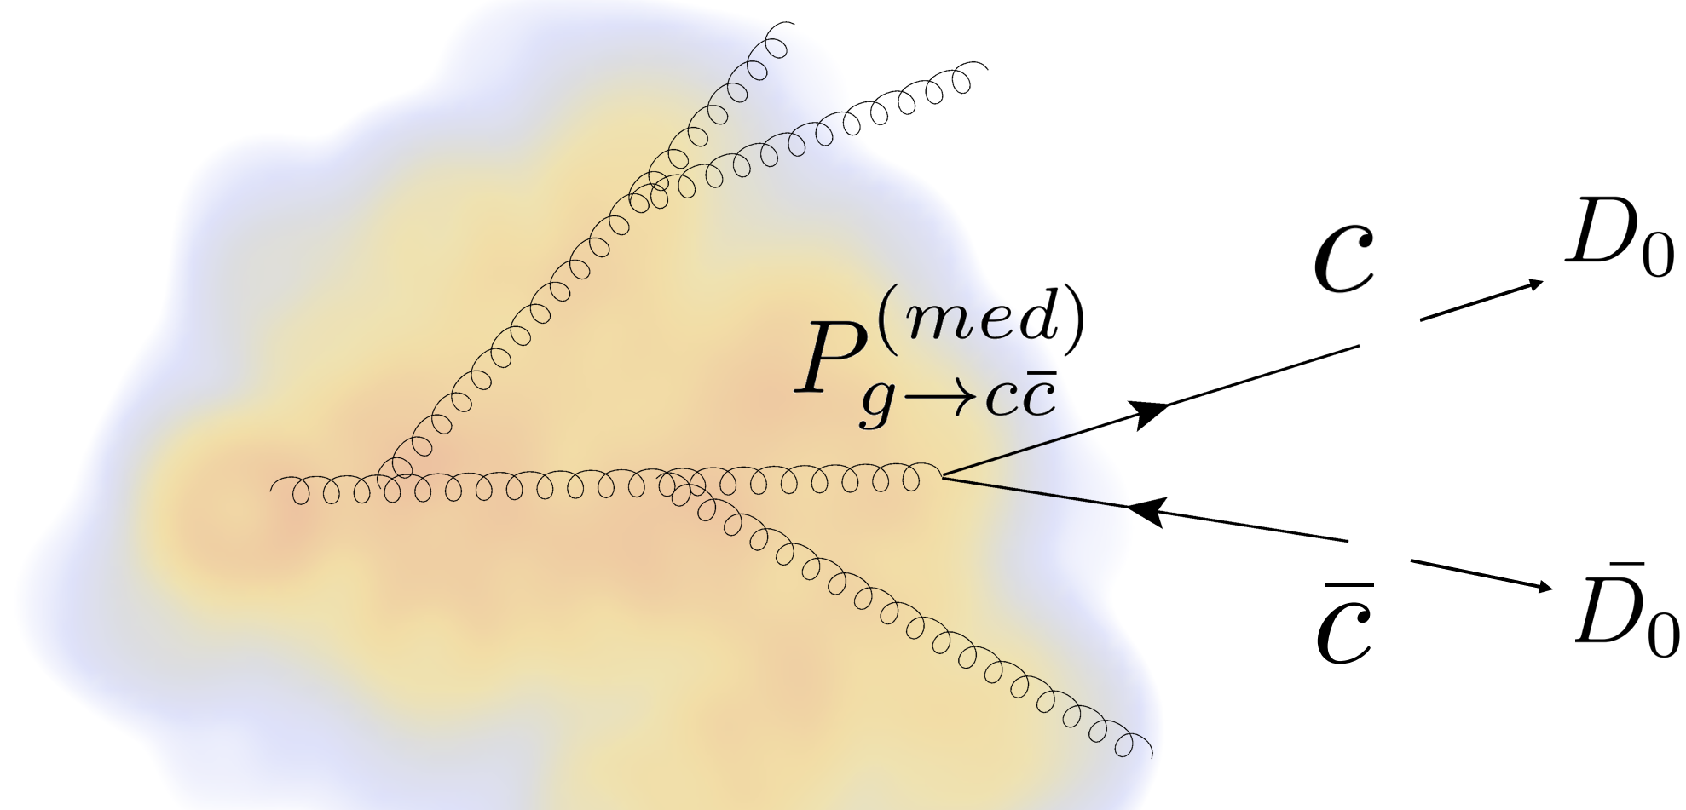
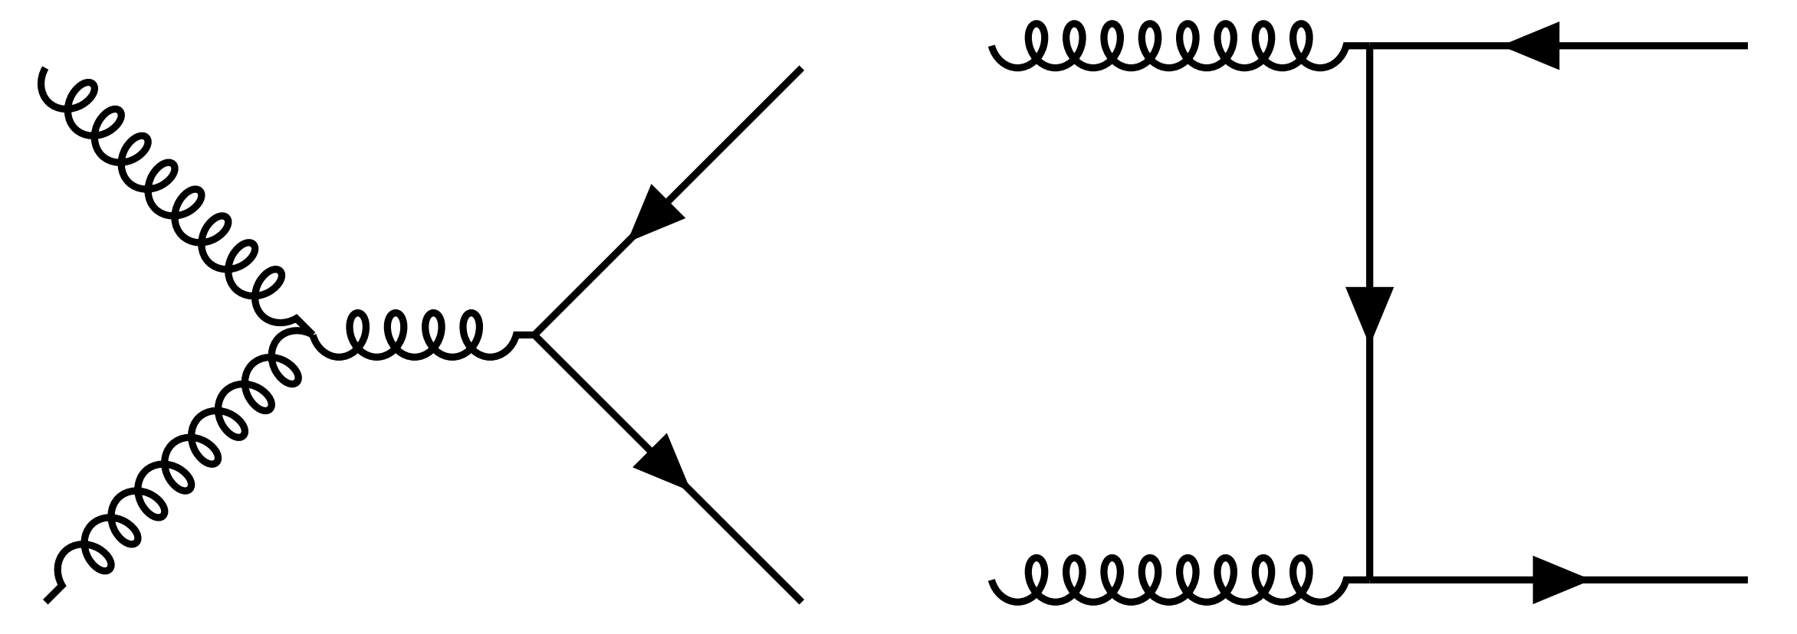
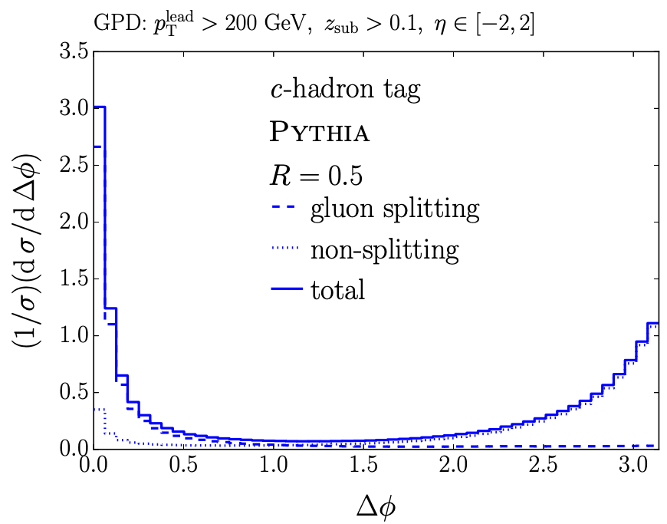
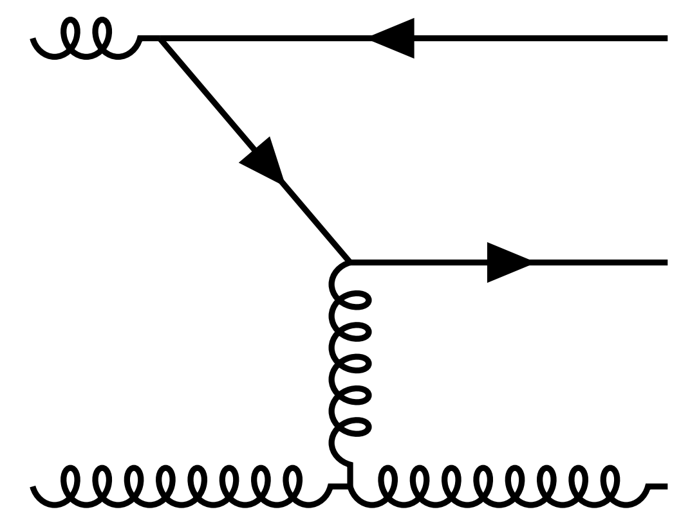
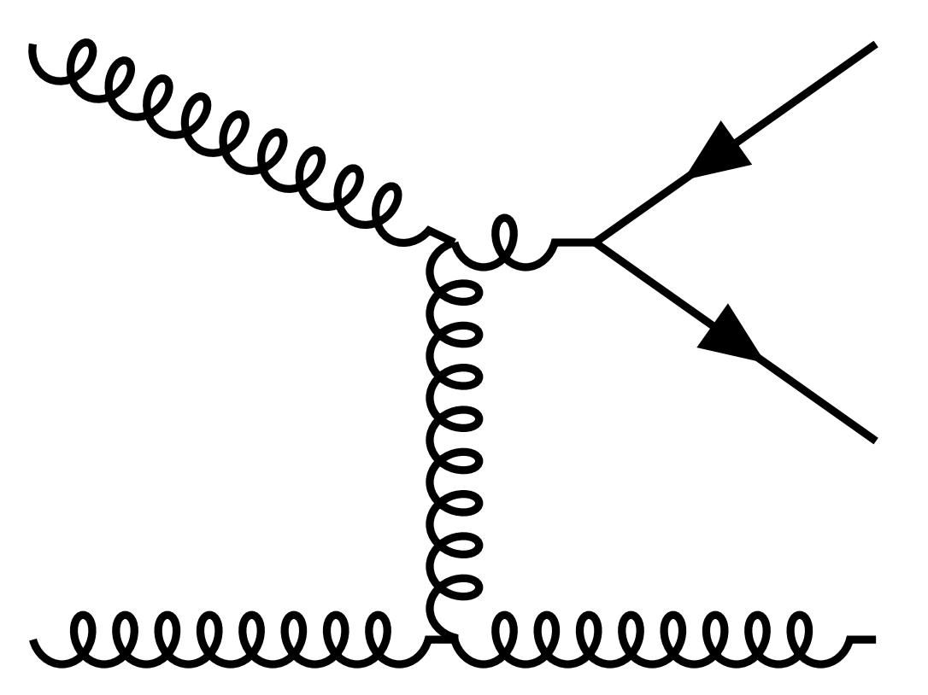
  Phenomenologically accessing the $g→c\overline{c}$ splitting in jets
  Leading processes for heavy quark production
  (approximately) collinear
Flavor creation
Flavor excitation
Gluon splitting
  Gluon splitting
  Non-gluon-splitting
Ilten, Rodd, Thaler, Williams [1702.02947]
Notes:
Unfortunately, the interpretation of jet modification observables often depends crucially on which proton-proton jets are taken to be a comparable baseline for a given heavy-ion measurement. In di-jet and inclusive jet studies, the standard answer is to compare heavy-ion jets to a proton-proton baseline with the same reconstructed pT. For example, comparing the jet production spectra for p-p and HI at the same reconstructed pT (as illustrated by the blue arrows) gives rise to the famous jet RAA.

Slide 15
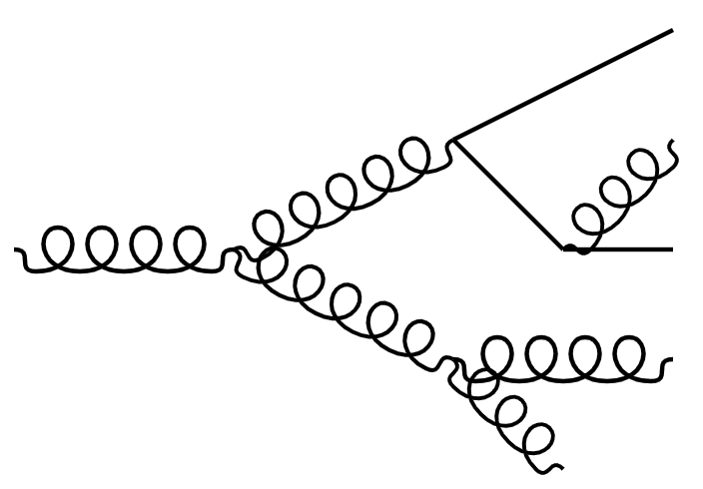
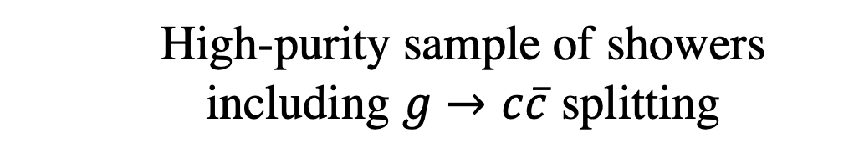


  Phenomenologically accessing the $g→c\overline{c}$ splitting in jets
$${\overline{D}}^{0}$$
$$D^{0}$$
  High-purity sample of showers including $g→c\overline{c}$ splitting
  Expected experimental sensitivity already in Run 3/4
Notes:
Unfortunately, the interpretation of jet modification observables often depends crucially on which proton-proton jets are taken to be a comparable baseline for a given heavy-ion measurement. In di-jet and inclusive jet studies, the standard answer is to compare heavy-ion jets to a proton-proton baseline with the same reconstructed pT. For example, comparing the jet production spectra for p-p and HI at the same reconstructed pT (as illustrated by the blue arrows) gives rise to the famous jet RAA.

Slide 16
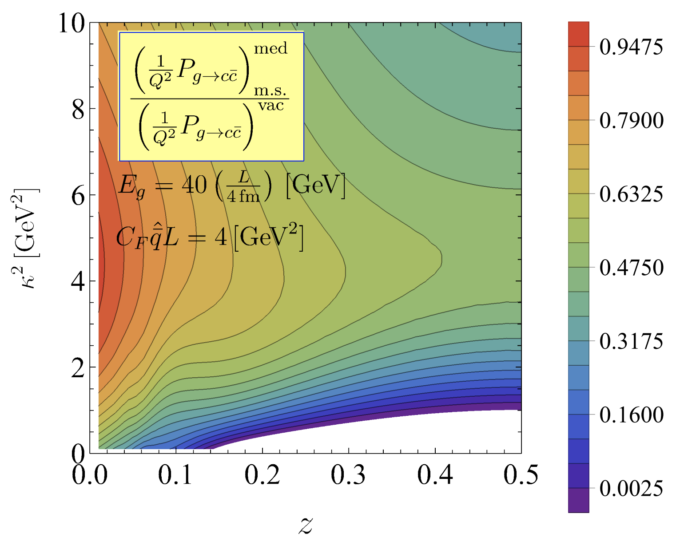
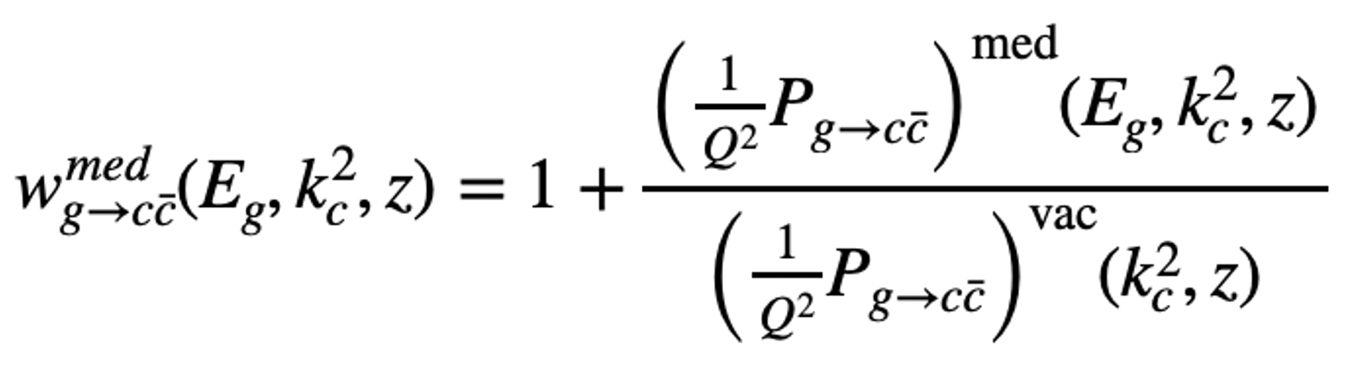



  Observing $g→c\overline{c}$ enhancement in jets
$${\overline{D}}^{0}$$
$$D^{0}$$
  Get kinematics of $g→c\overline{c}$
  Reweight each splitting by
Attems, JB, Innocenti, Mazeliauskas, Park, van der Schee, Wiedemann [2209.13600]
Notes:
Unfortunately, the interpretation of jet modification observables often depends crucially on which proton-proton jets are taken to be a comparable baseline for a given heavy-ion measurement. In di-jet and inclusive jet studies, the standard answer is to compare heavy-ion jets to a proton-proton baseline with the same reconstructed pT. For example, comparing the jet production spectra for p-p and HI at the same reconstructed pT (as illustrated by the blue arrows) gives rise to the famous jet RAA.

Slide 17
  Observing $g→c\overline{c}$ enhancement in jets
$${\overline{D}}^{0}$$
$$D^{0}$$
  Get kinematics of $g→c\overline{c}$
  Reweight each splitting by
Attems, JB, Innocenti, Mazeliauskas, Park, van der Schee, Wiedemann [2209.13600]
Notes:
Unfortunately, the interpretation of jet modification observables often depends crucially on which proton-proton jets are taken to be a comparable baseline for a given heavy-ion measurement. In di-jet and inclusive jet studies, the standard answer is to compare heavy-ion jets to a proton-proton baseline with the same reconstructed pT. For example, comparing the jet production spectra for p-p and HI at the same reconstructed pT (as illustrated by the blue arrows) gives rise to the famous jet RAA.

Slide 18


  $N_{D\overline{D}}/N_{jets}$ is dominantly sensitive to enhancement of $g→c\overline{c}$ splittings
$${\overline{D}}^{0}$$
  Enhancement of $N_{D\overline{D}}/N_{jets}$ is generated by modification of $g→c\overline{c}$
$$D^{0}$$
$${\overline{D}}^{0}$$
$$D^{0}$$
  Crucial for $R_{AA}$
  Modified all splittings in simple dipole shower
Hoeche [1411.4085]
Attems, JB, Innocenti, Mazeliauskas, Park, van der Schee, Wiedemann [2209.13600]
Notes:
Unfortunately, the interpretation of jet modification observables often depends crucially on which proton-proton jets are taken to be a comparable baseline for a given heavy-ion measurement. In di-jet and inclusive jet studies, the standard answer is to compare heavy-ion jets to a proton-proton baseline with the same reconstructed pT. For example, comparing the jet production spectra for p-p and HI at the same reconstructed pT (as illustrated by the blue arrows) gives rise to the famous jet RAA.

Slide 19
  Going forward: other unique signatures
  Broadening
  Can use jet substructure to access broadening at hadron-level
Notes:
Unfortunately, the interpretation of jet modification observables often depends crucially on which proton-proton jets are taken to be a comparable baseline for a given heavy-ion measurement. In di-jet and inclusive jet studies, the standard answer is to compare heavy-ion jets to a proton-proton baseline with the same reconstructed pT. For example, comparing the jet production spectra for p-p and HI at the same reconstructed pT (as illustrated by the blue arrows) gives rise to the famous jet RAA.

Slide 20
  Going forward: other unique signatures
  Formation time dependence
Notes:
Unfortunately, the interpretation of jet modification observables often depends crucially on which proton-proton jets are taken to be a comparable baseline for a given heavy-ion measurement. In di-jet and inclusive jet studies, the standard answer is to compare heavy-ion jets to a proton-proton baseline with the same reconstructed pT. For example, comparing the jet production spectra for p-p and HI at the same reconstructed pT (as illustrated by the blue arrows) gives rise to the famous jet RAA.

Slide 21
  Going forward: other unique signatures
  Formation time dependence
  Ongoing: how to quantify modification differentially in formation time?
  Access delayed probe of QGP
Notes:
Unfortunately, the interpretation of jet modification observables often depends crucially on which proton-proton jets are taken to be a comparable baseline for a given heavy-ion measurement. In di-jet and inclusive jet studies, the standard answer is to compare heavy-ion jets to a proton-proton baseline with the same reconstructed pT. For example, comparing the jet production spectra for p-p and HI at the same reconstructed pT (as illustrated by the blue arrows) gives rise to the famous jet RAA.

Slide 22

  A process with many exciting future avenues!
  So far..
  Medium-enhanced rate of $c\overline{c}$ production
  Outlook
  Broadening of $c\overline{c}$ pair from hadron level
  Formation time dependence of modification
  Clean process with a lot of exciting physics opportunities!
Notes:
Unfortunately, the interpretation of jet modification observables often depends crucially on which proton-proton jets are taken to be a comparable baseline for a given heavy-ion measurement. In di-jet and inclusive jet studies, the standard answer is to compare heavy-ion jets to a proton-proton baseline with the same reconstructed pT. For example, comparing the jet production spectra for p-p and HI at the same reconstructed pT (as illustrated by the blue arrows) gives rise to the famous jet RAA.

Slide 23
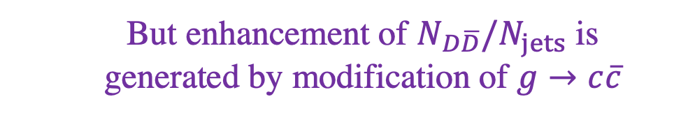
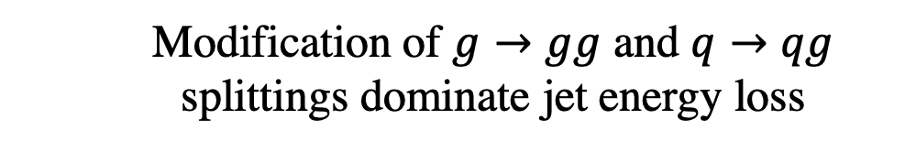
  $N_{D\overline{D}}/N_{jets}$ is dominantly sensitive to enhancement of $g→c\overline{c}$ splittings
  Modification of $g→gg$ and $q→qg$ splittings dominate jet energy loss
  But enhancement of $N_{D\overline{D}}/N_{jets}$ is generated by modification of $g→c\overline{c}$
Attems, JB, Innocenti, Mazeliauskas, Park, van der Schee, Wiedemann [2209.13600]
Notes:
Unfortunately, the interpretation of jet modification observables often depends crucially on which proton-proton jets are taken to be a comparable baseline for a given heavy-ion measurement. In di-jet and inclusive jet studies, the standard answer is to compare heavy-ion jets to a proton-proton baseline with the same reconstructed pT. For example, comparing the jet production spectra for p-p and HI at the same reconstructed pT (as illustrated by the blue arrows) gives rise to the famous jet RAA.

